Slide 1
Ozone Transport to the Los Angeles Basin
J. A. Neuman,^{1,2} M. Trainer,² K. A. Aikin,^{1,2} W. M. Angevine,^{1,2} J. Brioude,^{1,2} S. S. Brown,² J. A. deGouw,^{1,2} W. P. Dube,^{1,2} M. Graus,^{1,2} J. H. Flynn,³ J. S. Holloway,^{1,2} B. L. Lefer³, J. B. Nowak,^{1,2} D. D. Parrish,² I. B. Pollack,^{1,2} J. M. Roberts,² T. B. Ryerson,² and N. L. Wagner^{1,2}
¹Cooperative Institute for Research in Environmental Sciences, University of Colorado Boulder, Boulder, Colorado
²Chemical Sciences Division, Earth System Research Laboratory, NOAA, Boulder, Colorado
³Department of Earth and Atmospheric Sciences, University of Houston, Houston, Texas
Goal:
“What are the sources and physical mechanisms that contribute to high ozone
concentrations aloft that have been observed in Central and Southern California?”
Approach:
Large ozone concentrations in the lower free troposphere (1-4 km) during CalNex
Show that different sources have distinguishing air mass chemical composition
Identify ozone sources and transport over the LA Basin according to air mass chemical composition
Demonstrate that ozone aloft affects surface concentrations
Notes:
Use correspondence between source and chemical composition to characterize ozone over LA

Slide 2
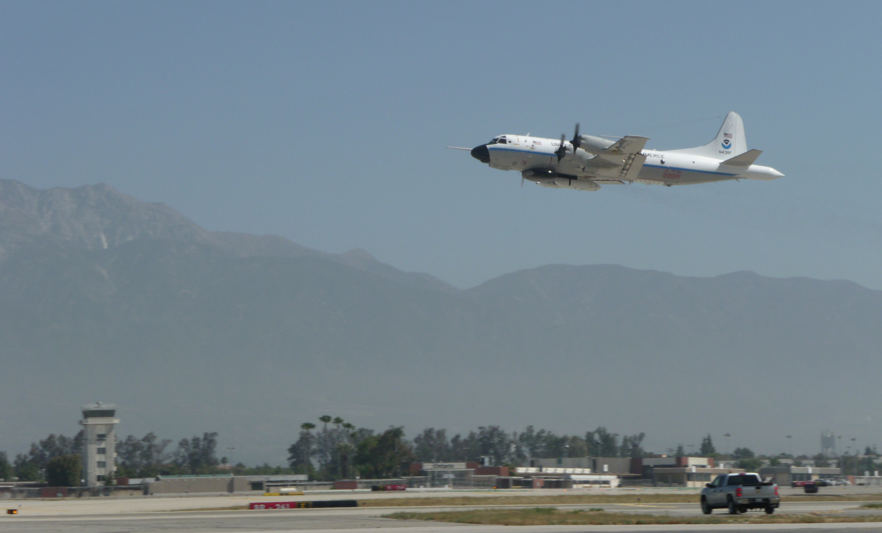
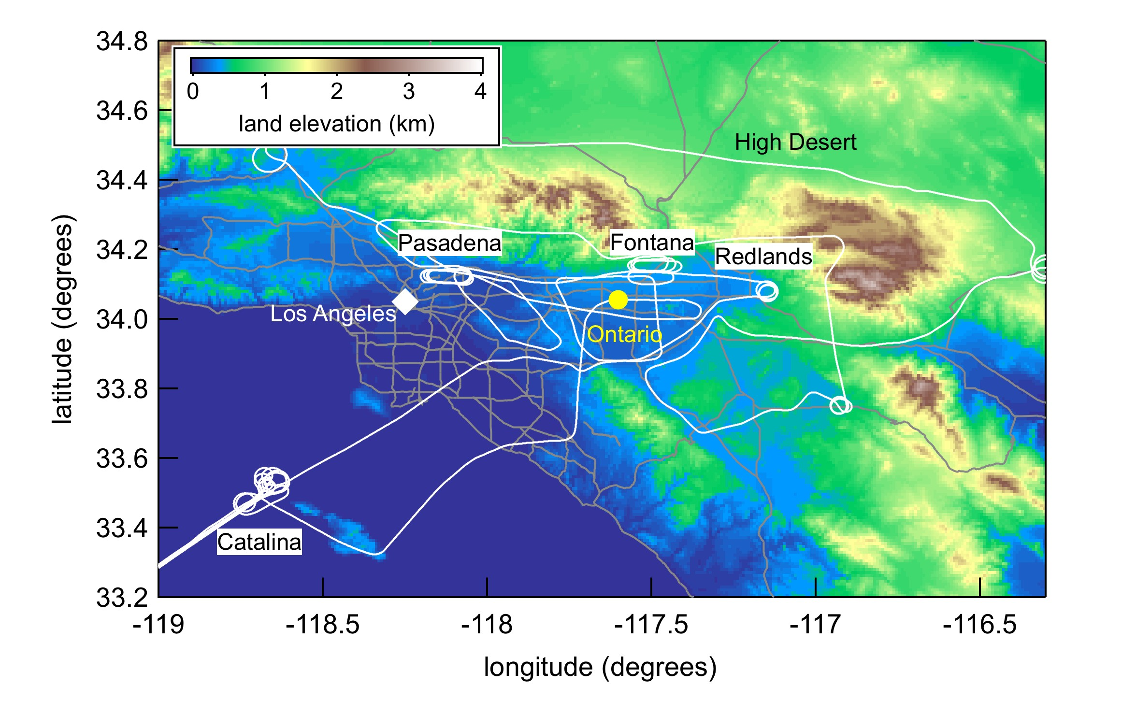
Experiment:
• NOAA WP-3 aircraft flights over California in May and June 2010
• Fast, in-situ measurements of ozone, ozone precursors, and tracers
• 7 daytime flights focused on LA Basin: May 4,8,14,16,19,21 and June 20, 2010
• Many vertical profiles between 0.2−4 km altitude
Photo: Harald Stark
Typical Flight Track over LA Basin

Slide 3
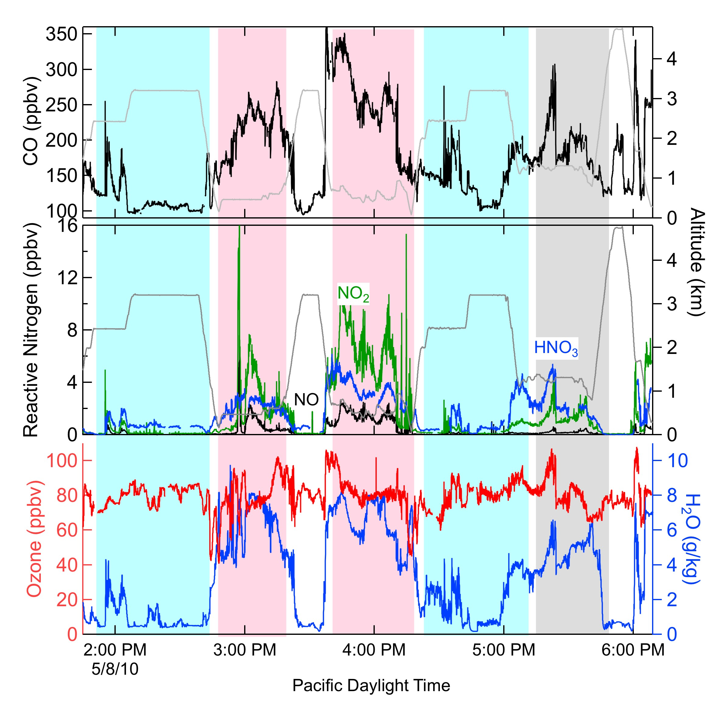
Aircraft Measurements
Mtns LA Basin Mtns Desert
Mixing Ratios (ppbv)
LA High Mtns
Basin Desert
CO 300 200 100
NOx 10 2 0.1
HNO₃ 6 4 1
O₃ 80 80 80
• Ozone increased aloft (and everywhere)
Notes:
CO – long lived tracer of urban emissions
NOx – short-lived tracer of urban emissions
HNO3 – sources in Strat as well as Trop

Slide 4
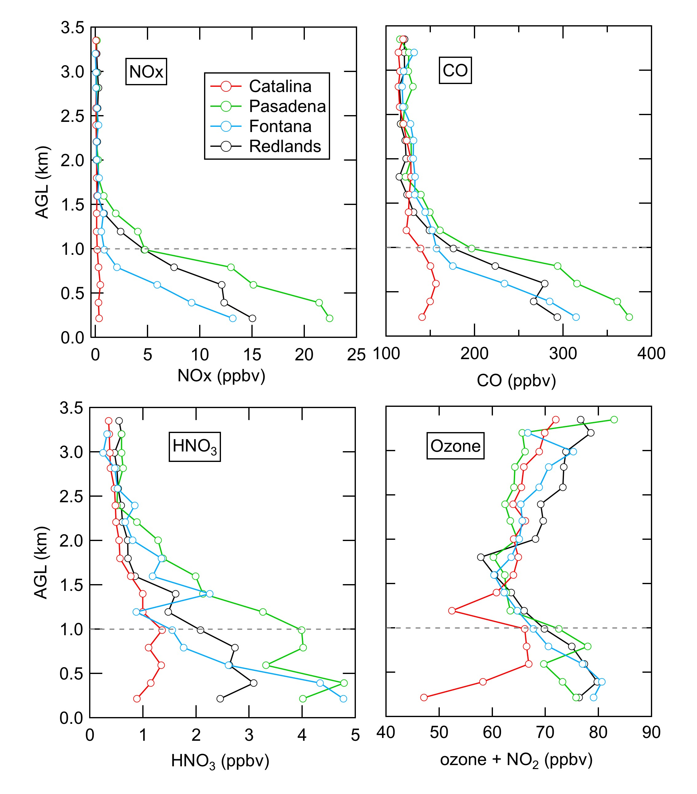
Trace Gas Concentrations from 32 vertical profiles on 6 flights
Average Boundary
Layer Height
• Composition similar at all locations from 1- 4 km
(lower free troposphere)
• In the boundary layer, concentrations largest closest to sources
• Ozone increased in the lower free troposphere
Notes:
Ozone +NO2 used here in the boundary layer to account for titration of ozone by NOx

Slide 5
Chemical composition identifies ozone sources and transport
Possible sources for air over the Los Angeles Basin:
Marine
Aged regional emissions
Stratosphere
Asia
Upper troposphere
Use gas phase measurements to distinguish ozone sources:
Water
CO
Reactive Nitrogen (HNO₃, NOx, PAN)
Next 4 slides: Show that each source has a distinct
chemical signature
Notes:
UT includes Strat/Asia over 1 week old

Slide 6
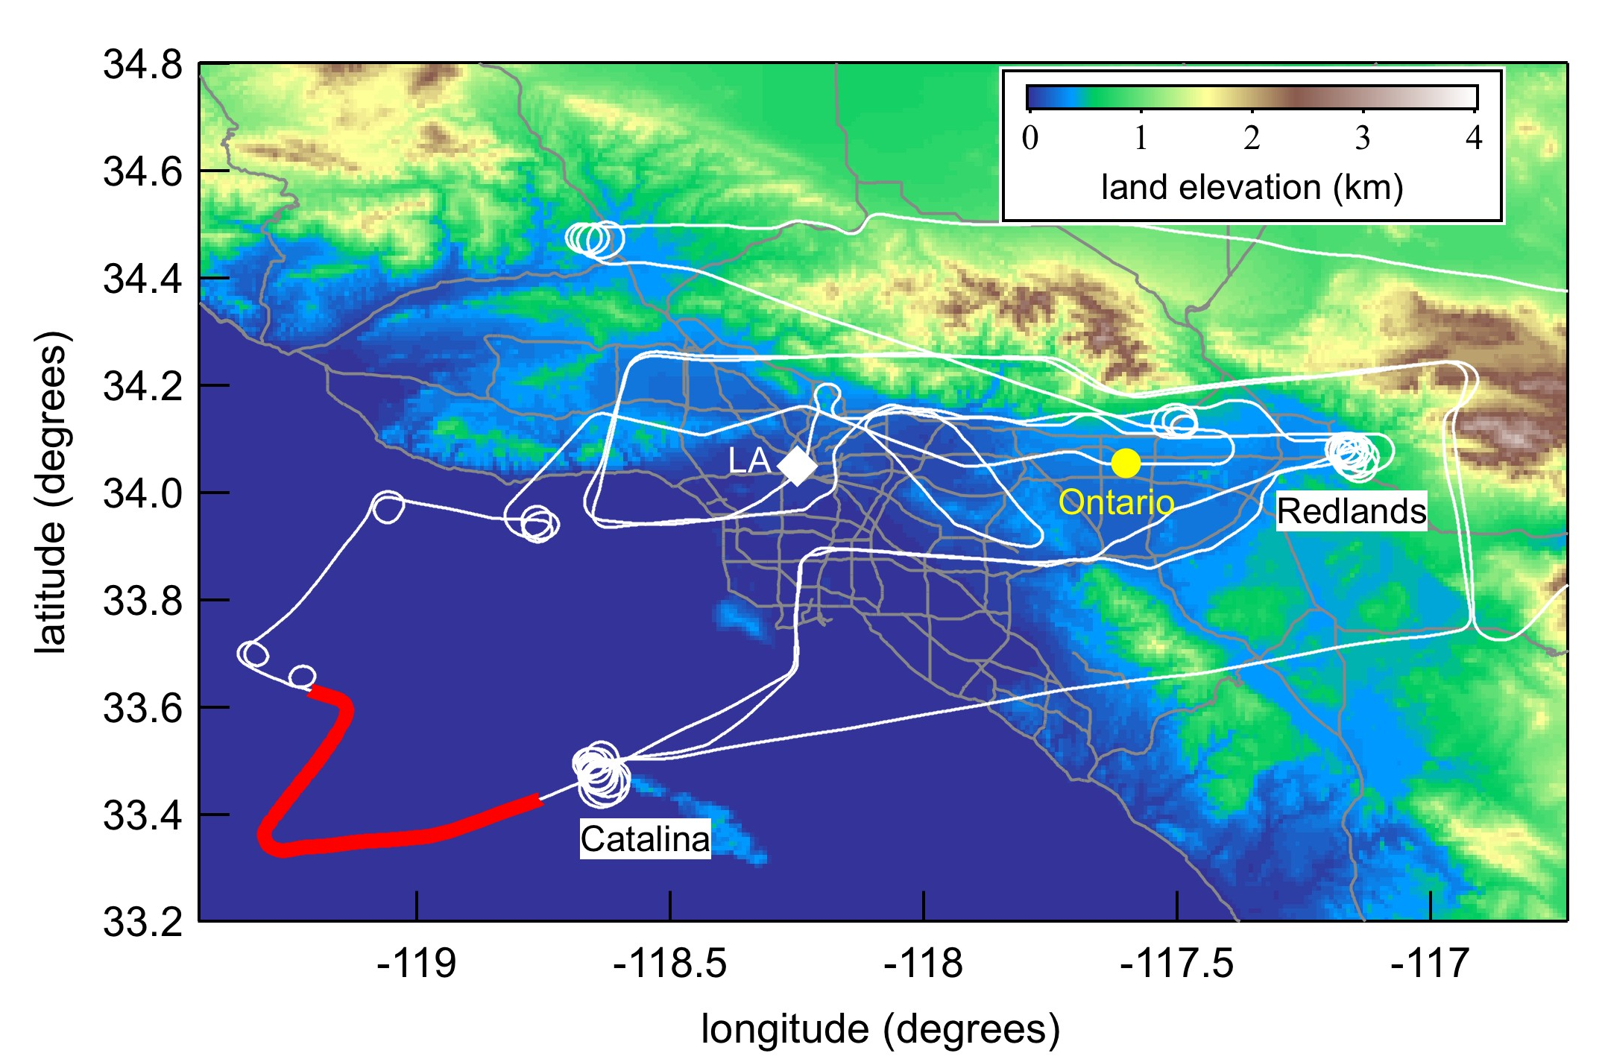
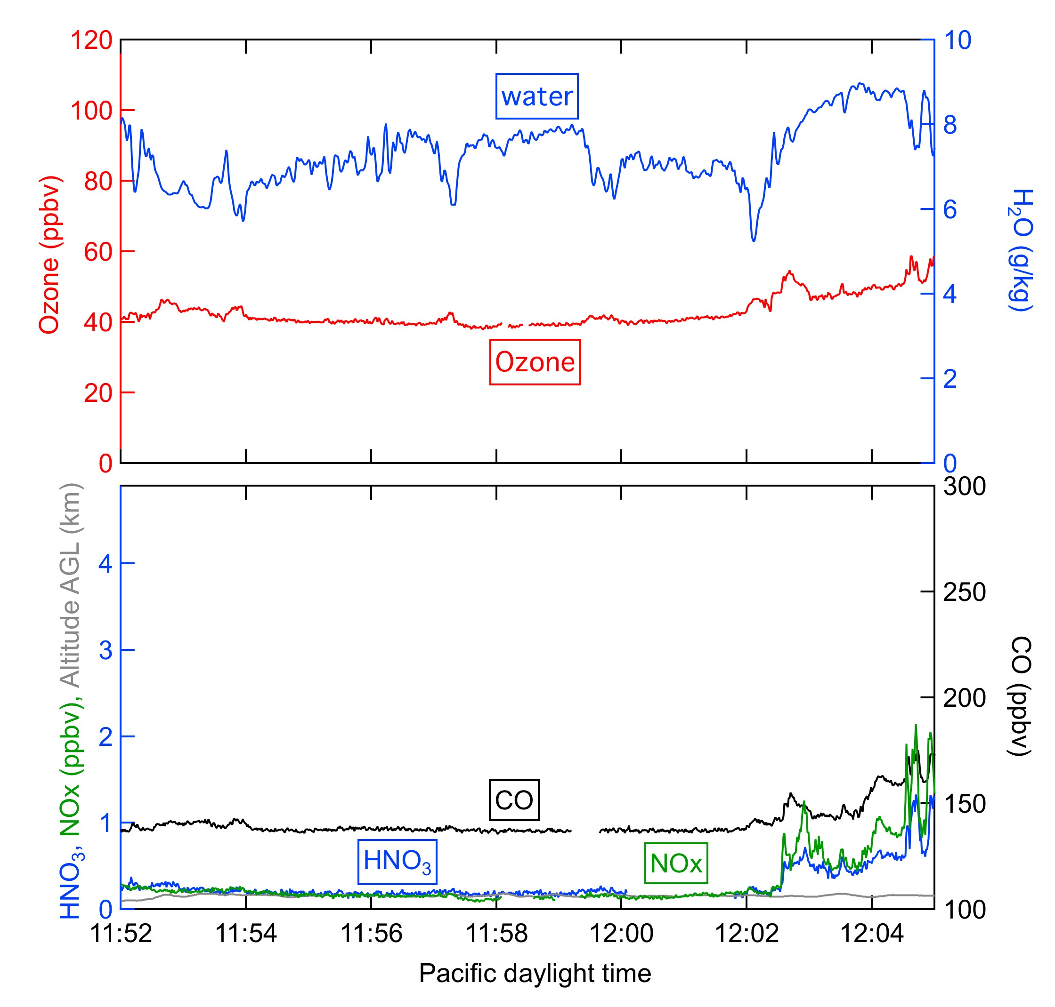
Chemical Composition
Marine
Over Pacific Ocean, May 8
150 m altitude
Increased Concentrations:
water
Decreased Concentrations:
Ozone, CO, HNO₃, NOx

Slide 7
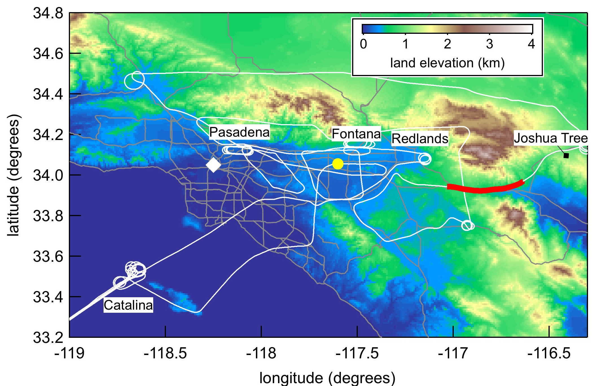
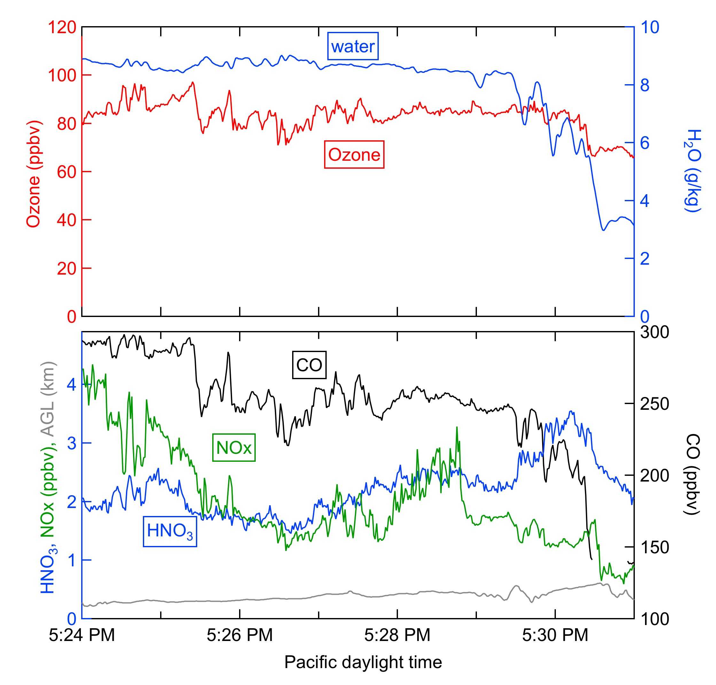
Chemical Composition
Aged Regional Emissions
Banning Pass, May 16
300-600 m AGL
Increased Concentrations:
water
Ozone and CO
(correlated)
Reactive Nitrogen
(partitions toward HNO₃)

Slide 8
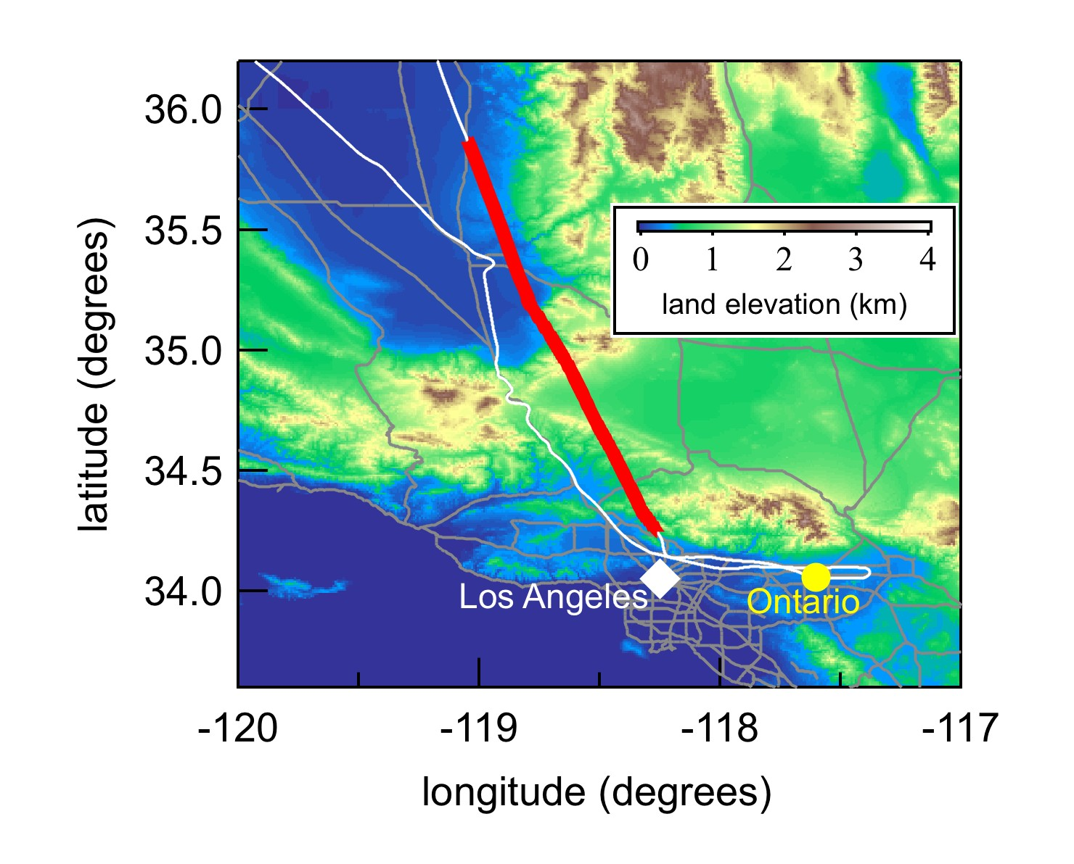
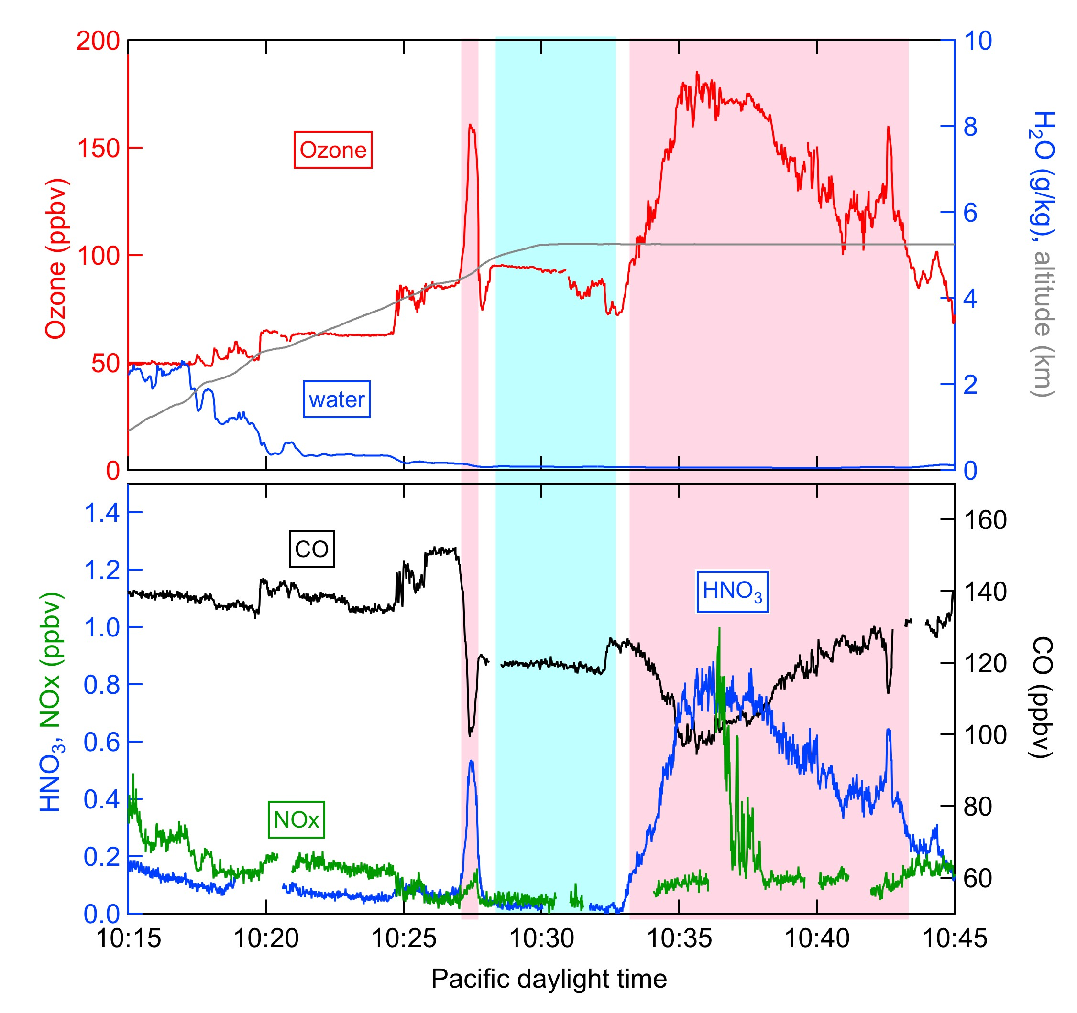
Chemical Composition
Stratosphere/
Upper Troposphere
Over Central Valley, May 11
UT Strat
Stratosphere:
Increased Concentrations:
Ozone and HNO₃
(correlated)
Decreased Concentrations:
CO, water
Upper Troposphere:
Increased Concentrations:
Ozone
Decreased Concentrations:
CO, water, HNO₃

Slide 9
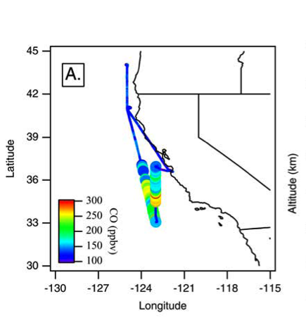
Chemical Composition
Transported Plumes from Asia
Over Pacific Ocean, May 2002
Nowak, J. B., et al. (2004), Gas-phase chemical characteristics of Asian emission plumes observed during ITCT 2K2 over the eastern North Pacific Ocean, J. Geophys. Res., 109, D23S19, doi:10.1029/2003JD004488.
Increased Concentrations:
CO, PAN
Decreased Concentrations:
HNO₃
Next 3 slides: Identify air masses over LA Basin during Calnex by their chemical composition

Slide 10
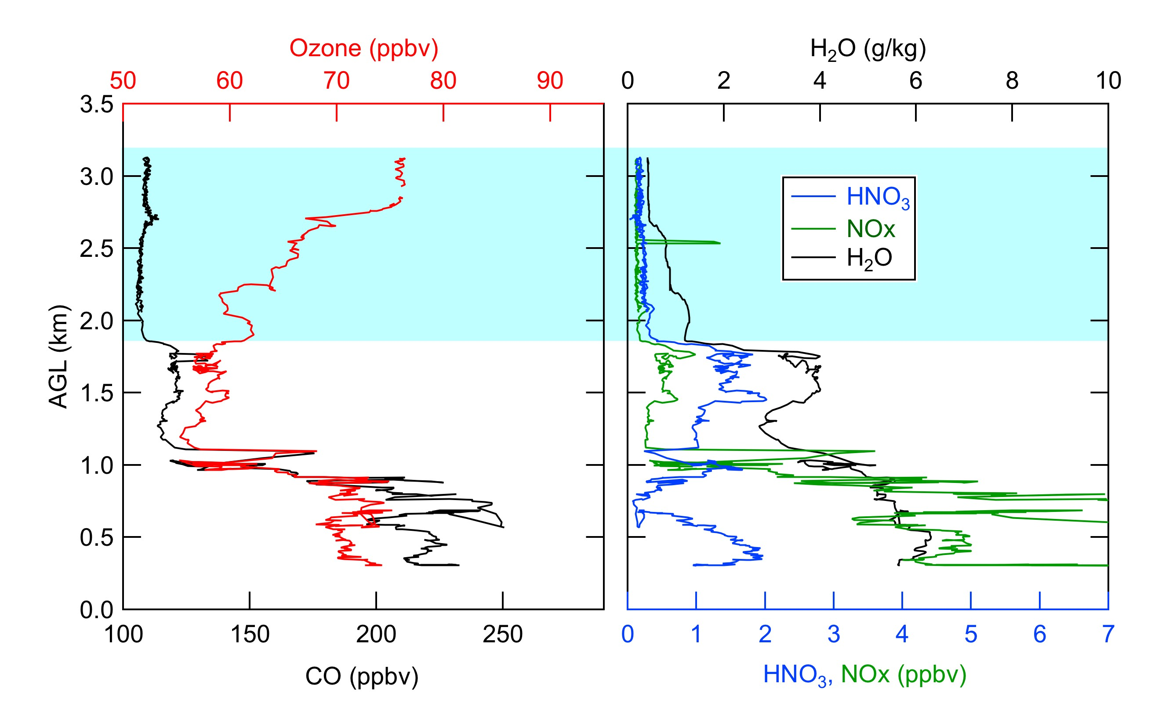
Ozone in the lower free troposphere over the LA Basin
Profile in east LA Basin on May 4
Upper
Tropospheric
Boundary
Layer
• Decreased CO, water, HNO₃
• Increased Ozone from Upper Tropospheric influence

Slide 11
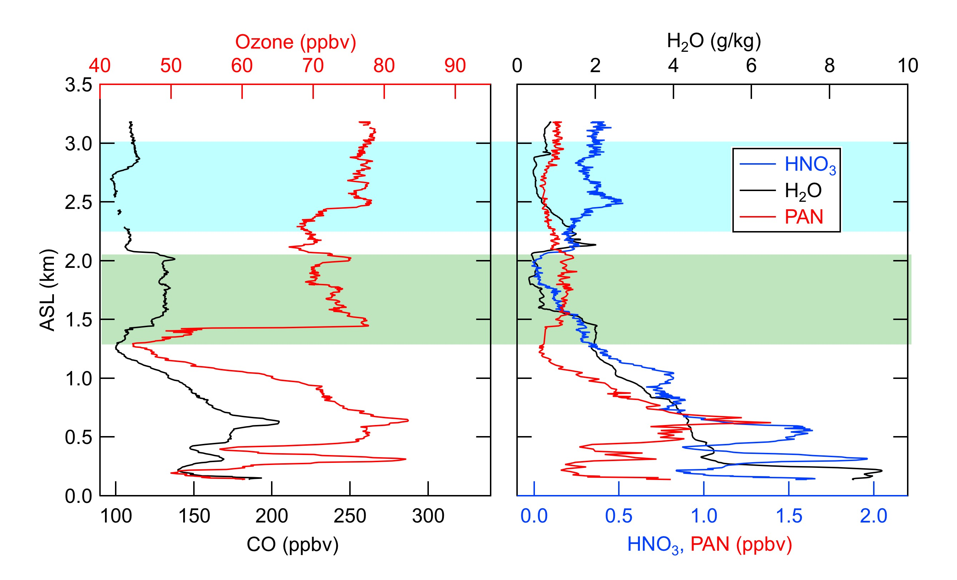
Ozone in the lower free troposphere over the LA Basin
Profile near Catalina Island on May 8
Upper
Tropospheric
Long Range
Transport
• Upper Troposphere: decreased CO, water, HNO₃
• Long Range Transport: decreased water, HNO₃; increased CO and PAN
• Increased Ozone from Upper Troposphere and Long Range Transport

Slide 12
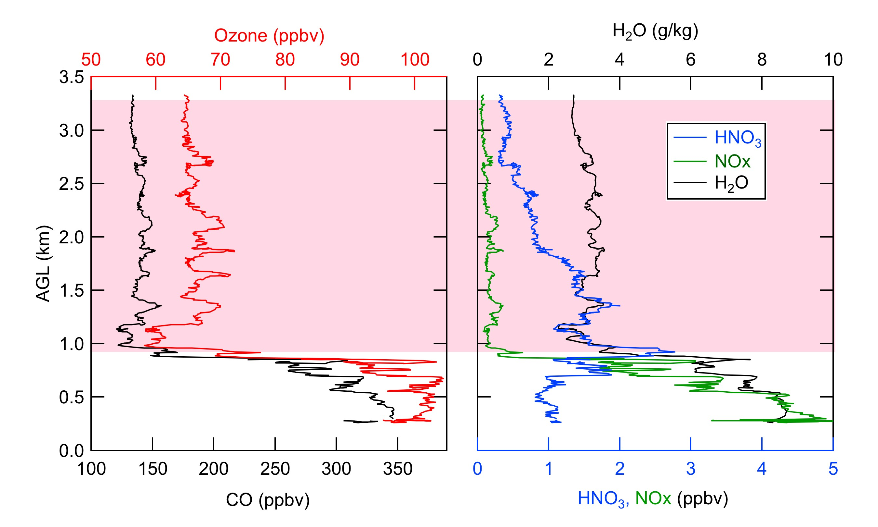
Ozone in the lower free troposphere over the LA Basin
Profile over Redlands on May 16
Aged
Regional
Emissions
Boundary
Layer
• Increased CO, water, HNO₃
• Increased Ozone from Aged Regional Emissions

Slide 13
Summary of 32 vertical profiles
Averages from 1.8 – 3.5 km altitude
Primary Air Mass Influence | Ozone (ppbv) |  | CO (ppbv) |  | HNO₃ (ppbv) | Water (g/kg) | Fraction of observations
Upper Tropospheric | 72 ± 8 |  | 108 |  | 0.41 | 0.75 | 40%
Aged Regional Emissions | 65 ± 5 |  | 130 |  | 0.81 | 2.9 | 42%
Long Range Transport | 71 ± 4 |  | 137 |  | 0.11 | 0.98 | 13%
Marine | 51 ± 7 |  | 98 |  | 0.65 | 3.4 | 5%
Stratospheric | Not observed below 4 km over LA Basin on 6 WP-3 flights

Slide 14
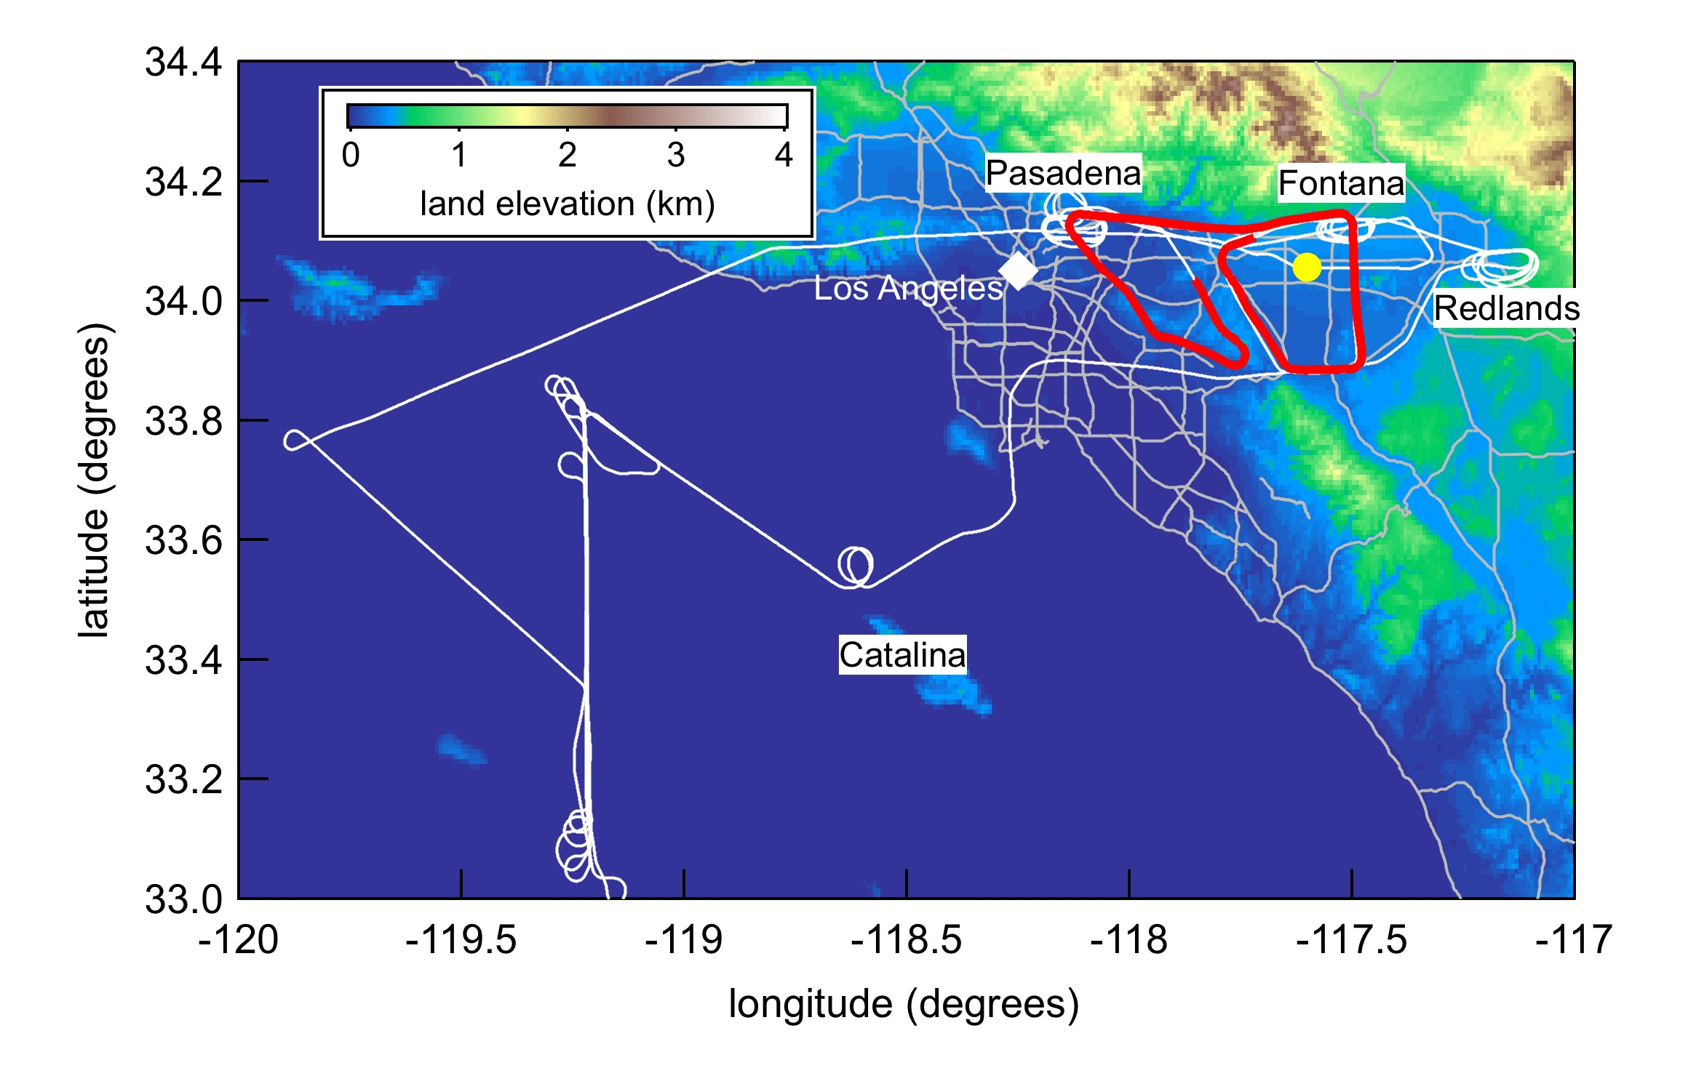
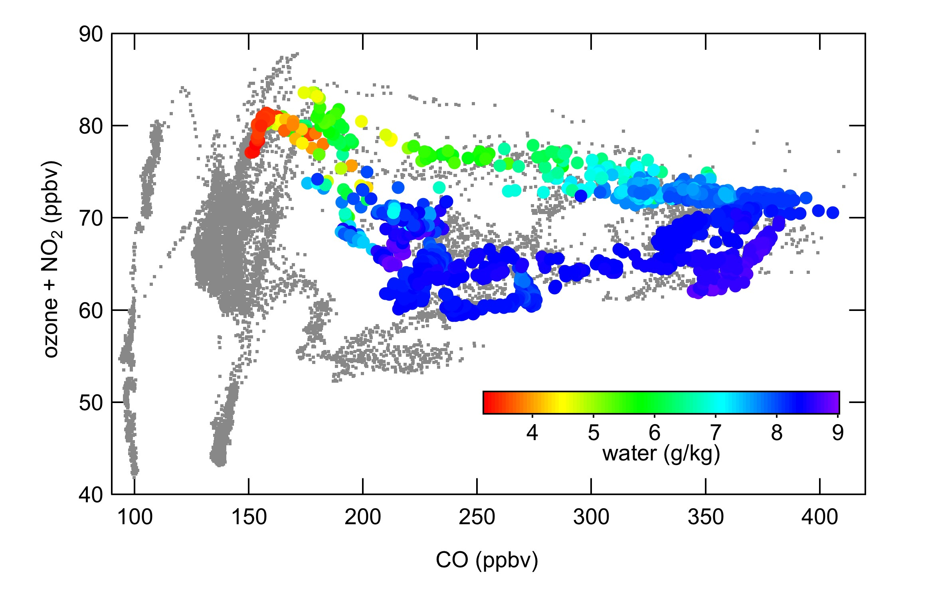
Example: Downward mixing of ozone into LA Basin, May 14
Ozone:CO correlation
• Gray points: Entire flight
• Colored points:
0.2 – 0.8 km altitude over East LA basin
• Dry air with increased ozone and low CO mixed into LA Basin
Notes:
Max altitude on May 14: 3.5 km
Dry air with low CO, high O3 regularly observed, but at much higher alts over Atlantic

Slide 15
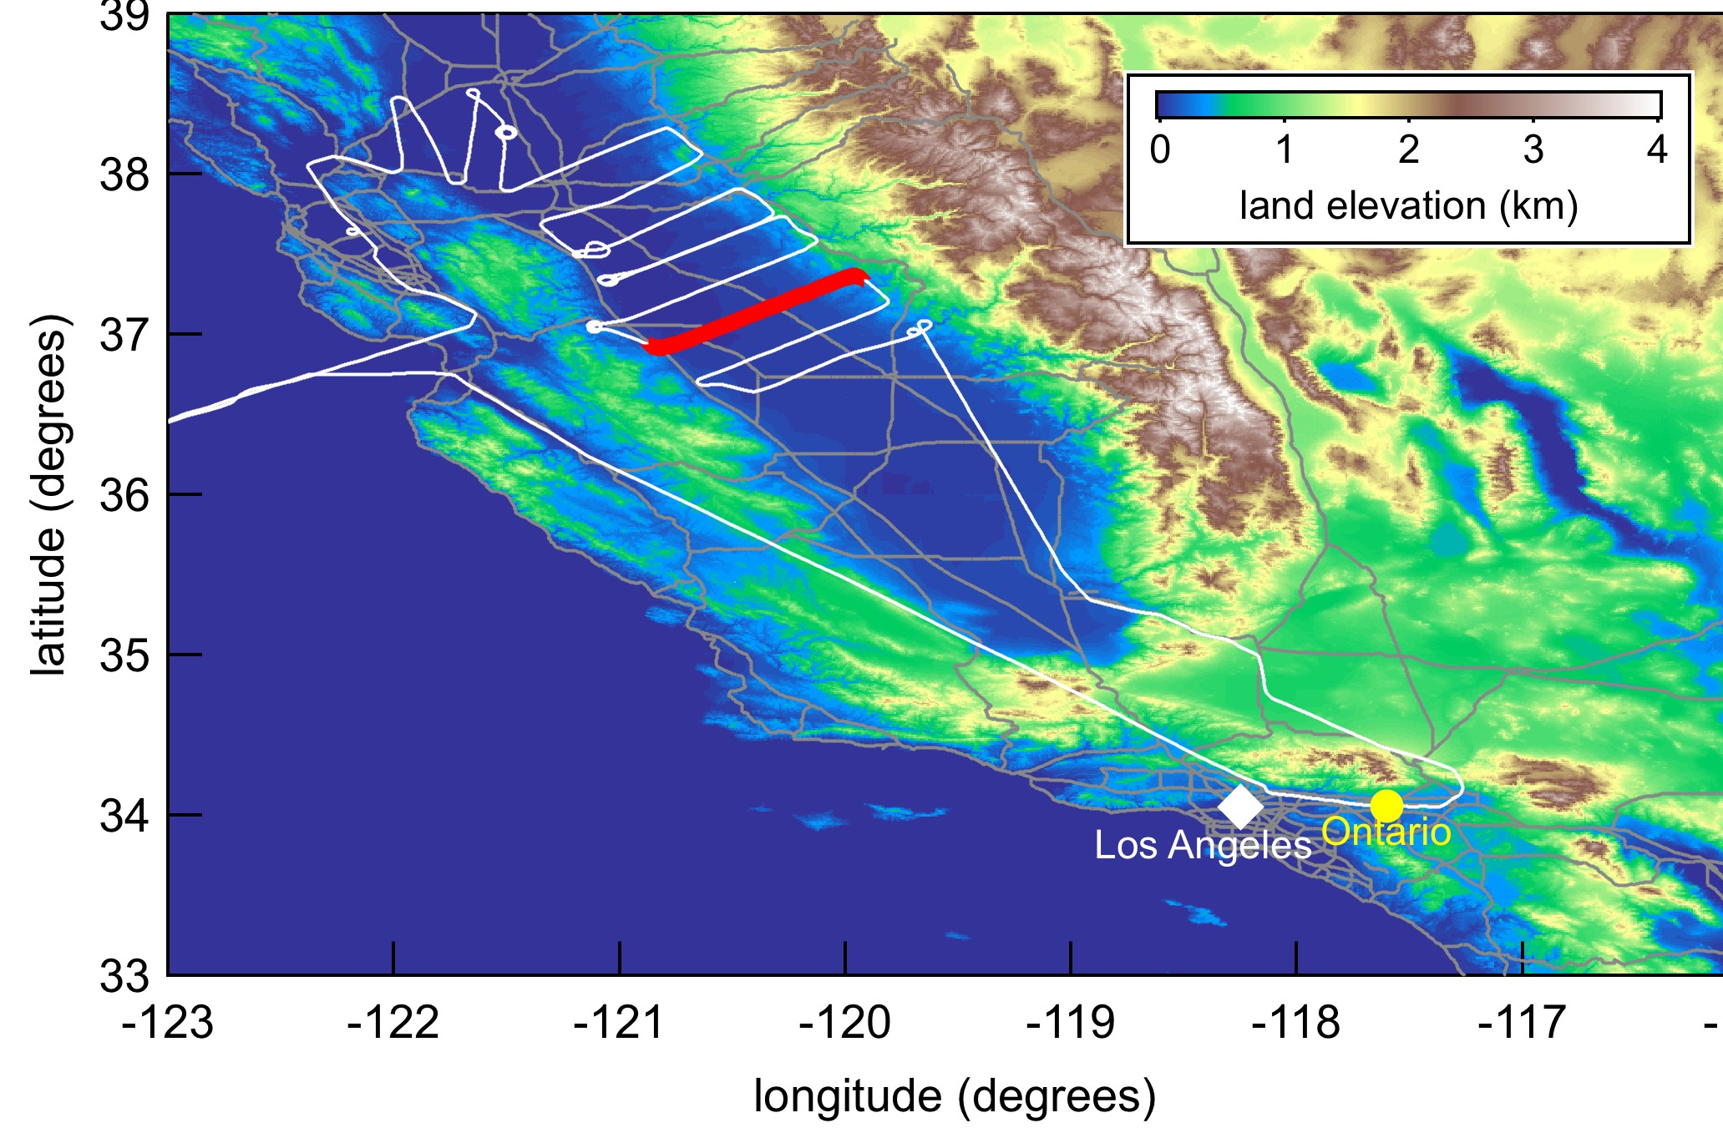
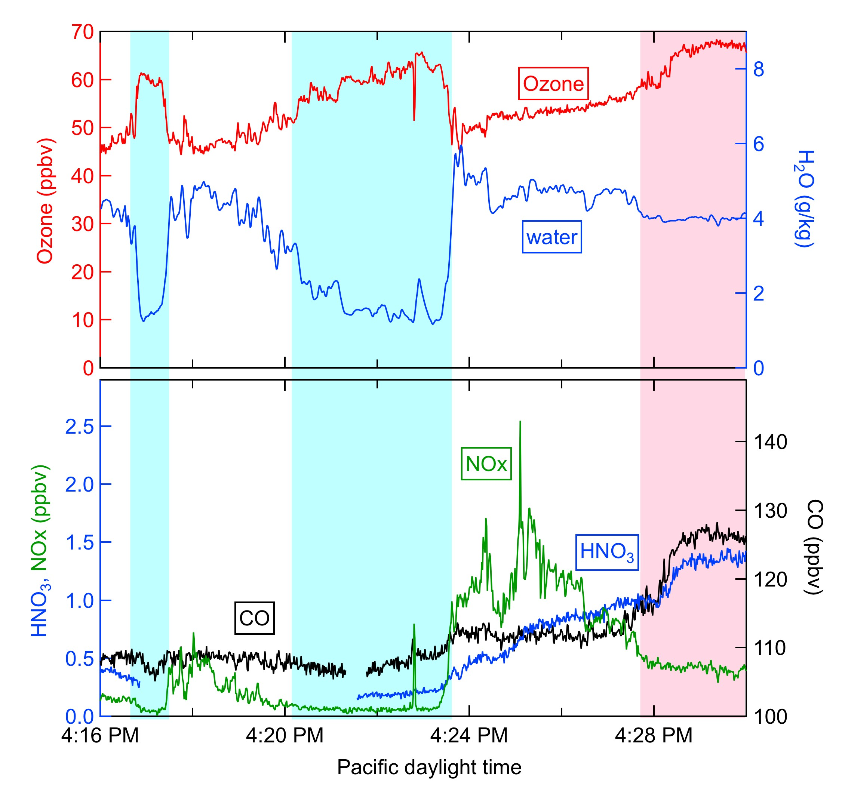
Example: Downward mixing of ozone into central valley, June 18
400 m AGL over San Joaquin Valley
• Decreased CO, water, HNO₃: Ozone from aloft mixed to surface
• Increased CO, HNO₃
Ozone from aged regional emissions
Upper Tropospheric
Influence
Aged Regional
Emissions

Slide 16
1. Ozone from upper troposphere an important source over the LA Basin. 2. Downward mixing of ozone may have same temporal and spatial pattern as photochemical production. 3. Entrainment of ozone from aloft affects correlations between ozone and tracers. 4. Ozone boundary condition at top of boundary layer is dynamic. Average values don’t reveal the conditions most important to exceedances. 5. Downward mixing of ozone aloft especially important over high desert (deep boundary layers). 6. Upper tropospheric influence seen in previous years, and could be monitored from commercial aircraft; Measurements of OZone, water vapour, carbon monoxide and nitrogen oxides by in-service AIrbus airCraft (MOZAIC) or In-service Aircraft for a Global Observing System (IAGOS).
Implications

Slide 18
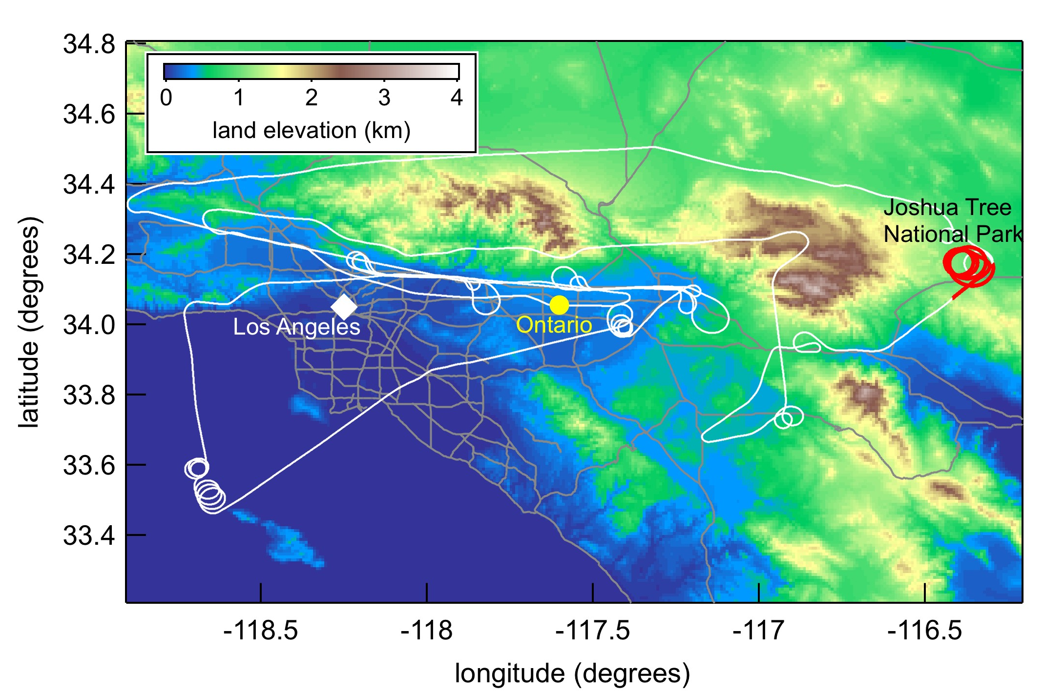
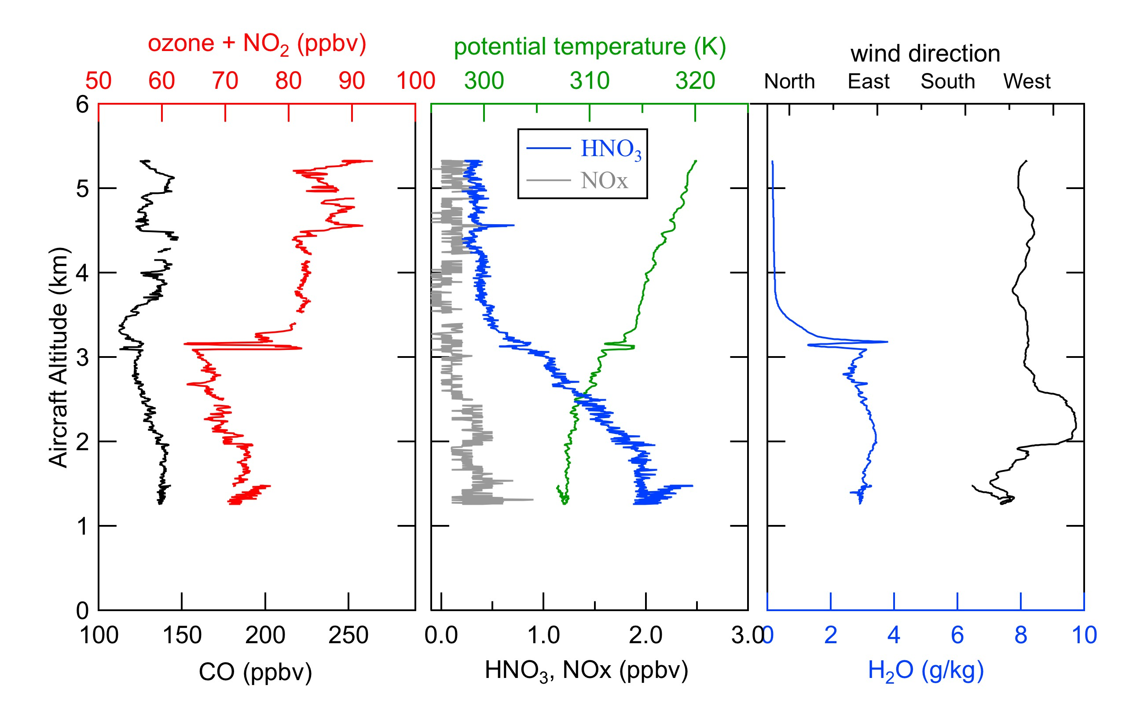
Example: Increased ozone
Joshua Tree National Park
May 4
Boundary Layer
• Decreased HNO₃, water aloft. CO variable.
Long Range Transport or Upper Troposphere
• Over high desert, deep mixing layers entrain ozone aloft

Slide 19
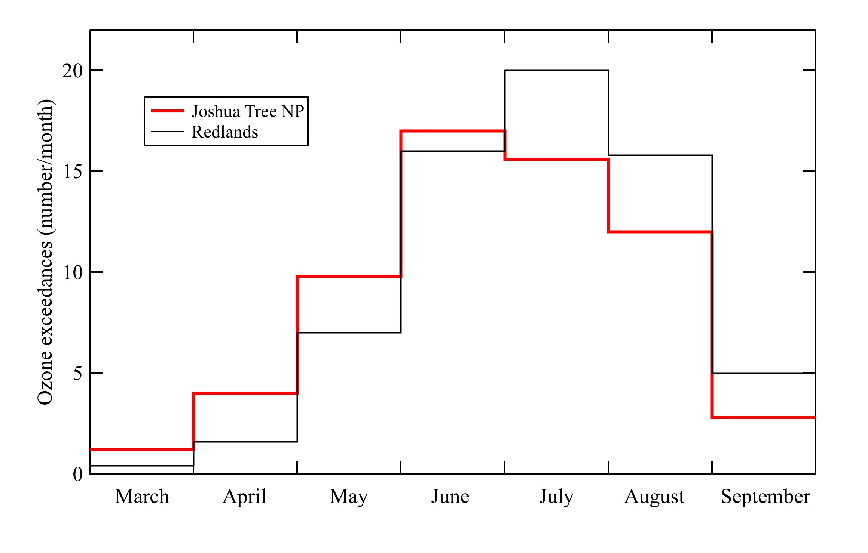
Daily exceedances of 75 ppbv daily 8-hr average ozone at Joshua Tree National Park and Redlands, averaged from 2006-2010
Joshua Tree has more exceedances in the spring

Slide 20
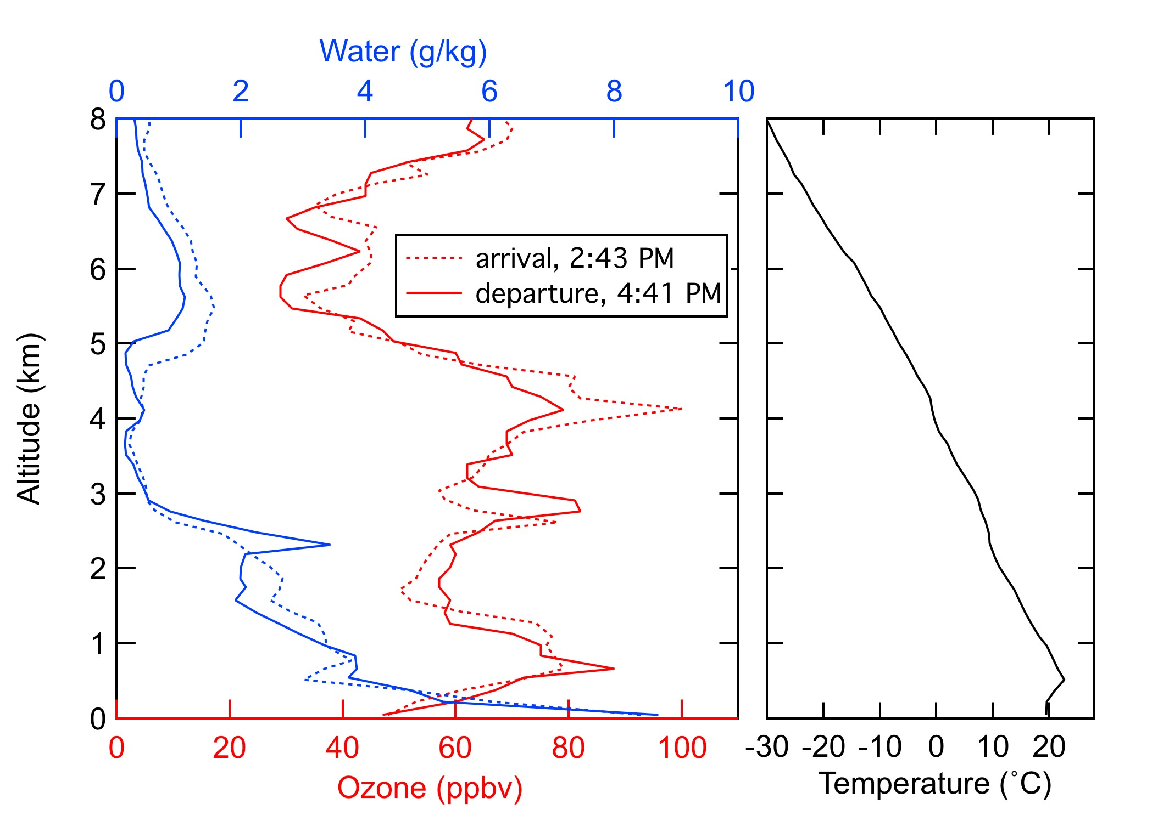
MOZAIC (Measurements of OZone, water vapour , carbon monoxide and nitrogen oxides by in-service AIrbus airCraft
May 12, 2005, in and out of LAX

