Slide 1



Molecular Characterization of Organic Aerosols from the Los Angeles Ground Site during the CalNex 2010 Campaign Using High-Resolution Mass Spectrometry
Laskin, J. Laskin, P. Roach, B. Heath
PNNL
T. Nguyen, N. Levac, D. Bones, A. Bateman, S. Nizkorodov
University of California, Irvine

Slide 2
Specific Objective:
Nitrogen Containing Organic Compounds
Ubiquitous in atmospheric aerosol, yet poorly characterized on a molecular level
May contributed to adverse health effects of particulate matter
May absorb visible light and contribute to “brown carbon” aerosol

Slide 3
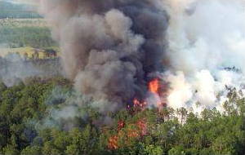

Conventional "Brown Carbon"
HULIS from biomass burning
Organic light-absorbing material from vehicular emissions
Andreae, Gelencser, Atmos. Chem. Phys. 2006
Jacobson J. Geophys. Res. 1999

Slide 4


"Brown Carbon" from SOA Aging
  NH₃ or amines
Fresh SOA: scatters light;
COOLS the surface
Aged SOA: absorbs light; WARMS the surface
Known to contain hetero-N compounds
Both biogenic and anthropogenic SOA undergo this type of aging
Laboratory Studies
(e.g. Bones et al, JGR 2010; Laskin J, et al Anal.Chem. 2010; Nakayama et al, JGR2010; De Haan et al, EST 2011)
Field Observations:
Mexico city (Roach, et al Anal.Chem. 2010), Shanghai (Wang et al, EST 2010)

Slide 5
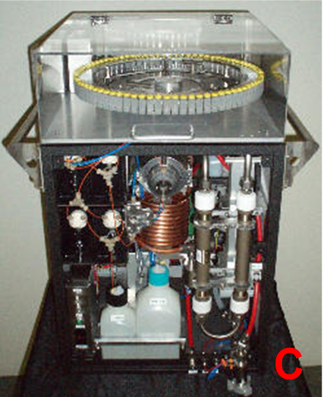
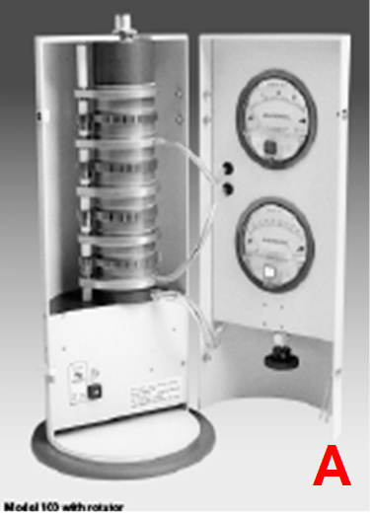
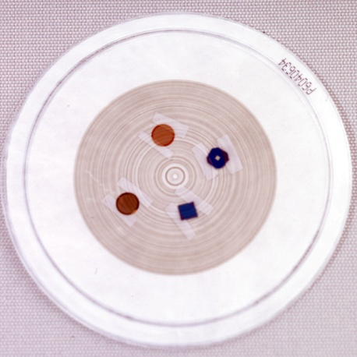
Types of Samples Collected
PILS (Particle-Into-Liquid Sampler)
  Particles collected straight in water
  30 min per sample
MOUDI Cascade Impactor
  Particles collected on Teflon and Al foil substrates
  6-hours per set of size segregated samples
  0-6 am; 6 am - noon; noon -6 pm; 6 pm - midnight
PILS
  High-Res.
  MS
  Substrates for SEM/EDX, X-ray spectro-microscopy, and Ice Nucleation studies

Slide 6



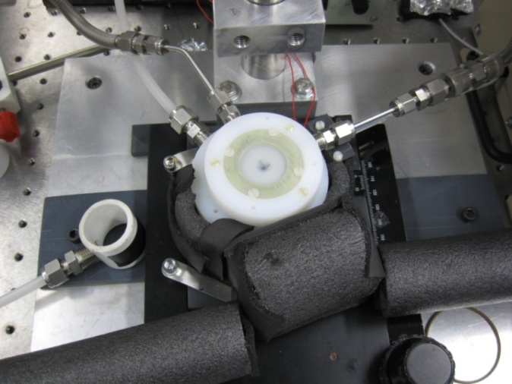
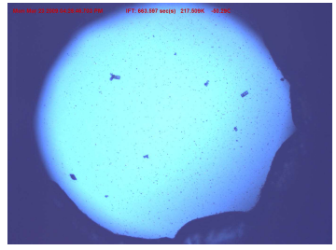
Optical Microscopy of
Heterogeneous Ice Nucleation
Bingbing Wang
Dr. Daniel Knopf
Poster 38
Notes:
Gas purity? Flow control?
Drierite gas traps??
Hygrometer, how u measure the dew point? What is frost point?
What is SCCM?
Onset ice nucleation? What is onset? Other meathods? CFDC?
Experimental Method
Aerosol particles will be deposited onto a hydrophobic glass slide and exposed to temperatures and relative humidities typical of the UT/LS region.
A novel homemade ice nucleation cell is developed which allows the control of temperature and relative humidity (RH).
The amount of water vapor is controlled by careful mixing a flow of dry Helium with a Helium flow saturated by water vapor.
The RH is determined by measuring the dew point of the gas flow using a chilled mirror hygrometer
By lowing the temp. of the cooling stage, the relative humidity with respect to ice is gradually increased until ice nucleation is observed using microscope.
The aim of ice nucleation study is to derive physical parameterization termed ice nucleation rate coefficient to describe ice nucleation.
Ice nucleation rate coefficient can be translated into an ice particle production rate for specific aerosol and particular atmospheric conditions.
6

Slide 7
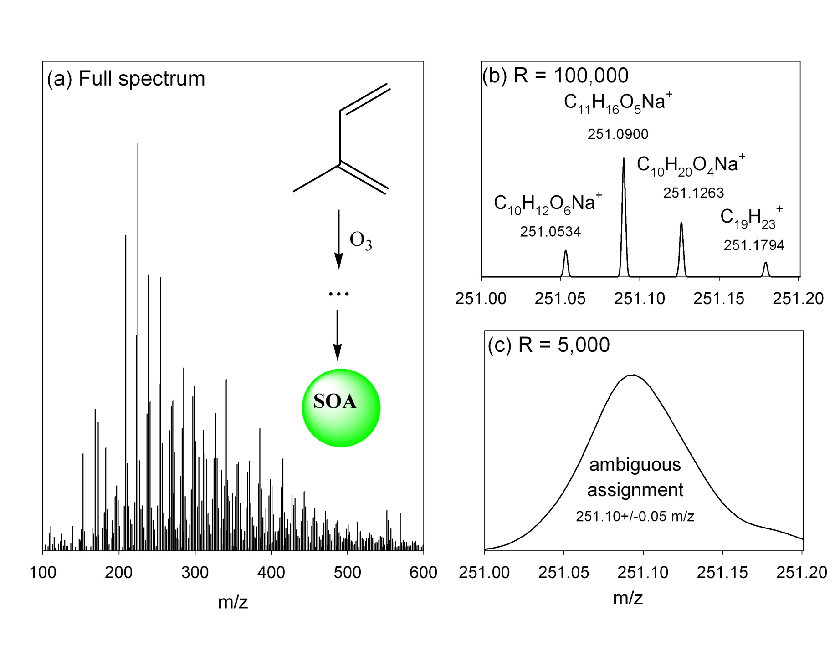
Advantages of High Resolution MS

Slide 8
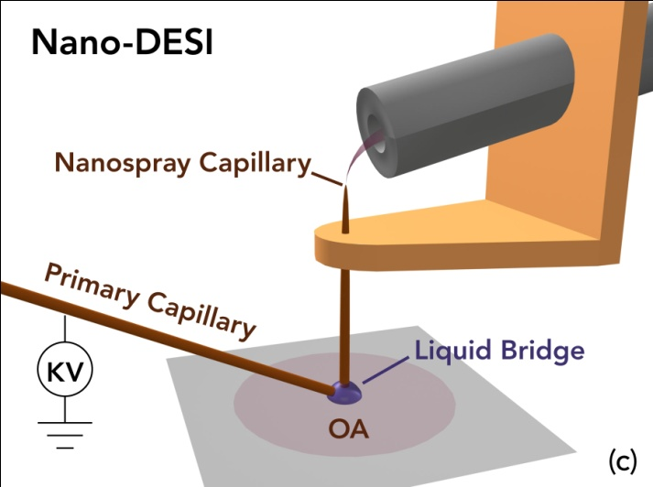

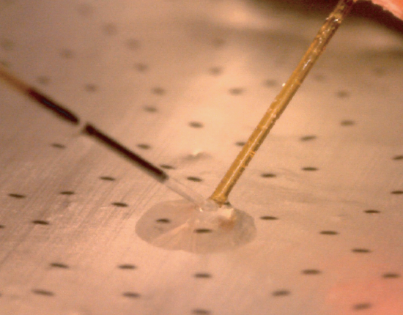
Analysis of OA Using Nano-DESI MS
Routine analysis of <10 ng OA
Probe size <100 μm

Slide 9
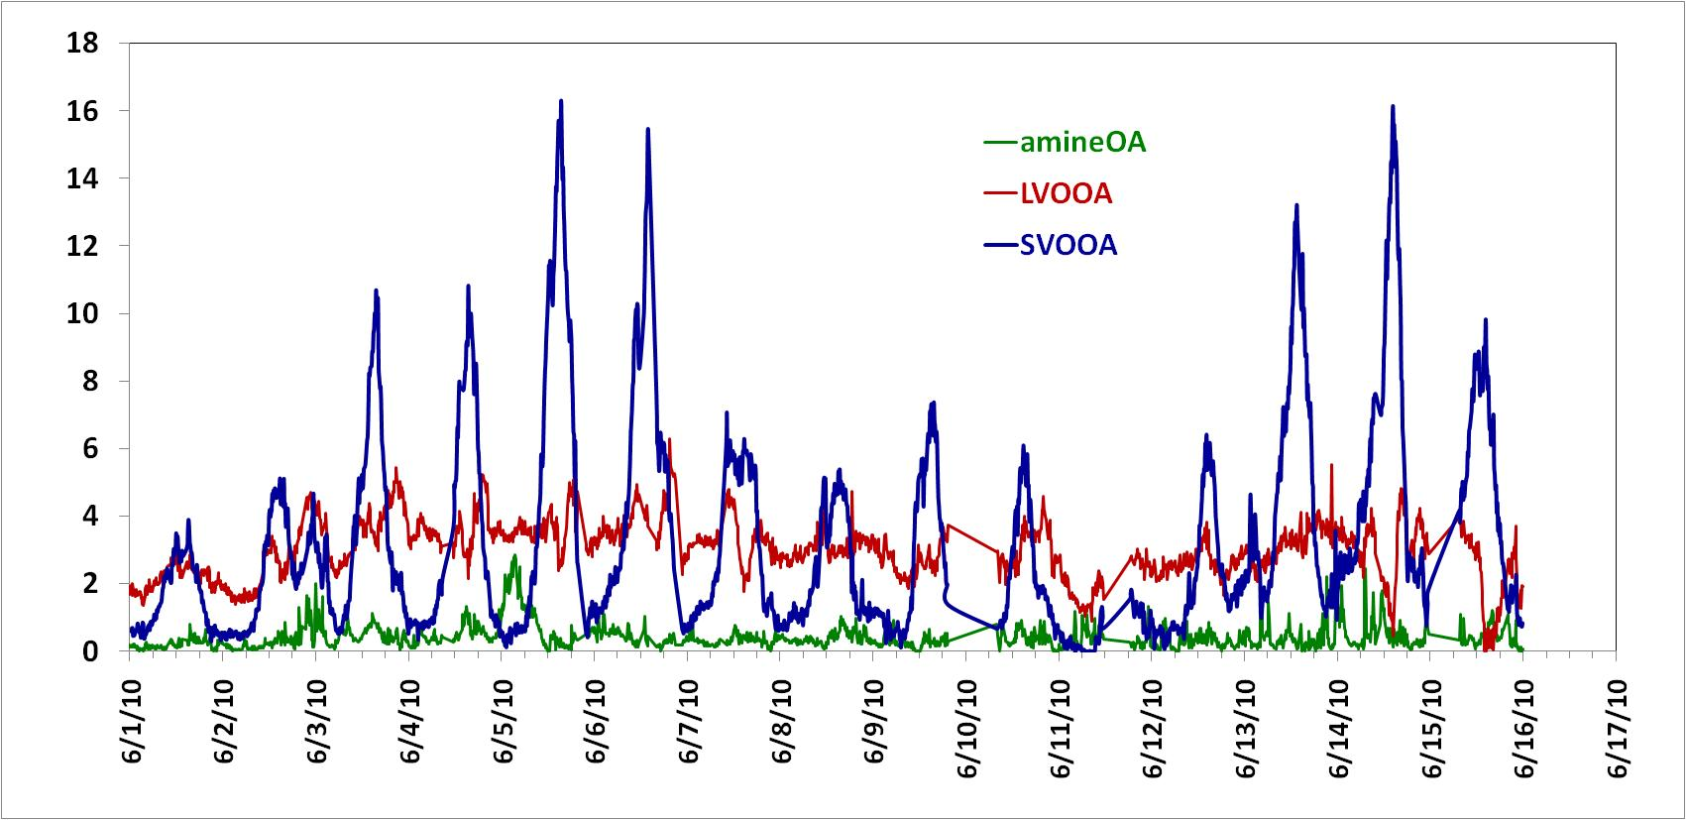
Promising Days for the HR-MS Analysis
AMS data from P. Hayes, J. Jimenez et al. (U. Colorado)
June 5: unusually large “ amine OA" signal in the morning

Slide 10
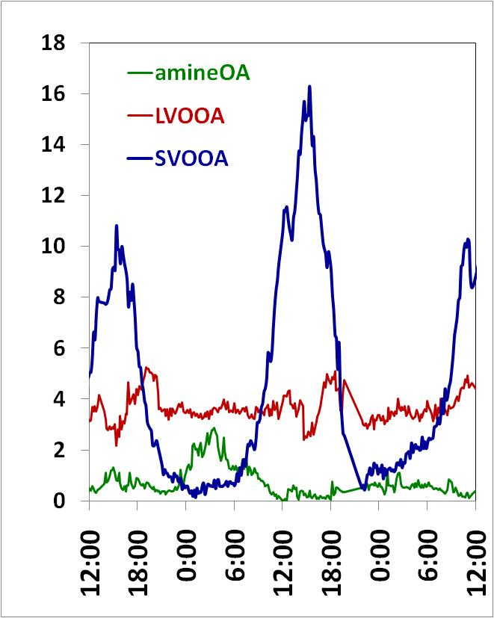
Nano DESI HR-MS
~40% peaks assigned
LVOOA
LVOOA
SVOOA
SVOOA

Slide 11
LVOOA and SVOOA are Chemically Related
(sample 6:00-12:00)
LVOOA
SVOOA
C₃₈H₆₄O₆-(CH₂)_{x} H⁺
KMD_{CH2}
C₂₀H₃₆O₄ -(CH₂)_{x} H⁺
C₁₆H₃₀O₃ -(CH₂)_{x} H⁺
C₁₅H₂₆O -(CH₂)_{x} H⁺
KM_{CH2}, Da

Slide 12
O/C Histograms
0:00-6:00
6:00-12:00
fresh emissions..?
C_{x}H_{y}N_{z}
12:00-18:00
18:00-24:00

Slide 13
N/C Histograms
0:00-6:00
6:00-12:00
C_{x}H_{y}N_{z}
12:00-18:00
18:00-24:00

Slide 14
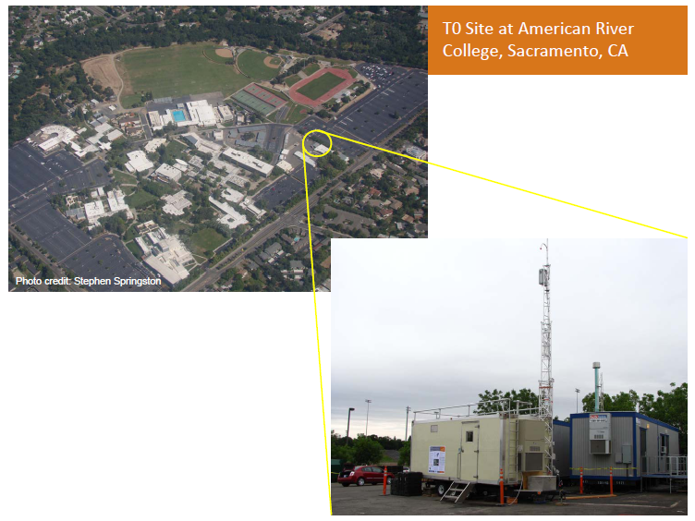
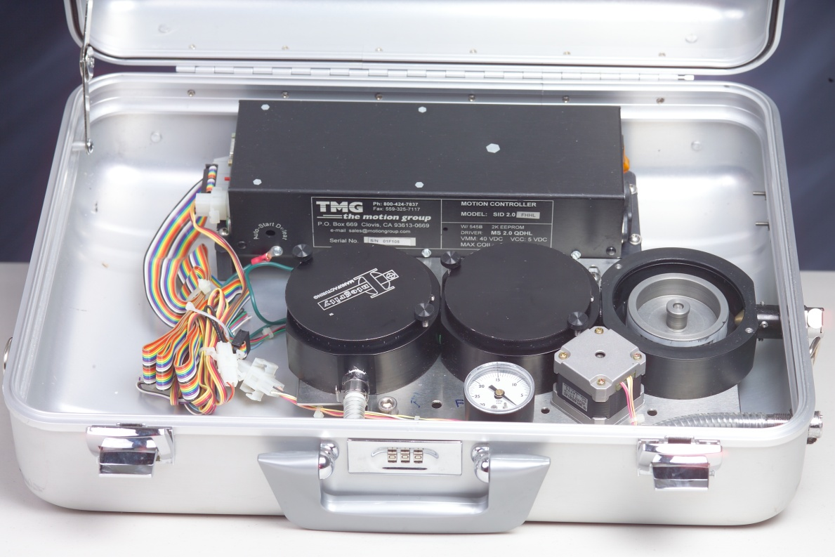
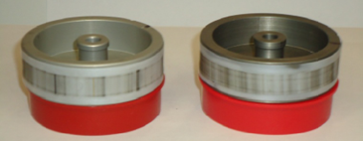
N-Organics in CARES samples
(DOE 2010 field study)
Photos: S. Springston
R. Zaveri
Sacramento,
T0 site

Slide 15
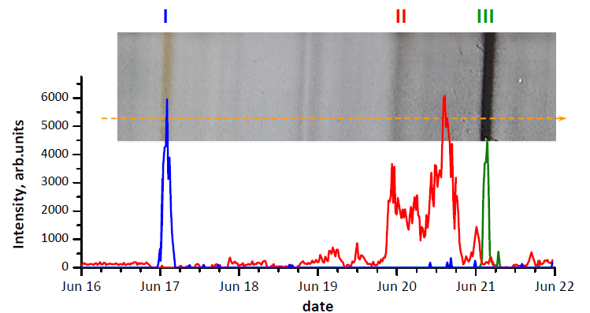
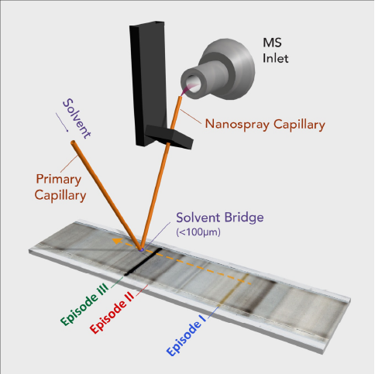
Nanospray DESI – Line Scan Analysis

Slide 16
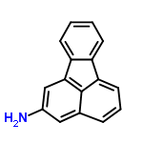
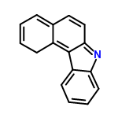
Nanospray DESI – Line Scan Analysis
or
Brown C Event
DBE
C_{x}H_{y}N₁
C₁₆H₁₁N₁
C_{x}H_{y}N₂
m/z

Slide 17
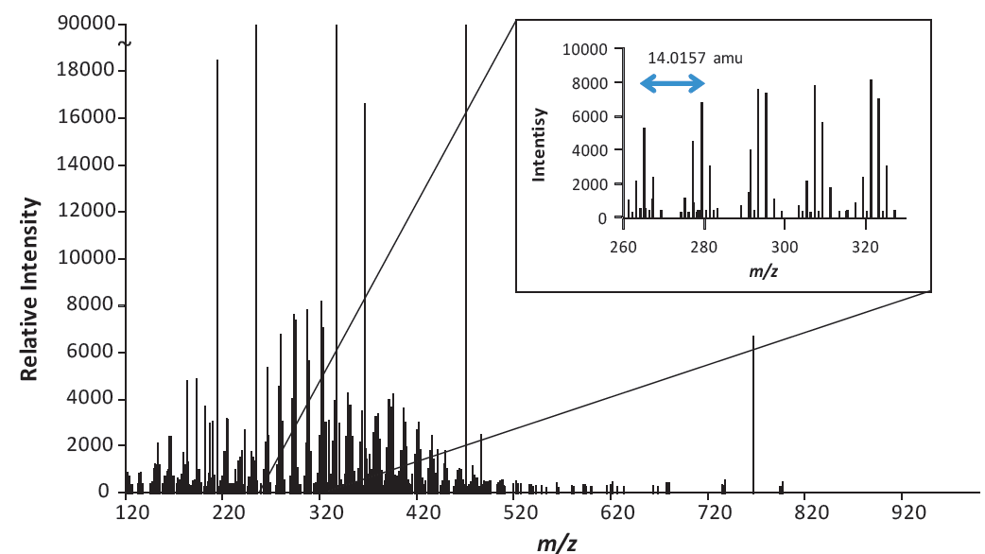
C_{x}H_{y}N_{z} – organics are ubiquitous in urban OA
Possible Sources:
Intensive Road Construction Activity at the Time of C_{x}H_{y}N_{z} Episode (field notes of R. Zaveri)
Fumes of Asphaltenes …?
Emissions from Vehicles with Catalytical Converters …?
C_{x}H_{y}N₁ – are also observed at the Bakersfield site
(R. Sellon, A. Goldstein, et al - Poster 31)
25% of identified peaks are:
aliphatic C_{x}H_{y}N₁, C_{x}H_{y}O_{z}N₁
- Amines

Slide 18
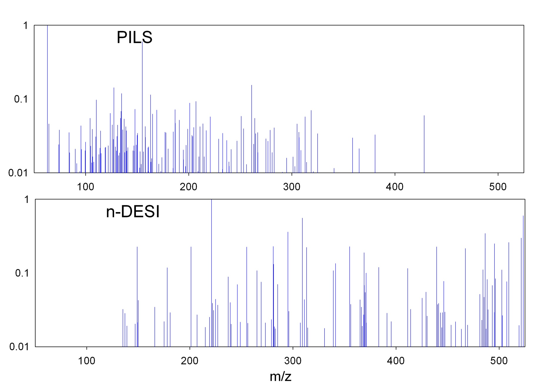
Outlook: PILS vs DESI: June 5, 12-6 pm
Very different subsets of compounds detected by two methods

Slide 19
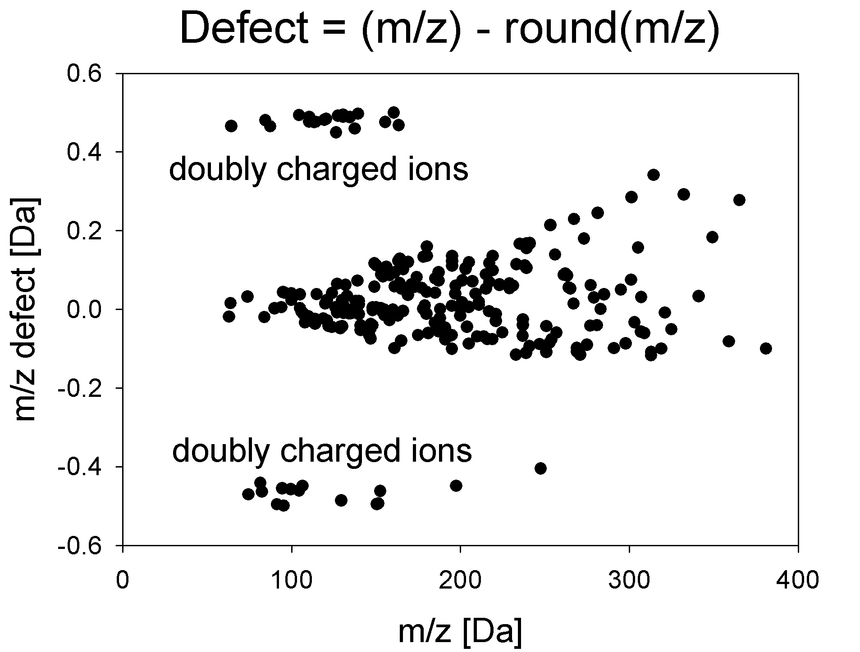
Multiply Charged Ions in PILS Spectra
(M-Ca²⁺, M-Mg²⁺, …)

Slide 20
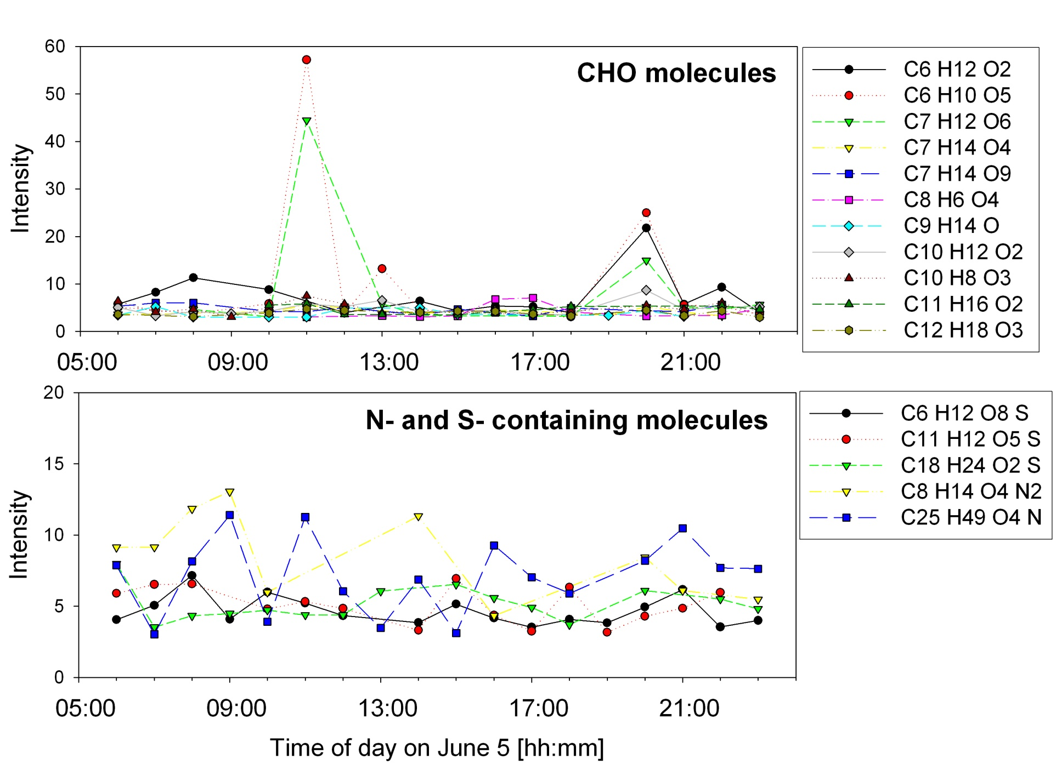
Time Series of WSOC Detected by PILS
Notes:
Note to self: these are peaks that
1. Could be assigned
2. Occur in at least half of PILS samples (so that time dependence can be plotted)

Slide 21
SUMMARY
Molecular-level HR-MS analysis provides critical information for interpretation of the OA types, their chemistry
Essential to assist with more detailed classification
Outlook:
Closure studies with the OA optical properties data indicative of “brown carbon”
Closure studies with the gas phase, VOC data focused on chemistry of SOA formation and aging

