Slide 1
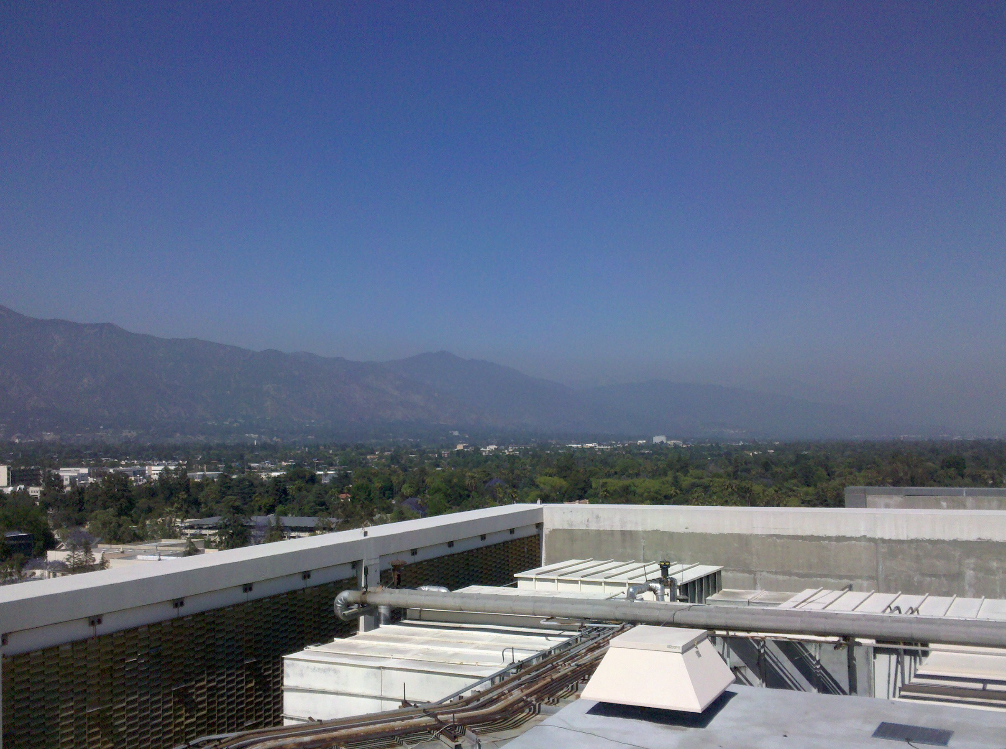
Aerosol Composition in Los Angeles During the 2010 CalNex Campaign
Studied by High Resolution Aerosol Mass Spectrometry
CalNex Data Analysis Workshop, May 16th – 19th 2011, Sacramento
Patrick L. Hayes^{1,2}, Amber M. Ortega^{1,3}, Michael J. Cubison^{1,2}, Weiwei Hu⁴, Darin W. Toohey³, James H. Flynn⁵, Barry L. Lefer⁵, Sergio Alvarez⁵, Bernhard Rappenglück⁵, James D. Allan⁶, John S. Holloway^{1,7}, Jessica B. Gilman^{1,7}, William C. Kuster⁷, Joost A. de Gouw^{1,7}, Paola Massoli⁸, Xiaolu Zhang⁹, Rodney J. Weber⁹, Ashley Corrigan¹⁰, Lynn M. Russell¹⁰, Jose L. Jimenez^{1,2}
CIRES, Boulder, USA; (2) Department of Chemistry and Biochemistry, University of Colorado, Boulder, USA; (3) Department of Atmospheric and Oceanic Science, University of Colorado, Boulder, USA; (4) College of Environmental Sciences and Engineering, Peking University, China; (5) Department of Earth and Atmospheric Sciences, University of Houston, USA; (6) National Centre for Atmospheric Science, The University of Manchester, UK; (7) NOAA, Boulder, USA; (8) Aerodyne Research Inc., Billerica, USA; (9) Georgia Institute of Technology, Atlanta, USA; (10) Scripps Institution of Oceanography, University of California San Diego, La Jolla, USA.

Slide 2
Chemical Composition of PM₁ Aerosols for Pasadena
Chloride
Black Carbon
Ammonium
Organic
Sulfate
Nitrate
Build up of organic aerosol concentrations over a period of several days. Residual organic aerosols and precursor species in the Pasadena area appear to undergo multiple days of aging.

Slide 3
Chemical Composition of Non-Refractory PM₁ Aerosols for Pasadena
Diurnal Average (6/3 – 6/9):
Organic diurnal trend consistent with transport times from source-rich western basin and the expected timescale of secondary production.
Nitrate diurnal trend influenced by dilution due to rising planetary boundary layer and evaporation of ammonium nitrate.

Slide 4
Positive Matrix Factorization (PMF): Time Series & Mass Spectra
Diesel Hydrocarbon-like
Organic Aerosol (HOA-D)
Non-Diesel Hydrocarbon-like
Organic Aerosol (HOA-ND)
Local Organic Aerosol
(LOA)
Semi-Volatile Oxygenated
Organic Aerosol (SV-OOA)
Low-Volatility Oxygenated Organic Aerosol (LV-OOA)
(HOA-D)
(HOA-ND)
(LOA)
(SV-OOA)
(LV-OOA)
PMF Background: Ulbrich et al. Atmos. Chem. Phys. 2009, 9, 2891.

Slide 5
Positive Matrix Factorization (PMF): Time Series & Mass Spectra
Diesel Hydrocarbon-like
Organic Aerosol (HOA-D)
Non-Diesel Hydrocarbon-like
Organic Aerosol (HOA-ND)
Local Organic Aerosol
(LOA)
Semi-Volatile Oxygenated
Organic Aerosol (SV-OOA)
Low-Volatility Oxygenated Organic Aerosol (LV-OOA)
(HOA-D)
(HOA-ND)
(LOA)
(SV-OOA)
(LV-OOA)
PMF Background: Ulbrich et al. Atmos. Chem. Phys. 2009, 9, 2891.

Slide 6
Positive Matrix Factorization (PMF): Time Series & Mass Spectra
Diesel Hydrocarbon-like
Organic Aerosol (HOA-D)
Non-Diesel Hydrocarbon-like
Organic Aerosol (HOA-ND)
Local Organic Aerosol
(LOA)
Semi-Volatile Oxygenated
Organic Aerosol (SV-OOA)
Low-Volatility Oxygenated Organic Aerosol (LV-OOA)

Slide 7
O_{x}(O₃ + NO₂) vs OOA
Slope of OOA vs. Ox plot is steeper for Pasadena in comparison to Riverside (SOAR-1).
The OOA vs. Ox slope is similar to that found in Mexico City for less aged aerosol (MILAGRO).
Reference for OOA vs. Ox plots:
Herndon et al. Geophys. Res. Lett. 2008, 35, L15804.
Wood et al. Atmos. Chem. Phys. 2010, 10, 8947.

Slide 8
Comparison of HOA Components with Combustion Emission Tracers
Gasoline Dominated
Diesel Dominated
Less-Diesel Influenced
More-Diesel Influenced

Slide 9
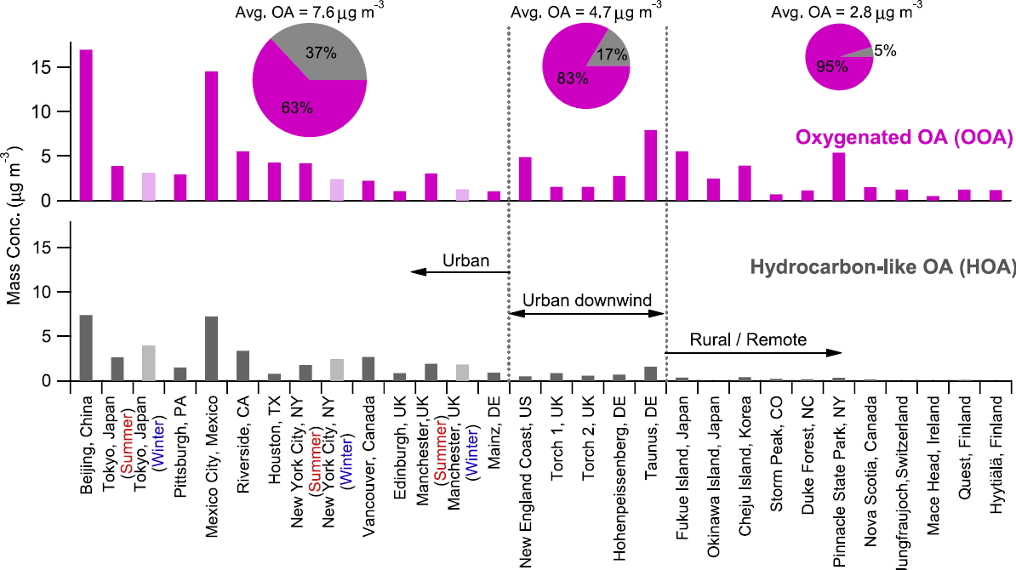
Positive Matrix Factorization (PMF): Time Series & Campaign Averages
LOA
HOA-ND
LV-OOA
HOA-D
SV-OOA
Taken from: Zhang et al. Geophys. Res. Lett. 2007, 34, L13801

Slide 10
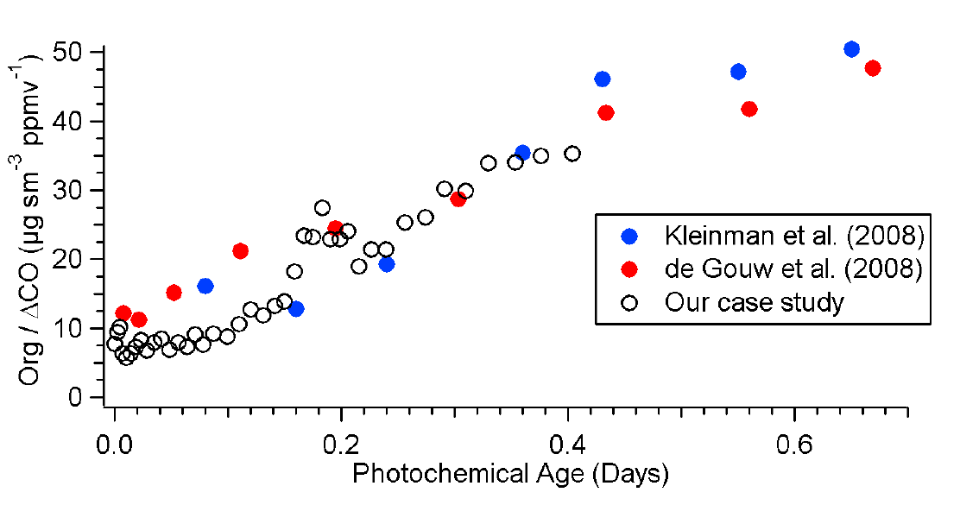
Evolution of Org/ΔCO
Mexico City:
Taken From: Dzepina et al. Atmos. Chem. Phys. 2009, 9, 5681.
Kleinman et al. (2008)
de Gouw et al. (2008)
Dzepina et al. (2009)
30

Slide 11
Evolution of Org/ΔCO
Mexico City:
Taken From: Dzepina et al. Atmos. Chem. Phys. 2009, 9, 5681.
Kleinman et al. (2008)
de Gouw et al. (2008)
Dzepina et al. (2009)
30
Pasadena:
For 6/2 -6/6
30
SOA from previous day?
HOA

Slide 12
Organic Aerosol Elemental Composition from High Resolution AMS data
HR-ToF-AMS Elemental Analysis Background: Aiken et al. Anal. Chem. 2007, 79, 8350.

Slide 13
The Van Krevelen Diagram, Pasadena vs. Riverside
A shallower slope significantly less than -1 for Pasadena could be due to a greater tendency for alcohol addition, or C-C bond breaking (fragmentation) reactions during aerosol aging. Alternatively, slope may be due to different mixing of primary and secondary organic aerosol components.
Reference for Van Krevelen Diagrams:
Heald et al. Geophys. Res. Lett. 2010, 37, L08803.

Slide 14
The Van Krevelen Diagram, Pasadena vs. Riverside
A shallower slope significantly less than -1 for Pasadena could be due to a greater tendency for alcohol addition, or C-C bond breaking (fragmentation) reactions during aerosol aging. Alternatively, slope may be due to different mixing of primary and secondary organic aerosol components.
Reference for Van Krevelen Diagrams:
Heald et al. Geophys. Res. Lett. 2010, 37, L08803.

Slide 15
Thermodenuder + AMS and Volatility Distributions
Total OA:
POA (using C₄H₉ as surrogate):
Method From: Faulhaber et al. Atmos. Meas. Tech. 2009, 2, 15.

Slide 16
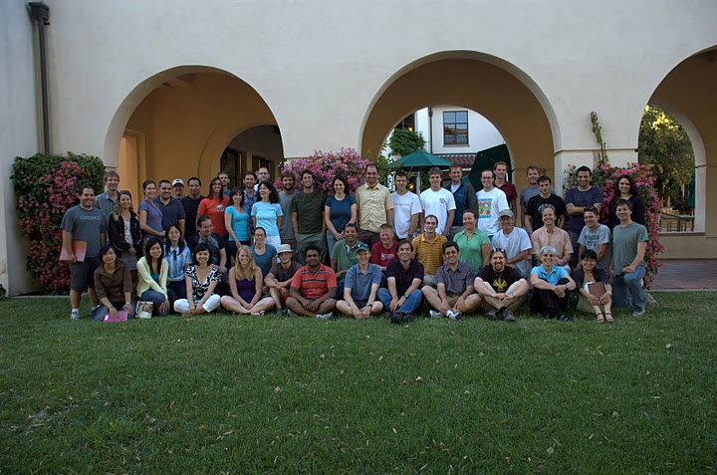


Acknowledgements
Funding:
CalNex Pasadena Ground-Site Team
&
CalNex Scientific Community

Slide 17
Back-Up

Slide 19
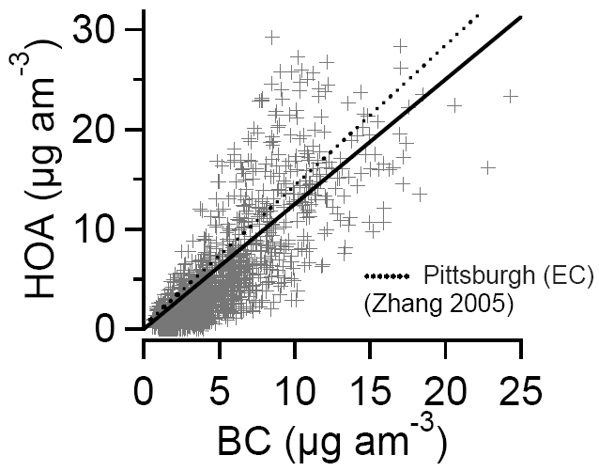
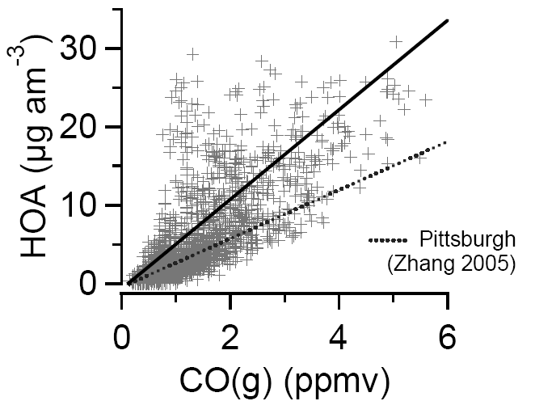
HOA-D vs. Black Carbon, ‘HOA-D + HOA-ND’ vs. CO(g)
Slope = 1.41
Slope
= 1.25
Mexico City
Slope = 5.71
Slope = 3.33
Mexico City
Me

Slide 20
O_{x}(O₃ + NO₂) vs SV-OOA, Back-Up

Slide 21
f44 vs. f43 plot (with PMF Results)

Slide 22
AMS Comparison with SMPS, UHSAS (Part 1)

Slide 23
AMS Comparison with SMPS, UHSAS (Part 2)

Slide 24
AMS Comparison with SMPS, UHSAS (Part 3)

Slide 25
Calculated Mie Scattering vs. CAPS (Part 1)

Slide 26
Calculated Mie Scattering vs. CAPS (Part 2)

Slide 27
AMS OM vs. Sunset Online OC
Online Sunset OC data was corrected by multiplying the data by 2.57. This value was calculated from correlation plots of online and HiVol OC data. Without this correction the (AMS OM):(online OC) is unrealistically high.

Slide 28
Comparison of AMS OM vs FTIR OM (Russell Group UCSD)

Slide 29
Comparison Plots: TAG-AMS OM (Aerodyne) vs. AMS OM (Univ. CO.)

Slide 30
Comparison Weekday vs. Sunday – HOA Components & Tracers
Solid – Mean
Dashed – Median
References on Weekday/Weekend Effect in LA-area: Millstein et al. Atmos. Environ. 2008, 42, 632. Marr et al. Atmos. Environ. 2002, 36, 2327.

