Slide 1

Aircraft Aerosol Mass Spectrometer Measurements over the Los Angeles Basin during CalNex
Jill S. Craven
Caltech, Seinfeld/Flagan Research Group
Presented at CalNex Data Analysis Workshop

Slide 2
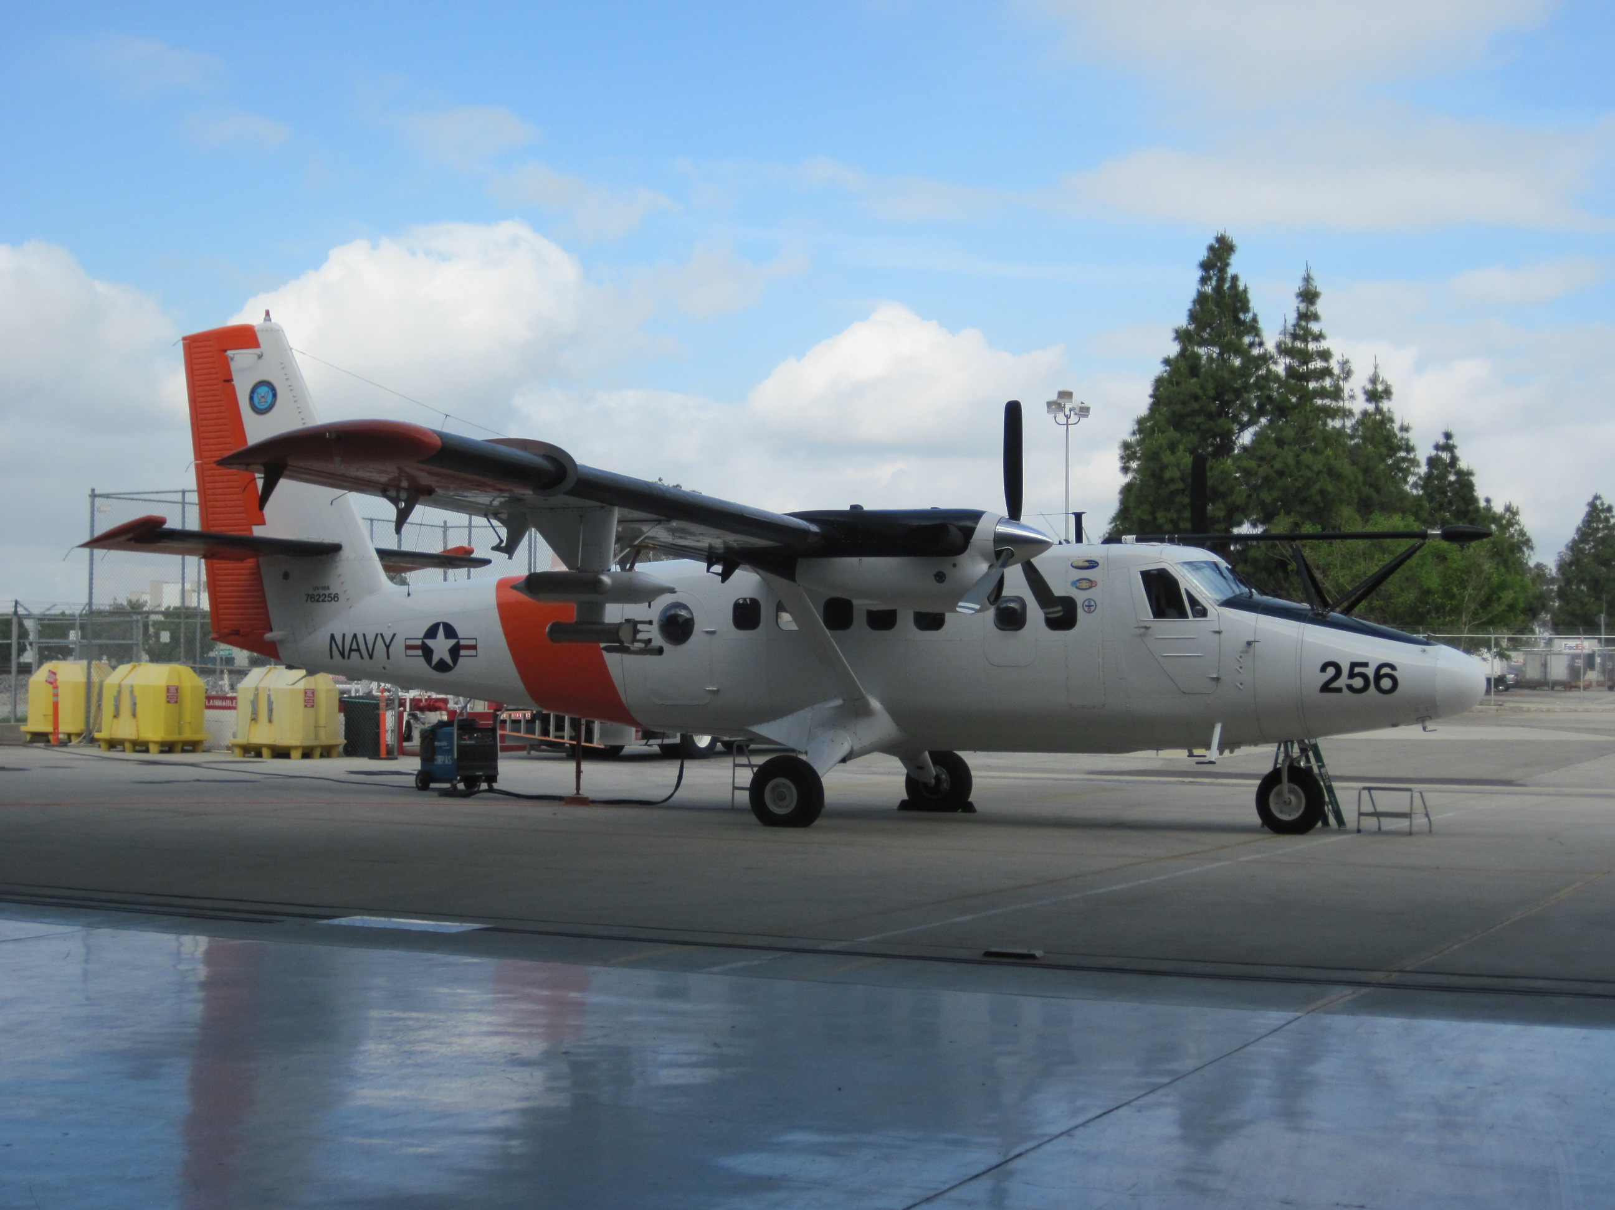
Flight Path Overview
RF # | Flight Date | Mission Type
10 | 5/18/10 | San Jaoquin valley, just after a front
11 | 5/19/10 | LA Basin, coordinated flight plan, N-S tracks
12 | 5/20/10 | San Jaoquin valley, morning clouds; El Cajon pass
13 | 5/21/10 | LA Basin, 2 loops, N-S tracks, El Cajon & Banning passes
14 | 5/22/10 | San Jaoquin valley, N-S track up to Fresno and back
15 | 5/24/10 | LA Basin, with Santa Ana, El Cajon pass, and Salton Sea
16 | 5/25/10 | LA Basin, with Santa Ana, El Cajon pass, and Salton Sea
17 | 5/27/10 | LA Basin, 3 loops
18 | 5/28/10 | LA Basin, 3 loops, with tanker fire on 91
CIRPAS Twin Otter
Notes:
For our Mission, we flew for the entire month of May in the LA and Bakersfield Basins on the CIRPAS twin otter platform. Because it’s a small aircraft, I split the the time with Kim Prather’s ATOFMS instrument. For the flights I was one, we flew 3 in the Bakersfield Basin and 6 in the LA Basin, but for one of those flights there were AMS instrument problems. For this presentation I will be focusing on the flights in the LA Basin.

Slide 3
LA Basin Aerosol Composition: Regional Differences
Notes:
There were two types of flight paths we did in the LA Basin, one of them being aloop pattern around the basin, two of which are shown here. What I’ve done is color code regions of interest in the Basin, or where the aerosol composition was much different than the average. The Caltech Ground Site is the Region in Orange, the NE portion of the basin is in blue and the what we call the long beach region is in grey. We started in Ontario ad flew around the Basin Counter Clockwise. One more thing to notes I that we flew late morning through early afternoon, as displayed by the local time.
In the long beach region, the Sulfate Aerosol is at its highest. In the NE region, each time we go around the loop, we intercepted a huge plume of ammonium nitrate aerosol and organic aerosol. In the Caltech region, is more characteristic of average organic and inorganic values for the basin.
One thing to notice about these two flights in particular, is that from a Thursday to a Friday the organic loading increases, while the ammonium nitrate goes down. Some of that may be because the pollution from yesterday was still around.

Slide 4
LA Basin Aerosol Mass Fraction
Notes:
Another way to look the composition is with the aerosol mass fraction. What I have done here is plot the mass fraction of the organic, and inorganics, as well as BC against latitude and longitude.
From these two graphs, you can see how the Sulfate mass fraction is dominated in the SW region of the basin, as you go from east to west, the Ammonium NItrate fraction becomes more and more important. Another thing to notice is how the organic fraction remains relatively constant. We will look more into the type of organic aerosol in the next slide. The Average Mass loading from both flights are shown in the pie charts below, one for each flight.
The increase in organic fraction reflects an increase in organic loading as seen in the previous slide. The Black Carbon average fraction increased because we sampled a tranker fire on that day. During the Tanker fire the BC mass fraction was 50 % of the mass.

Slide 5
LA Basin Average Organic Mass Spectrum
Notes:
So now, lets move to investigating the organic aerosol throughout the basin.
Here are the average organic mass spectra from the two basin flights and in the upper RH side of the mass spectrum I”ve included the f44 vs f43 plots. m/z 44 and m/z 43 have been shown to be two large and important masses in the organic mass spectra and for the most part are true for our dataset as well. These two masses are mass spectra tracers for acid-derived and non-acid oxygenates and their trend up the f44 f43 triangle space indicates what type of organic aerosol they are an. From both of these plots suggest that they are OA was semi-volatile aerosol, not as aged.

Slide 6
LA Basin Difference Spectra
May 28 Flight
Notes:
Factorization is a good way to determine the type of organic aerosol, and I am still working on this, but in the meanwhile, you can tell the differneces of OA between regions by taking the average organic smass spectrum from a particular region and subracting the average organic aerosol from the entire basin. That is what I have done here.

Slide 7
LA Basin vs Outflow Aerosol Composition
Notes:
Outflow loading is a lot lower, which is what we would expect the further you get from a source of pollution since it would be diluted.
In the Basin, where the nitrates and other inorganics have a significant portion of the aerosol mass, in the outflow it is mainly organic. The Banning Pass seems to have more pollution. It is Lower in elevation than the El Cajon Pass and/or there is probably more traffic on the 10 going over the banning pass.

Slide 8
Outflow Difference Organic Mass Spectrum
Notes:
The difference in the organic spectrum clearly shows an enhancement of the m/z 44, which is a spectra tracer to oxidized aerosol, very common to AMS literature. Something else to note, is that there is a depletion in HOA tracers (m/z 41, 43, 55, 57).

Slide 9
Organic Composition vs Longitude
Notes:
Here are the same three flights, where the O:C ratio (which is an approximate for UMR instruments) versus longitude, and there is a clear trend upwards as you move W to E within the basin (at least for one of the flights) and then is continues to go up in the outflow.
For flight 13, 15 and 16, the OC goes up, so pollution is getting slightly aged (day to day).

Slide 10
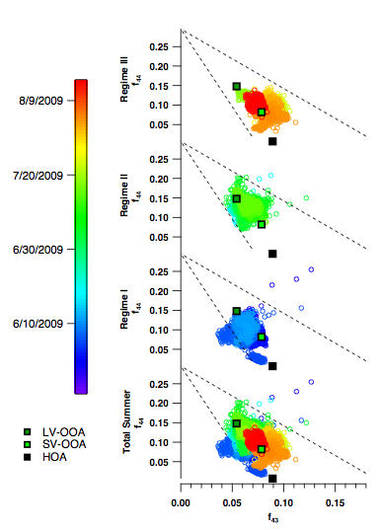
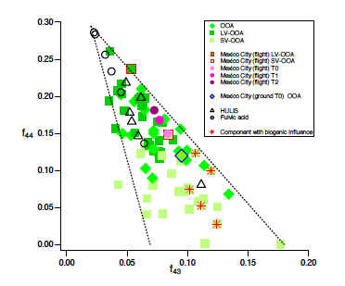
f44 vs f43 plot
PACO Study from 2009
Hersey et al. 2010 ACPD
Ng et al. 2010 ACP
CalNex Twin Otter Data
m/z 44 (mostly CO₂⁺)
m/z 43 (mostly C₂H₃O⁺)
spectral signatures of acid-derived species and non-acid oxygenates, respectively
f44=(m/z44)/(total organic)
f43=(m/z43)/(total organic)
Organic Aerosol in LA Basin at 1200 feet AGL is mostly SV-OOA type aerosol
Future PMF analysis will rigorously show the different contributions to LA Basin organic aerosol
Organic aerosol composition varies over summer months
Notes:
Earlier I mentioned the f44 vs f43 plot, which was published in Ng et al 2010 ACP. In her work she showed the fraction of 44 and 43 from several ambient studies and their factorization results and she found that semivolatile aerosol was in the lower portion of the graph with a wide spread of f43 values, and the lower-volatility were in the top part of the graph, with the idea that as things are more aged, they start to look more like eachother (fit into a tighter area).
For our flighs, which are all shown, they are mainly SV in nature. There are a few points on the boundary of the LV-SV and theese are from the outflow.
Talk about PACO.

Slide 11
Vertical Profiles
Notes:
For this figure, we plotted the flights that contained vertical transepts. In all cases we think we reach free troposphere as indicated by the sharp concentration drop off.
Not plotted is Black Carbon data, but in Andrew Metcalf’s poster (tomorrow) he has correlated the mean lag, which is a proxy for particle thickness which goes up with altitude. Most of the aerosol is made up of organic and what appears to be inorganic nitrate formation

Slide 12
Aerosol Nitrate
Aerosol Nitrate in both Los Angeles and Bakersfield is largely inorganic nitrate
Notes:
Lastly, aerosol nitrate is composted of two fragments in the AMS spectrum, m/x 30 and m/z 46 and when you plot them against each other. They match quite well with the inorganic NH4NO3 calibrations we carry out. This suggests that the nitrate we measure is largely inoranic, and not organic, at least with the sensativity our our instrument.

Slide 13
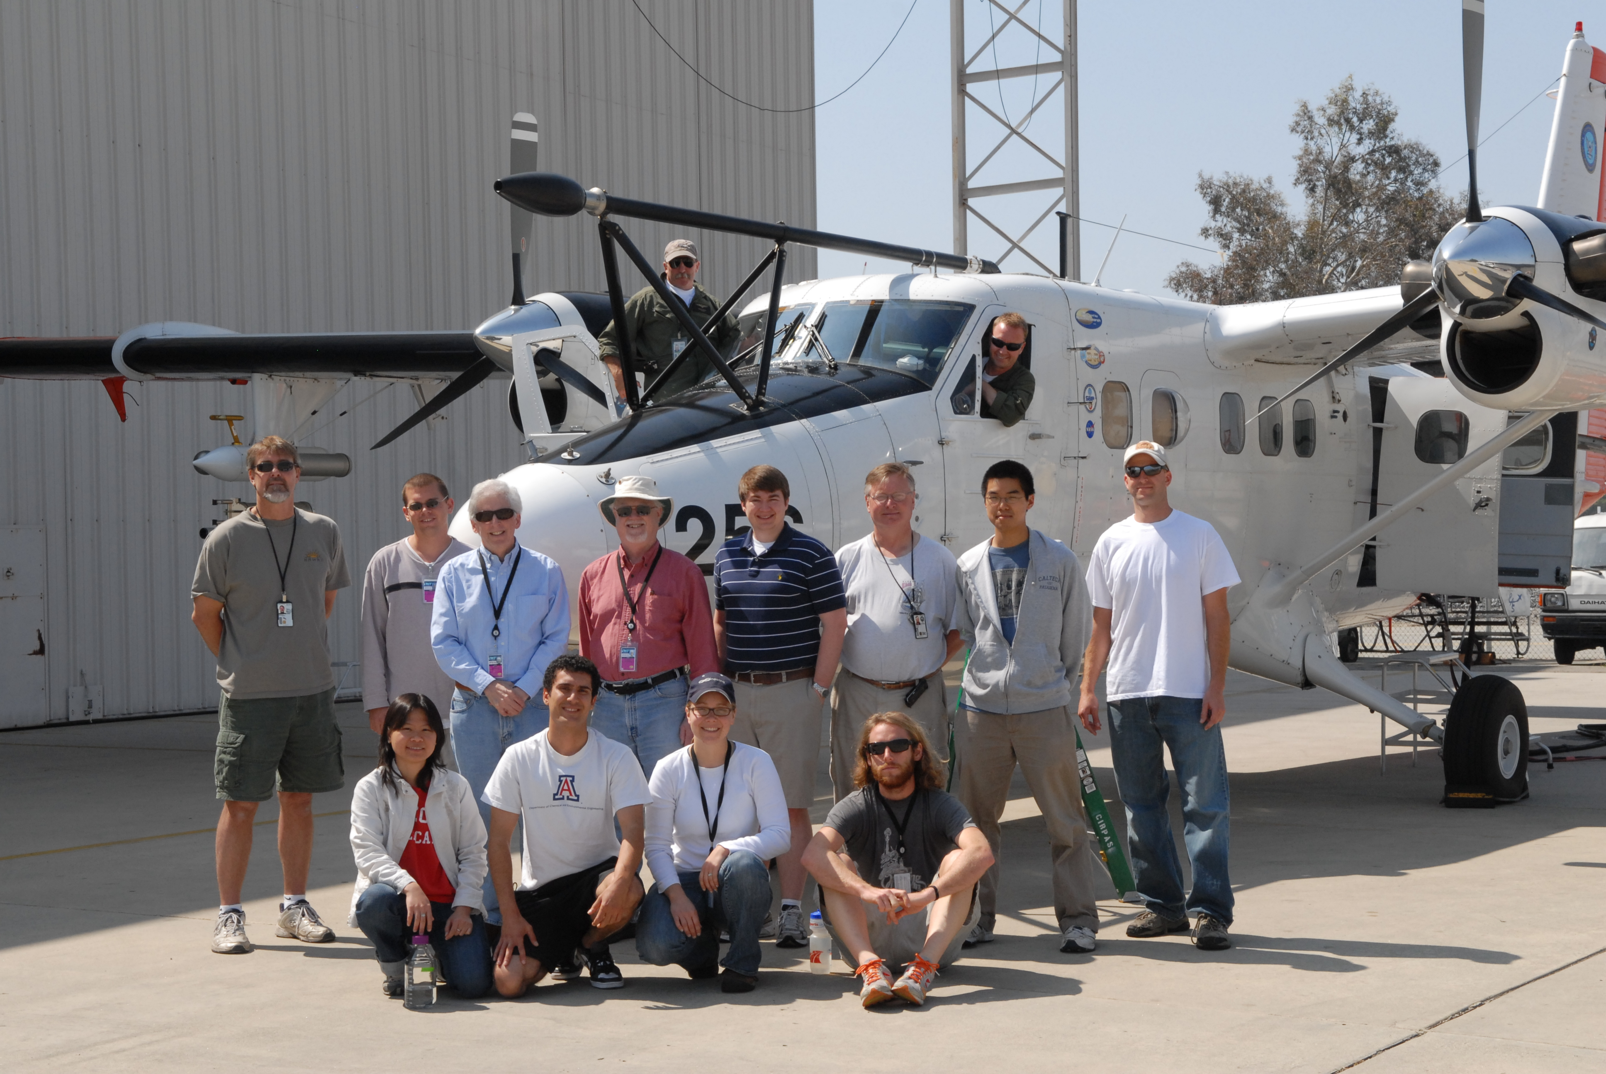
Acknowledgements
Poster 23: Black Carbon
NOAA
CIRPAS Mechanic, Pilots, and Scientists
Scientists from University of Arizona, Georgia Tech, University of California San Diego and Caltech
Poster 24: CCN
Poster 26: WSOC

