Slide 1
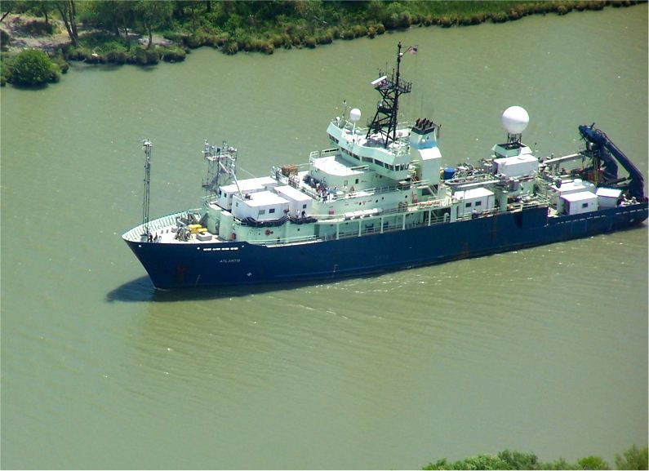
Chemical and Physical Properties of Aerosols Measured Onboard the R/V Atlantis during CalNex
NOAA/PMEL Atmospheric Chemistry Group
Funded through the NOAA Climate and Air Quality Programs

Slide 2
Data Analysis
Q-AMS: chemistry
DMPS-APS: aerosol number size distributions
Meteorological parameters measured on the ship
http://saga.pmel.noaa.gov/data/
Thermo-denuder SMPS system: changes in number size distributions heated to 230°C
FLEXPART products (Jerome Brioude UofCO & NOAA-ESRL)

Slide 3
Submicrometer NR Aerosol Mass along the Atlantis Cruise Track
Mean concentration 3.5 ug m⁻³ (0.05 – 19 ug m⁻³)

Slide 4
Case Studies
Background marine air flow to CA
Inland – Sacramento Ship Channel
Santa Monica Bay
Port of Long Beach/LA

Slide 5
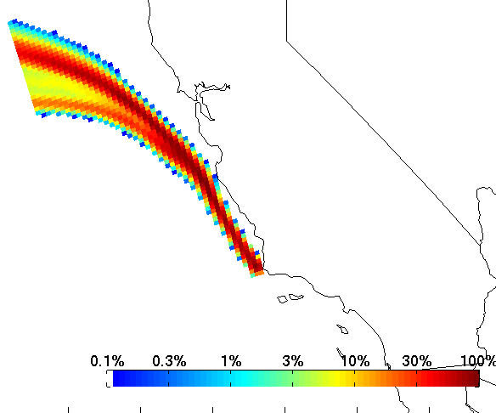
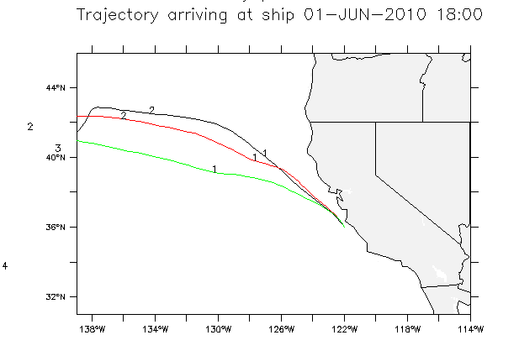
Case Studies
Background marine air mass – on shore flow to CA
Hysplit back trajectory
Flexpart total column residence time
Notes:
Radon values low during this entire period.
HC, CO and nitrogen oxides show no anthropogenic influence.

Slide 6
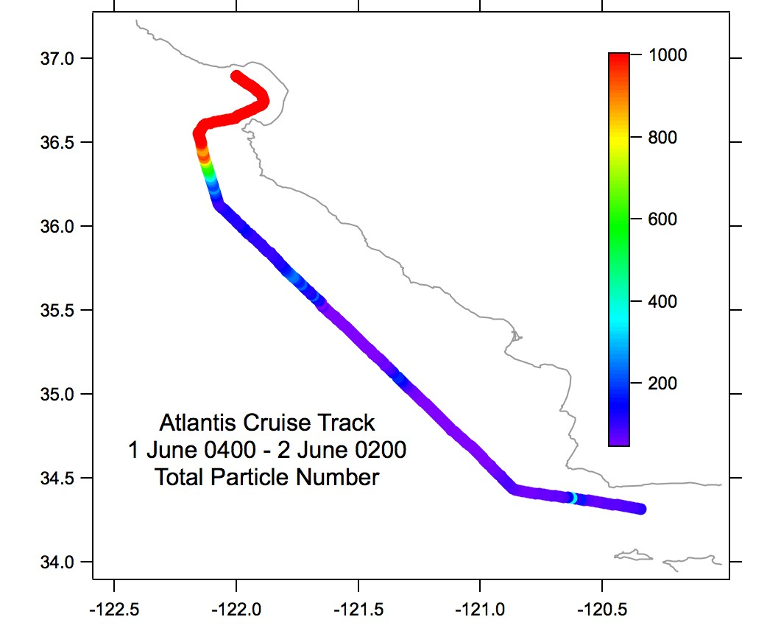
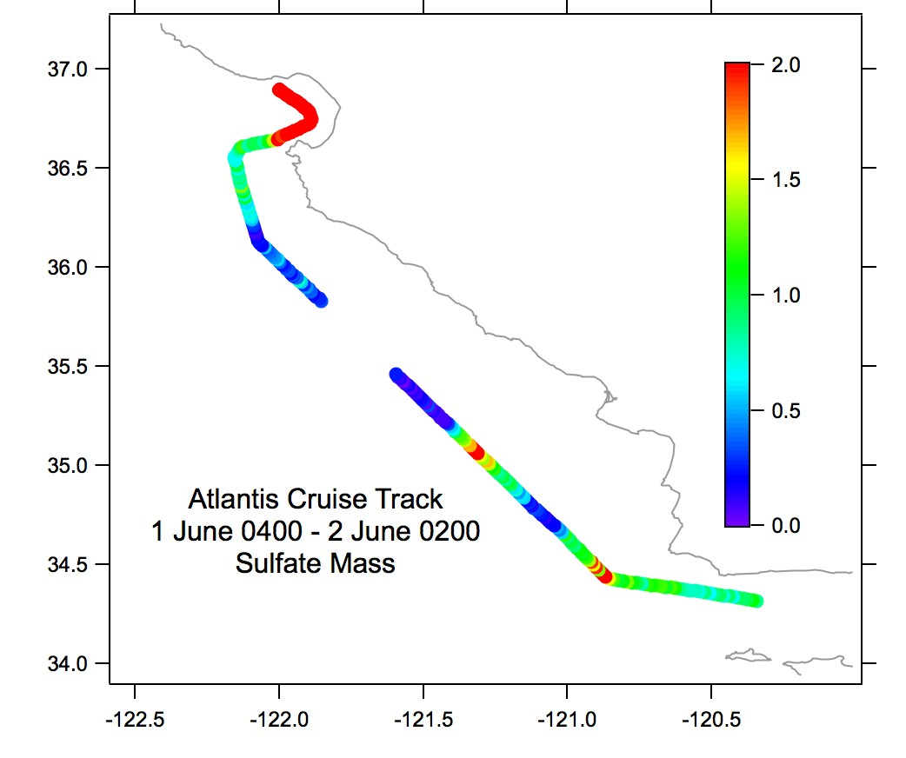
Particle Number (cm⁻³) Sulfate Mass (ug m⁻³)

Slide 7
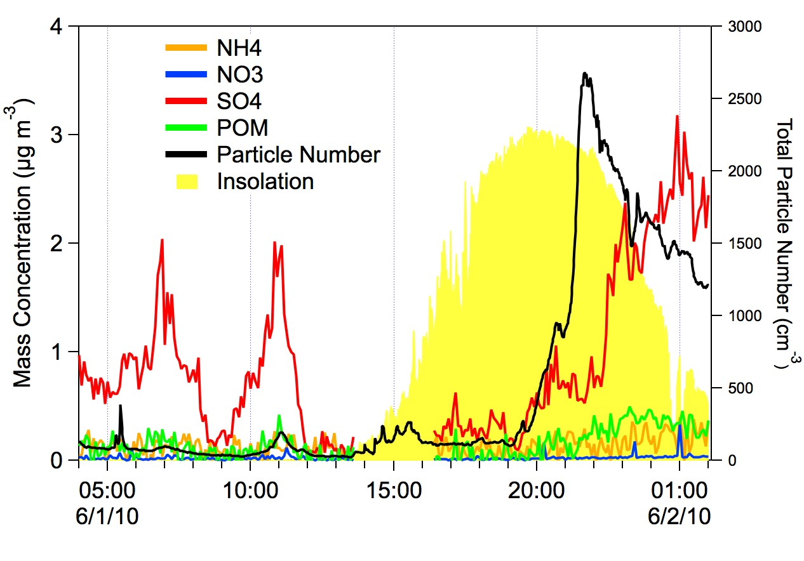
Very low organic aerosol concentrations.
Very acidic submicrometer sulfate aerosol (NH₄⁺/SO₄⁼ MR <<1).
Burst of small particles (high number low mass) in afternoon.

Slide 8
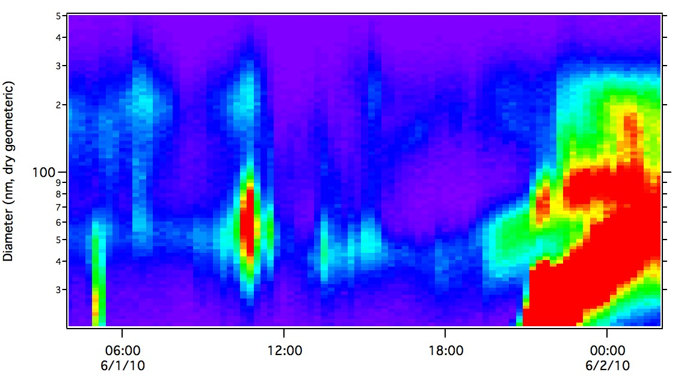
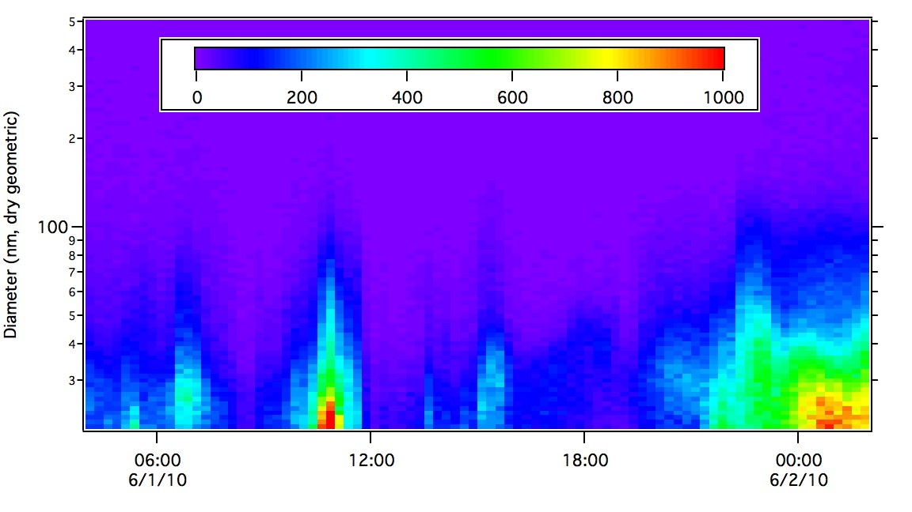
Ambient T
Accumulation mode
Aitken mode
Accumulation and Aitken modes have a volatile component
230°C
Seasalt number mode

Slide 9
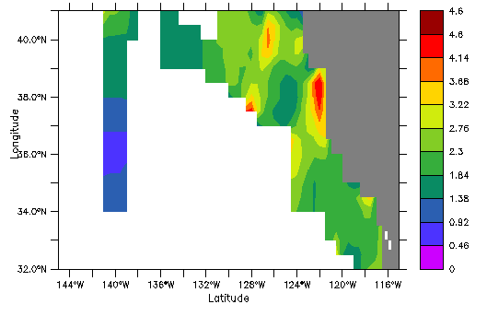
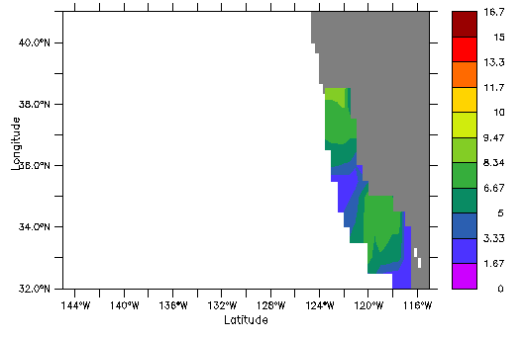
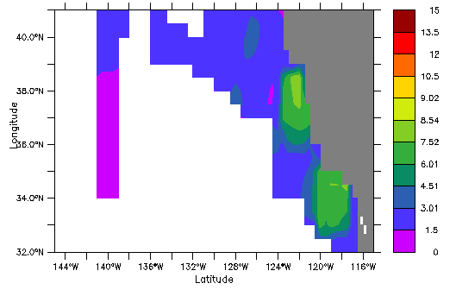
Pre-CalNEX
226 measurements
1985-2010
CalNex
850 measurements
Seawater DMS Concentrations
May-October
http://saga.pmel.noaa.gov/dms/
Sulfur Transport to CA
5 day DMS lifetime, 35% onshore flow
2.3e8 gS/day (Bates & Cline, 1985)
US West Coast Shipping, 0.5% S Fuel
0.13e8 gS/day (Eric Williams, CSD)
Combined data sets
Notes:
Assumes all ship emissions reach shore.

Slide 10
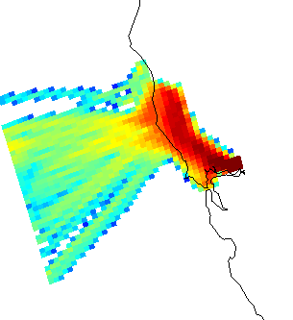
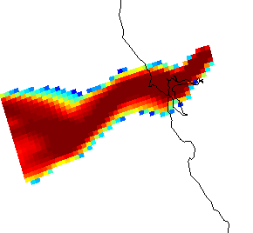
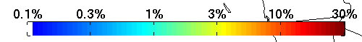
Case Study 2
Sacramento Ship Channel
June 4-6, 2010
Surface residence time plots
06/04 at 1100-1400
06/05 at 2000-2300
Jerome Brioude
http://www.esrl.noaa.gov/csd/metproducts/flexpart/static_pages/atlantisimage.html

Slide 11
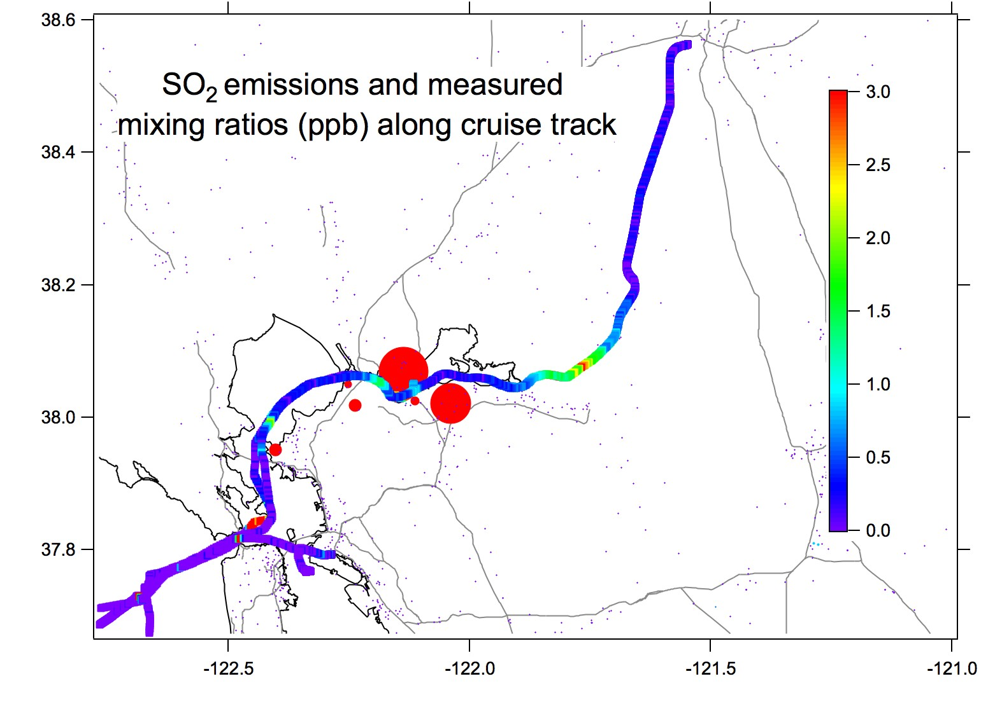

Slide 12
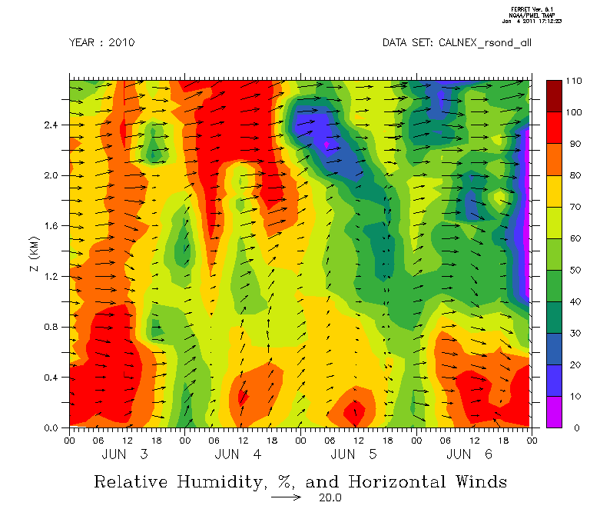
Notes:
Marine air prior to 3 June 1500 and post 6 June 0600.
4 June southwesterly flow bringing air from San Pablo/Suisun Bay.
5 June westerly flow.

Slide 13
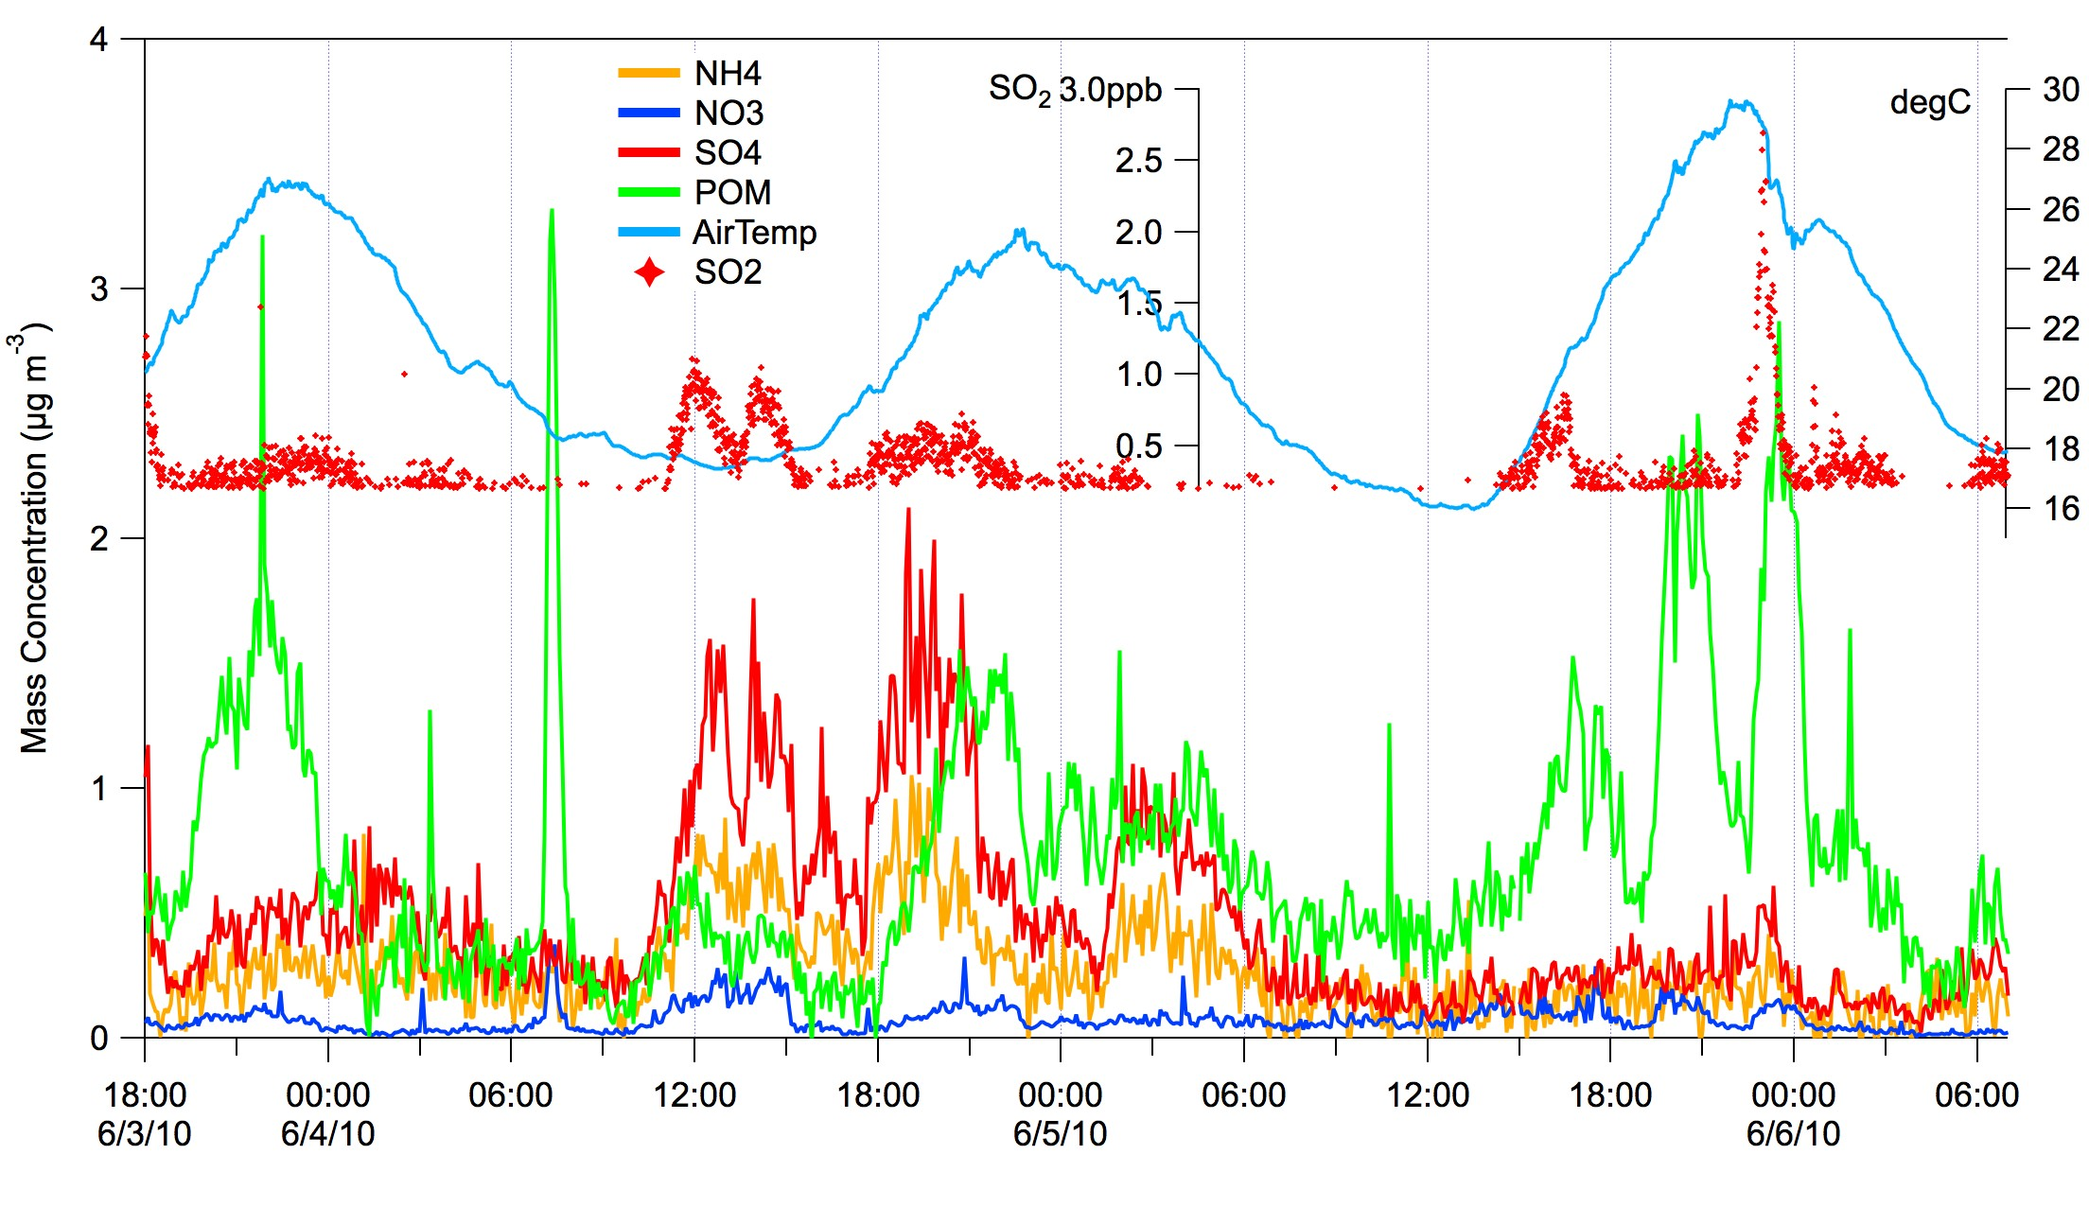
Sacramento Ship Channel
Turning Basin
Turning Basin
Suisun Bay
Notes:
Much less acidic aerosol. Nitrate also present.
SO2 from point sources in Suisin Bay. With distance from source we also see sulfate.
Organic aerosol increases during the day.

Slide 14
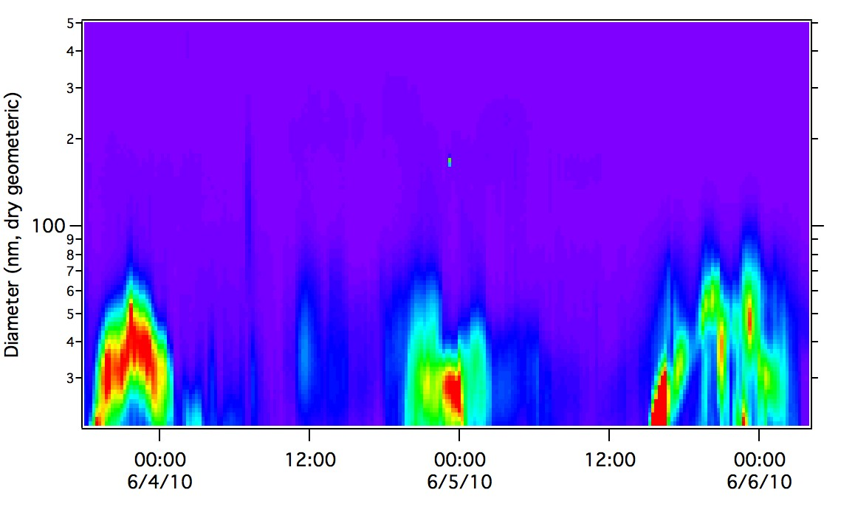
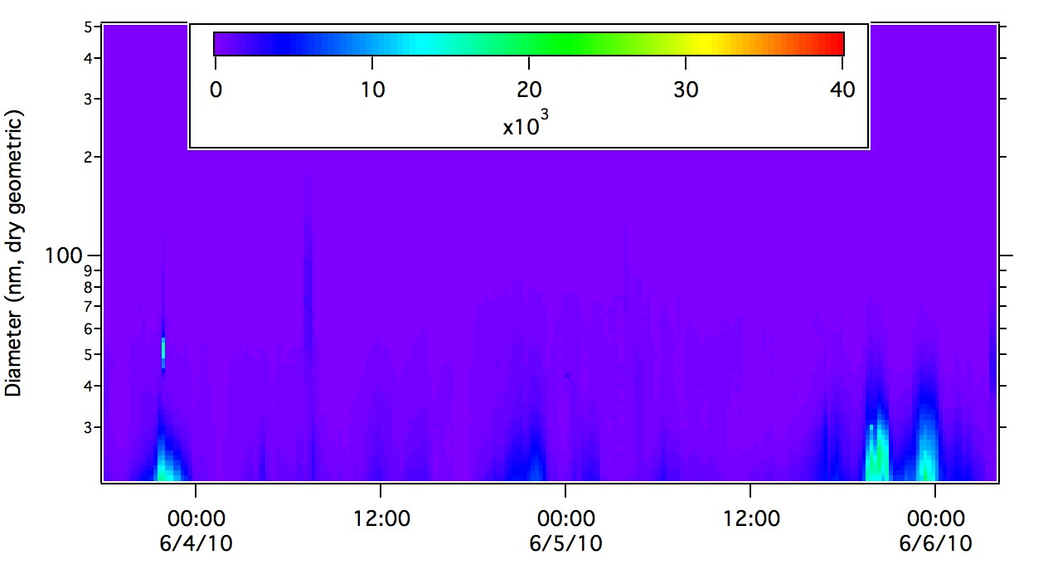
Ambient T
Mid-day local time aerosol nucleation events
230°C
Aerosol size reduced upon heating

Slide 15
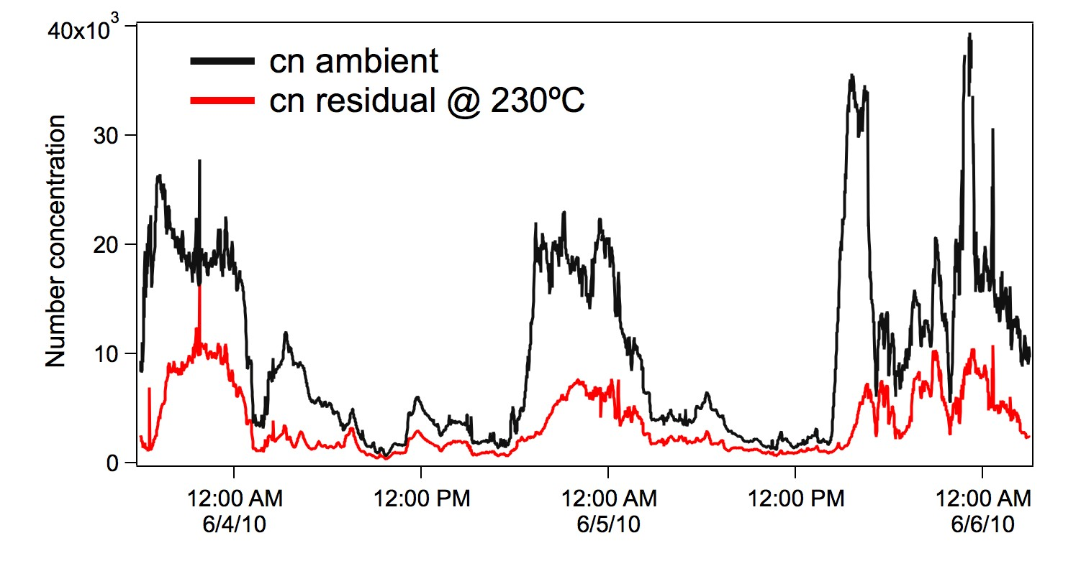
Ambient T
Mid-day local time aerosol nucleation events
230°C

Slide 16
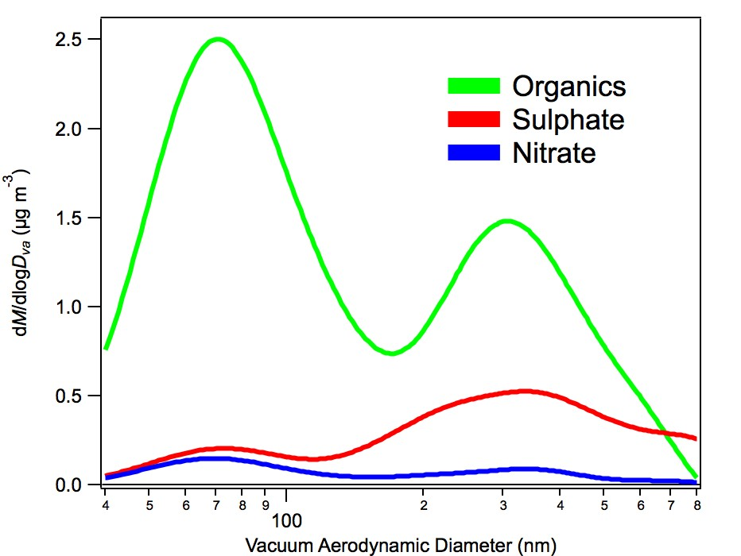
Mass size distribution 3 June 2010, 1930-2330

Slide 17
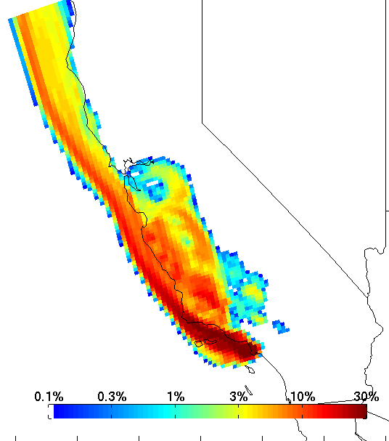
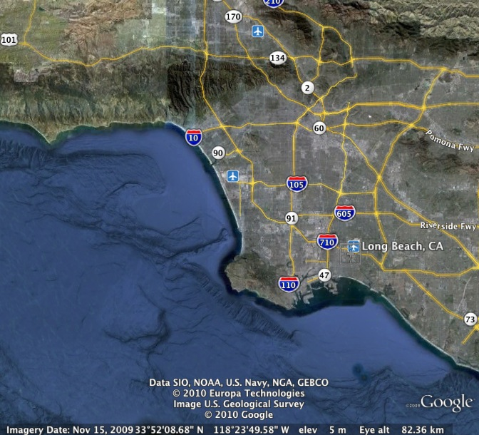
Case Study 3
Santa Monica Bay #1
16 May 2010

Slide 18
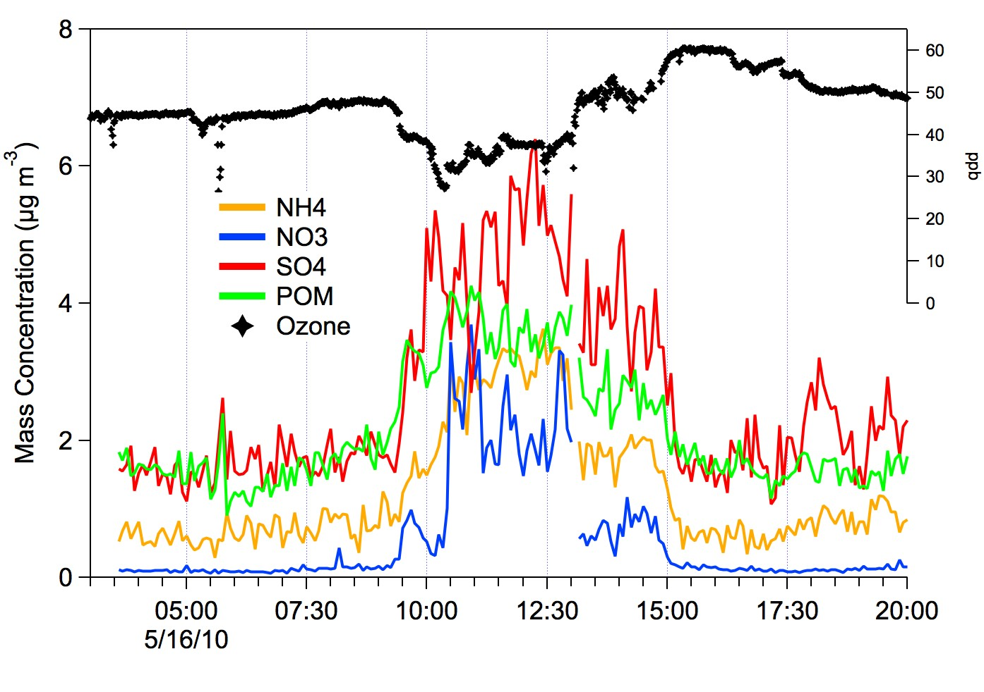
Santa Monica Bay #1
Sunday, 16 May 2010, pre-dawn plume

Slide 19
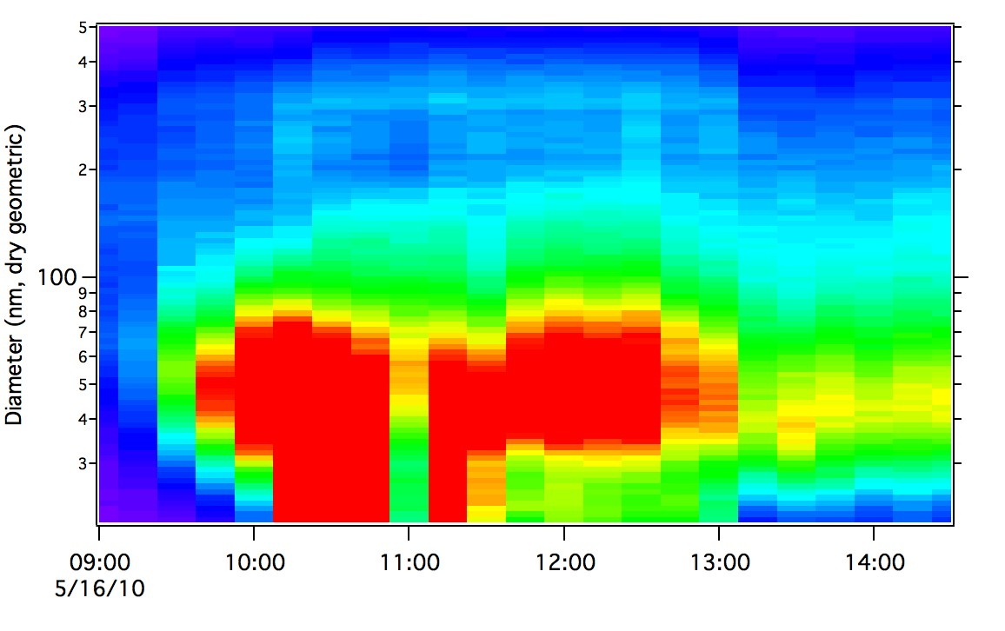
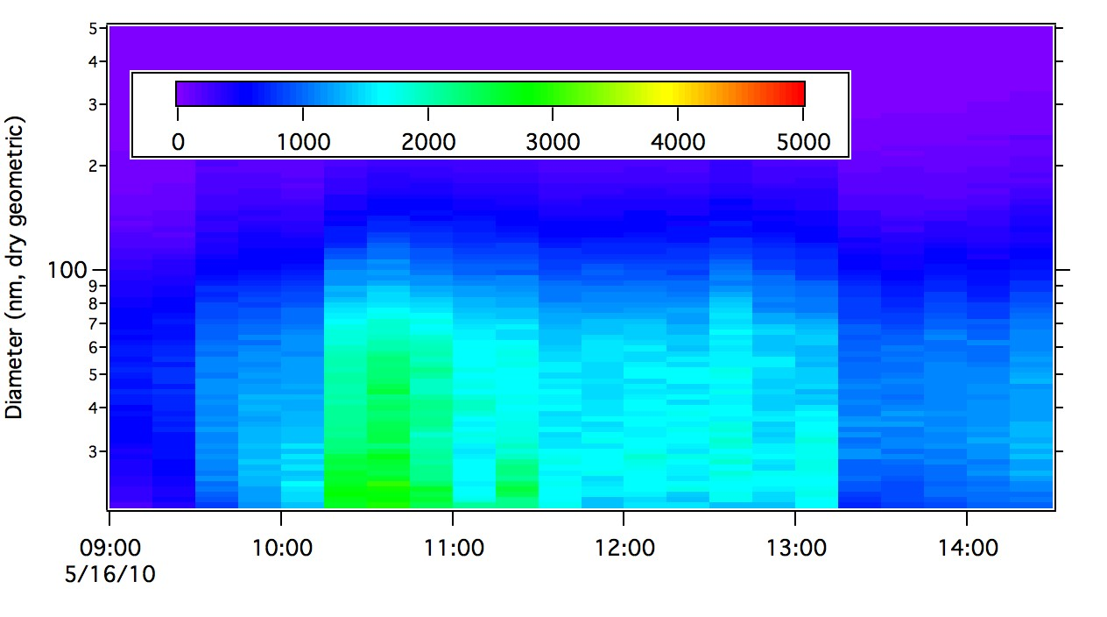
Number distribution dominated by Aitken and Nuclei mode particles.

Slide 20
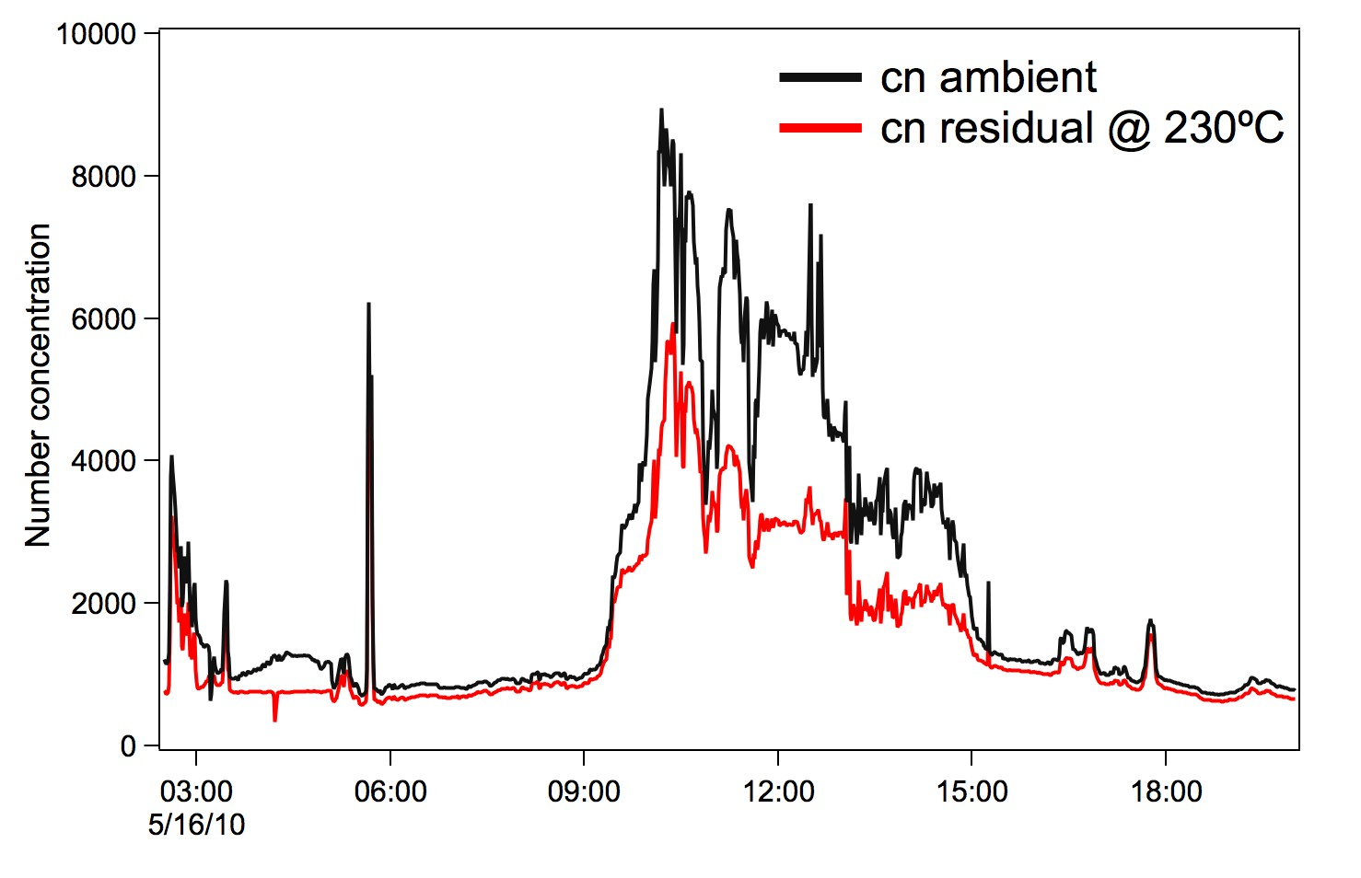
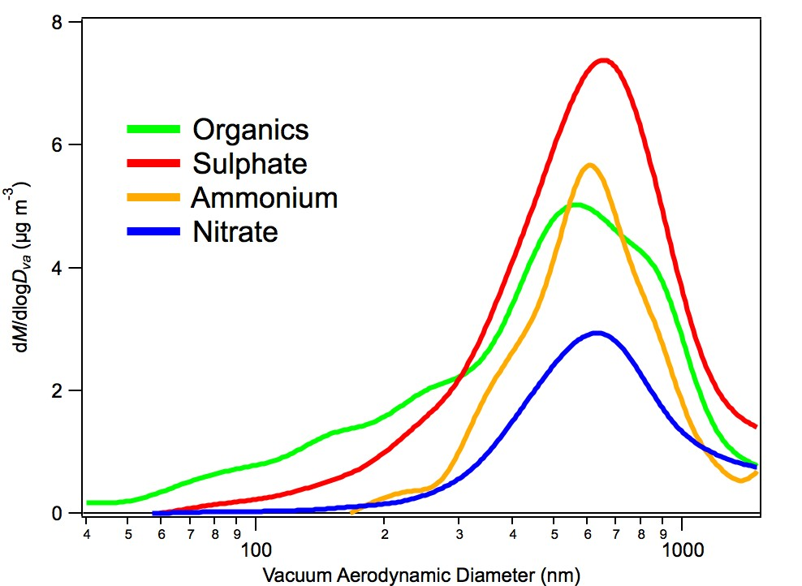
Santa Monica Bay #1
Sunday, 16 May 2010, pre-dawn plume

Slide 21
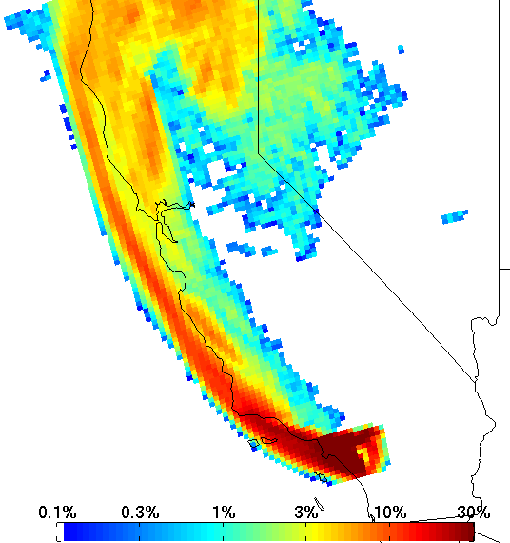
Santa Monica Bay #2
24 May 2010, Off the airport

Slide 22
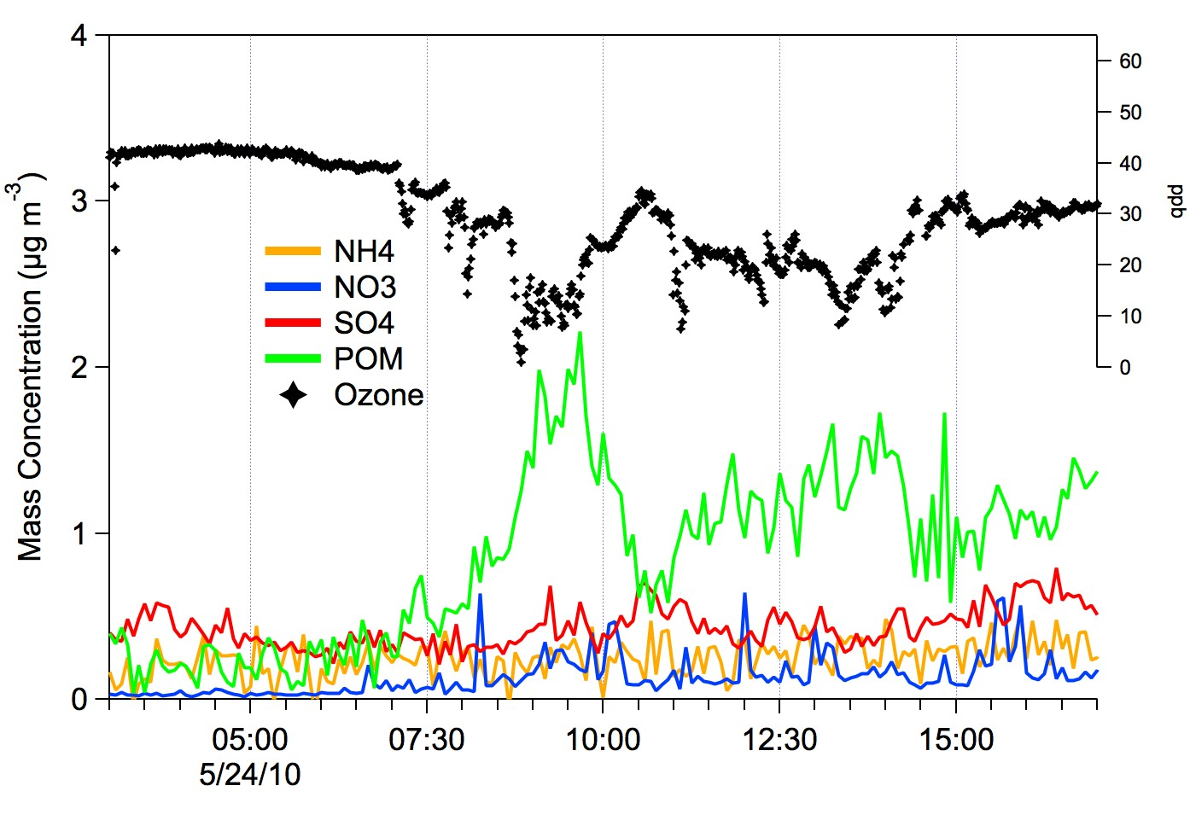
Santa Monica Bay #2
24 May 2010, Off the airport

Slide 23
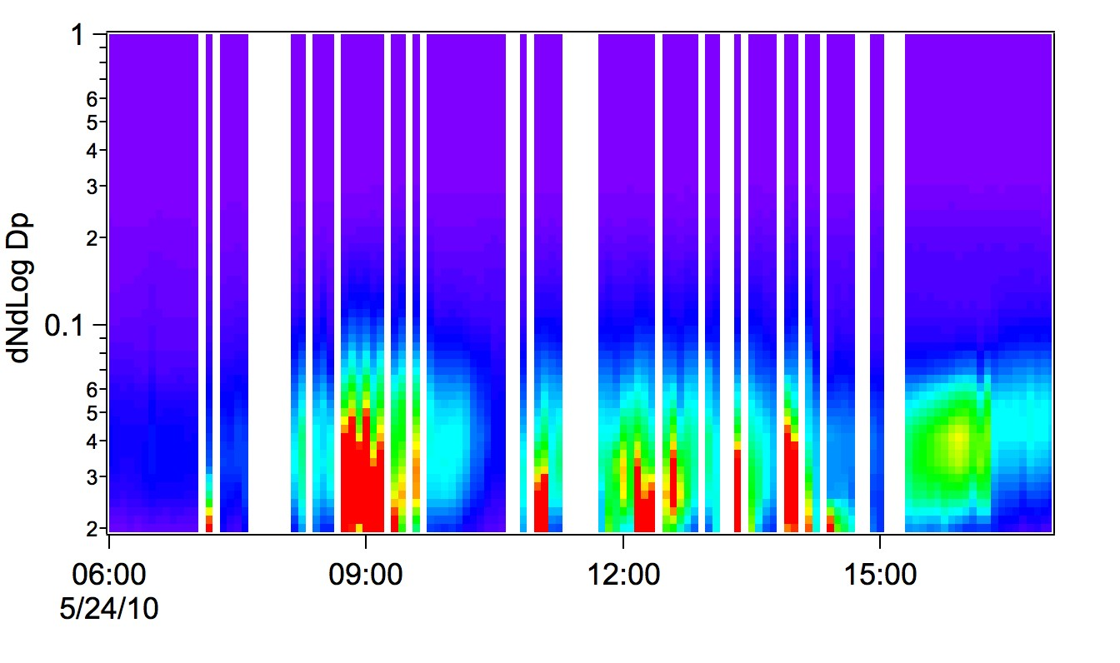
Santa Monica Bay #2
24 May 2010, Off the airport

Slide 24
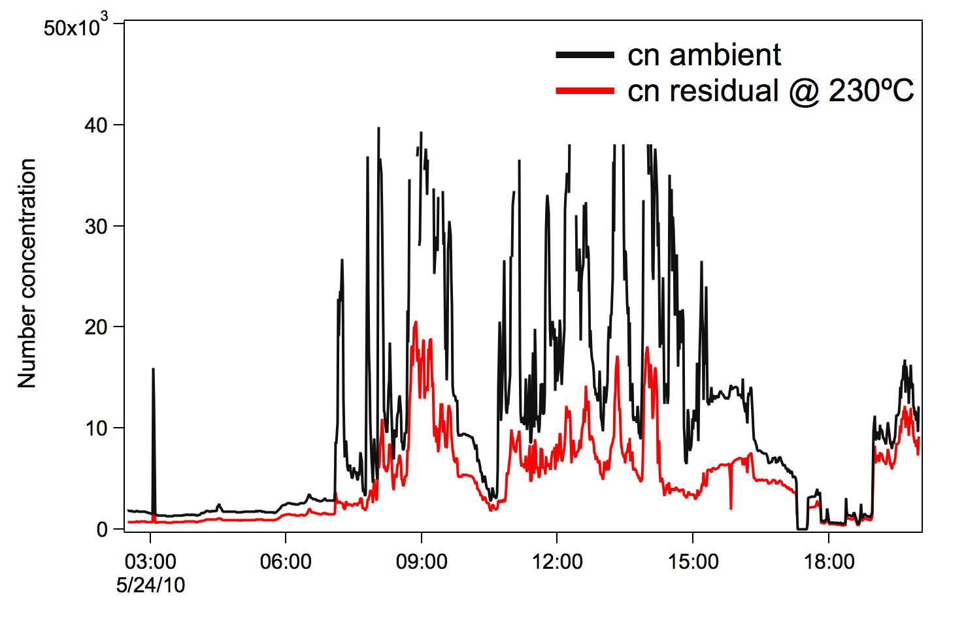
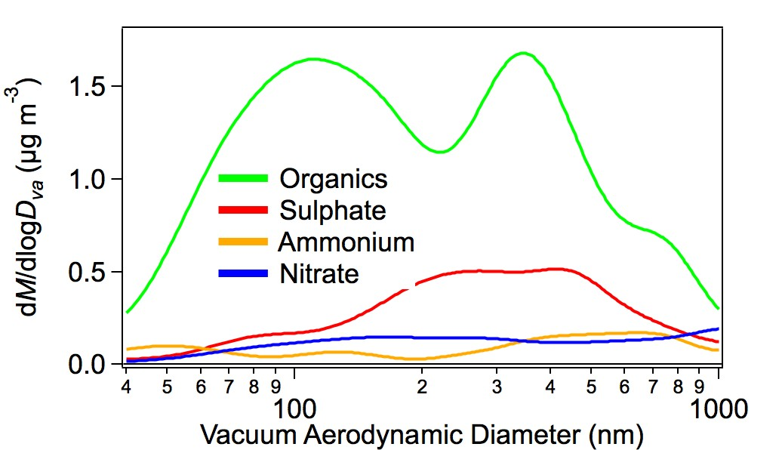
Santa Monica Bay #2
24 May 2010, Off the airport

Slide 25
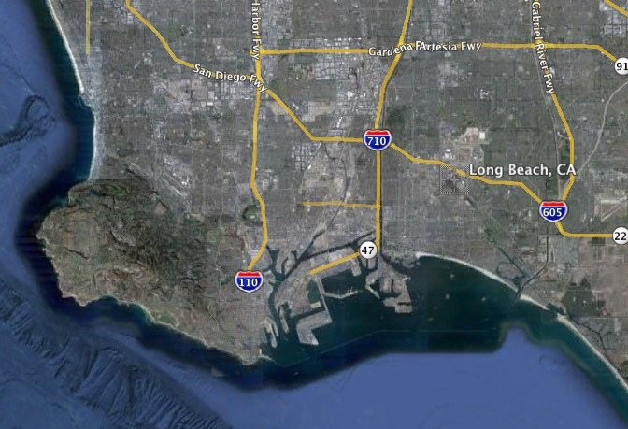
Case Study 4
Port of Long Beach/LA

Slide 26
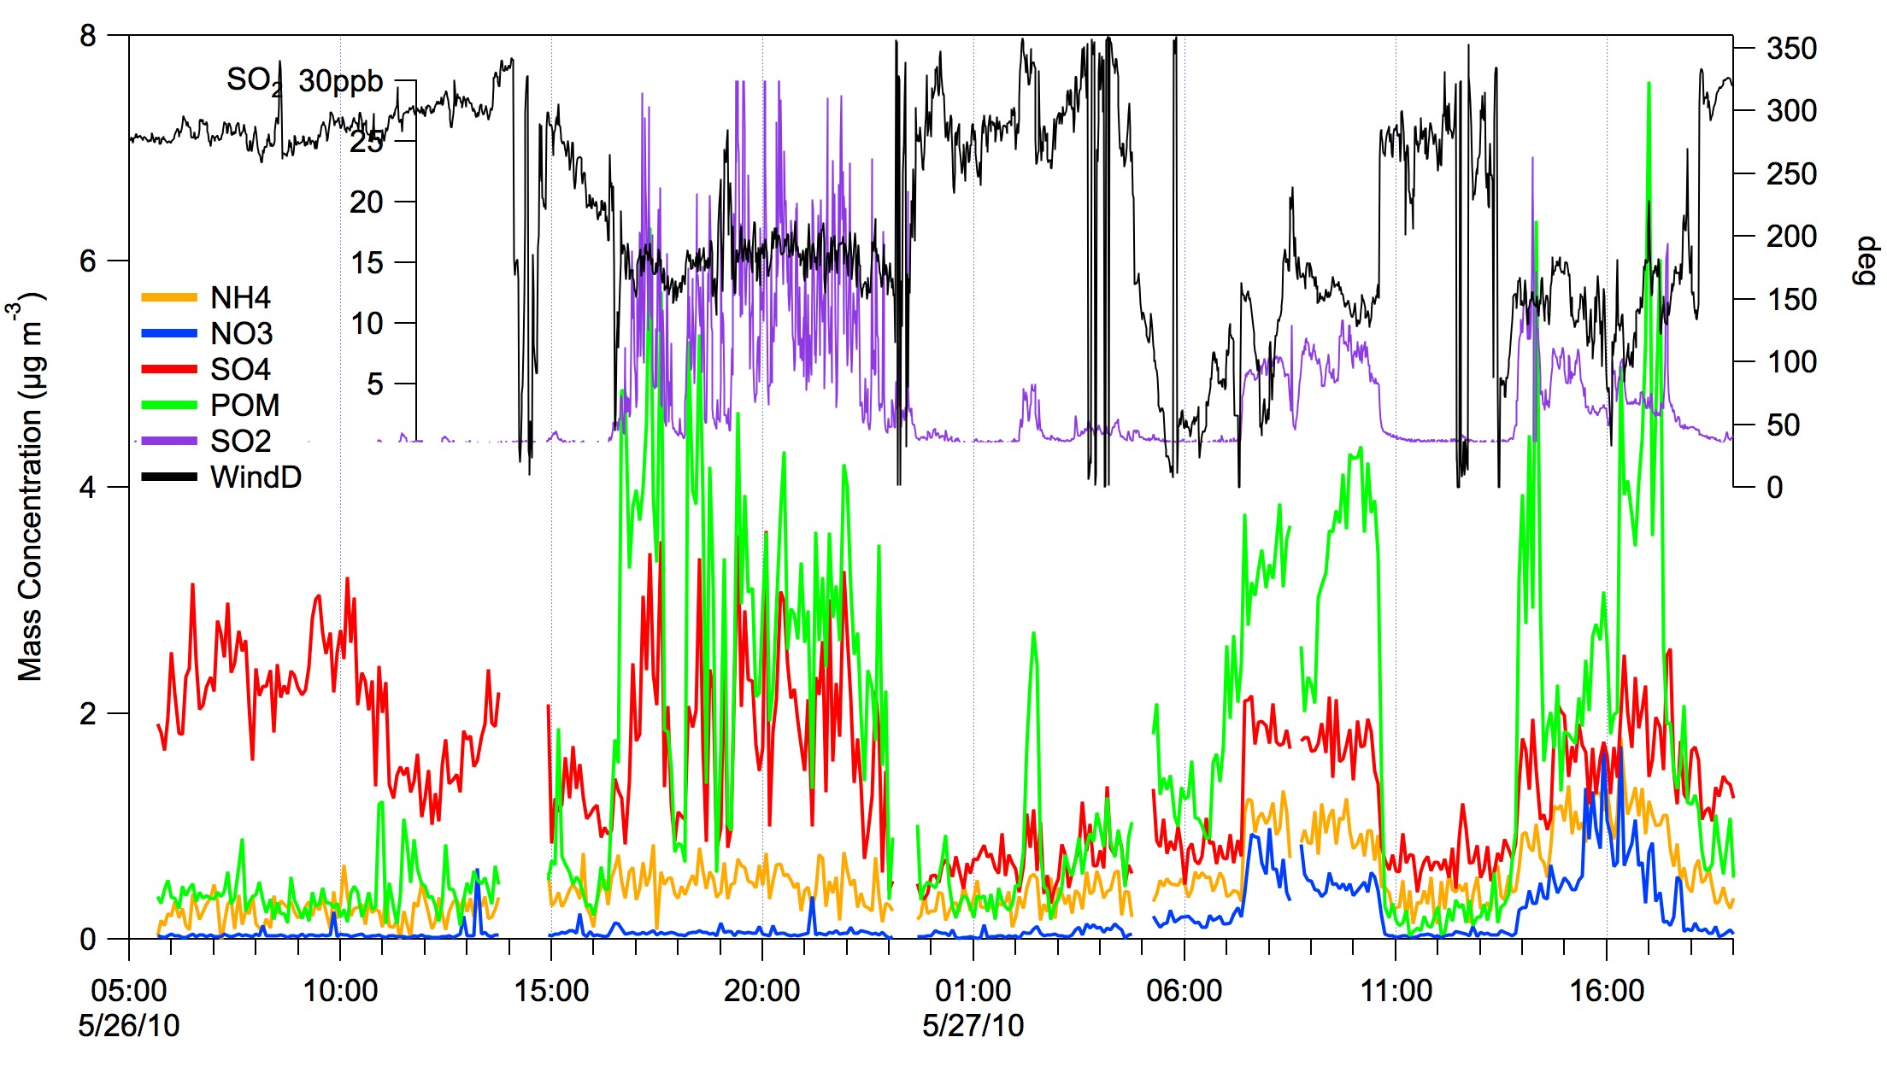
Case Study 4
Port of Long Beach/LA
S NW SE NW SE NW
Notes:
Offshore marine aerosol low in POM, NH4, NO3
Southerly flow – high SO2, low NH4, NO3
NW flow – similar org and so4, neutralized aerosol
SE flow – NO3 more NH4

Slide 27
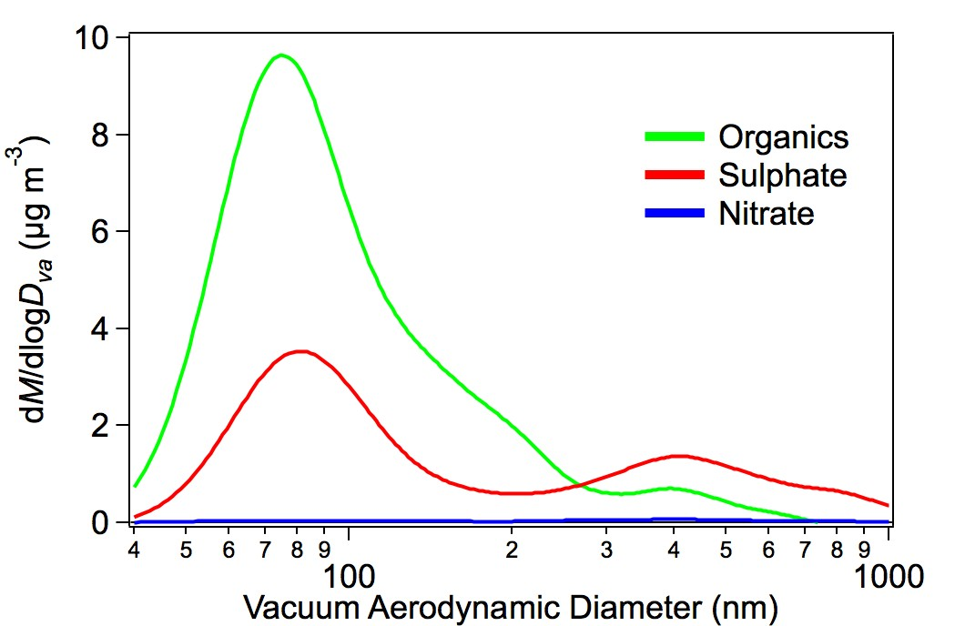
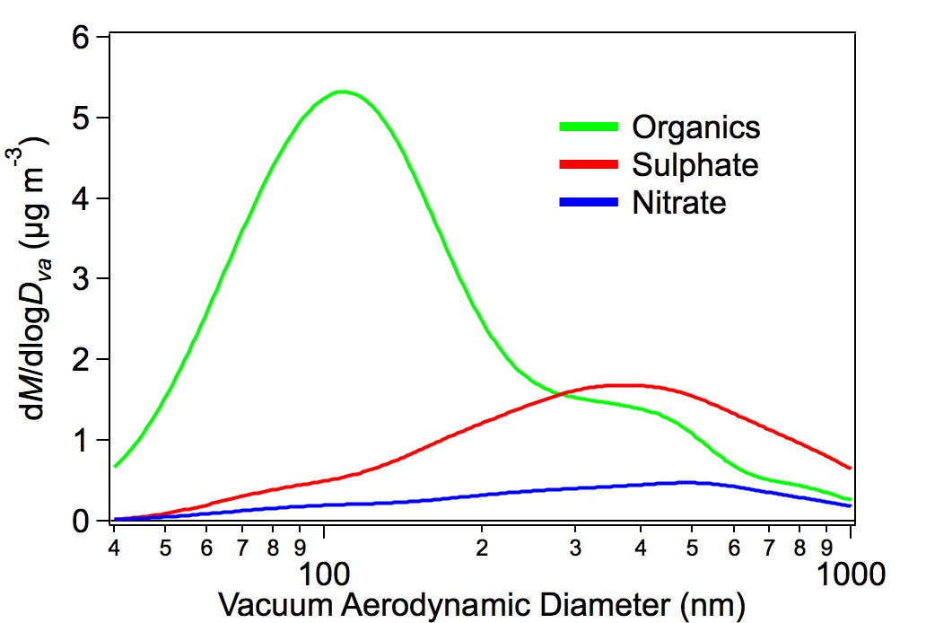
Case Study 4
Port of Long Beach/LA

Slide 28
Summary
Background marine air mass – on shore flow to CA, most likely aerosol mixed into the MBL from the FT. Background concentration of ≈2 μg/m³ of acidic sulfate.
Inland – Sacramento Ship Channel. New particle production each day mainly organic mass on a non-volatile core. Sulfate mass hours downwind of major point sources.
Santa Monica Bay – seabreeze bringing highest aerosol mass concentrations measured during the experiment. Organic/sulfate/nitrate on non-volatile core.
Port of Long Beach/LA – S flow (SO2, organic mass), NW flow (low aerosol mass concentration), SE flow (elevated organic, sulfate, nitrate, ammonium mass concentrations)

Slide 29
Summary of CalNex Emission Factor Data
Ship type g NO₂ /kg fuel g SO₂ /kg fuel g CO /kg fuel Speed, knots # ships
Container ships 78.4±34.7 (23) 7.1±6.5 (21) 4.3±6.5 (23) 8.1 – 20 18
Freighters 64.0±24.8 (3) 3.6±3.7 (3) 2.5±2.1 (2) 5.7 – 11.4 3
Tankers 62.2±6.7 (2) 7.2±9.4 (2) 2.2±3.2 (2) 11.7 – 14.7 2
Vehicle carrier 57.0±13.7 (3) 7.2±7.2 (3) 7.6±11 (3) 7.4 – 18.1 1
Cruise ships 55.7±5.6 (5) 0.5±0.3 (5) 0.7±1.0 (5) 11.1 – 20.6 3
High-speed (ferries) 33.7±13.2 (12) 0.1±0.4 (11) 2.9±3.7 (11) 7.0 – 30.1 6
Anchored ships 26.4±16.1 (21) 4.0±6.8 (21) 6.9±9.4 (21) 0 12
Summary of Houston Emission Factor Data
Ship type g NO₂ /kg fuel g SO₂ /kg fuel g CO /kg fuel
Container ships 59.8±20.8 (9) 30.4±16.6 (6) 9.8±6.4 (10)
Freighters 87.0±29.6 (11) 20.4±15.6 (11) 7.0±3.5 (10)
Tankers 79.2±23.4 (12) 27.3±17.4 (9) 16.7±15.3 (9)

Slide 30
SO₂ Emissions from Commercial Marine Vessels
1.
Mission Avg. SO₂ EF fuel %S Max SO₂ EF fuel %S
CalNex 2010 4.4 (±5.7) 0.2 28 1.4
TexAQS 2006 15.5 (±16.7) 0.78 70 3.5
Current ARB regulations cap marine fuel S at 1.5% for MGO; 0.5% for MDO
• Our data indicate 100% compliance with regulation
2.
Biogenic vs Commercial Marine Vessel Sulfur Sources off the California Coast
DMS emission and import (Bates and Lamb, GBC, 1992): 7.1e6 mol/day
(Assume: 5 day (summer) DMS lifetime; average wind speed; 35% onshore)
Import of DMS sulfur = 2.3e8 gS /day
US west coast ship SO₂ emissions for 2002: 80,200 metric tons (Corbett, 2004)
(Assume: CA fraction of coast = 0.62; all emissions reach shore; fuel S = 2.7%)
Import of CMV sulfur = 0.68e8 gS /day (0.13e8 gS/day with 0.5% S fuel)
• New ARB regs take place in 2012 ➔ fuel S < 0.1%
• North American Emission Control Area regs take place in 2012 ➔ fuel S <1%
in 2015 ➔ fuel S <0.1%

Slide 31
Sulfur Dioxide Emissions from Ships During CalNex 2010
Eric Williams NOAA/ESRL/CSD
BACKGROUND
• Marine Notice 2009-4; 25 Jun 2009
requires cleaner fuels in 24 NM zone
MGO at < 1.50 % fuel-S
MDO at < 0.5 % fuel-S
• Applies to all engines and boilers
CalNex study May-Jun 2010
• R/V Atlantis: NOAA-chartered
• Gas-phase and aerosol measurements
• Marine vessel emissions was a focus
CalNex 2010 Emission Factor Data
Ship type g SO₂ /kg fuel %fuel-S
Container ships 7.1±6.5 (21) 0.36
Freighters 3.6±3.7 (3) 0.18
Tankers 7.2±9.4 (2) 0.36
High-speed (ferries) 0.1±0.4 (11) 0.01
Anchored ships 4.0±6.8 (21) 0.20
STUDY MAXIMUM 28.4 1.42
STUDY MEDIAN 0.69 0.03
Houston 2006 Emission Factor Data
Ship type g SO₂ /kg fuel % fuel-S
Container ships 30.4±16.6 1.52
Freighters 20.4±15.6 1.02
Tankers 27.3±17.4 1.37
STUDY MAXIMUM 70.4 3.52
STUDY MEDIAN 6.39 0.32
R/V Atlantis cruise track and ports
Exhaust Plume from tanker Taipan
SUMMARY and FINDINGS
• To date 123 ship plume analyses are done
• Data show compliance with 1.5% fuel-S limit
• More than 80% compliance with 0.5% limit
• Our data measure all emissions from the
stack – main engine, aux engine, boilers
• Our data cannot distinguish what fuel
types – HFO, MDO, MGO – are in use
• Median fuel-S is X10 lower for CalNex
than for Houston
Slope = 5.0 ppbv/ppmv
E.F. = 23.0 g SO2/kg fuel
Fuel-S = 1.15% by weight
MEASUREMENTS
• Highly correlated CO2 and SO2
• CO2 is measure of fuel burned
• SO2 only from fuel-S content
ANALYSIS
• Calculate slope of SO2 vs CO2
• Slope * 4.6 = Emission factor
• Emission factor/20 = % fuel-S
Notes:
SO2 instrument has slower response than CO2; seen in lack of fine structure in time trace
SO2 data are uncertain to ±15%; CO2 data are uncertain to ±0.10 ppmv
Slope uncertainty is data dependent; typically ±10%
Conversion factor (4.6) is uncertain to ±5% due to assumptions made
Emission factors uncertain to ±10-20% (data dependent)
Factor of 20 has no uncertainty; comes from chemical stoichiometry
Data in tables are averages ± std. dev. of mean
CalNex STUDY MEAN = 2.8 g SO2 / kg fuel
Houston STUDY MEAN = 15.3 g SO2 / kg fuel

Slide 32
