Slide 1
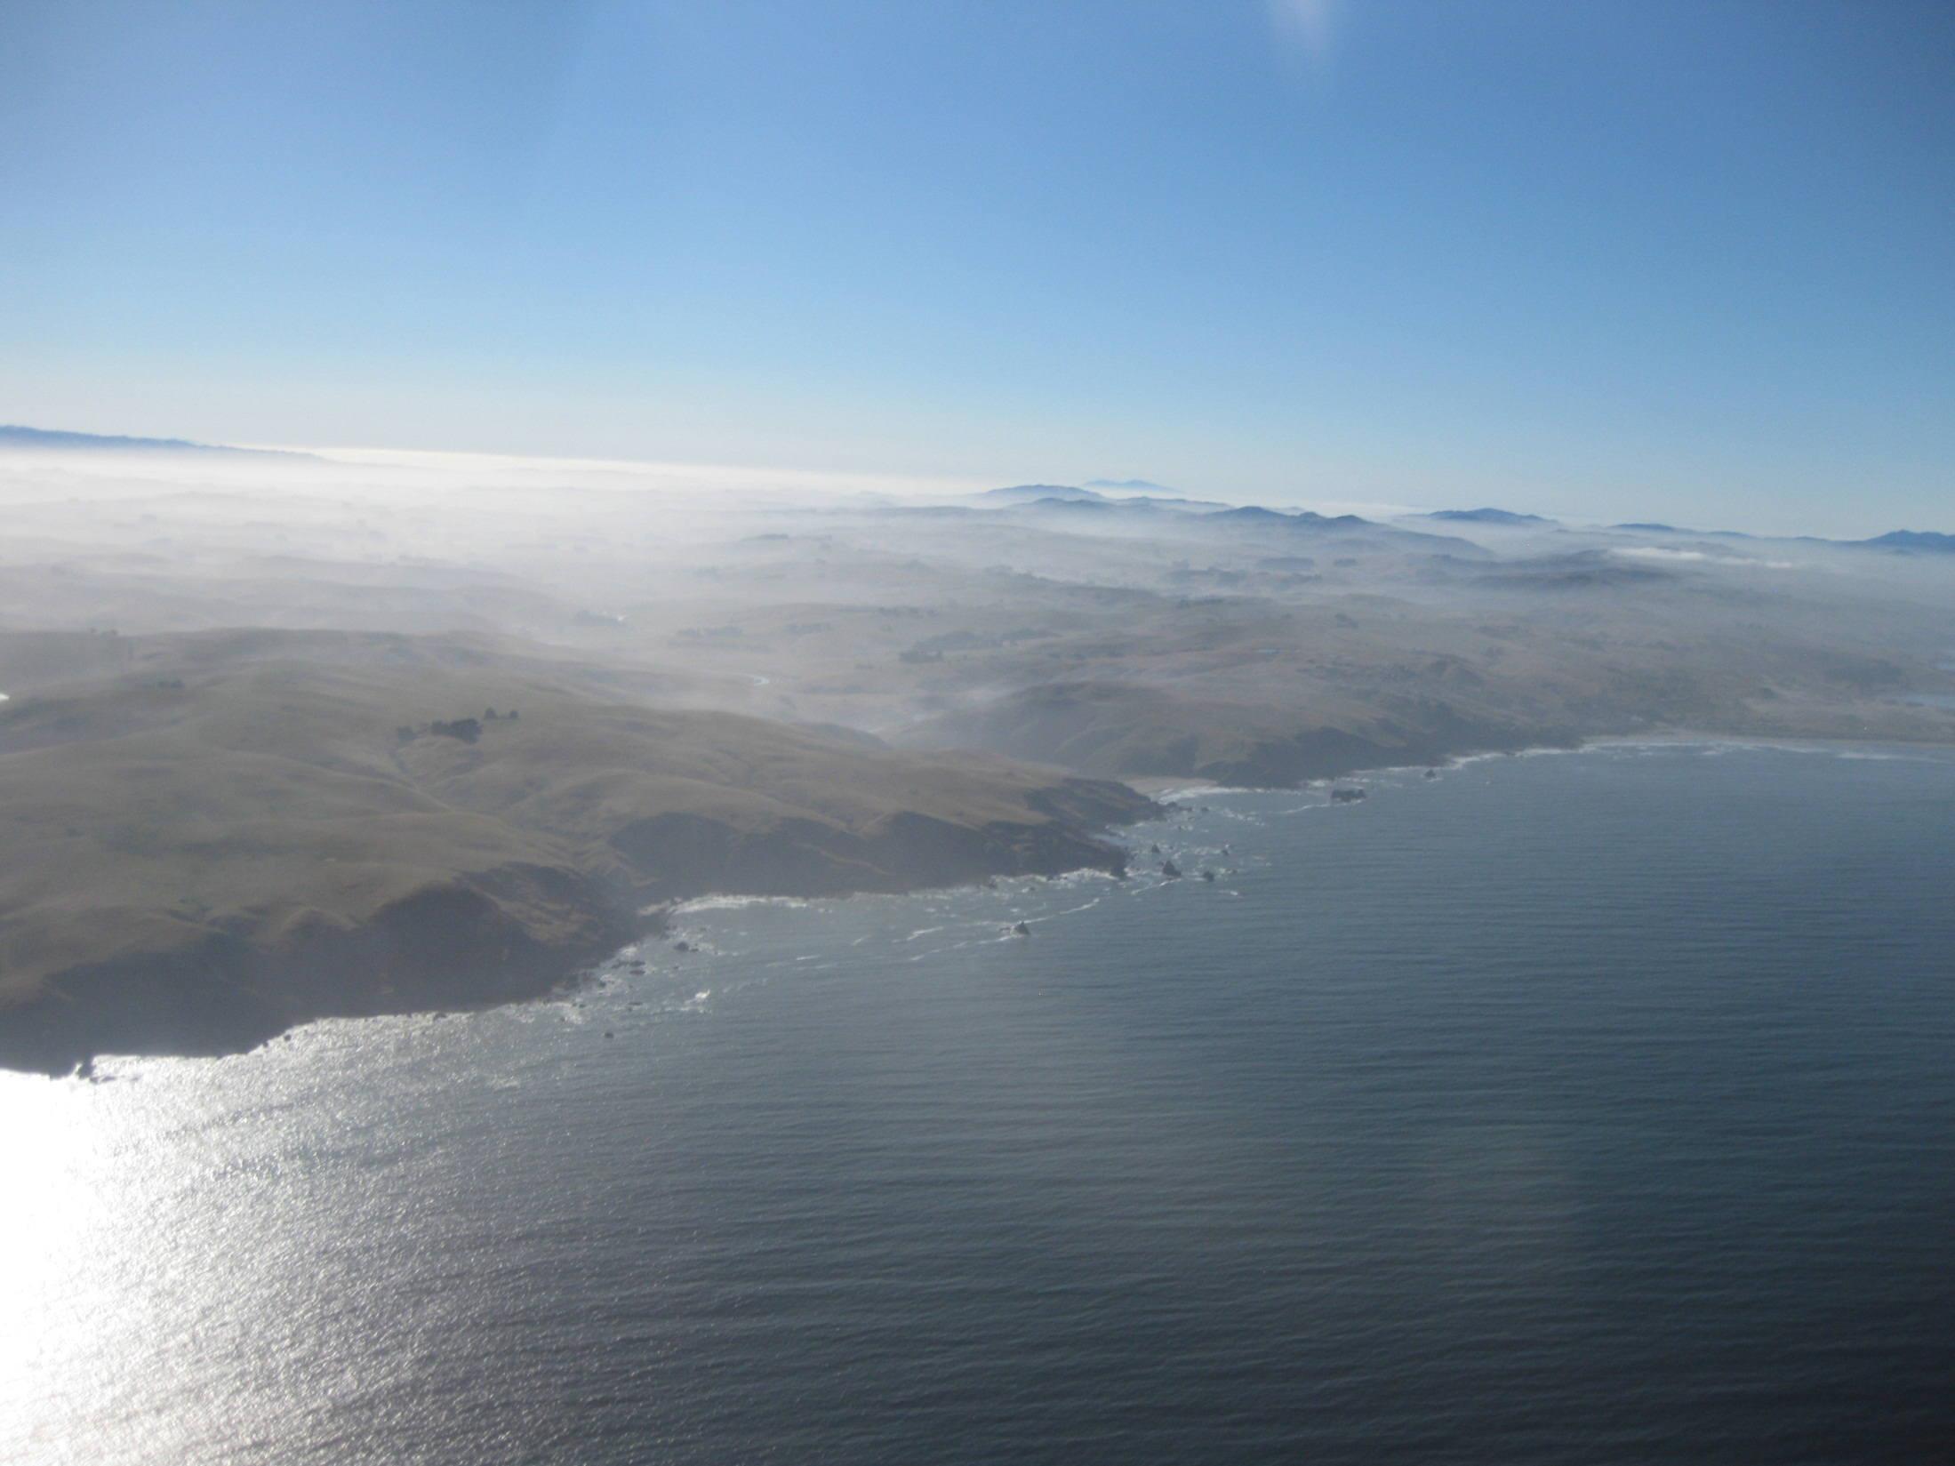
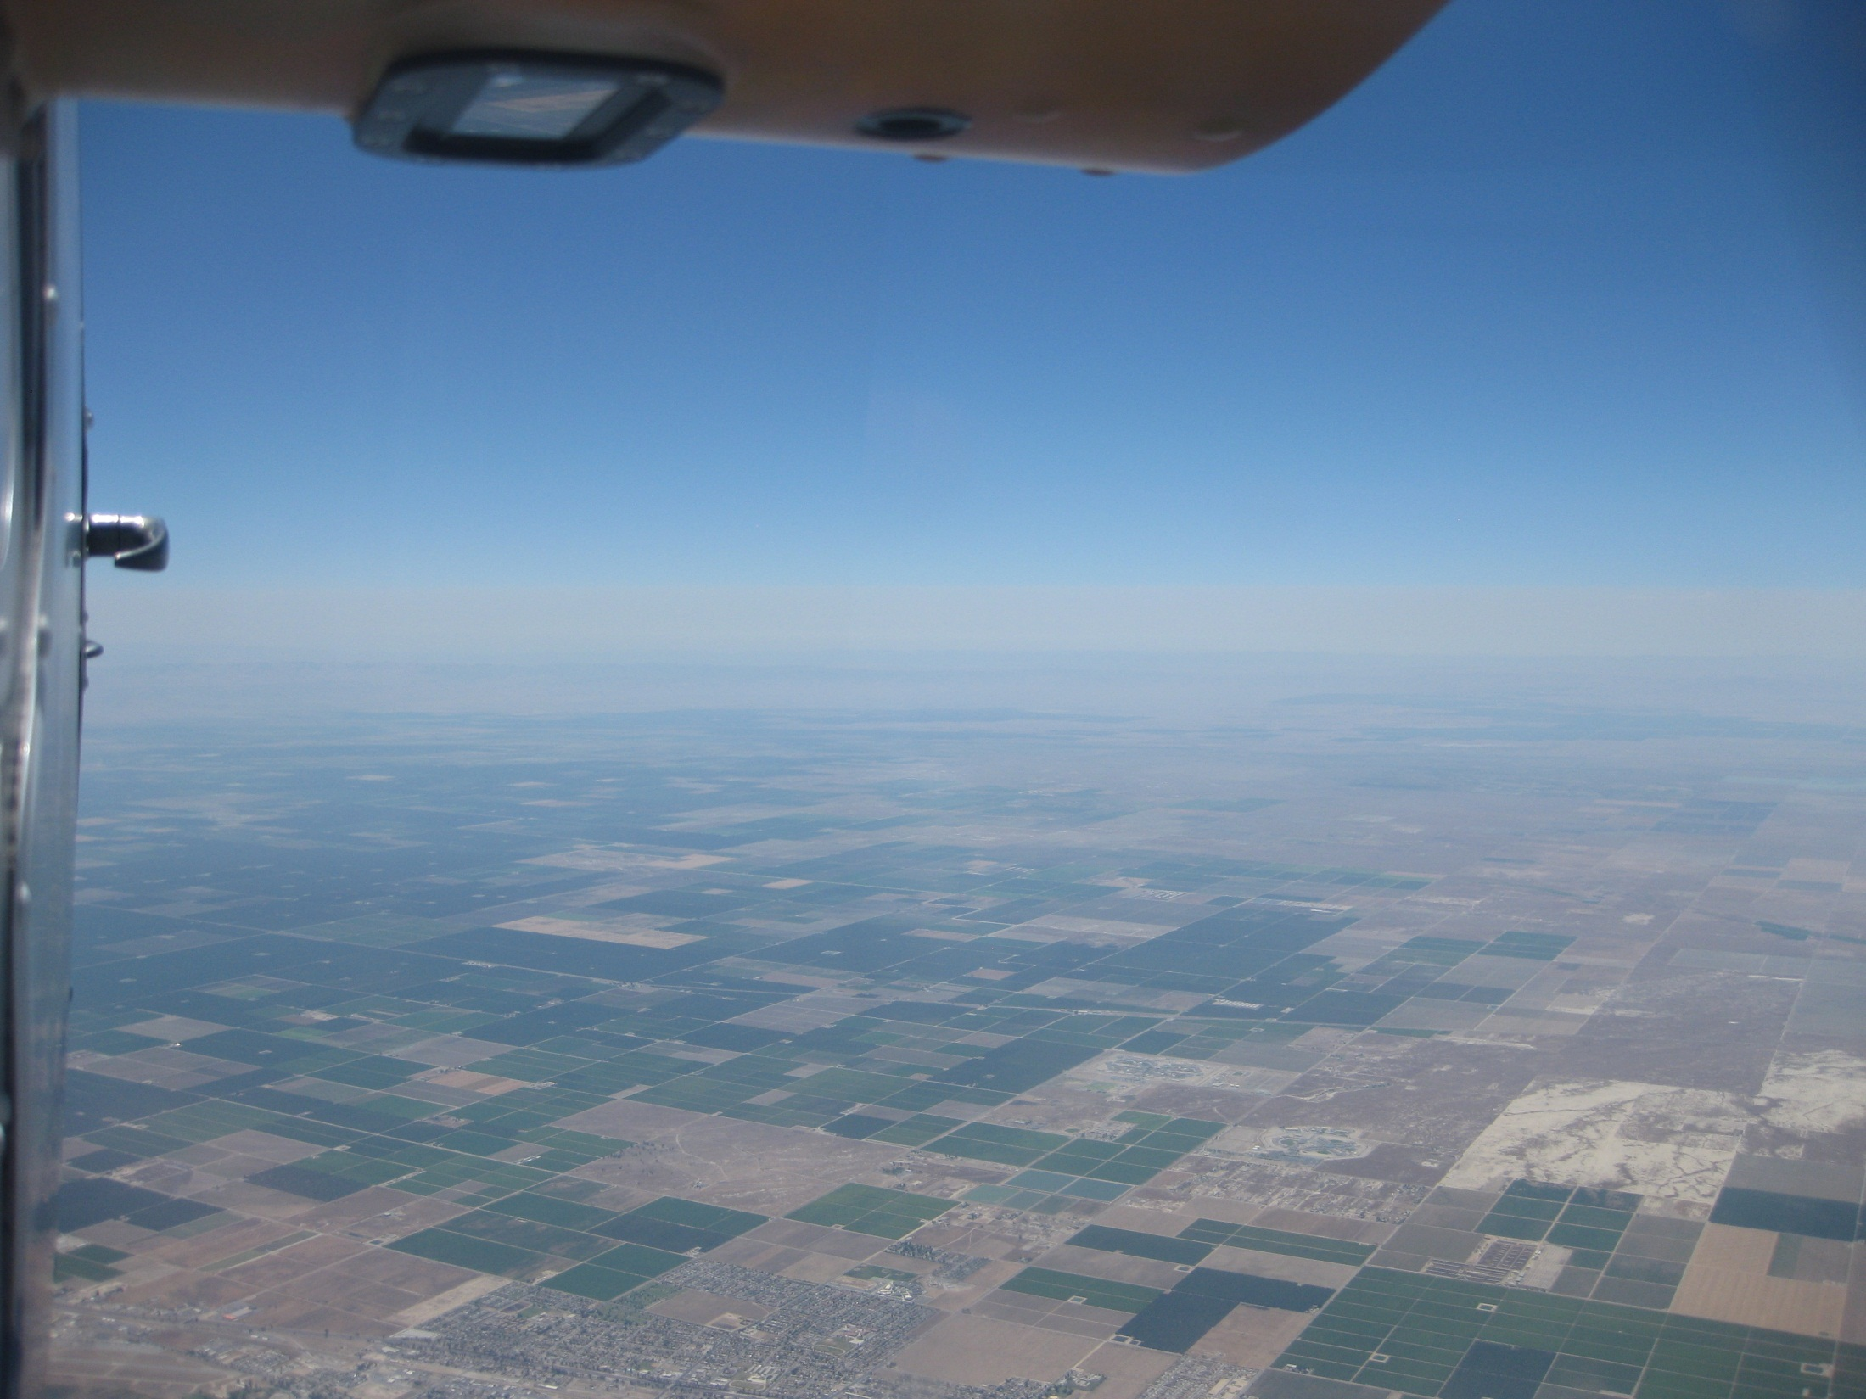
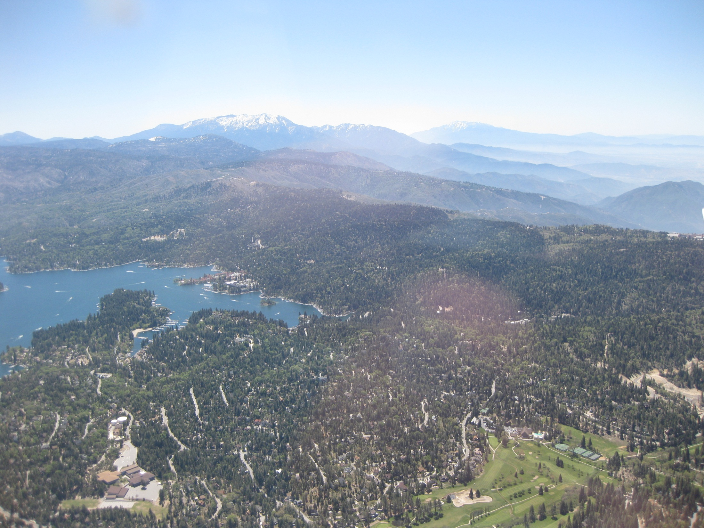
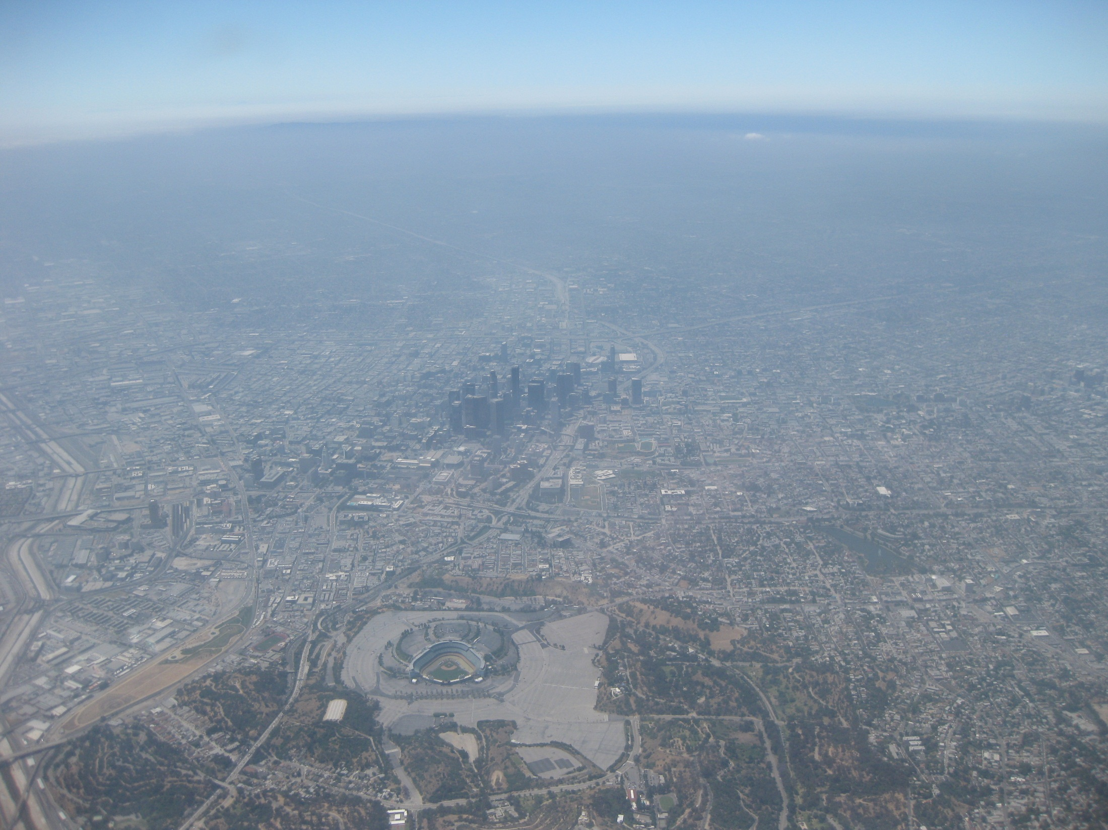
Column observations of NOx and OVOC over California during CalNex and CARES
Rainer Volkamer^{1,2}, Sunil Baidar^{1,2}, Hilke Oetjen¹, Ivan Ortega¹, Roman Sinreich¹, Si Wang Kim^{2,3}, Chenxia Cai⁴
¹Dept. Chemistry and Biochemistry, University of Colorado, Boulder CO
²CIRES, University of Colorado, Boulder CO
³NOAA/ESRL/CSD, Boulder CO
⁴Air Resources Board, Sacramento CA
Objectives:
Assess boundary conditions , NOx emissions, and OVOC abundance (HOx, SOA)
Map 2D distributions and vertical profiles (SoCAB, Central Valley, Northern California)
Assess pollutant transport (splitting of flows, mountain passes, high deserts)
Enhance value of ground sites (Caltech, Bakersfield, Cool)

Slide 2
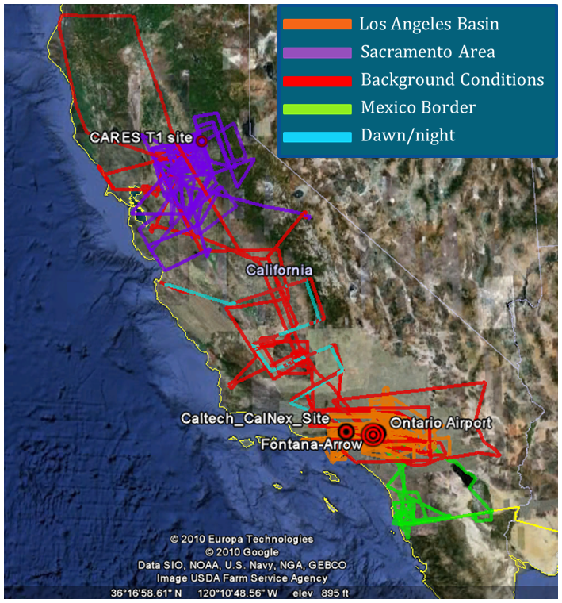
Overview CALNEX and CARES activities
CU Airborne MAX-DOAS:
May 19, 2010 – July 19, 2010
Total of 52 flights
flight duration: up to 4.5 hours
207 total flight hours
CU Ground MAX-DOAS:
Caltech (May 15-Nov)
Fontana Arrows (May 15-Nov)
CARES T1 (June 11-28)
CU LED-CE-DOAS:
Caltech (May 14 - June 16)
e.g., Glyoxal (15ppt@1min)
Posters: Baidar et al. (AMAX-DOAS), Ortega et al. (GMAX-DOAS),
Thalman et al. (LED-CE-DOAS)

Slide 3
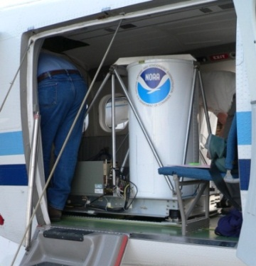
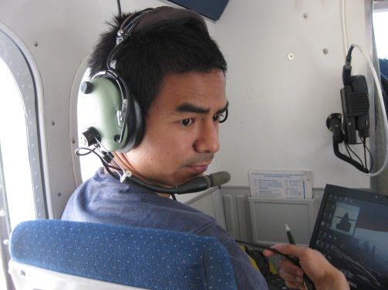
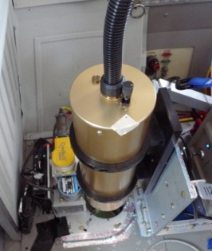
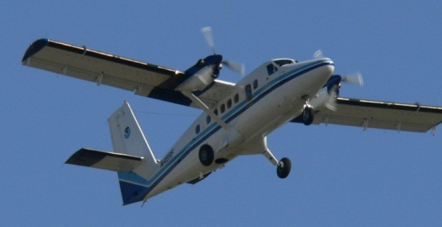
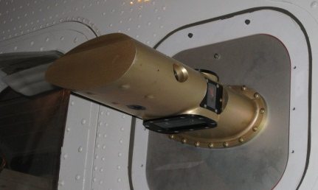
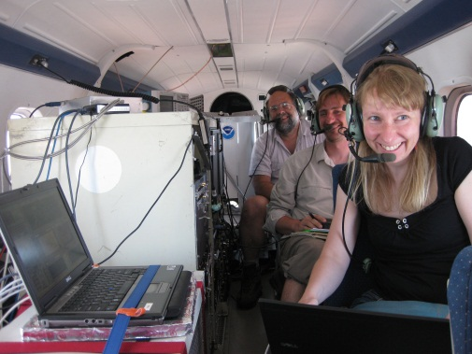
NOAA Twin Otter – optical remote sensing
Primary instruments:
  Downward-looking ozone and aerosol Lidar (TOPAZ = Tunable Optical Profiler for Aerosols and oZone)
  U of Leeds Scanning Doppler Lidar
  CU Airborne Multi-Axes Differential Optical Absorption Spectroscopy (CU AMAX-DOAS) Instrument
Additional instruments:
  In situ O₃, temperature, pressure
  Radiometers (surface temp, albedo)
  CU motion compensation system
Senff et al., Langford et al. WED
12.5 deg
off nadir
Track

Slide 4
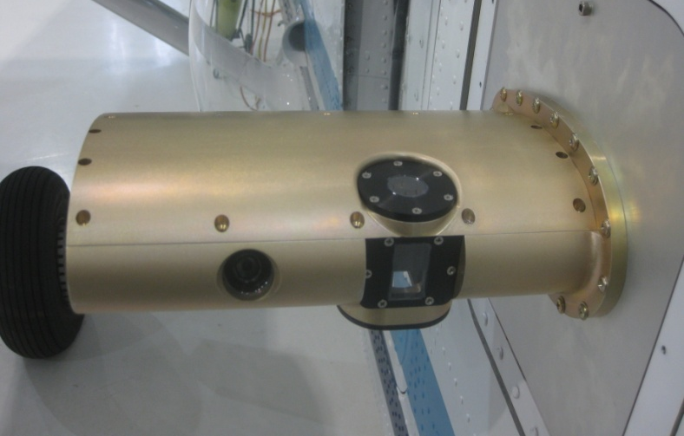
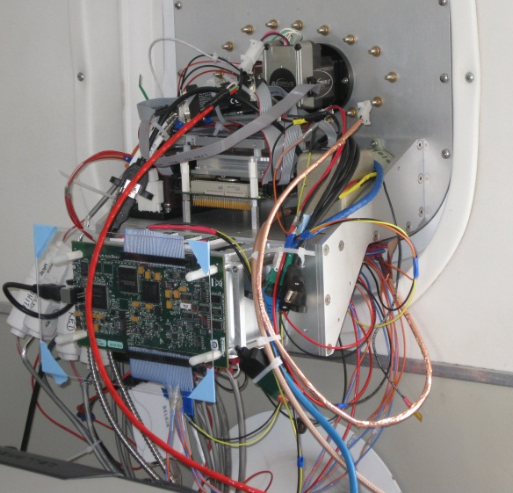
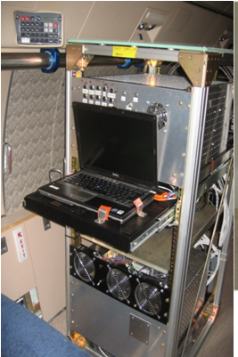
CU AMAX-DOAS instrument & concept
Photons travel on parallel paths from the sun into the Earth‘s atmosphere.
absorber layer
Rotating prism telescope
Real-time motion compensation
2 synchronized spectrometers/CCDs
absorber layer
surface
single-scattering approximation
Retrieval:
Measured spectra are analysed with the DOAS method. This yields the integrated absorber density along the light path: the so-called slant column density

Slide 5
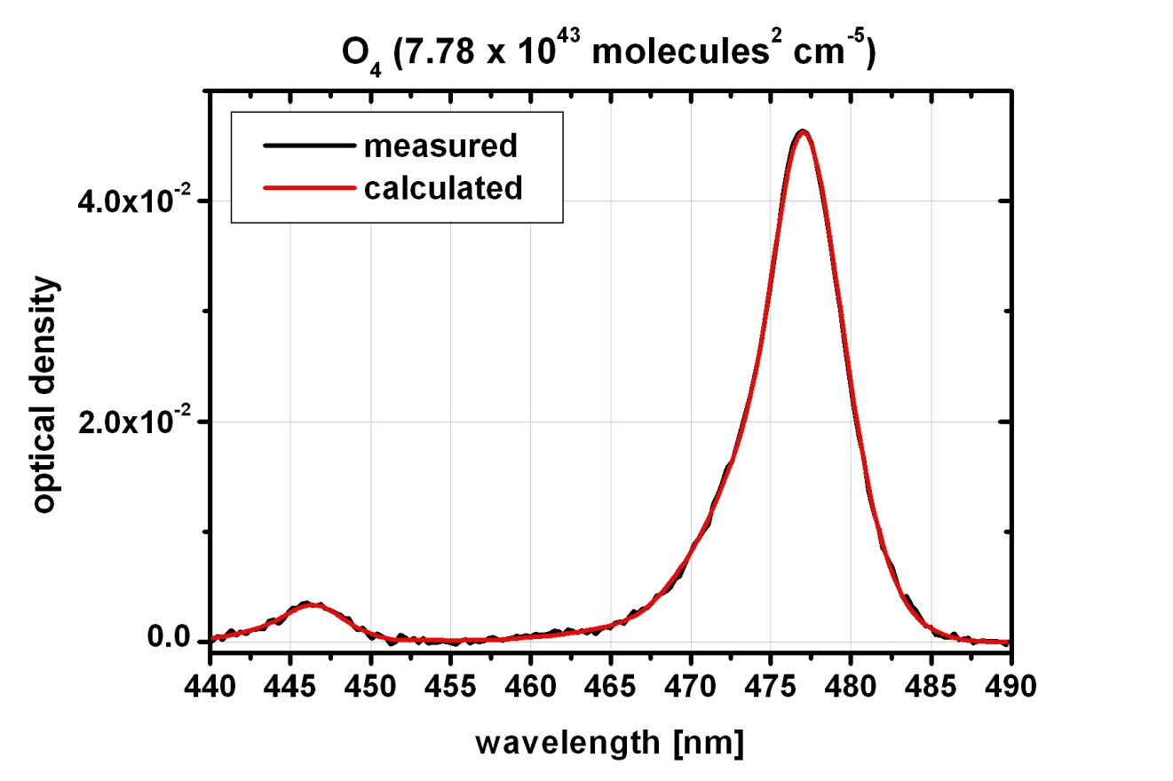
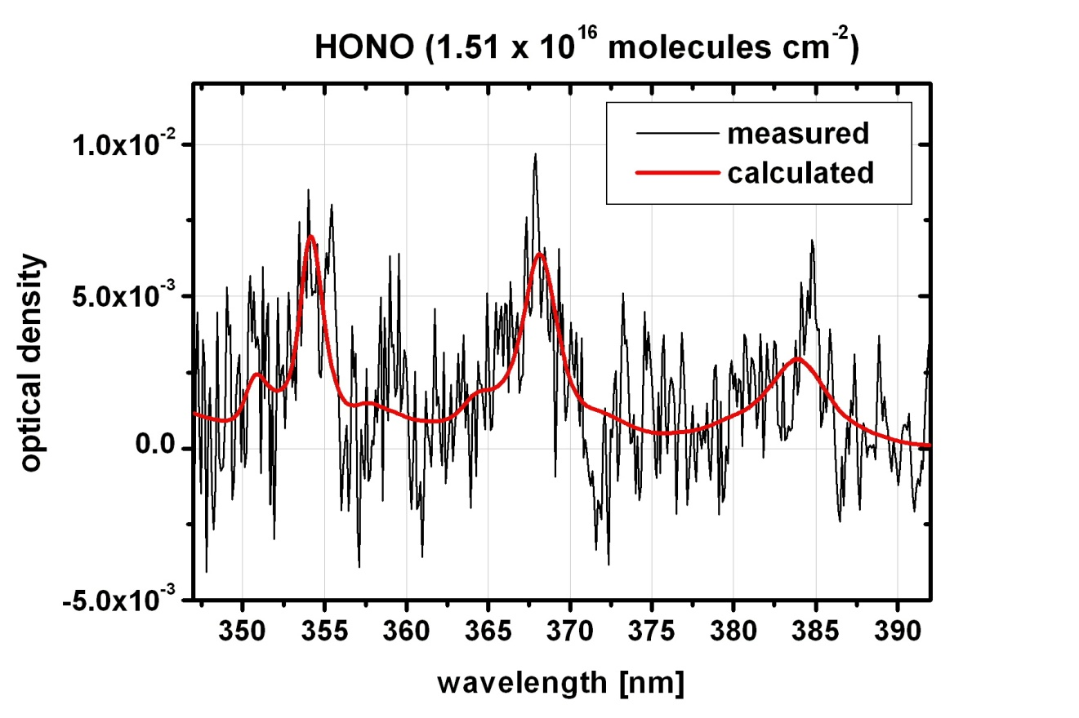
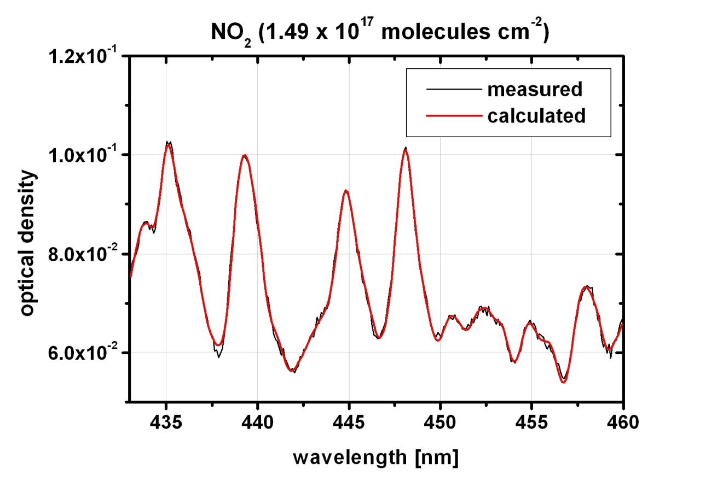
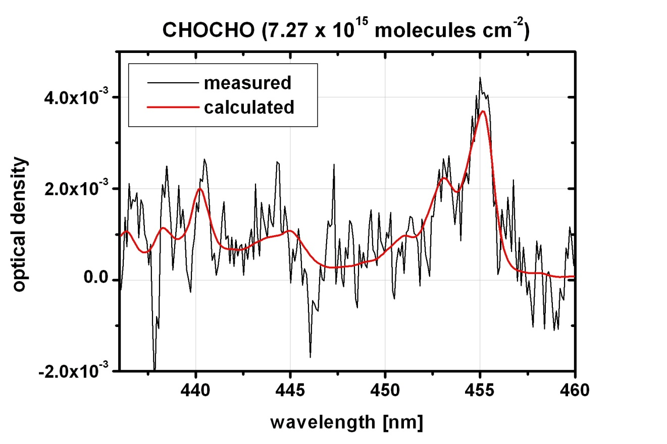
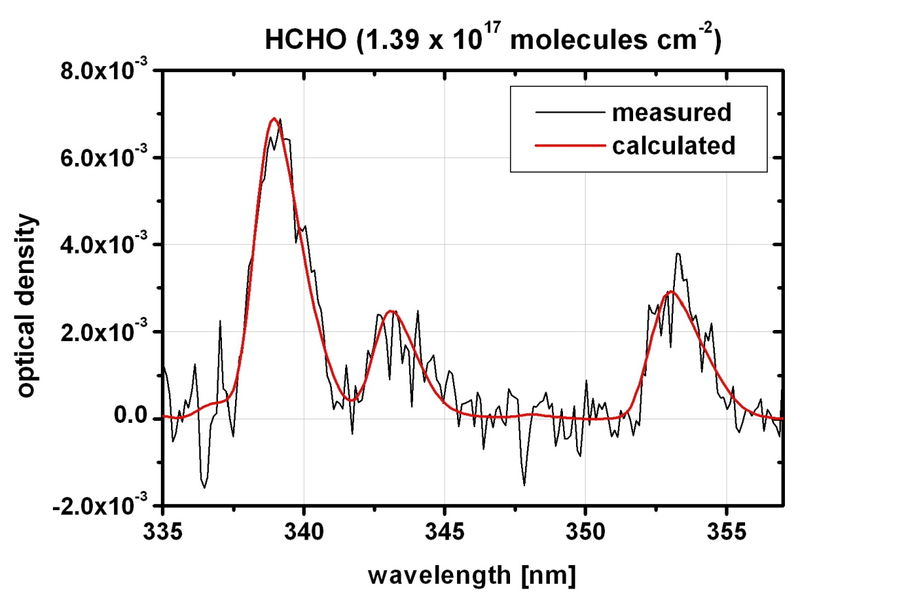
Spectral proof of measured gases

Slide 6
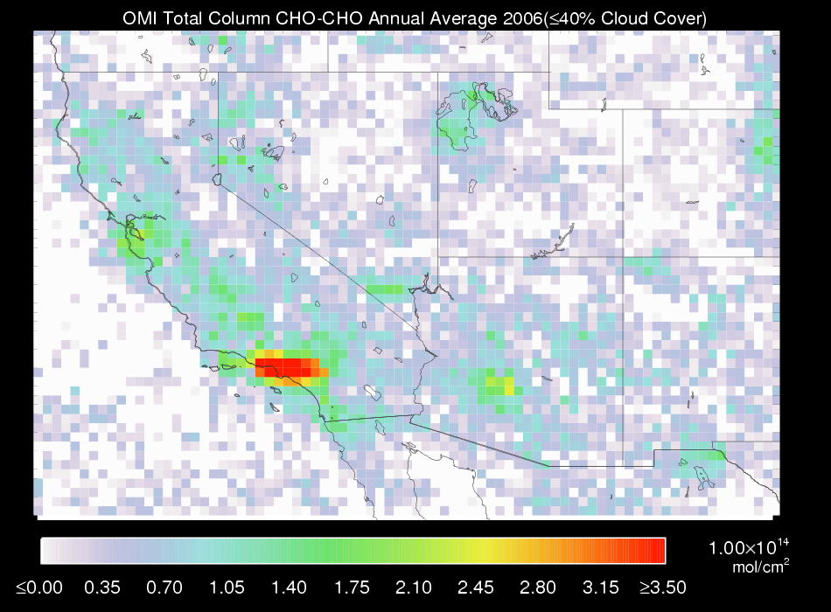
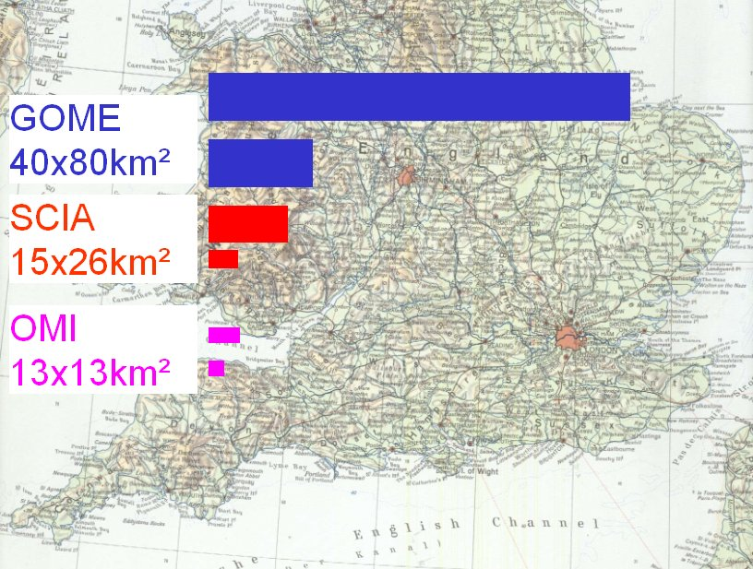
Sampling extended spatial Scales
Los Angeles
WRF-Chem, UCD-CIT: 4x4km²
CU AMAX-DOAS sampling strategy consisted in sequential zenith-to-NADIR scanning (2 sec/spectrum). NADIR resolution: 1km along track.
Inherently averaged column measurement over PBL, or 20-60km forward view. This is directly comparable to scale probed from satellites.
Mobile column observations complement in-situ measurements, and bridge scales between ground-based networks and atmospheric models.

Slide 7
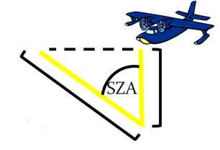
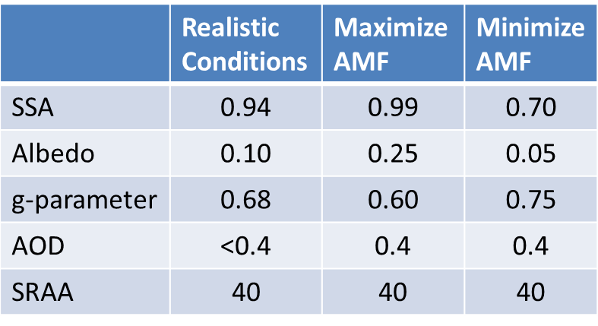
Sensitivity studies geometric AMF
Geometric Approximation
For SZA < 60 deg a conservative estimate of error is <30%

Slide 8
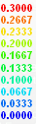
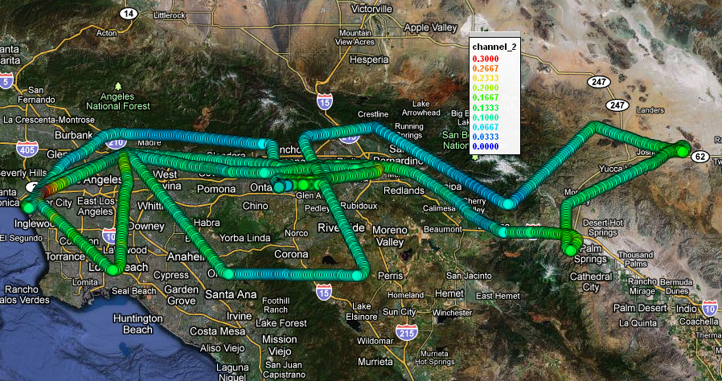
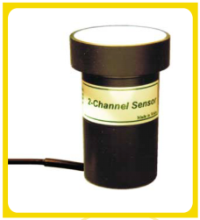
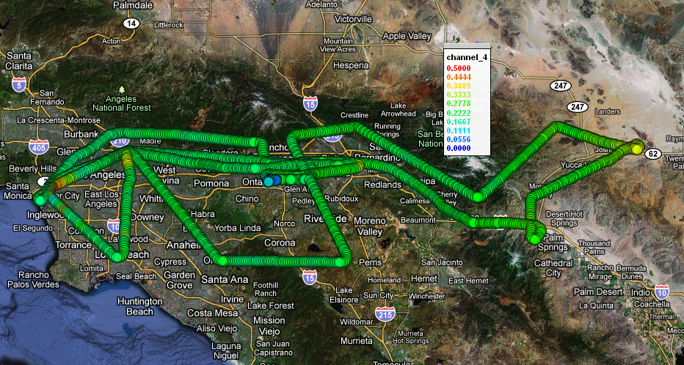
Surface Albedo
Preliminary data RF#46
Measurement principle:
  Differential Irradiance
  atmospheric correction
CALNEX upgrade 2010:
  4 channels
  360nm
  478nm O₄ bands
  630nm
  868nm
Channel 2
Channel 2: 478 nm
Channel 4
Channel 4: 868 nm

Slide 9
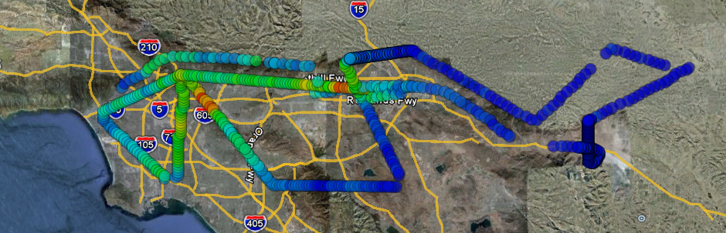
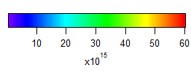
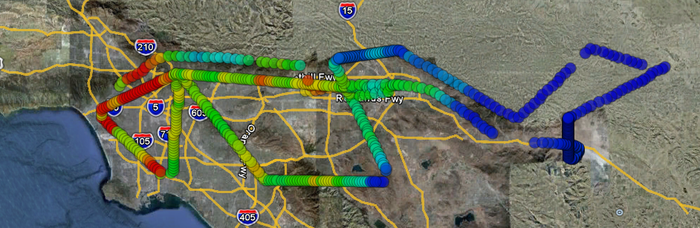
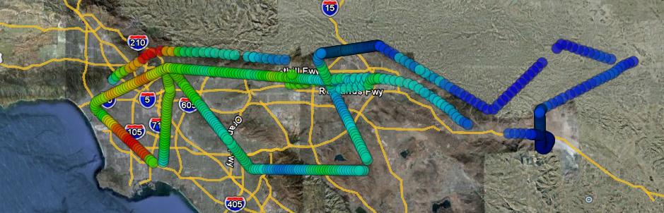
Case study: South Coast Air Basin
Observations RF#46, 7/16, AM
WRF-Chem Model (EPA NEI 2005)
CMAQ Model (ARB ARCTAS 2008)
Observed NO₂ VCD is lower than predicted by both models.

Slide 10
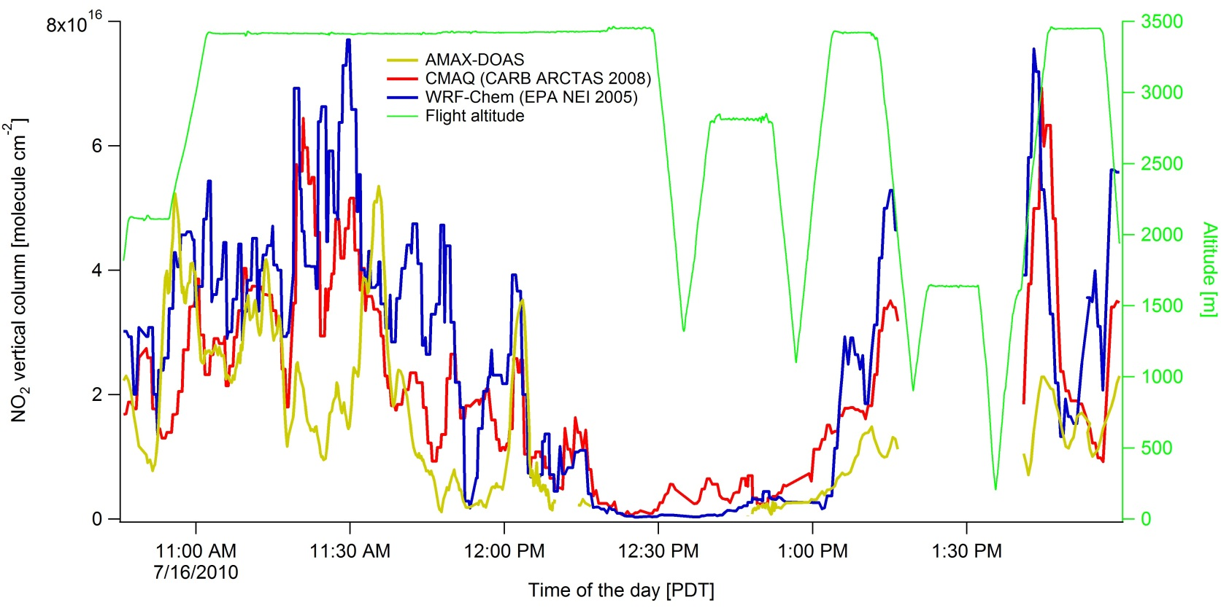
Case study South Coast Air Basin (cont)
Measurements show NO2 transport towards East
Both models show flow primarily into Santa Clarita area
Differences over downtown

Slide 11
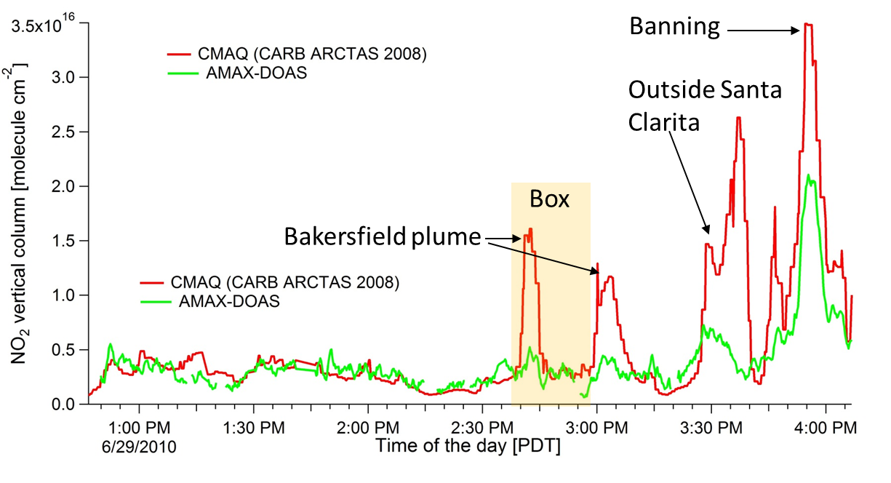
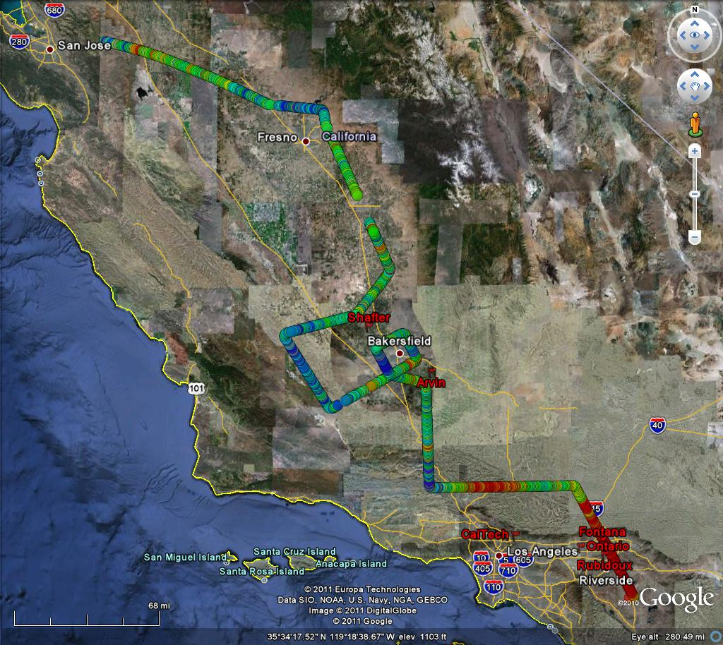
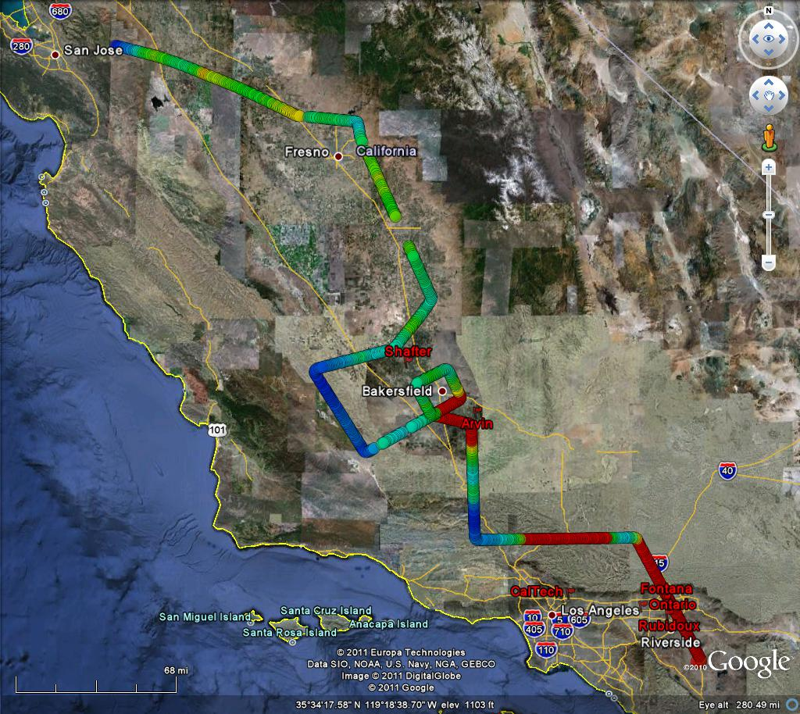
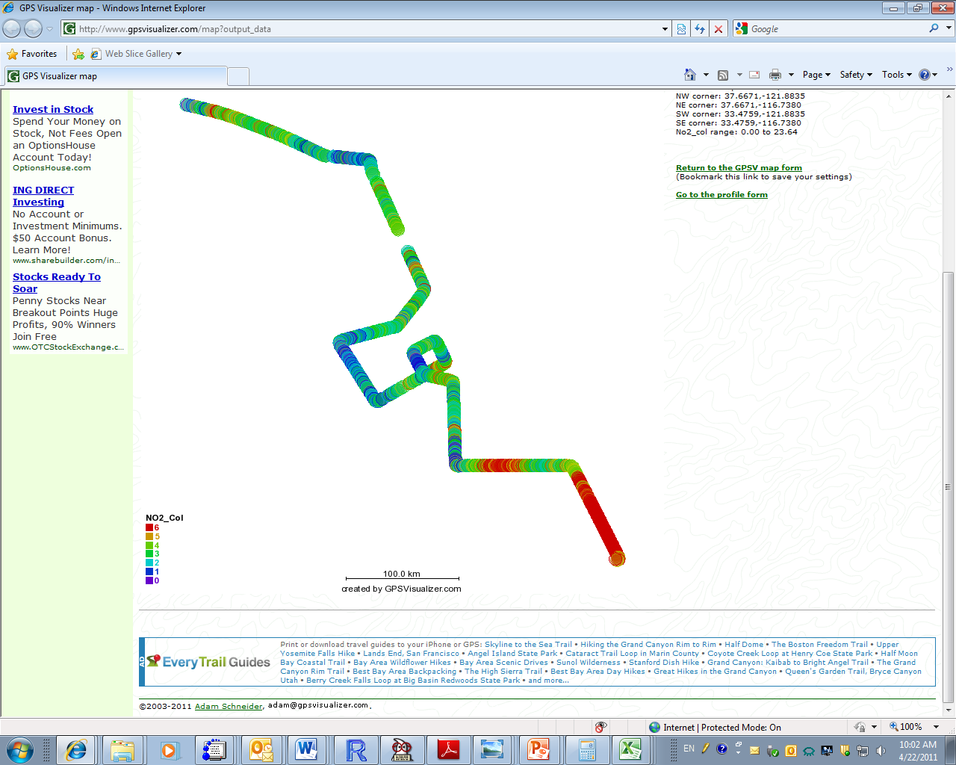
NO₂ VCD mapping Central Valley
Observation (Flight#34, 6/29)
CMAQ Model (ARB ARCTAS 2008)
Cai, Kaduwela et al. WED
Airflow
10¹⁵ molec/cm²
Locations of elevated NO₂ VCD match reasonably well
Quantitative agreement only over Central Valley

Slide 12
Comparison of Emission Inventory in LA box
Inventory | NOx [mol/km²/hr] | CO [mol/km²/hr]
EPA NEI 2005 | 100 | 1197
Millstein and Harley, EST (Yr 2005) | 61 | 450
CARB ARCTAS 2008 | 73 | 440
Projected for 2010* | 34
* projection based on 9%/year decrease 2005-2008 (Russell et al., 2010)
Acknowledgement:
Stu McKeen, Greg Frost, Dev Millstein, Rob Harley for providing emission information.

Slide 13
Conclusions: NO2 horizontal mapping
NO2 VCD is reasonably well constrained by the geometric AMF approximation (error < 30%, likely much smaller)
For arbitrarily selected case studies NO2 VCD agrees well in Central Valley, but not downwind of urbanizations, where NO2 emissions are observed much lower than predicted (factor 2-5)
Strong NO2 gradients are observed within SoCAB. NO2 transport into Santa Clarita was lower than predicted, leading to instances where NO2 was observed higher than predicted.

Slide 14
Vertical profiles: Non-linear Optimal Estimation
Radiative transfer ¹⁾
Radiative transfer¹⁾
measured O₄ SCDs
simulated O₄ SCDs
AMF
measured NO₂ SCDs
convergence?
inversion²⁾
aerosol
profile
NO₂
profile
¹⁾ http://rtm.iup.uni-heidelberg.de/McArtim
²⁾ Rodgers (2000)

Slide 15
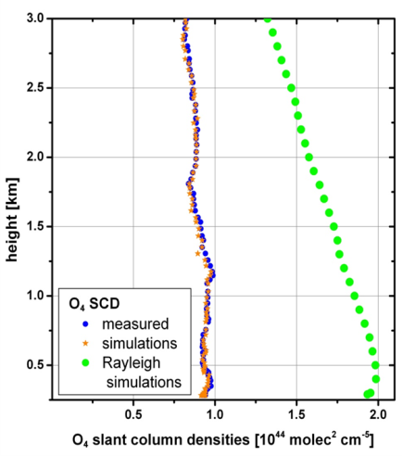
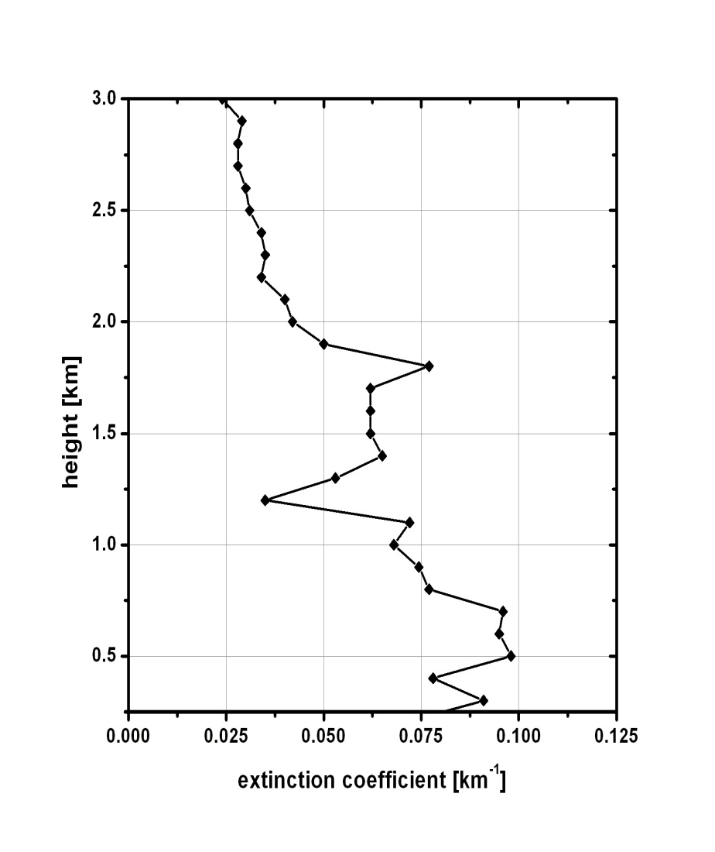
Example: NO₂ and extinction vertical profile
July 18, 2010 (6:20-6:29 am)
Notes:
0 degree Elevation angle only.

Slide 16
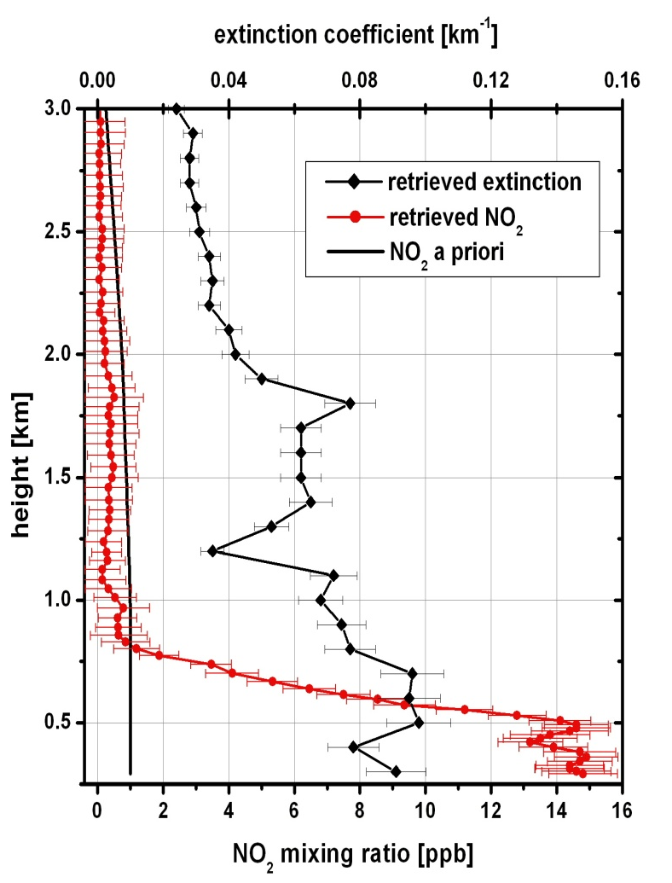
Example: NO₂ and extinction vertical profile
July 18, 2010 (6:20-6:29 am)
aged
residual layer
residual layer
mixed
surface layer
Notes:
0 degree Elevation angle only.

Slide 17
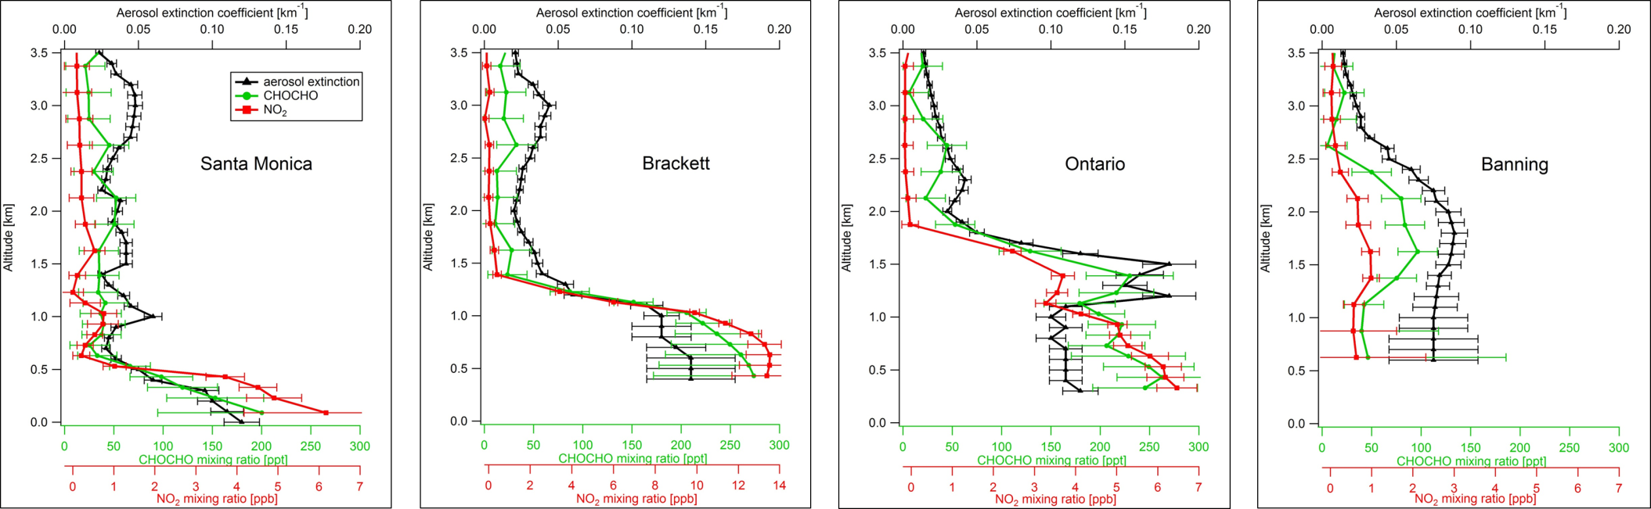
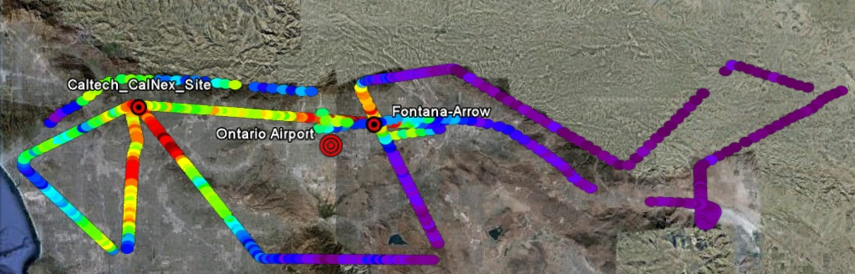
NO₂ and CHOCHO vertical distributions
PBL increase from West to East of the SoCAB
A heterogeneous airmass !
Glyoxal in FT indicates rate of VOC oxidation outside PBL

Slide 18
Conclusions and Outlook
CU AMAX-DOAS is a unique instrument to map 3D distributions:
  First systematic MAX-DOAS implementation from aircraft
  Motion compensation challenge overcome, albedo, stratospheric photon path
  Aerosol extinction and numerous trace gases (also H₂O, BrO, IO, OClO)
Innovative means to address scaling problem:
  Fills gap in mobile observational capabilities between in-situ, satellites and atmospheric models
NO2 emissions testing points to a need to adjust inventories
NO2 as a tracer for plume transport (splitting of flows)
Glyoxal in the ‘free troposphere’
Outlook:
  Compare with our ground MAX-DOAS column observations
  Synergies with TOPAZ LIDAR to constrain Ox = NO2 + O3 column
  Synergies with HALO LIDAR to constrain fluxes across boundaries (box budgets)
  Refine RTM: Assimilate albedo
  Atmospheric model testing: towards constraining the rate of VOC oxidation
  Satellite comparisons
  Add value to ground sites?
Funding: CARB 09-317, NSF-CAREER

Slide 19
Science Objectives
Emissions
How can we improve the emissions inventory for NOx and aerosol precursors?
Chemical Transformation and Climate Processes
What are the sources and physical mechanisms that contribute to high ozone concentrations aloft?
Are there significant differences between Central Valley and South Coast Air Basin precursors or ozone formation chemistry?
What are the most important formation processes for secondary organic aerosol?
Transport and Meteorology
What are proper oceanic boundary conditions for coastal and regional atmospheric chemistry modeling?
How best can we characterize and model air flow over coastal waters and the complex terrain of California?
What are the important transport corridors for key chemical species and under what conditions is that transport important?
Notes:
Get back to Christoph (2-3 lines of txt)
Transport / splitting flows / boxes
ARB contract
Workshop objectives

