Slide 1
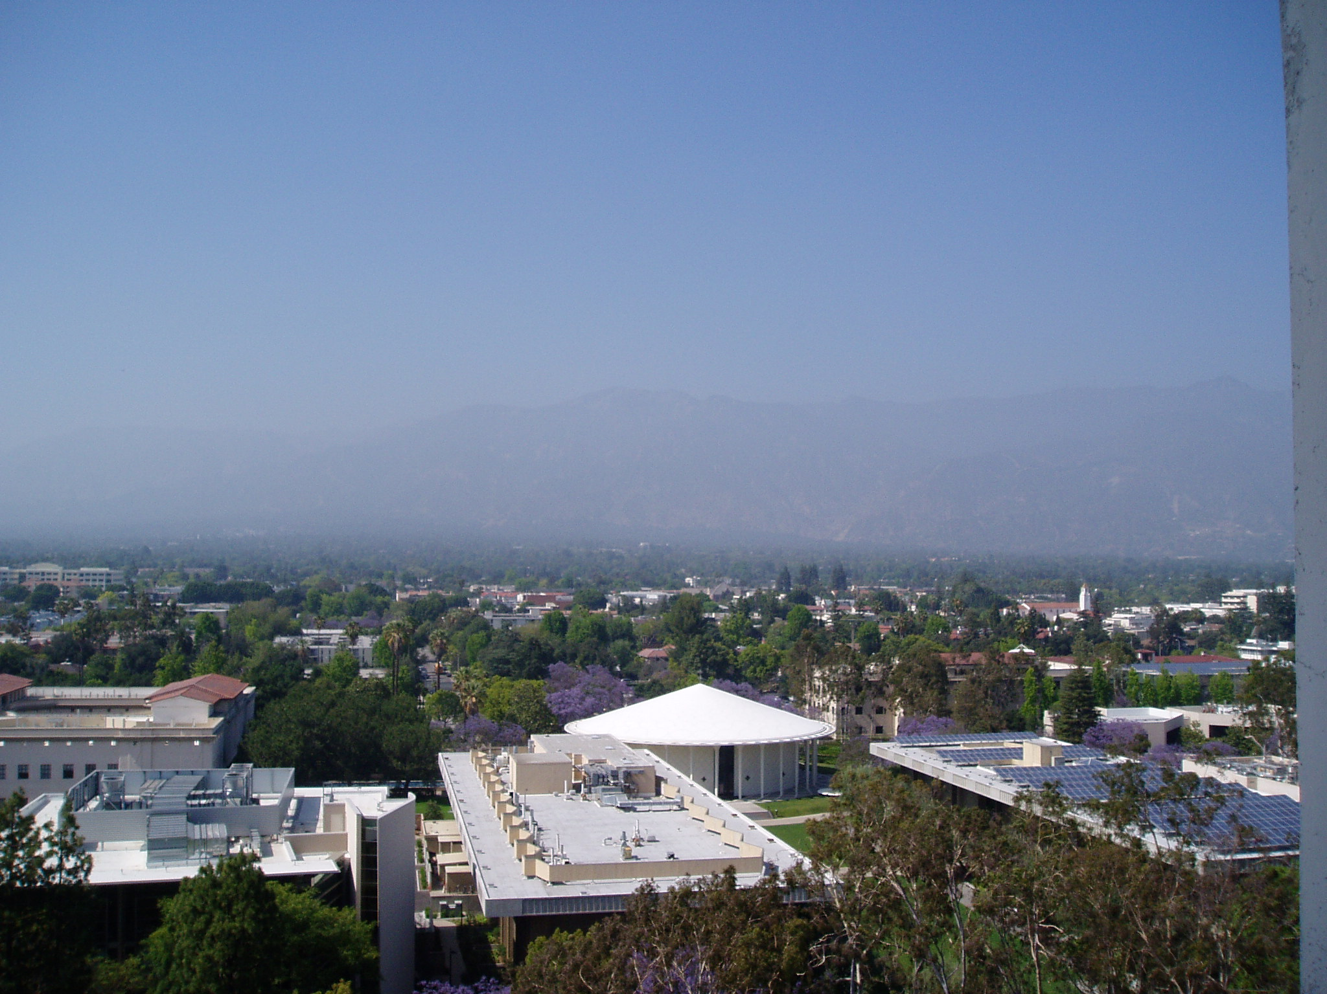
Nocturnal Vertical Gradients of
O₃, NO₂, NO₃, HONO, HCHO, and SO₂ during CalNex 2010
Tsai Catalina, Kam Weng Wong, Olga Pikelnaya, Steven C. Hurlock, Ross Cheung, Christine Haman, Barry Lefer, and Jochen Stutz
University of California, Los Angeles

Slide 2
Motivation
To better understand the chemical and mixing processes that influence atmospheric composition at night.
To determine the removal of NOx from the nocturnal boundary layer by NO₃ chemistry.
To study the formation of HONO and its impact on OH.
To examine how nocturnal chemistry affects the initial condition for ozone formation during the day.

Slide 3
Nocturnal Chemistry
Nocturnal Chemistry in the Polluted BL
Capping Inversion
O₃
NO₃
N₂O₅
NO₂
Residual Layer
Stable Nocturnal
Boundary Layer
O₃
O₃
HC
O₃
NO₃
NO₂
NO
N₂O₅
NO₂
HONO
OH + NO
NO

Slide 4
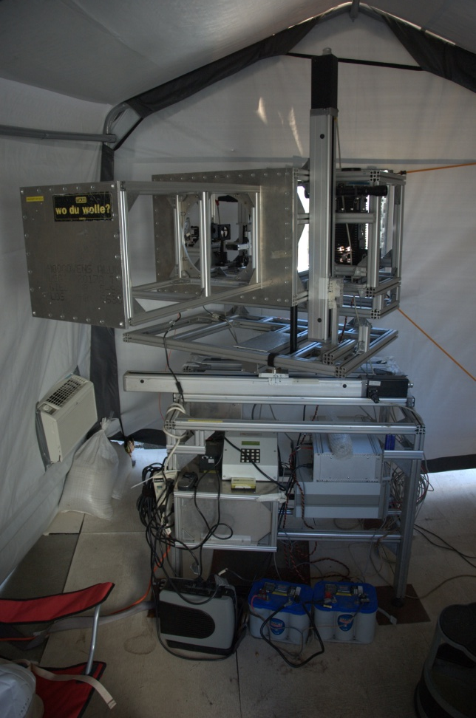
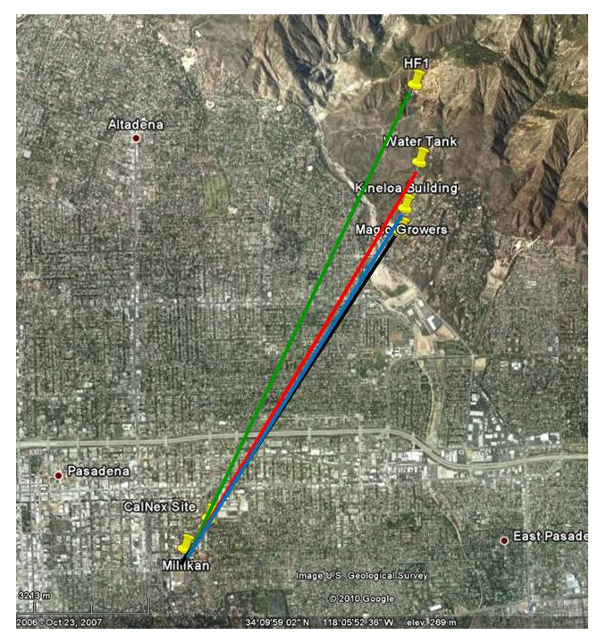
CalNex LP-DOAS Set Up
May 15 2010 – June 16 2010
Los Angeles Supersite: Caltech
(LP-DOAS)
(Google map)

Slide 5
Trace Gas Profile Retrieval
Measured Path Averaged Concentrations
Retrieved Height Interval Concentrations (subtracting scale from the ground upwards)
Highest Interval
(255-556m) 301m
556m
Upper Interval
(121-255m) 134m
255m
(78-121m) 43m
Middle Interval
121m
(33-78m) 45m
Lowest Interval
78m
10m
33m
78m
5.4 km
5.6 km
6.3 km
7.0 km

Slide 6
Trace Gases Vertical Profiles

Slide 7
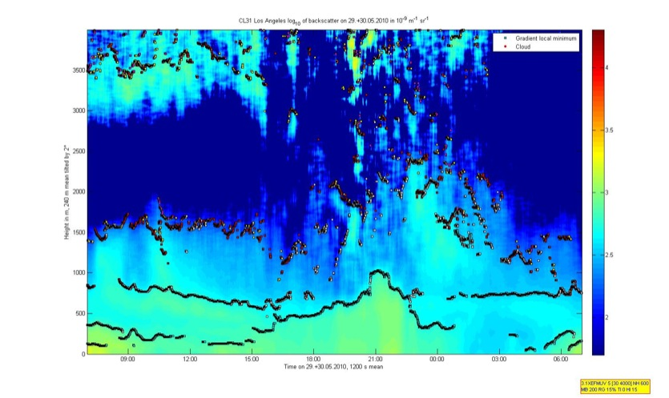
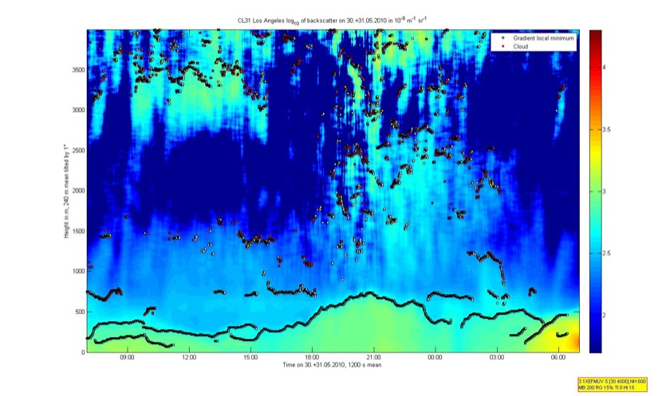
Trace Gases Vertical Profiles
May 29– 30, 2010
Height in m, 240 m mean tilted by 2⁰
Los Angeles log₁₀ of backscatter in 10⁻⁹ m⁻¹ sr⁻¹
2000
4
1500
3.5
1000
3
500
2.5
2
0
20:00
02:00
08:00
Time 1200 s mean
Stable Nocturnal Boundary Layer.
Profiles are driven by titration of O₃ by NO.
O₃ + NO → NO₂ + O₂

Slide 8
Nocturnal Vertical Gradient
May 29 – 30, 2010

Slide 9
NO₃ Chemistry
May 26 – 27, 2010
NO₃ production rate:
τ_{NO3}(PSS) = (K₁(T) •[NO₂] •[O₃])
[NO₃]
P(NO₃) = K₁(T) •[NO₂] •[O₃]
K₁ = 1.43x10⁻¹³*e^{-2470/T}
Mixing ratio of N₂O₅
NO₃ + NO₂ + M ↔ N₂O₅ + M
K = 5.58x10⁻²⁷*e^{10724/T}

Slide 10
NO₃ Chemistry

Slide 11
NOx loss in the NBL
Reactions of NO₃ radical:
NO₃ + NO → 2 NO₂ zero NOx loss
NO₃ + HC → organic nitrates → → SOA 1 NOx loss
NO₃ → → aerosol uptake 1 NOx loss
NO₃ + NO₂ ↔ N₂O₅ →aerosol uptake 2 NOx loss
Overall loss frequency of NO₃ radical :
f_{NO3}(tot) = f_{NO3}(NO) + f_{NO3}(HC) + f_{NO3}(aer) + f_{NO3}(N₂O₅)
(Stutz et al., 2010)

Slide 12
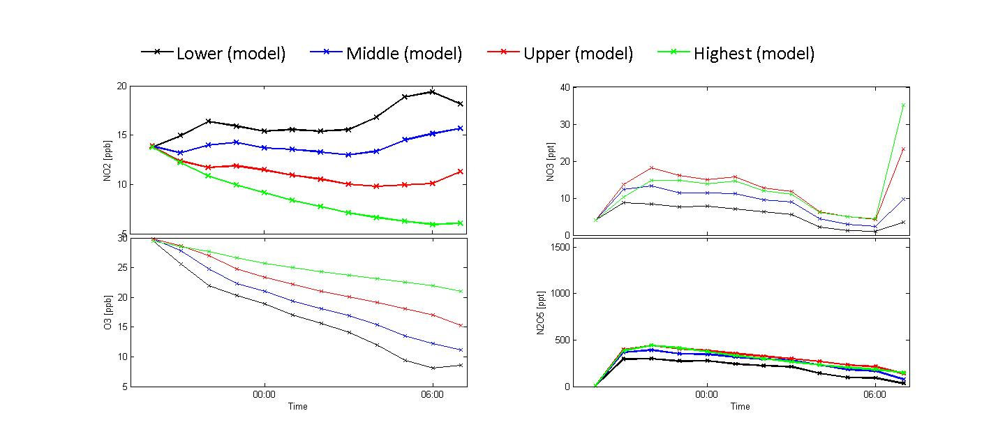
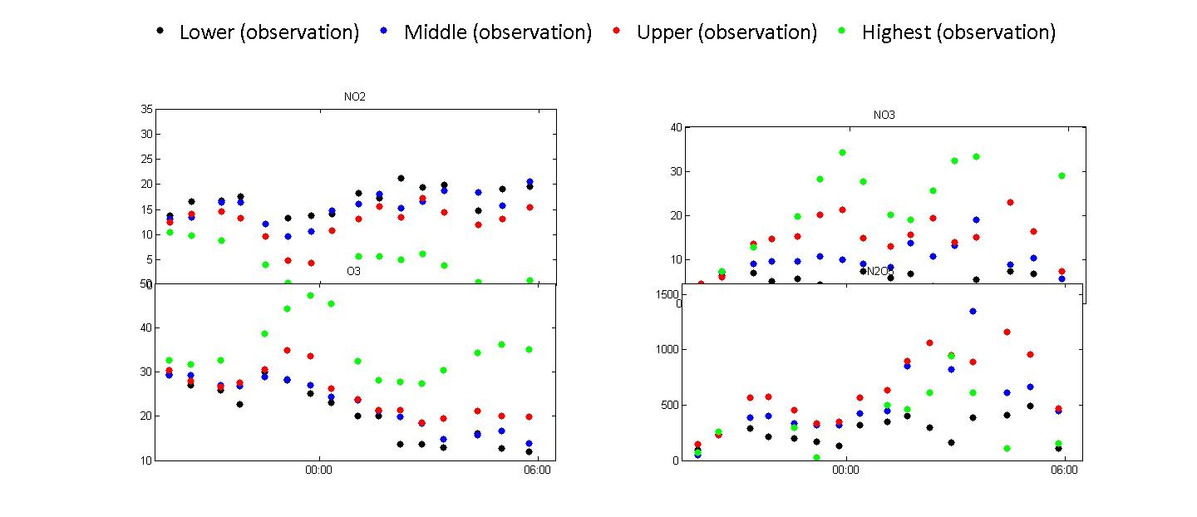
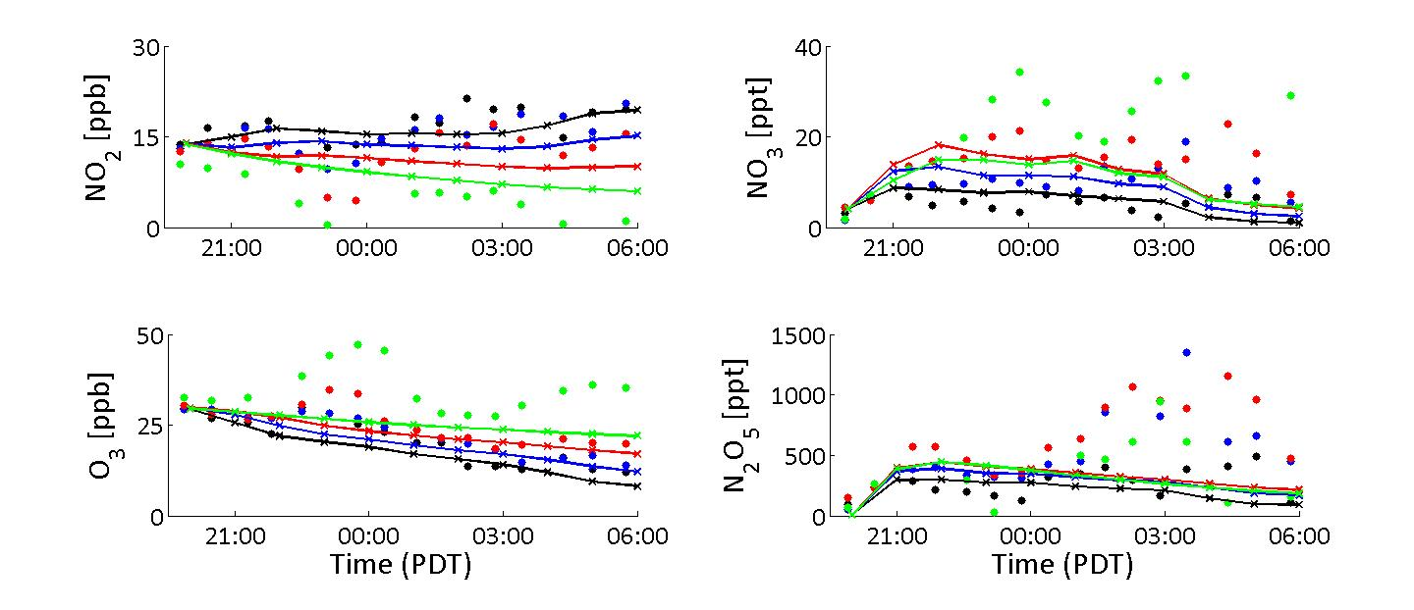
RCAT8.2 1-D radical chemistry and transport model
Gas-phase Regional Atmospheric
Chemistry Mechanism (RACM) :
- 84 reactive species
- 249 gas-phase chemical reactions
27 boxes from 0-3 km (log scale below 1 m).
Biogenic and anthropogenic emissions .
Deposition and chemistry on ground and
aerosol.
May 27 – 28, 2010

Slide 13
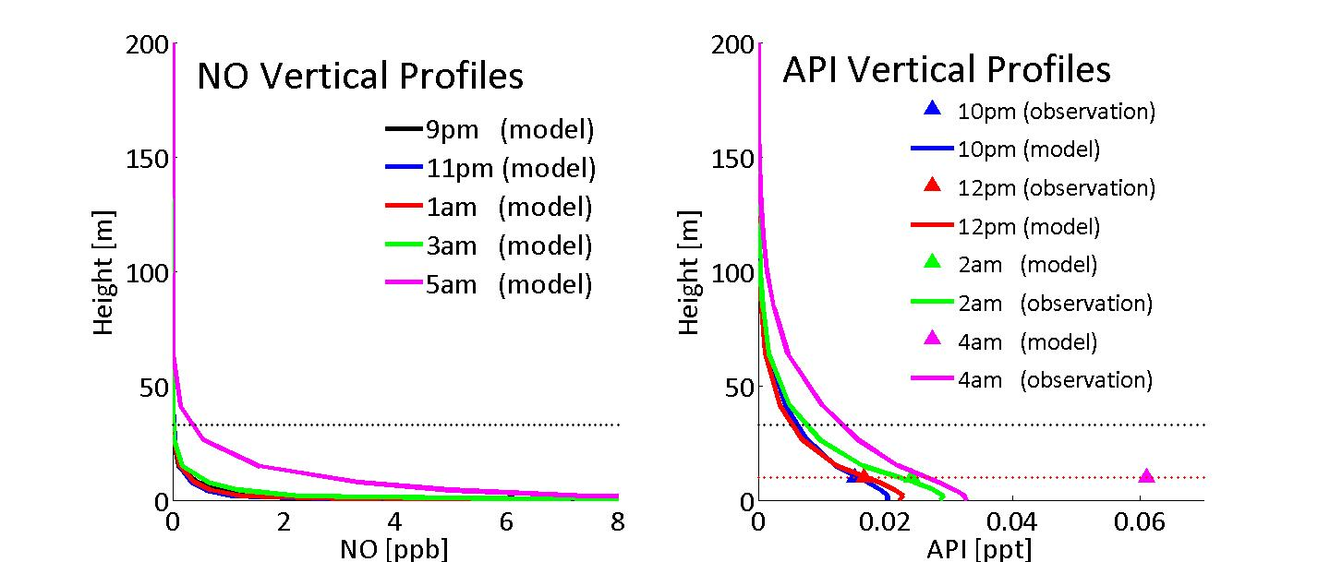
Preliminary NO₃ Loss Rate
f_{NO3}(tot) = f_{NO3}(NO) + f_{NO3}(HC) + f_{NO3}(aer) + f_{NO3}(N₂O₅)
(Observations scaled with vertical profiles)
(HC data provided by NOAA)

Slide 14
Preliminary NOx Loss
NOx Loss Rate

Slide 15
Conclusion
Nocturnal vertical gradients of trace gases were observed during CalNex.
Ozone and NO₂ showed typical diurnal variation found in polluted areas: small ozone and large NO₂ mixing ratios at night and the opposite during the day.
Nocturnal NO₃ and N₂O₅ mixing ratios were elevated during the experiment, indicating an active radical chemistry in the nocturnal boundary layer during CalNex -Los Angeles
Assuming that NO₃ is predominantly lost through N₂O₅ uptake we found ~ 1ppb/hr nocturnal NOx loss averaged over the lowest 500 m of the atmosphere (Houston ~1ppb/hr).

Slide 16
OUTLOOK
Vertical profiles of HCHO and HONO will be investigated.
Further analysis using the 1D model will be performed to analyze NO₃ ,HCHO, HONO and ClNO₂.

Slide 17
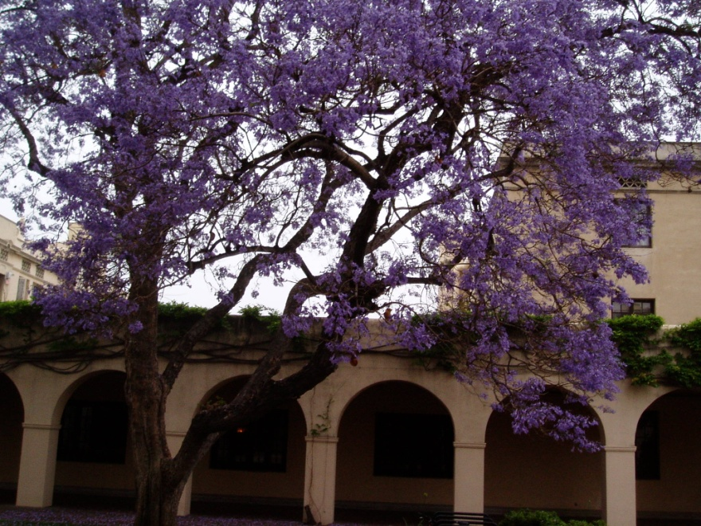
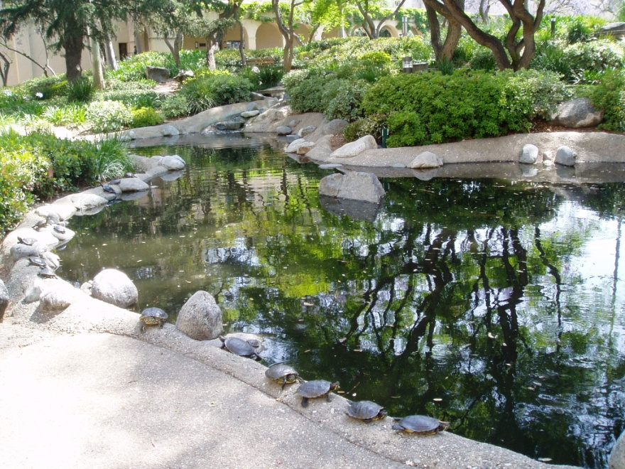

Acknowledgement
California Air Resources Board
Caltech

