Slide 1
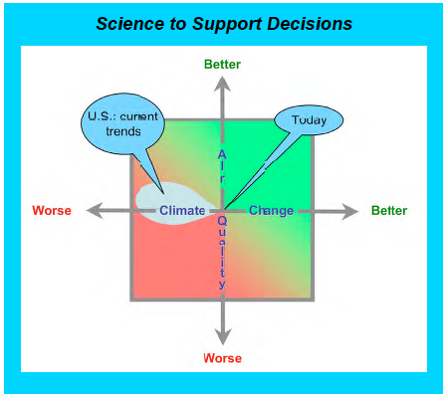
Atmospheric Chemistry and Transport
Science Questions

Slide 2
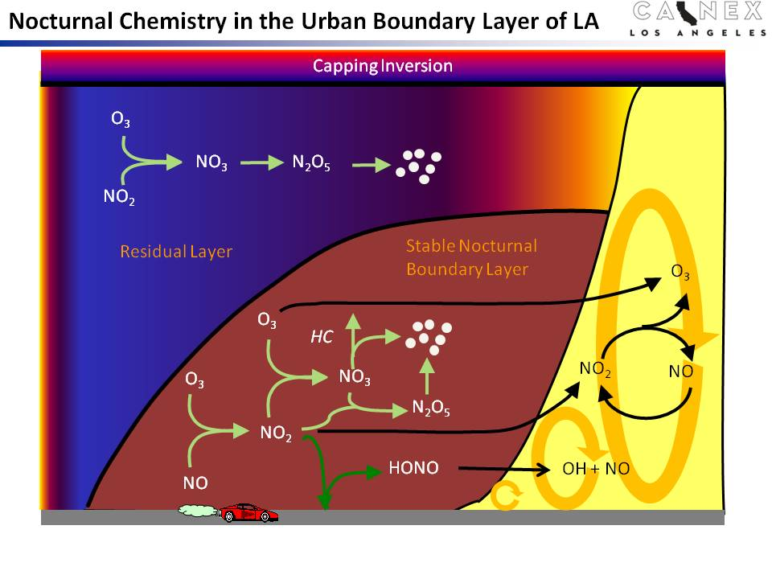
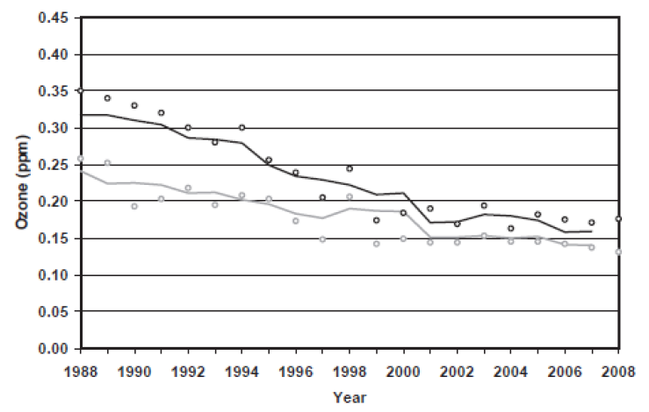
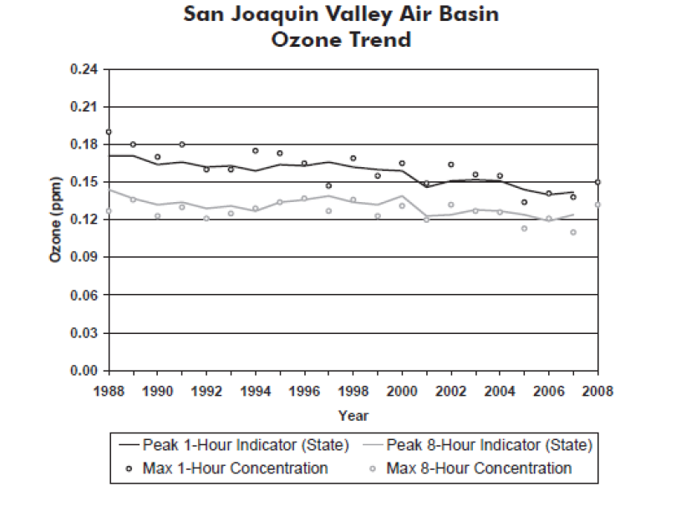
Nocturnal Chemistry:
  Change with altitude? Meteorology?
  NOx and VOC loss?
  Influence on daytime ozone and aerosol?
  Formation of daytime radical precursors?
Ozone (and aerosol) formation in the Central Valley and South Coast Air Basin
  Radical precursors and HO_{x} budget?
  Role of chlorine?
  Influence of local and regional meteorology?
  Ozone sensitivity and its reaction to emission reduction?
  Natural vs. anthropogenic emissions?
  Regional differences in California?
  Fate of VOC’s?
  Gas-to-particle conversion?
South Coast Air Basin
San Joaquin Valley Air Basin

Slide 3
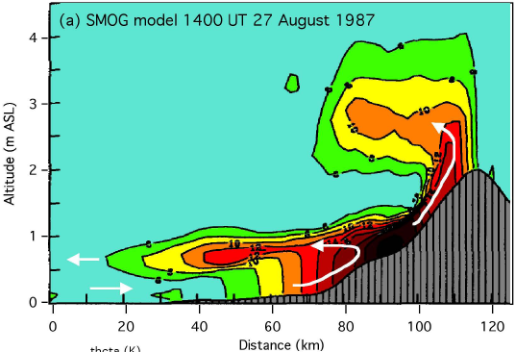
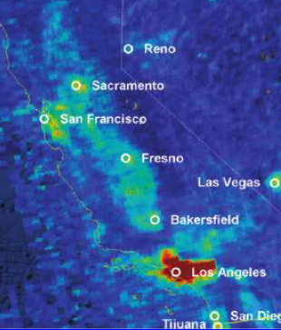
Ozone and pollutant transport at the surface and aloft
  Oceanic boundary conditions?
  Sources of high ozone concentrations aloft?
  Inflow and outflow of air in the SCAB and CV?
  Impact of long-range transport?
Chemistry and transport model?
  How well is the complex meteorology captured?
  Are emissions accurately represented?
  Are physical/chemical processes missing in models?
  What is the optimal grid resolution?
  How well are aerosols described?
Aerosol Questions → Jose’s intro, tomorrow at 9:50am…..

Slide 4
Session Organization

