Slide 1
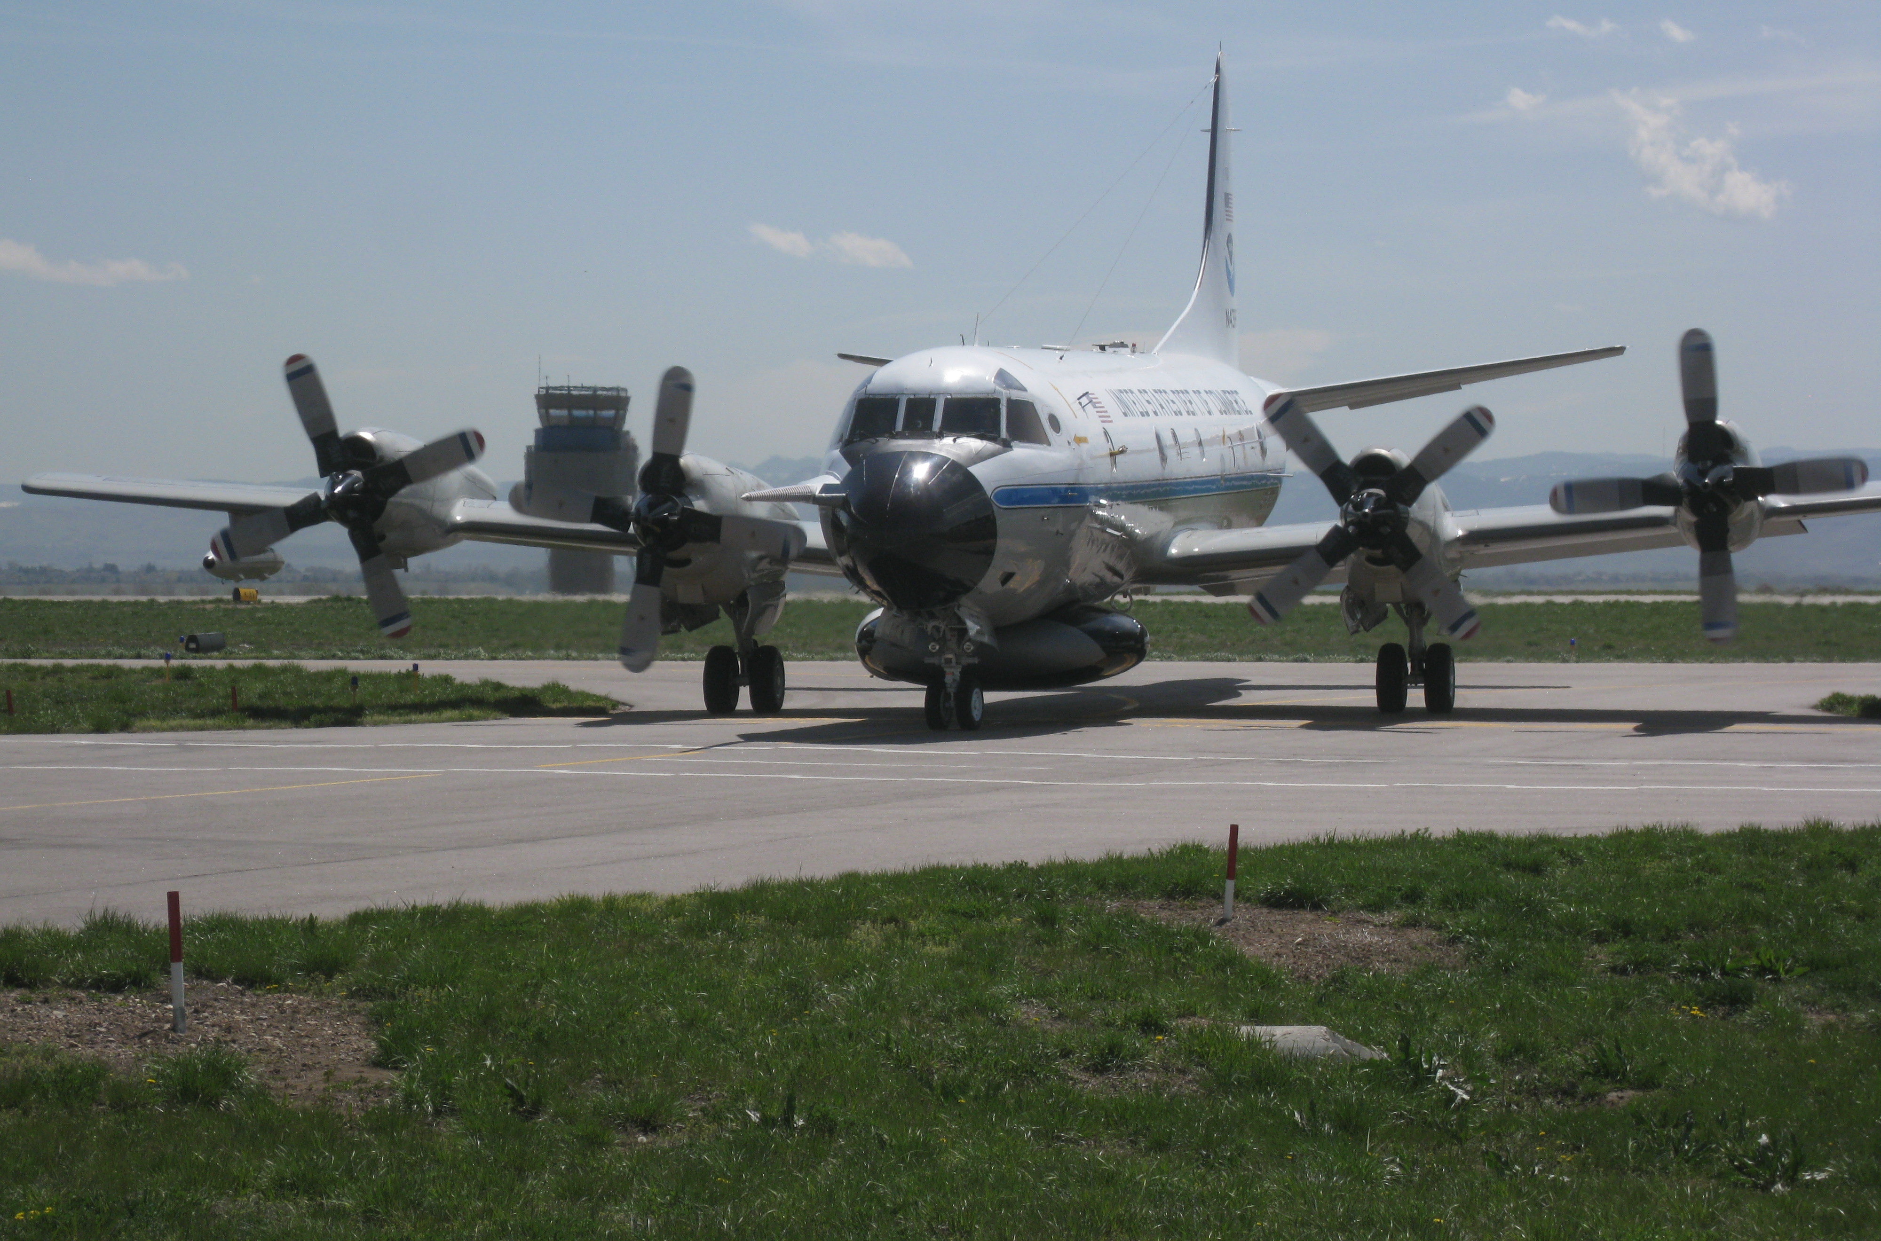
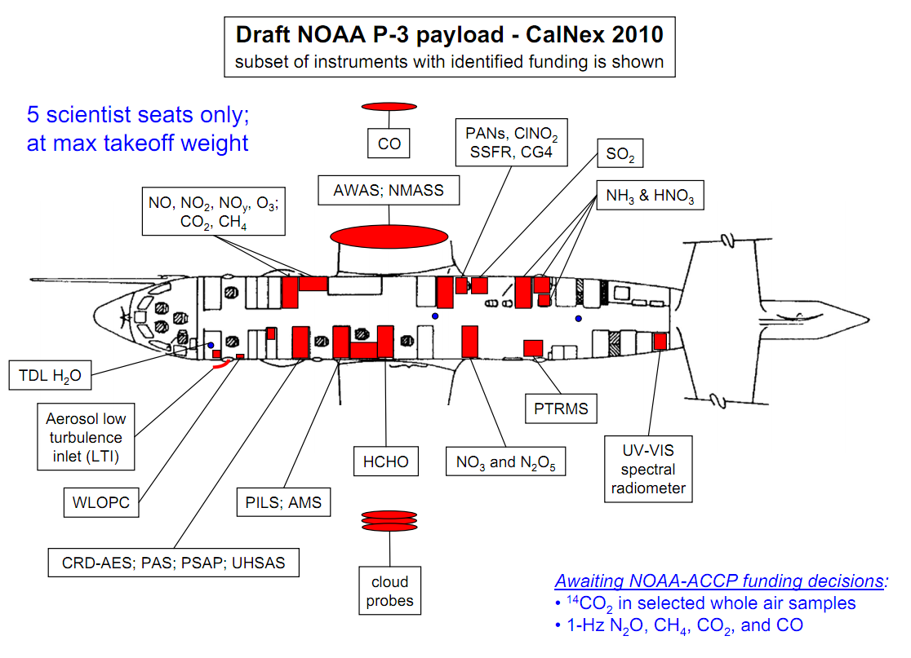
Constraints on Methane Emissions from California’s Central Valley using CalNex WP-3 Aircraft Data and a Lagrangian Transport Model
CO
CH₄
Gregory Santoni¹, Bin Xiang¹, Eric Kort¹, Bruce Daube¹, Roisin Commane¹, Elaine Gottlieb¹, Jeff Peischle^{2,} John Holloway², Tom Ryerson², Michael Trainer², Thomas Nehrkorn², Wayne Angevine², Steven Wofsy¹
N₂O
CO₂
1 - Harvard University, School of Engineering and Applied Sciences and Department of Earth and Planetary Sciences, Cambridge, Ma, U.S.A.
2 – National Ocean and Atmospheric Administration

Slide 2
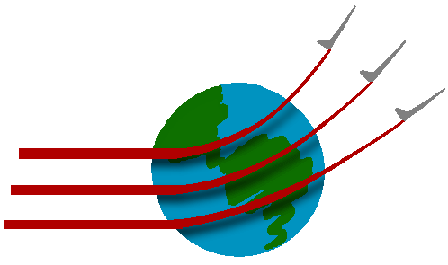
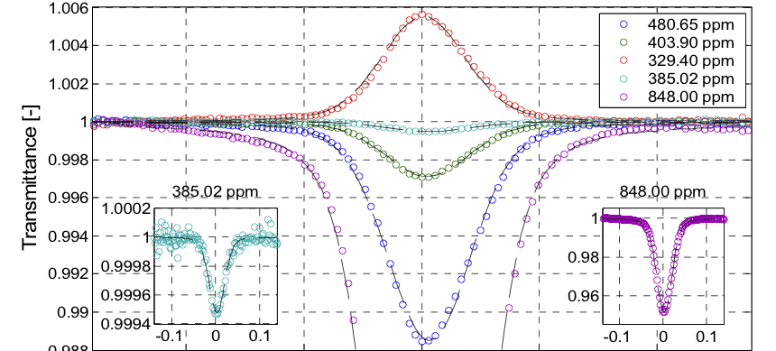
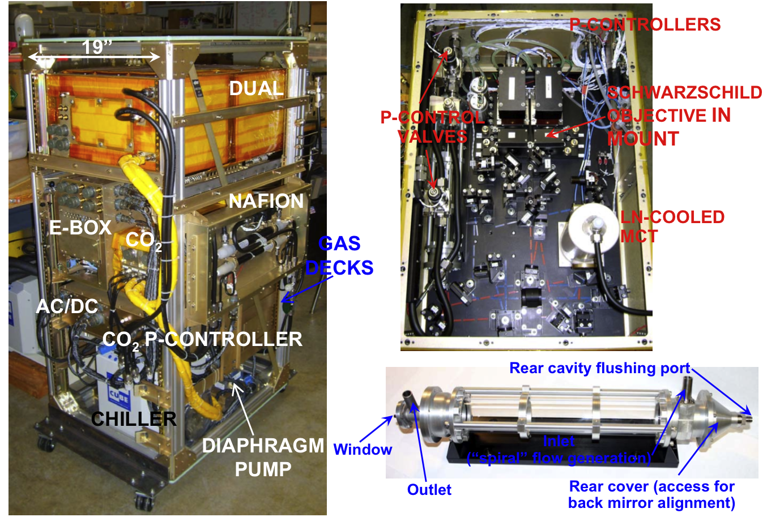
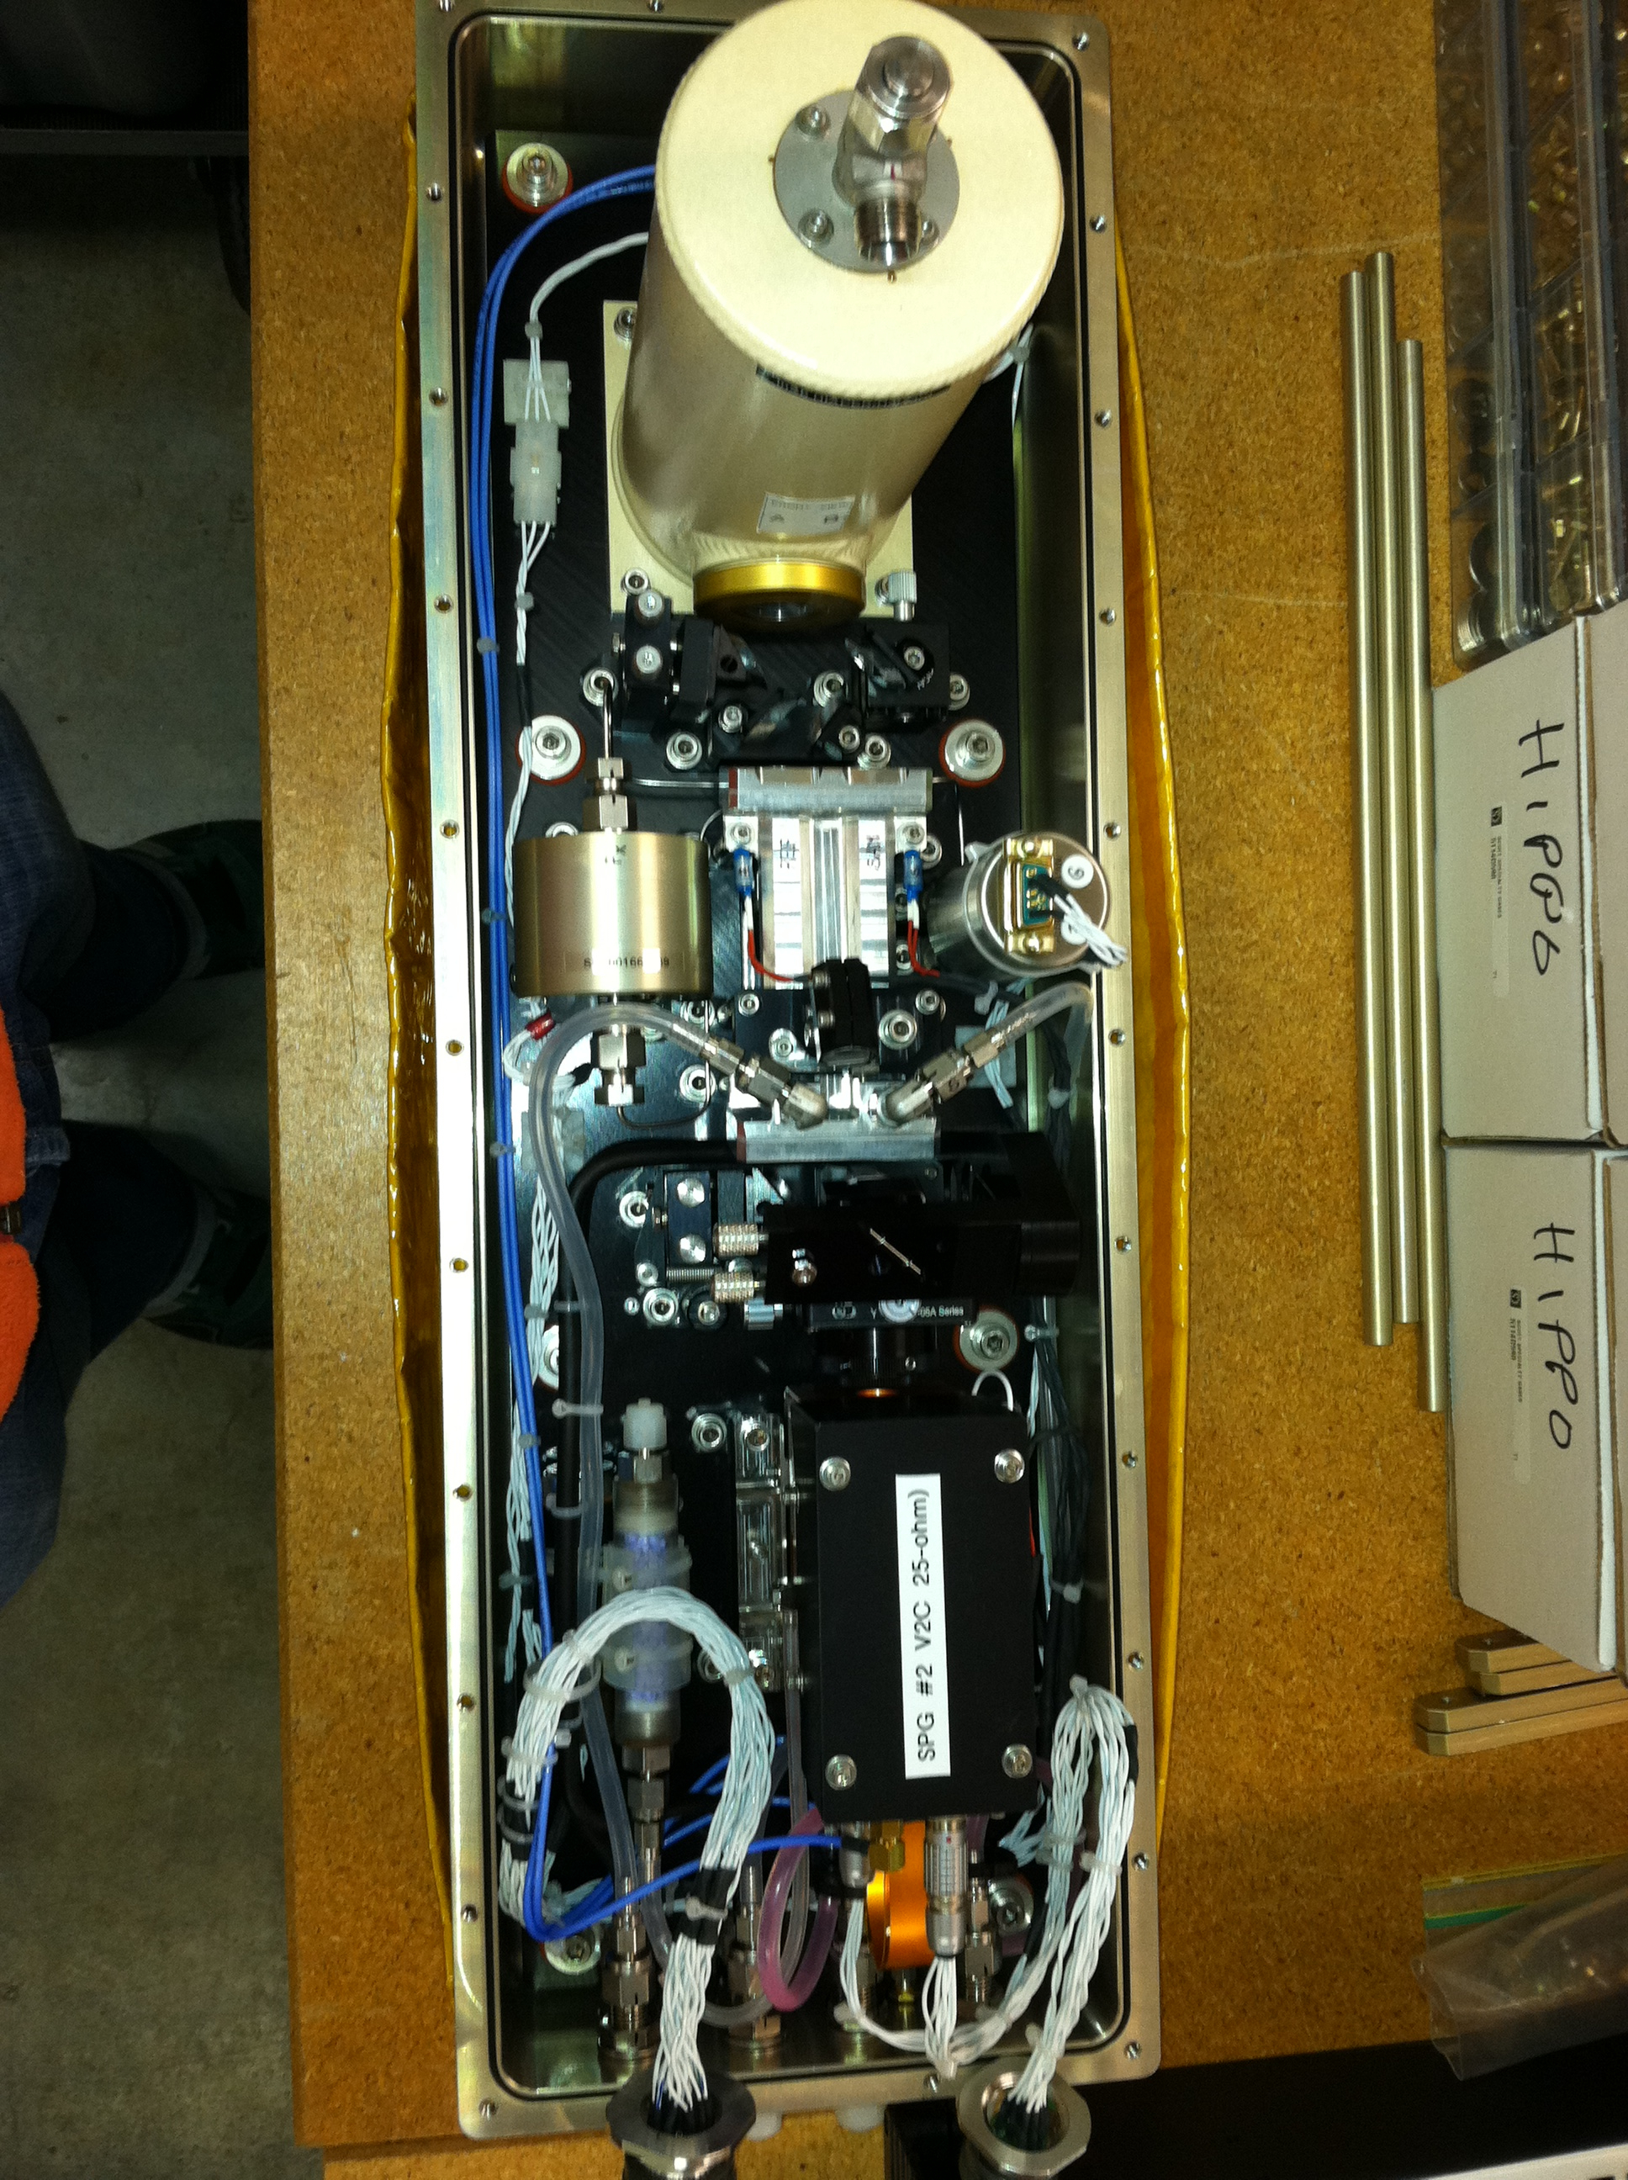
QCL Spectrometer: CO₂
Rodrigo Jimenez
Sunyoung Park
Bruce Daube
J. Barry McManus
David D. Nelson
Mark S. Zahniser
CO₂: 1σ = 20 ppb

Slide 3
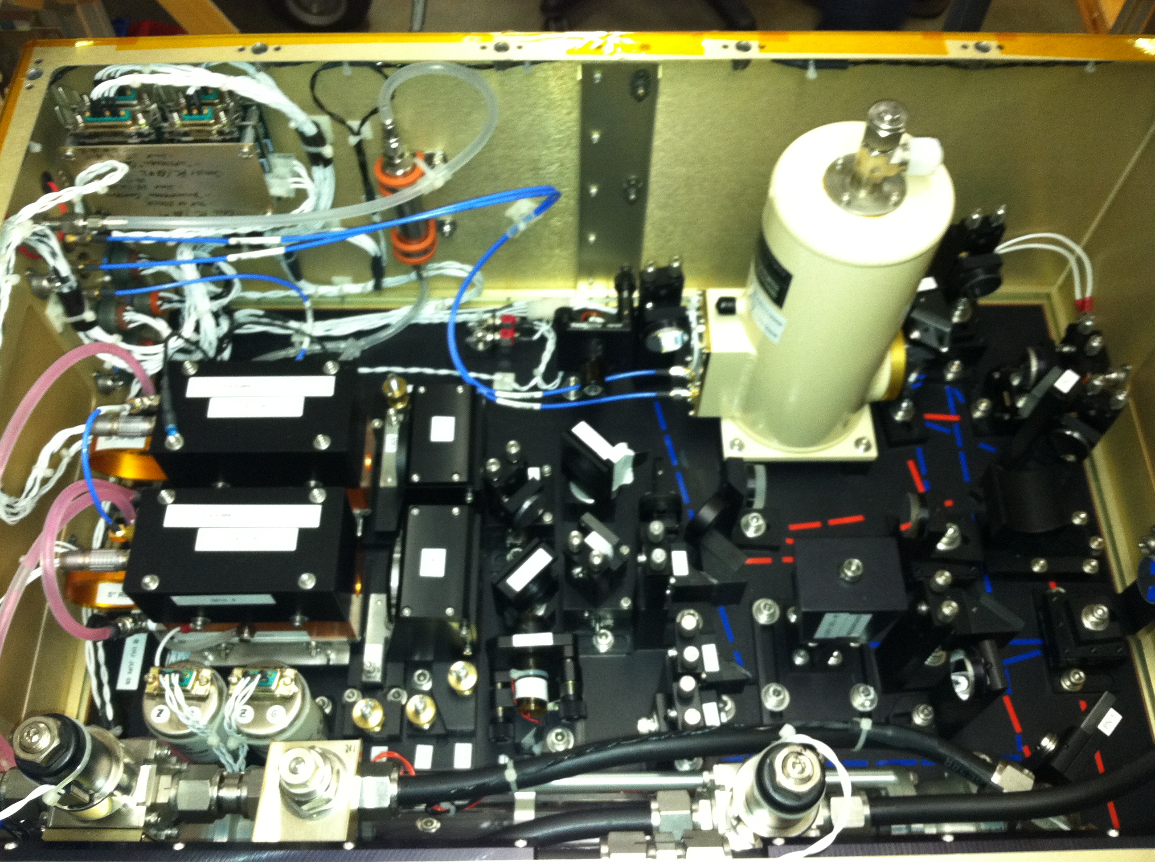
QCL Spectrometer: Dual
Rodrigo Jimenez
Sunyoung Park
Bruce Daube
J. Barry McManus
David D. Nelson
Mark S. Zahniser
CO: 1σ = 0.2 ppb
N₂O: 1σ = 0.09 ppb
CH₄: 1σ = 0.5 ppb

Slide 4
QCLS Final QA/QC vs. RA Data

Slide 5
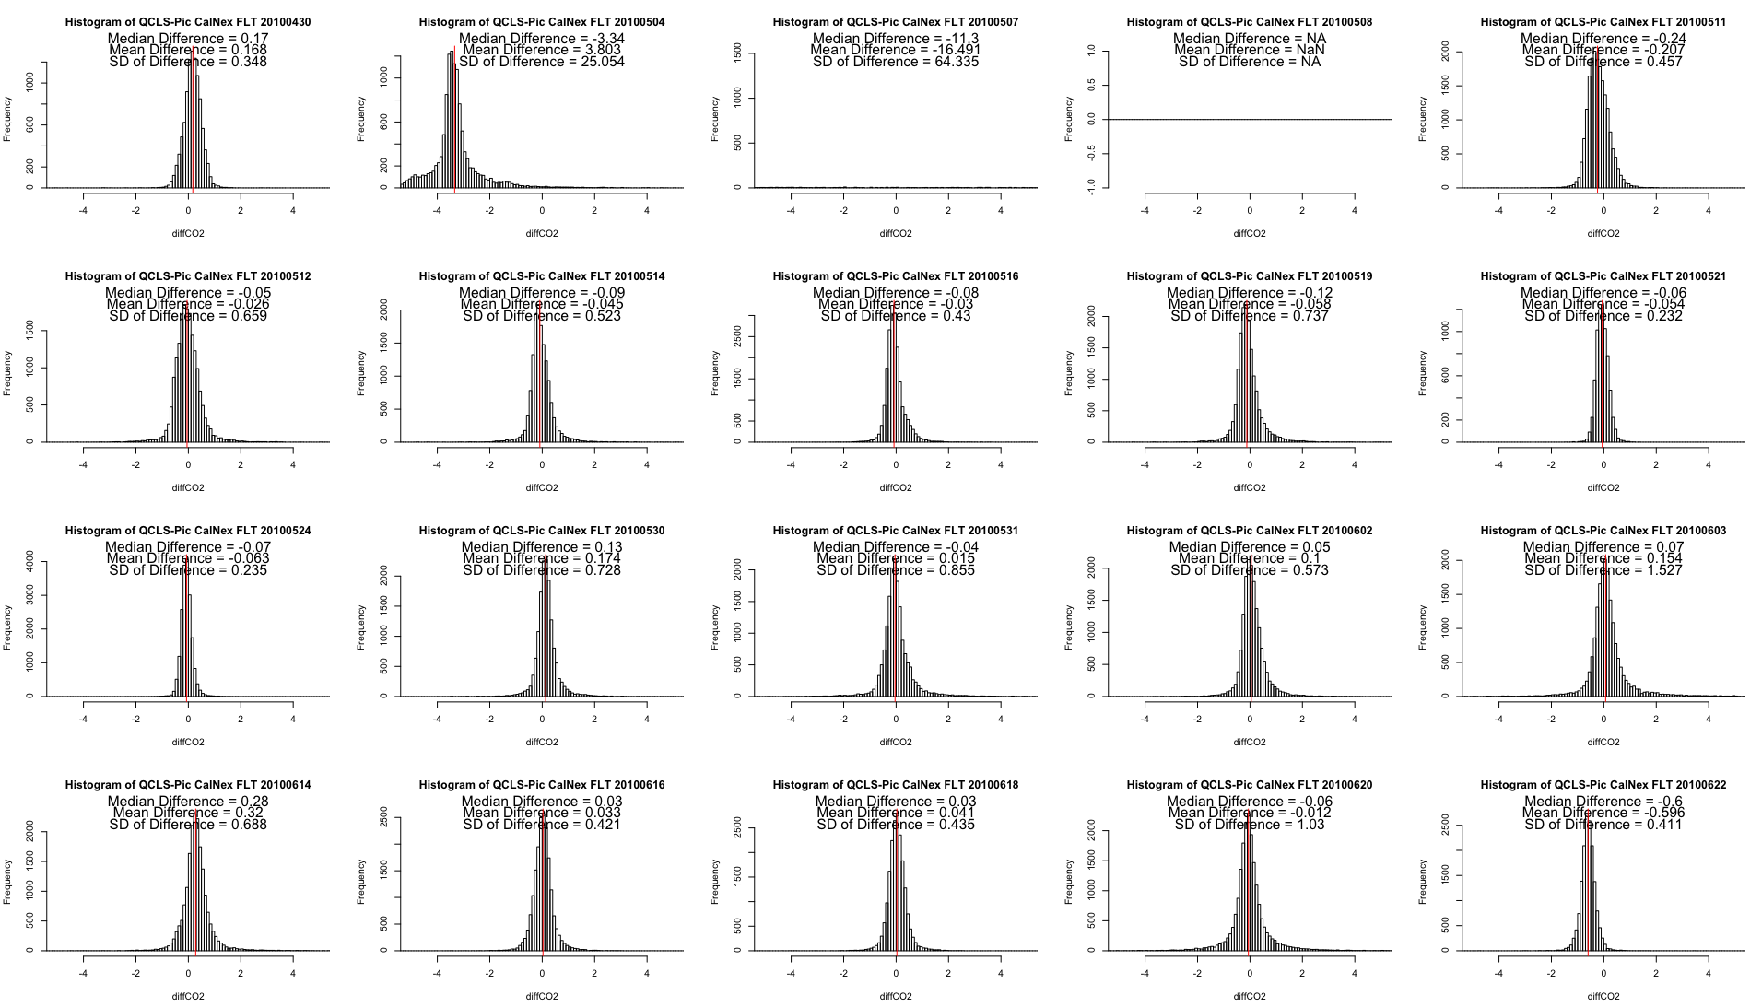
Instrument Intercomparison: CO₂
Jeff Peischl
Tom Ryerson
}
Median Difference
0.05 ppm
Picarro CRDS vs. QCLS CO₂

Slide 6
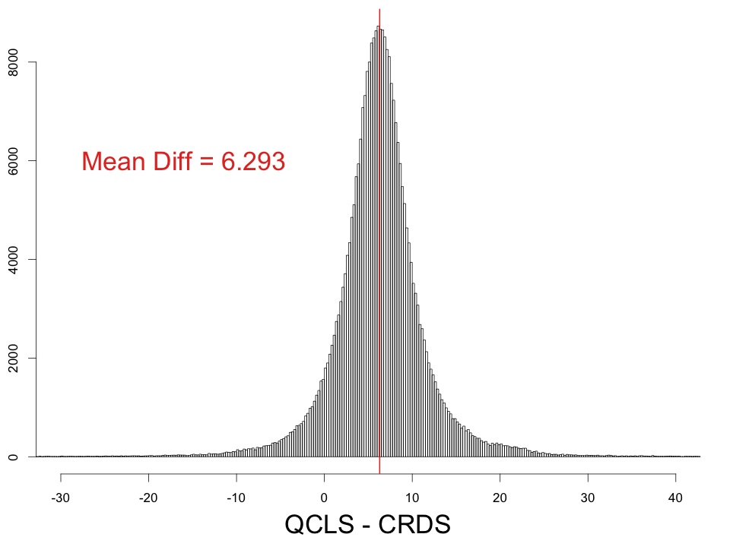
Instrument Intercomparison: CH₄
Picarro CRDS
Jeff Peischl
Tom Ryerson
Median Difference
6.3 ppb
Counts

Slide 7
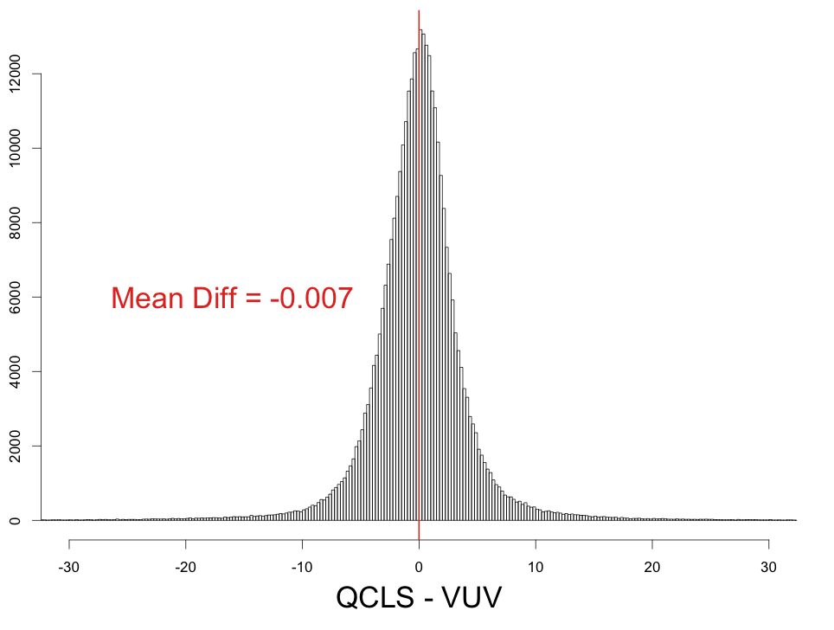
Instrument Intercomparison: CO
Vacuum UV
John Holloway
Median Difference
0.02 ppb
Counts

Slide 8
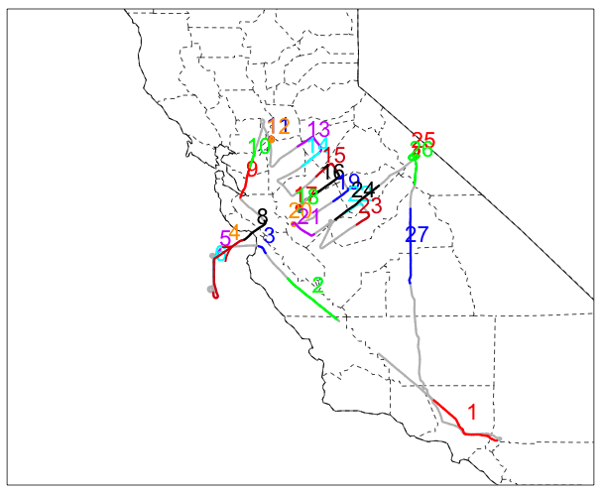
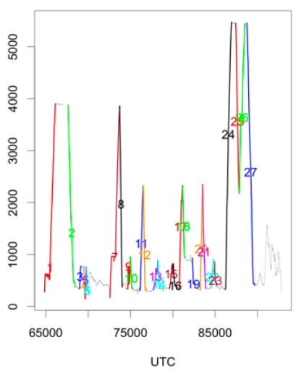
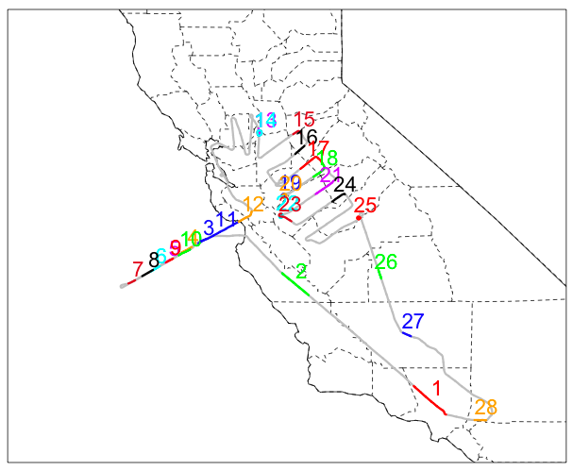
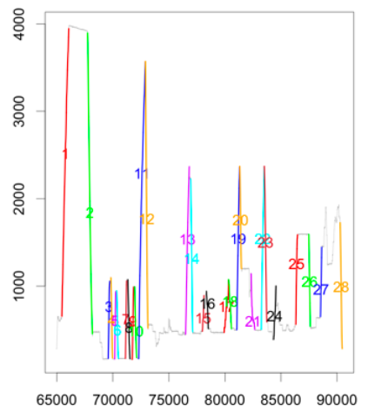
Central Valley Vertical Profiles
Altitude (m)
05/12/2010
UTC
Altitude (m)
06/18/2010
UTC

Slide 9
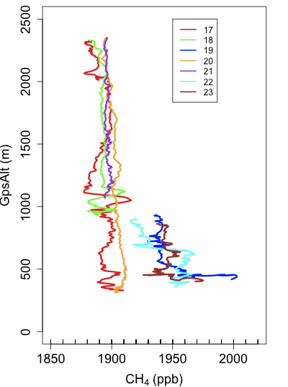
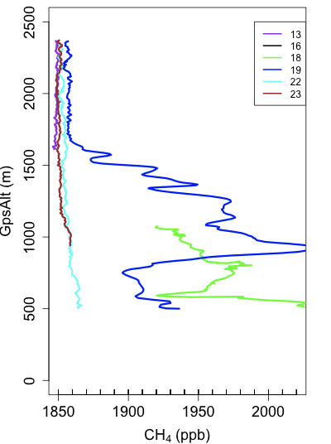
CH₄ Profiles
05/12/2010
06/18/2010

Slide 10
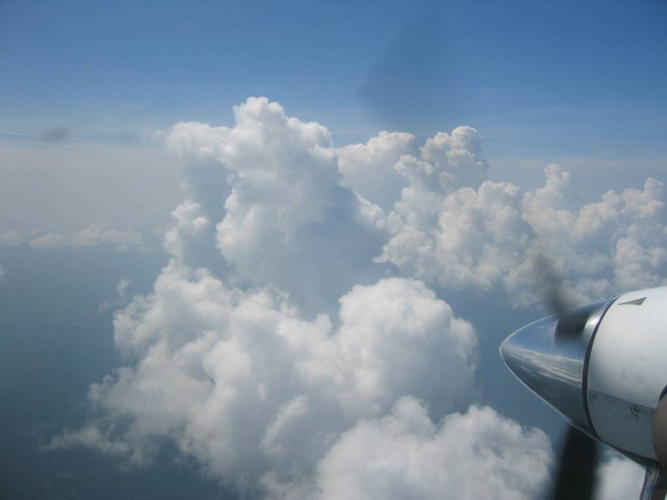
Modeling Framework
WRF Meteorological model output drives transport
Wayne Angevine
Stochastic Time-Inverted Lagrangian Transport model
Receptor-oriented time-inverted model
Notes:
Particles as little AIR PARCELS
Contrast GRIDCELL vs Lagrangian approaches: Particle locations are independent of gridcells and can be subgridscale—avoids gridcells
Run BACKWARD in time: Pioneered by people like Marek and Roger

Slide 11
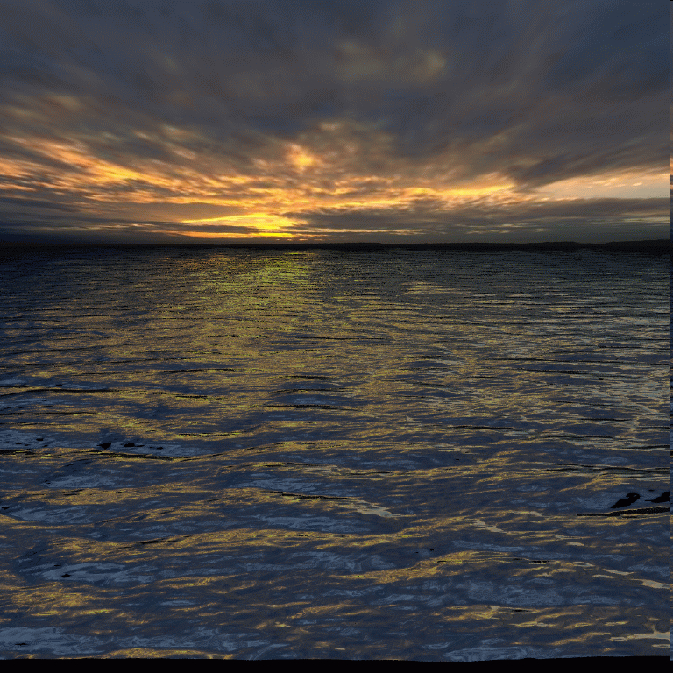
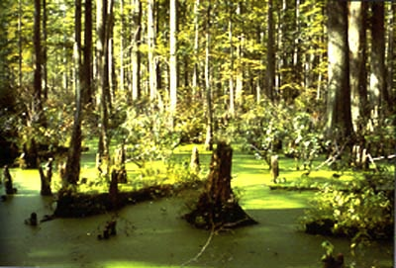
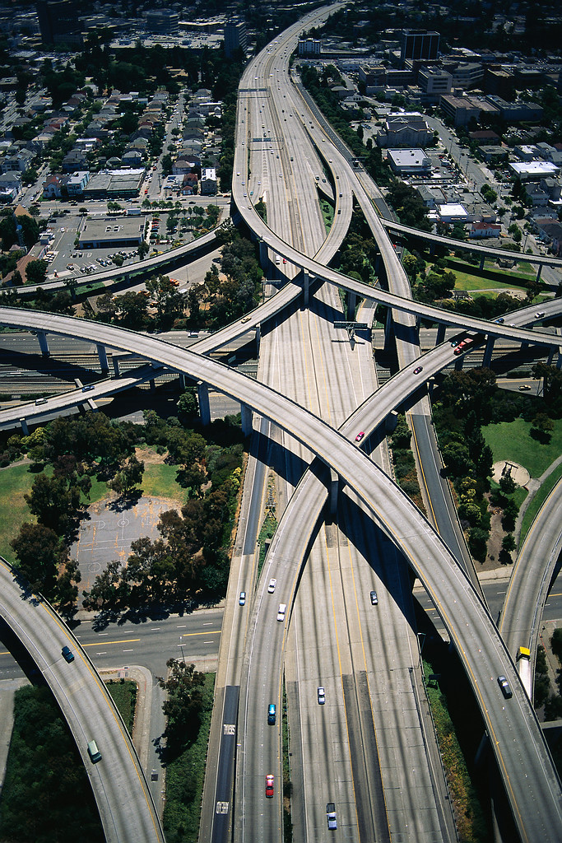
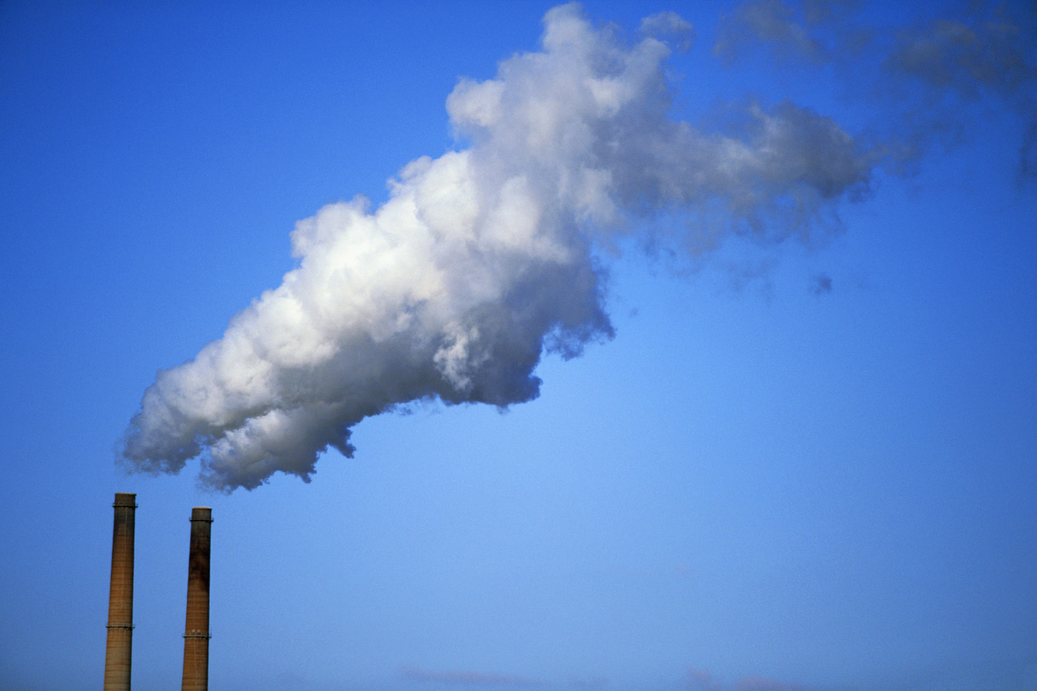
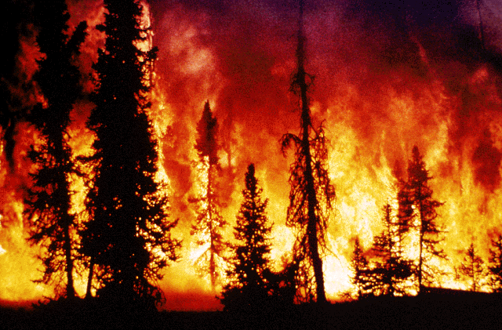
Modeling Framework
Particles tell where air is arriving from and link observations with upstream sources/sinks
Modeled surface fluxes, emission inventories, chemistry, and boundary conditions determine concentrations of air encountered

Slide 12
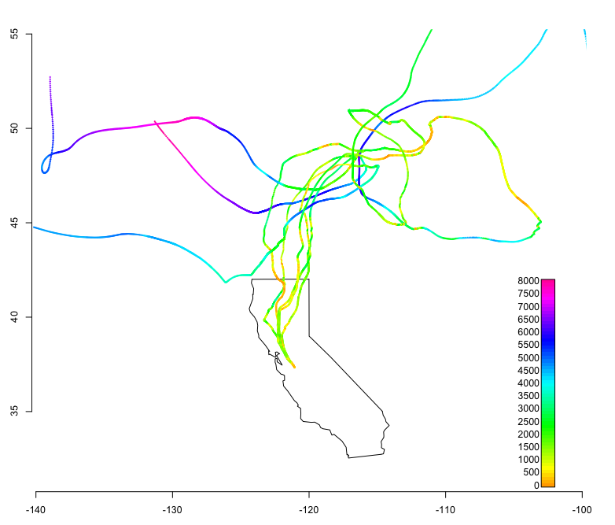
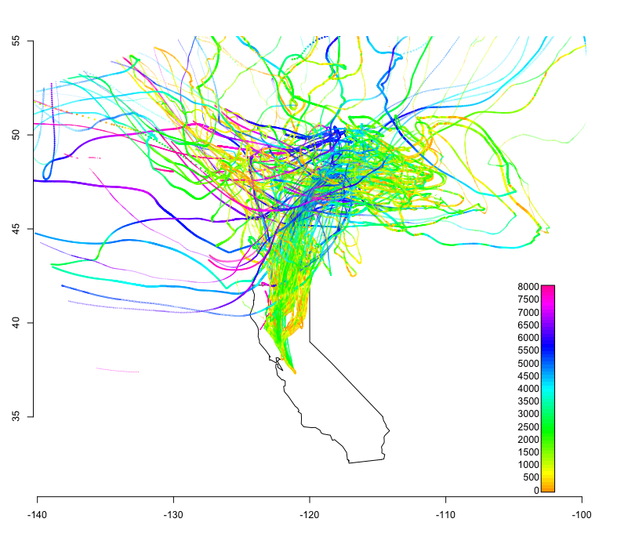
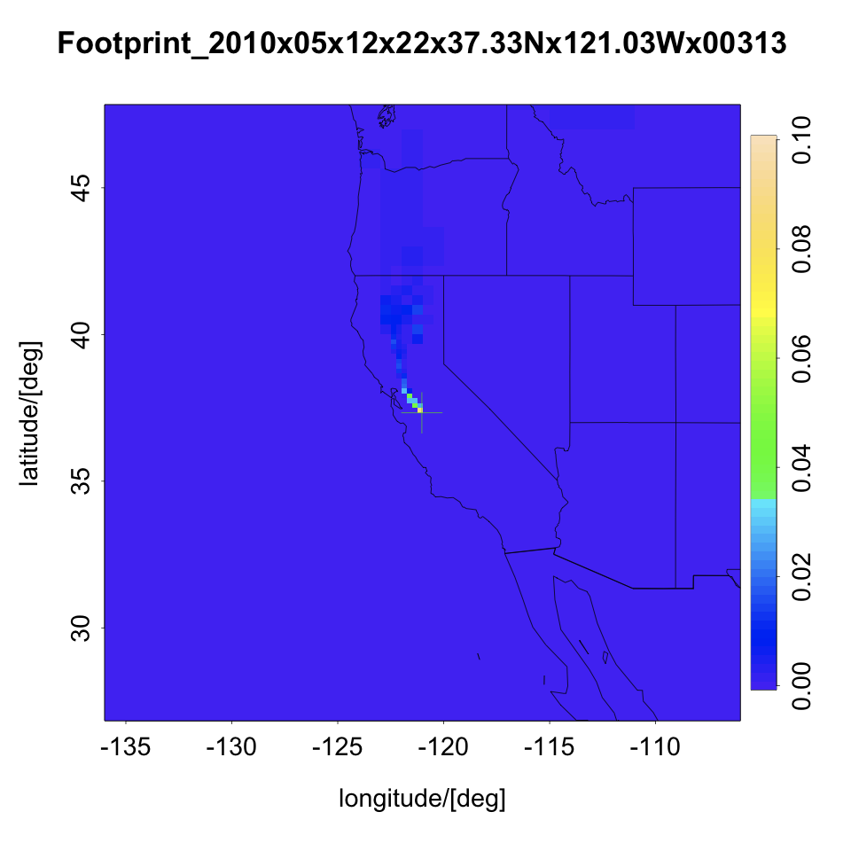
From Trajectories to Footprints
LAT
ppb/μmol/m²s
LON

Slide 13
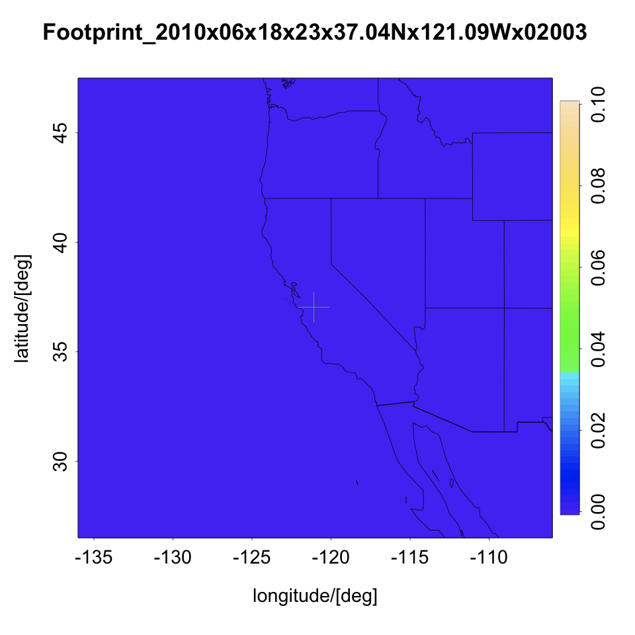
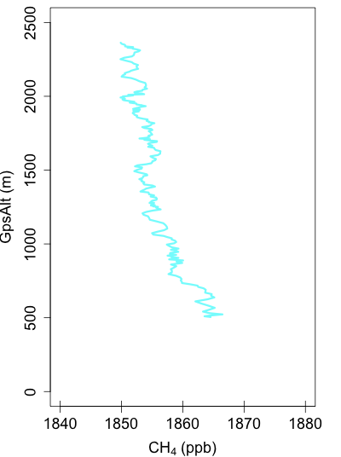
Footprints for 06/18 Profile
{
{
{

Slide 14
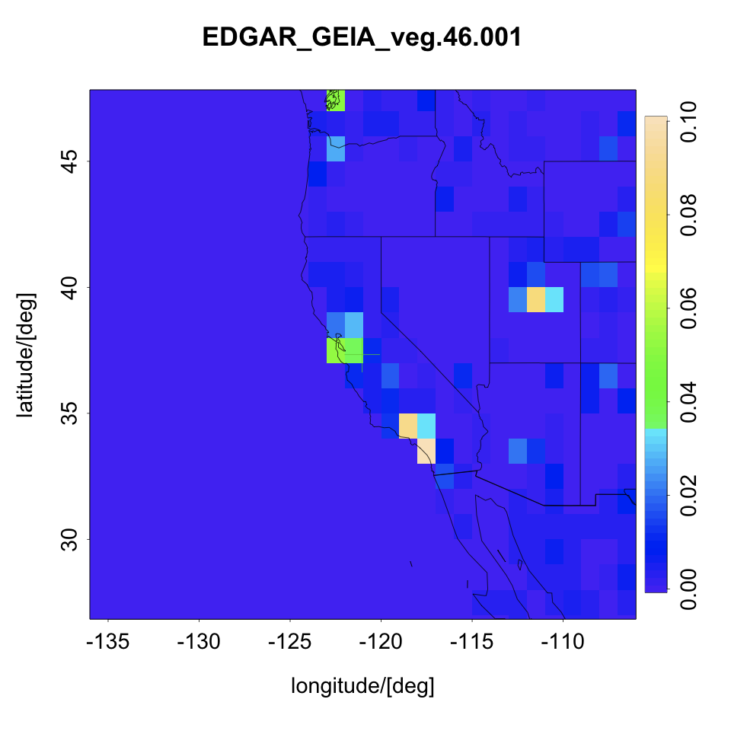
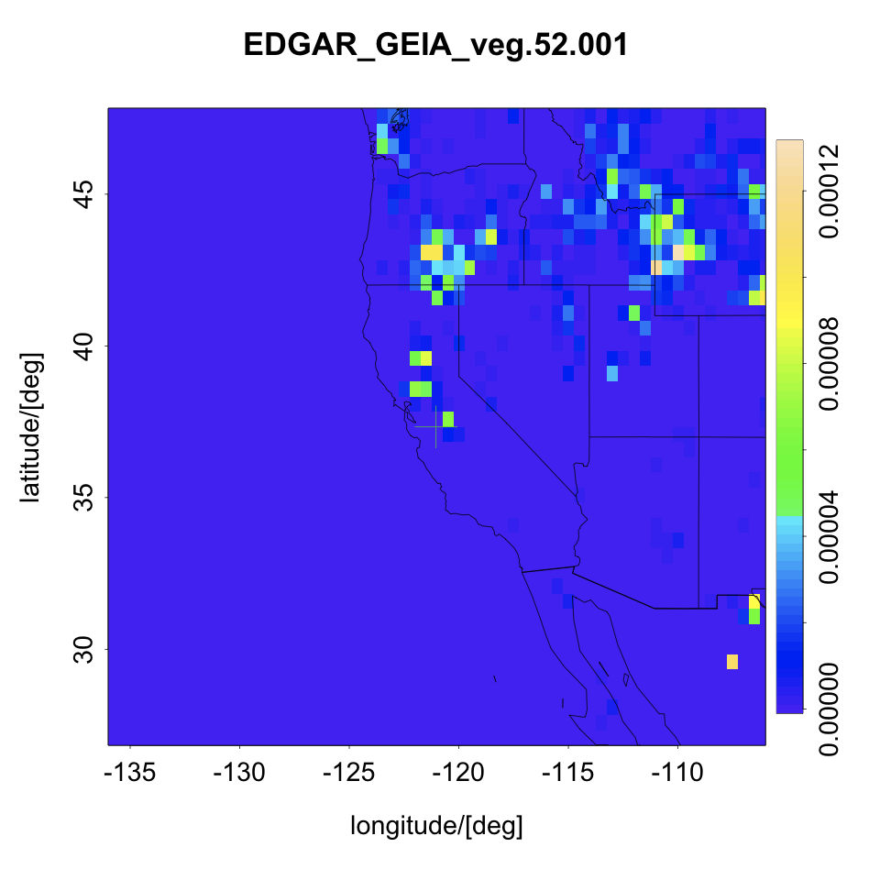
Emission Inventories
Emission Inventory * Footprint + B.C. = Observed Mixing Ratio
EDGAR: Emissions Database for Global Atmospheric Research.
Total Anthro annual CH₄ emissions
1° x 1° resolution
Jed Kaplan’s wetlands
May
1/4° x 1/6° resolution
μmol/m²s
μmol/m²s

Slide 15
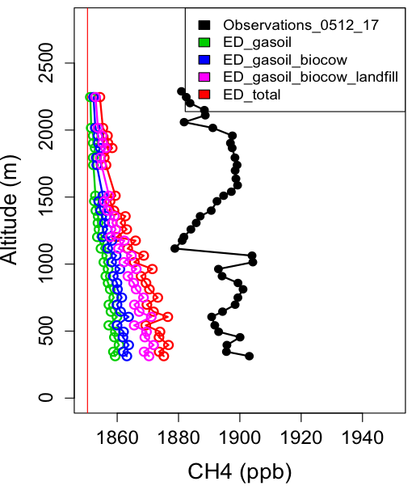
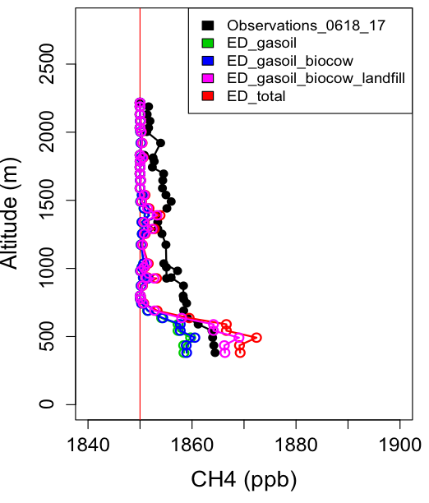
Modeled Profiles

Slide 16
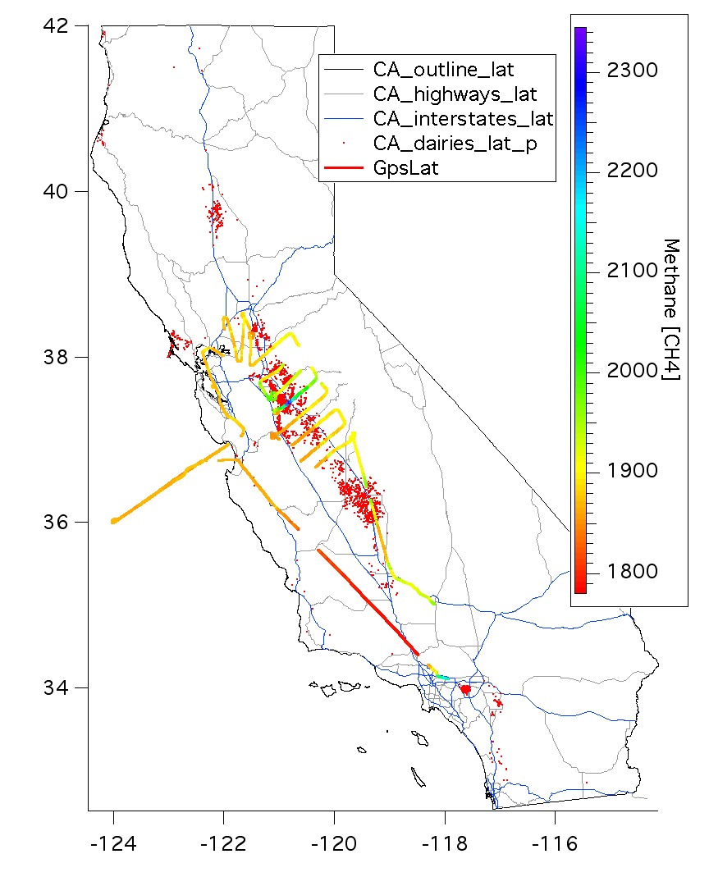
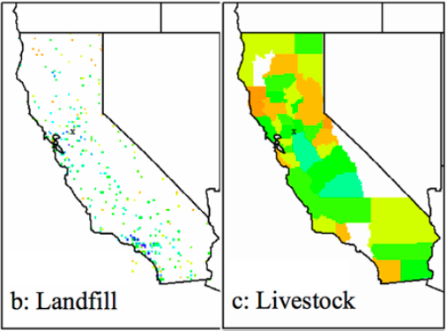
Conclusions/Future Work
Need for finer resolution inventories
- both point and area sources (these exist)
Appropriate boundary conditions
- difficult in California
100+ profiles outside of L.A. basin during
~50 flight hours
Inversions onto a priori emission inventories
Comparisons to Flexpart
From Zhao et al. (2009)
Acknowlegdements
WP-3 Flight Crew, NOAA instrument teams, John Lin, Christoph Gerbig, NSF Graduate Research Fellowship
gsantoni@gmail.com

Slide 19
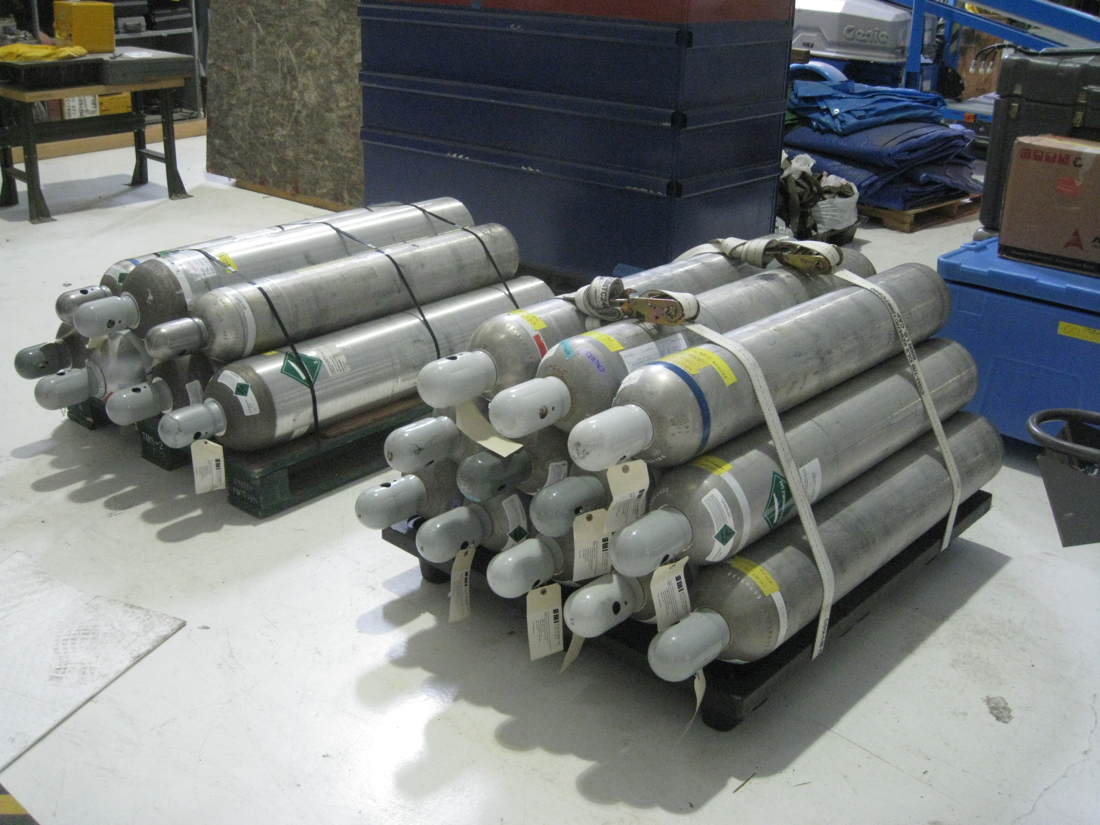
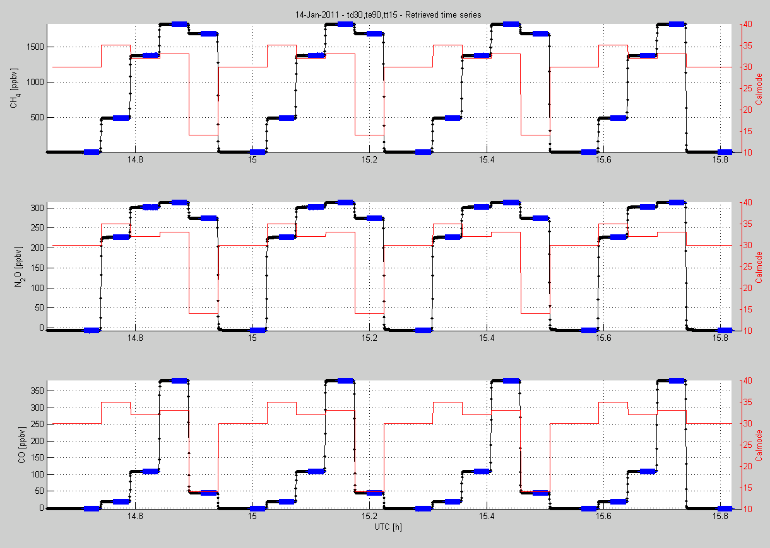
Calibration

Slide 20
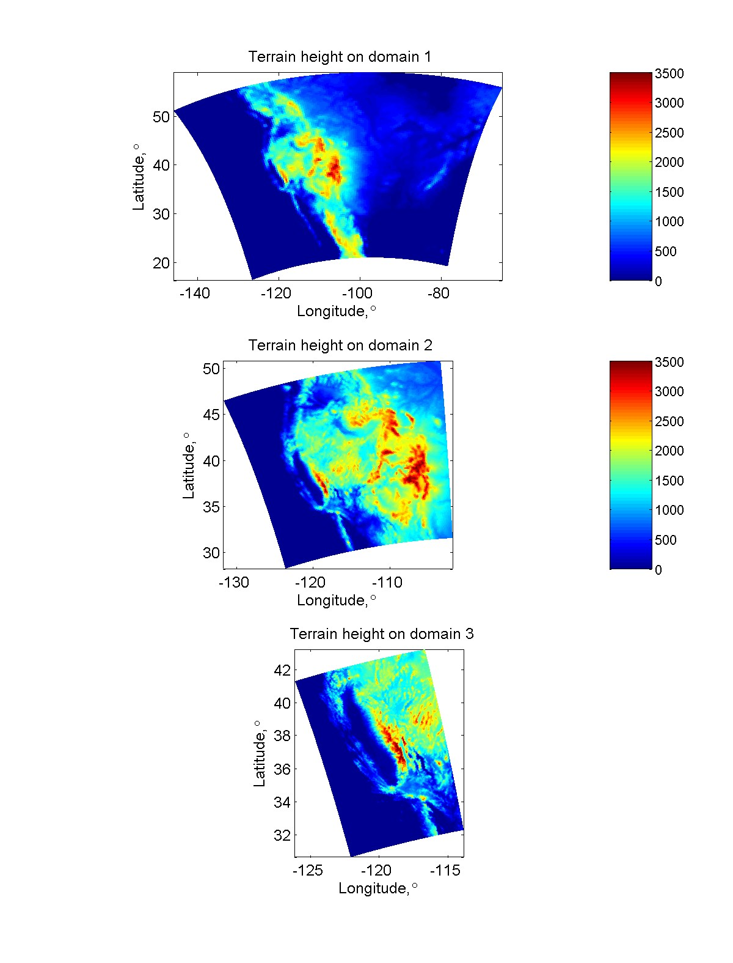
WRF domains

Slide 21
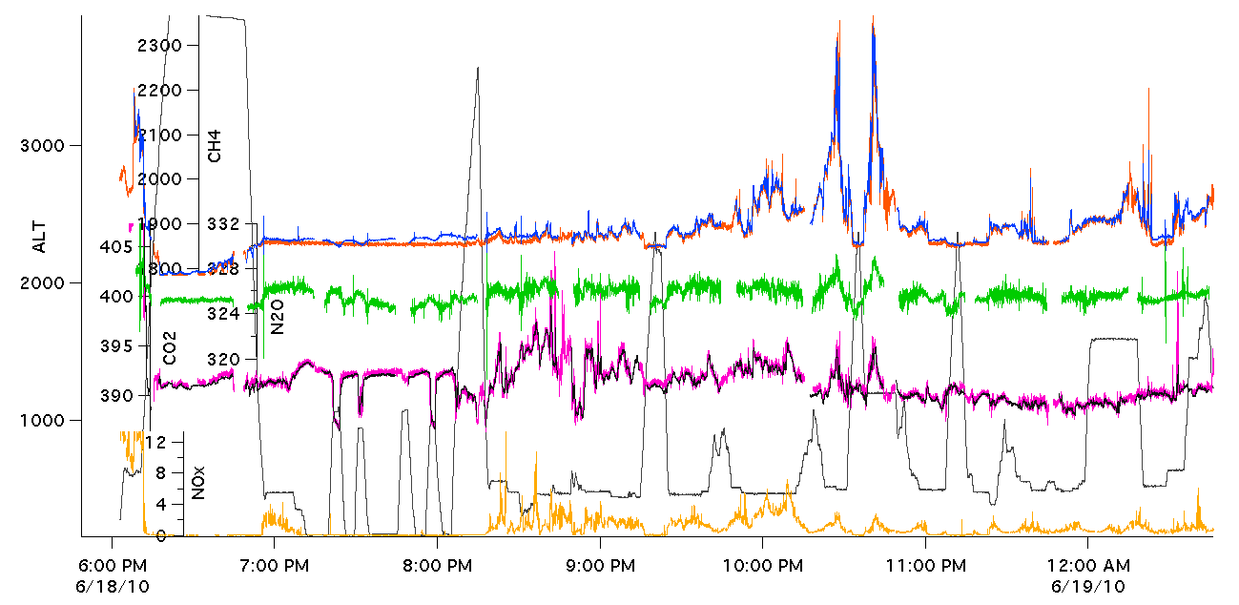
June 18th, 2010 Time Series

Slide 22
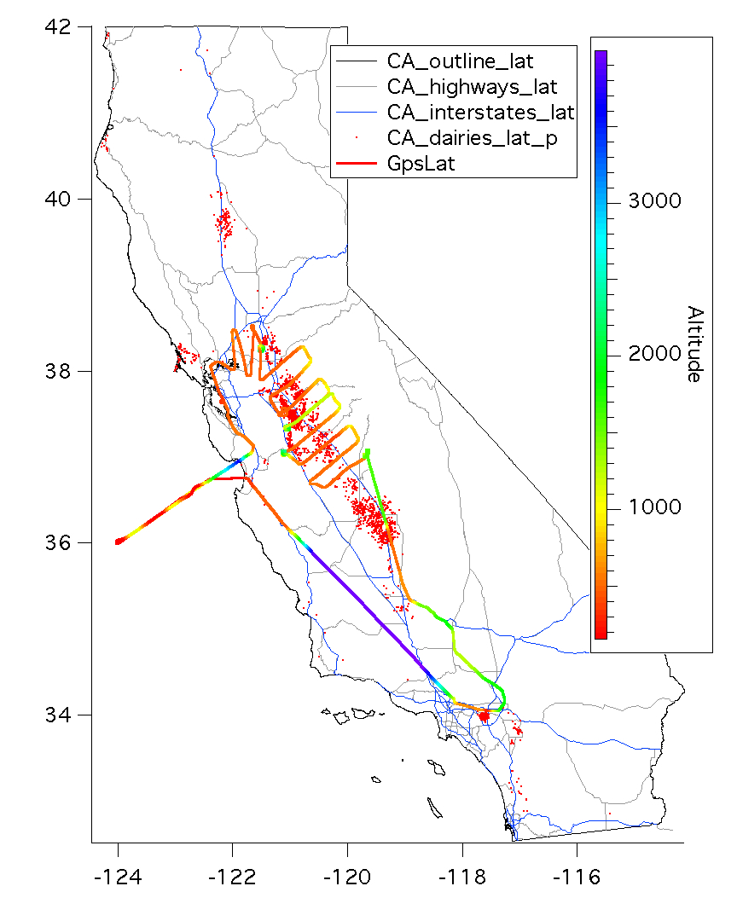
Central Valley CH₄ June 18th, 2010

