Slide 1
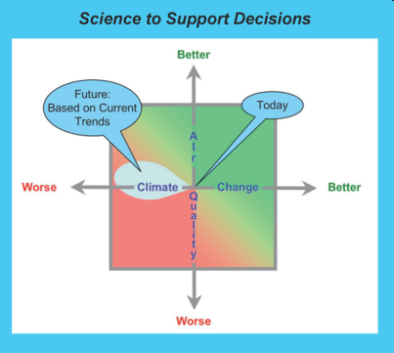
Chemical and Aerosol Data Assimilation Activities during CalNex
R. Bradley Pierce
NOAA/NESDIS/STAR
Allen Lenzen¹, Todd Schaack¹, Tom Ryerson², John Holloway², Ilana Pollack², Ann Middlebrook², Roya Bahreini², Dan Lack², Owen Cooper², Sam Oltmans², Chris Hostetler³, Rich Ferrare³
¹ University of Wisconsin-Madison, ²NOAA ESRL Chemical Sciences Division, Boulder, CO,
³NASA Langley Research Center, Hampton, VA
CalNex 2010 Data Analysis Workshop May 16 – 19, 2011, Sacramento CA

Slide 2
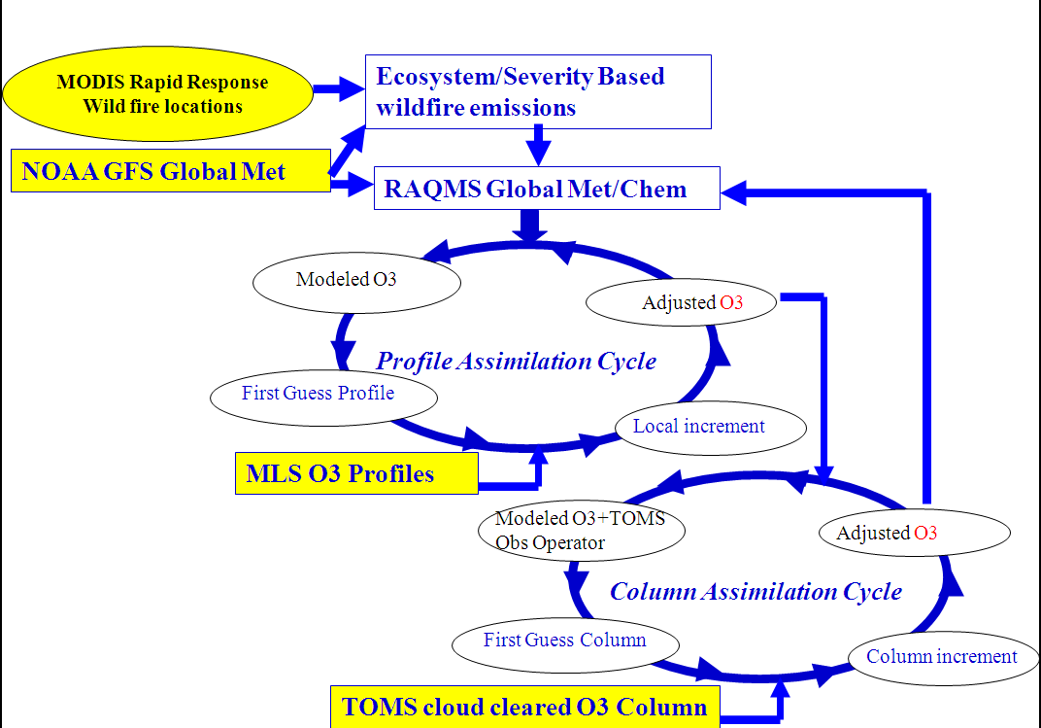
RAQMS CalNex O3 Assimilation Procedure
OMI cloud cleared O3 column
Demonstration of:
Real-time assimilation of Microwave Limb Sounder (MLS) stratospheric ozone profiles
Real-time assimilation of Ozone Monitoring Instrument (OMI) total ozone column
Real-time incorporation of Moderate Resolution Imaging Spectroradiometer (MODIS) fire detection
Notes:
2
2

Slide 3
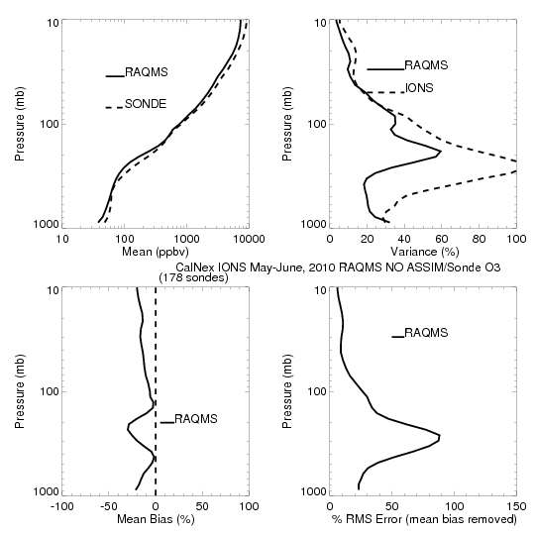
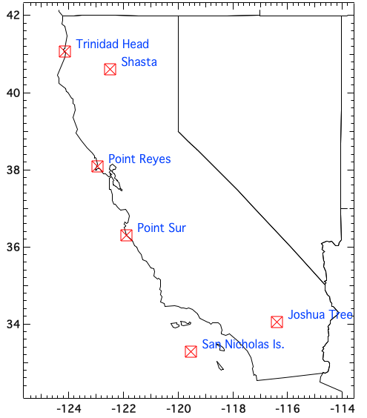
CalNex-2010 O₃ sondes – Owen Cooper (NOAA ESRL)
CalNex Ozonesonde
NO ASSIM
RAQMS NO ASSIM
is low biased up to
30% of Ozonesonde

Slide 4
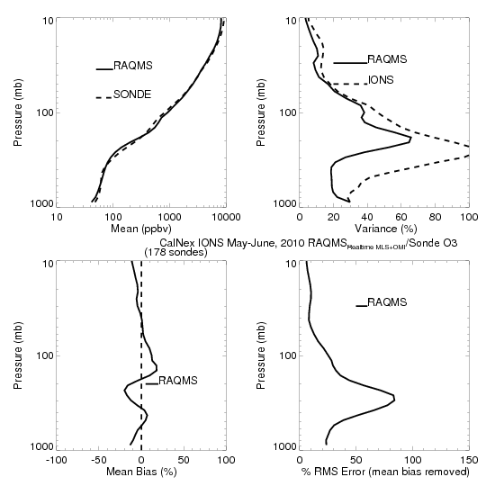
CalNex-2010 O₃ sondes – Owen Cooper (NOAA ESRL)
CalNex Ozonesonde
MLS+OMI
ASSIM
RAQMS MLS+OMI
analysis is within
20% of Ozonesonde

Slide 5
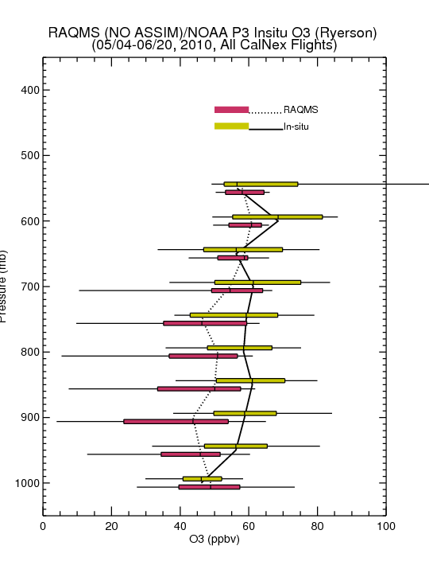
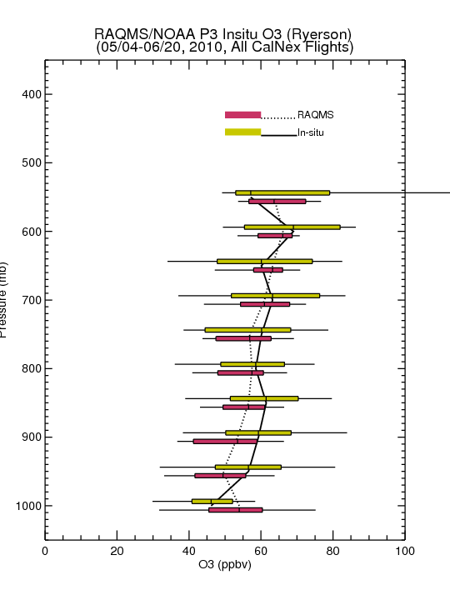
Comparison with NOAA P3 Insitu O3 Measurements
(Primarily LA Basin/Central Valley)
No Assim
MLS+OMI Assim
Assimilation of MLS+OMI O3 retrievals results in increased lower-tropospheric O3 (and improved agreement with airborne insitu O3) over Southern California
Insitu O3 from Tom Ryerson, NOAA ESRL

Slide 6
RAQMS CalNex AOD Assimilation Procedure
Demonstration of:
Real-time assimilation of MODIS Aerosol Optical Depth (AOD)
Real-time incorporation of MODIS based biomass burning emissions
Notes:
6
6

Slide 7
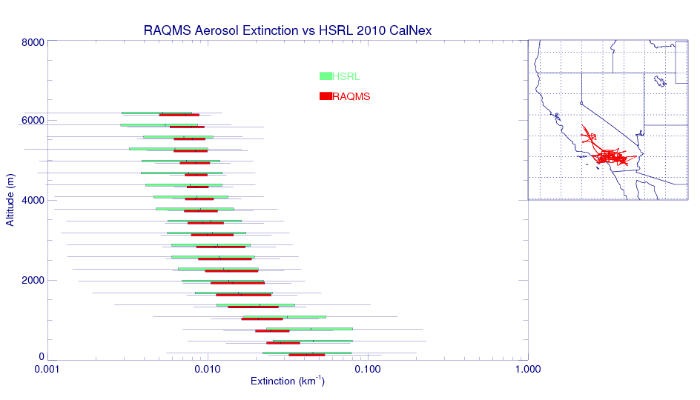
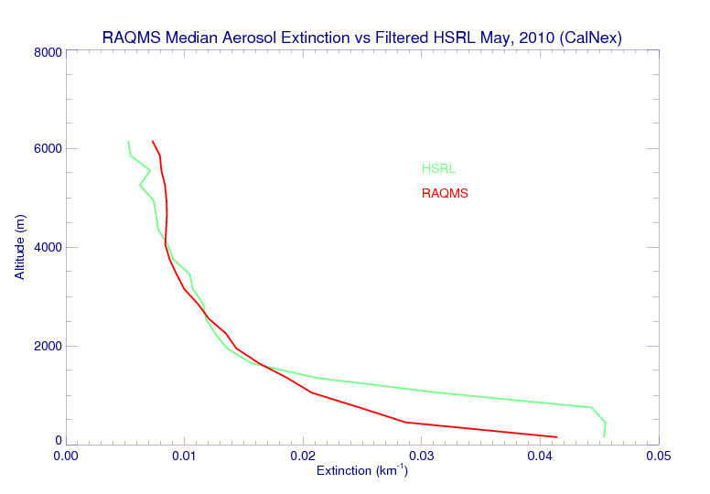
Comparison with HSRL Lidar Measurements
(Primarily LA Basin, Chris Hostetler, NASA LaRC)
RAQMS free tropospheric median aerosol extinction is in very good agreement with HSRL
Variability is underestimated, particularly for lower values of aerosol extinction
Largest biases are found within the LA Basin Boundary Layer (below 1000m) were RAQMS median extinction is low

Slide 8
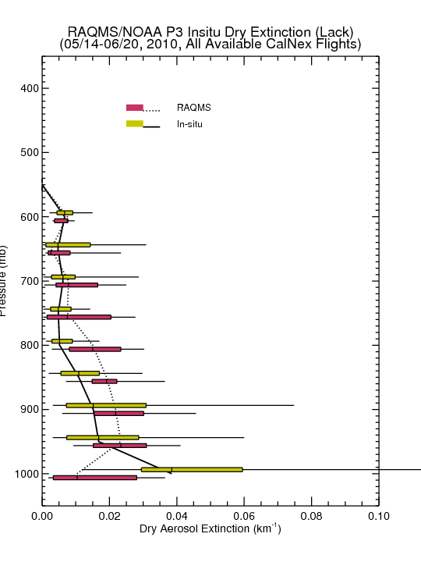
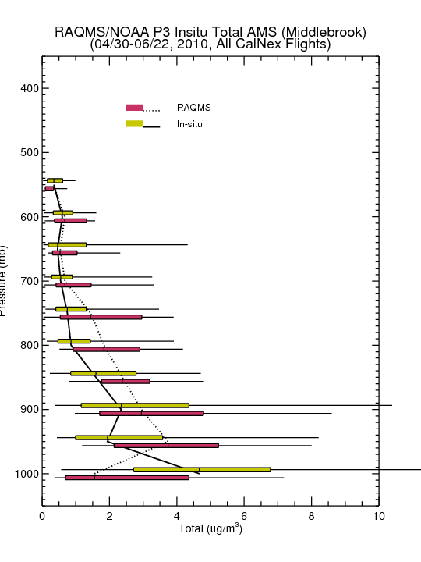
Comparison with NOAA P3 Insitu Aerosol Measurements
(Primarily LA Basin/Central Valley)
Need to better understand size range of measured insitu dray mass and Extinction measurements
Boundary Layer extinction underestimates arise due to underestimates in local LA sources and neglect of nitrate aerosol in GOCART module
Assimilation of MODIS AOD results in overestimates of free tropospheric aerosol dry mass due to uncertainties in hydroscopic growth

Slide 9
Assessment of Global 850mb O3 and Aerosol Extinction Forecast Skill
Anomaly Correlations (AC)
Correlation between forecast and analysis
May-June mean removed
Spectrally truncated to wavenumber 20
Averaged from 20N-80N
useful Skill
http://www.emc.ncep.noaa.gov/gmb/STATS/html/monarch.html

Slide 10
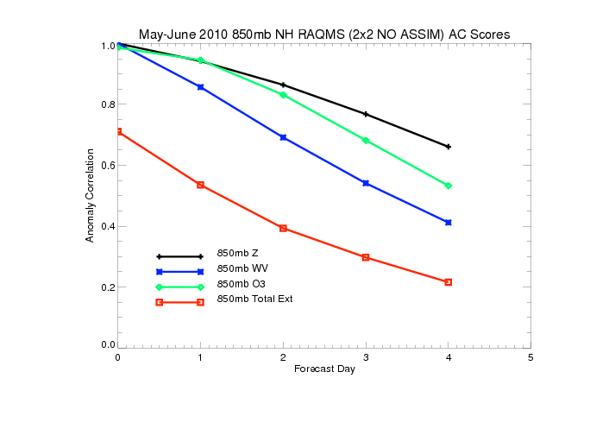
Northern Hemisphere 850mb May-June 2010 Anomaly Correlations (AC)
(No Assimilation)
useful Skill
850mb ozone forecasts have useful skill past 3 days (significantly better than water vapor)
850mb extinction forecasts do not have useful skill at 1 day

Slide 11
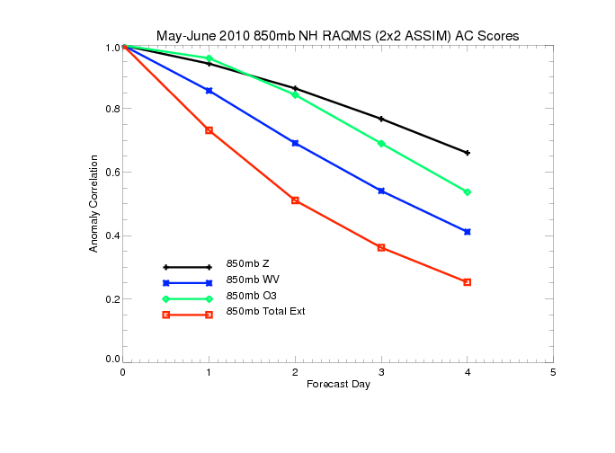
Northern Hemisphere 850mb May-June 2010 Anomaly Correlations (AC)
(With MLS/OMI/MODIS Assimilation)
useful Skill
Assimilation of O3 retrievals results in slight improvements in 850mb ozone forecasts
Assimilation of AOD retrievals results in significant improvement in 850mb extinction
forecasts with useful skill at ~1.5 days

Slide 12
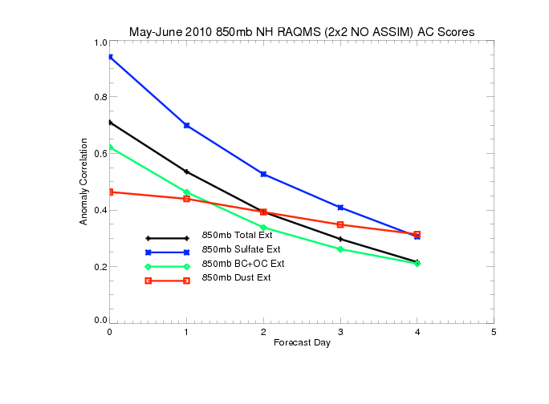
Northern Hemisphere 850mb May-June 2010 Anomaly Correlations (AC)
(No Assimilation)
useful Skill
Only 850mb SO4 extinction forecasts useful skill past 1 day
Black and organic carbon (BC+OC) and dust extinctions are both poorly initialized and
forecasted

Slide 13
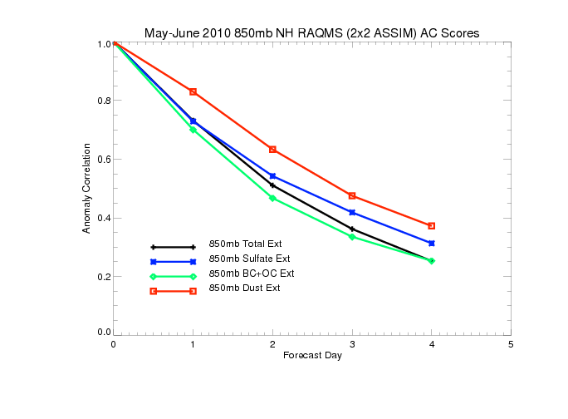
Northern Hemisphere 850mb May-June 2010 Anomaly Correlations (AC)
(With MODIS Assimilation)
useful Skill
MODIS AOD assimilation results in small changes in 850mb SO4 extinction forecasts
MODIS AOD assimilation results in significant improvements in black and organic carbon (BC+OC) and dust forecast skill (dust prediction useful at 2 days)

Slide 14
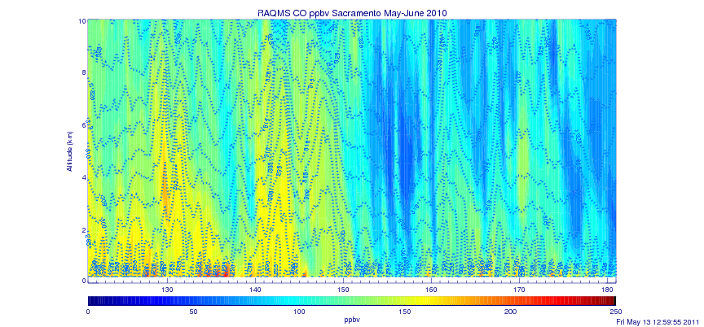
Sacramento CO May-June 2010
RAQMS 1x1 Degree Re-analysis
May 10-12
May 22-24

Slide 15
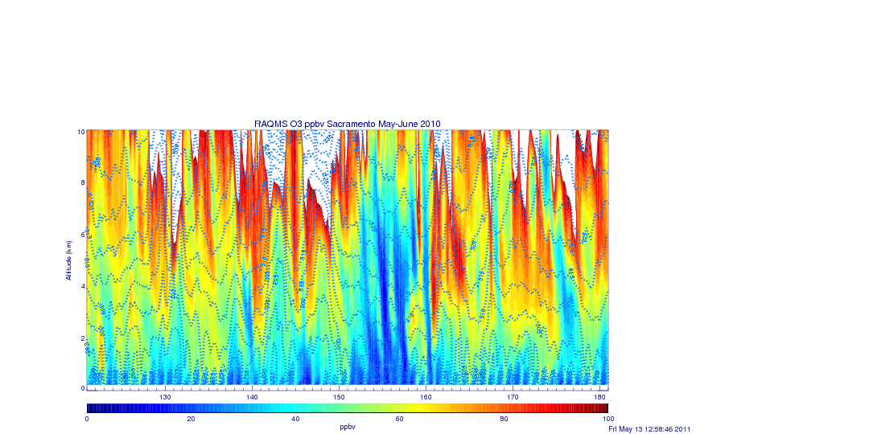
Sacramento O3 May-June 2010
RAQMS 1x1 Degree Re-analysis
May 10-12
May 22-24

Slide 16
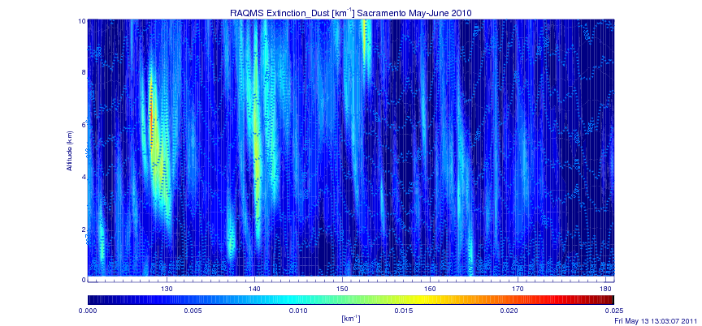
Sacramento Dust Extinction May-June 2010
RAQMS 1x1 Degree Re-analysis
May 10-12
May 22-24

Slide 17
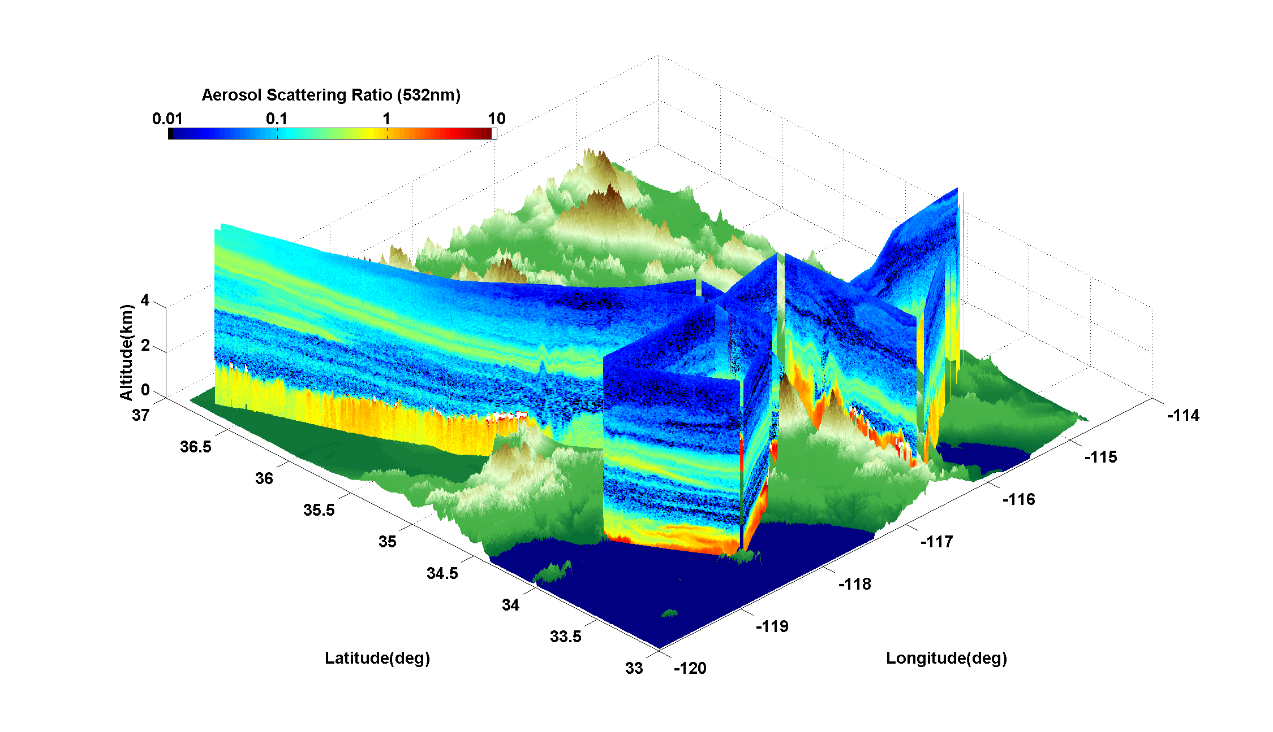
HSRL aerosol Scattering Ratio
Saturday, May 22, 2010
HSRL data from Chris Hostetler and Rich Ferrare, NASA LaRC
Notes:
17

Slide 18
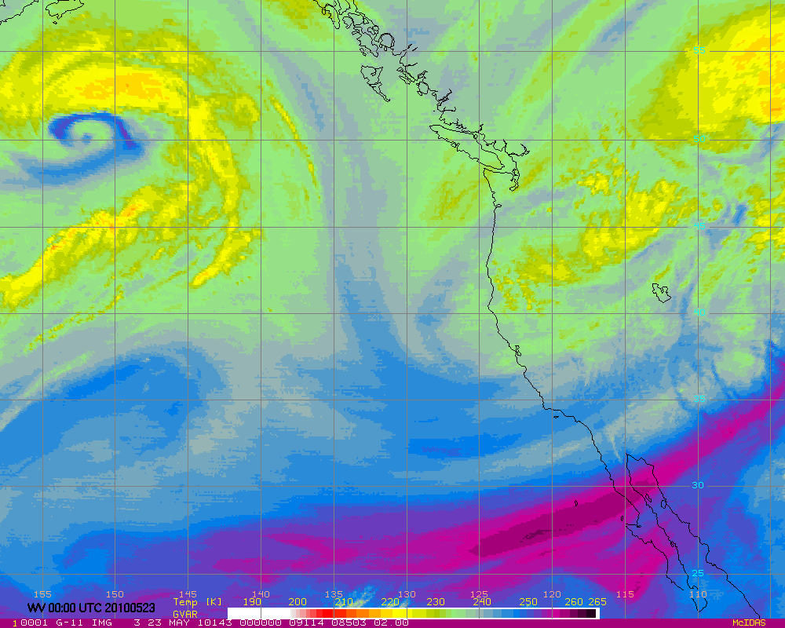
GOES WV 00Z 20100523 (Saturday Afternoon)
Notes:
18

Slide 19
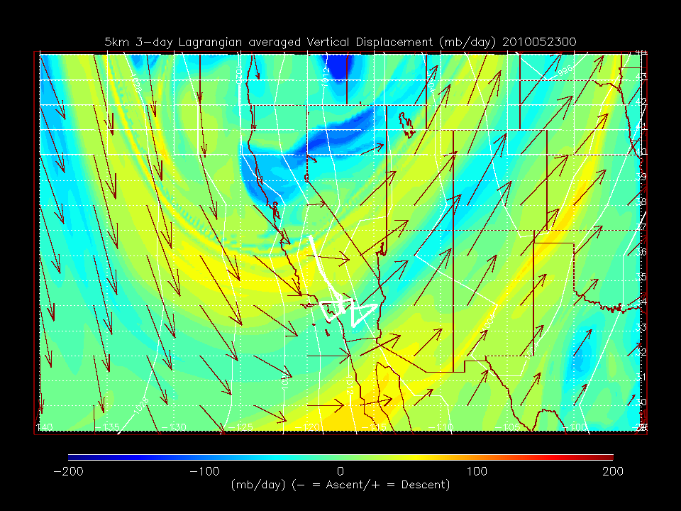
GOES WV 00Z 20100523 (Saturday Afternoon)
RAQMS RDF 5km Lagrangian Descent Forecast
Notes:
19
19

Slide 20
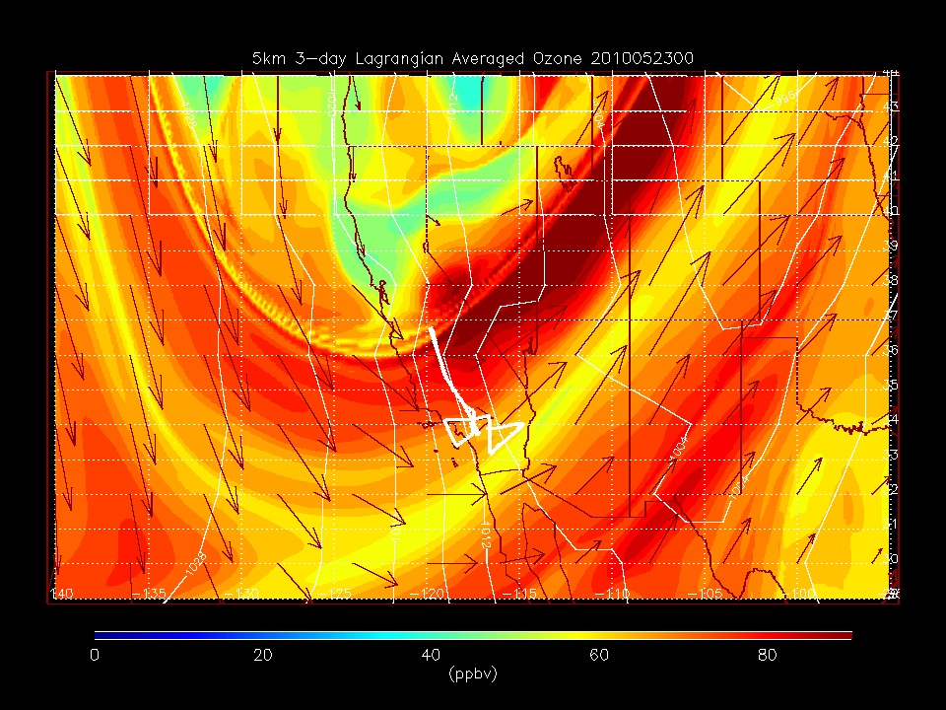
GOES WV 00Z 20100523 (Saturday Afternoon)
RAQMS RDF 5km O3 forecast
Notes:
20

Slide 21
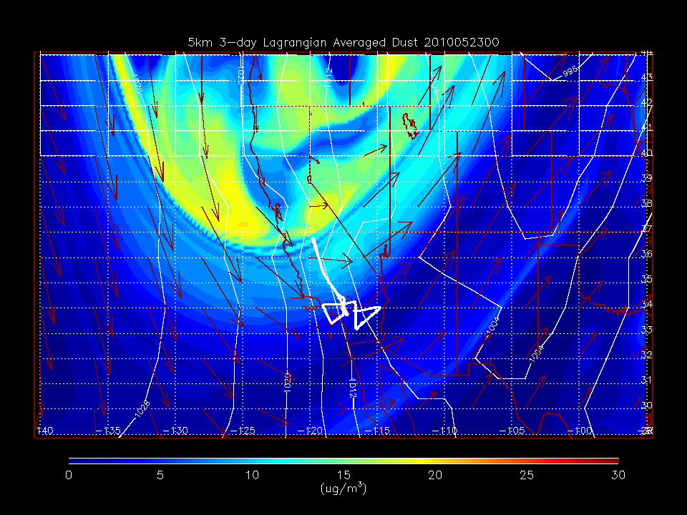
GOES WV 00Z 20100523 (Saturday Afternoon)
RAQMS RDF 5km Dust forecast
Notes:
21
21

Slide 22
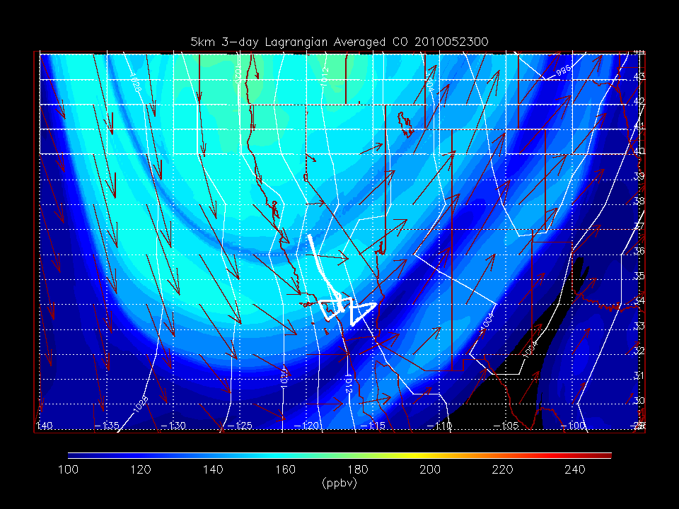
GOES WV 00Z 20100523 (Saturday Afternoon)
RAQMS RDF 5km CO forecast
Notes:
22
22

Slide 23
RAQMS RDF 5km CO forecast
RAQMS RDF 5km O3 forecast
5km RDF CO, O3, Dust, and Vertical Displacement 00Z 20100523 (Saturday Afternoon)
RAQMS RDF 5km Dust forecast
RAQMS RDF 5km Descent forecast
Notes:
23

Slide 24
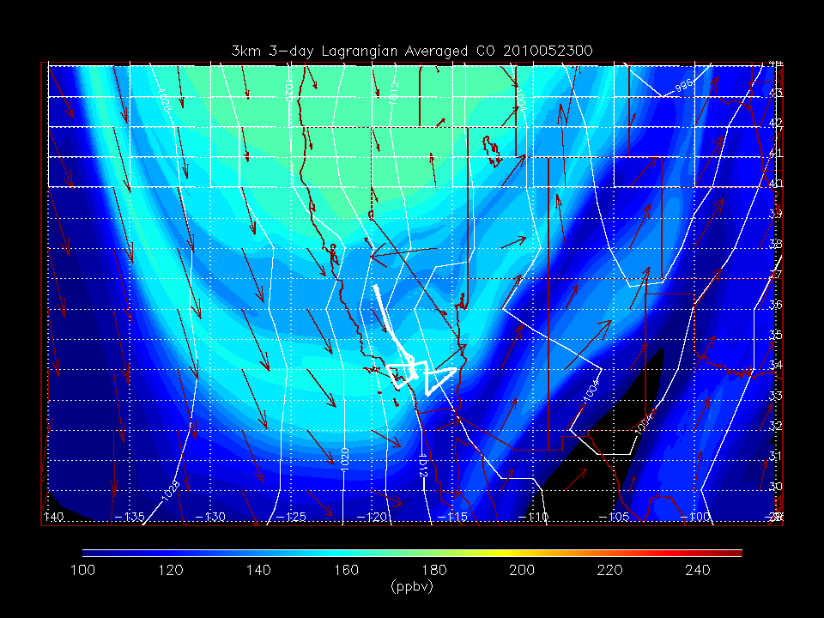
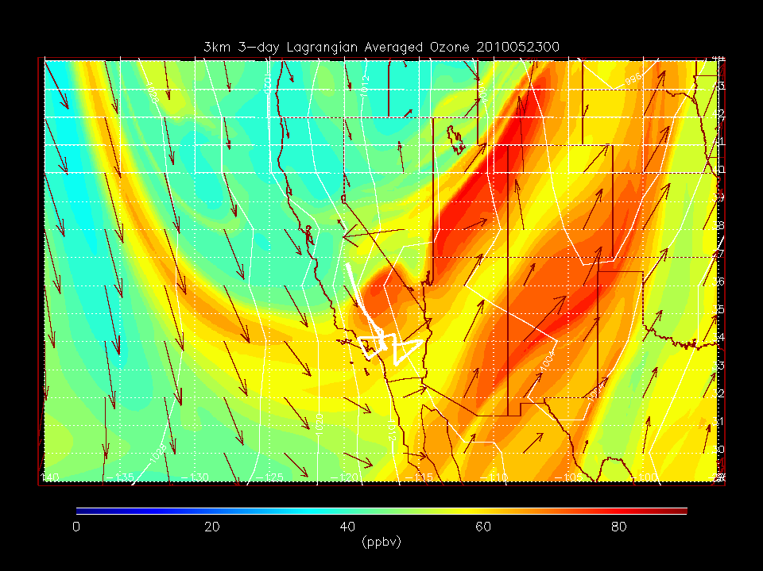
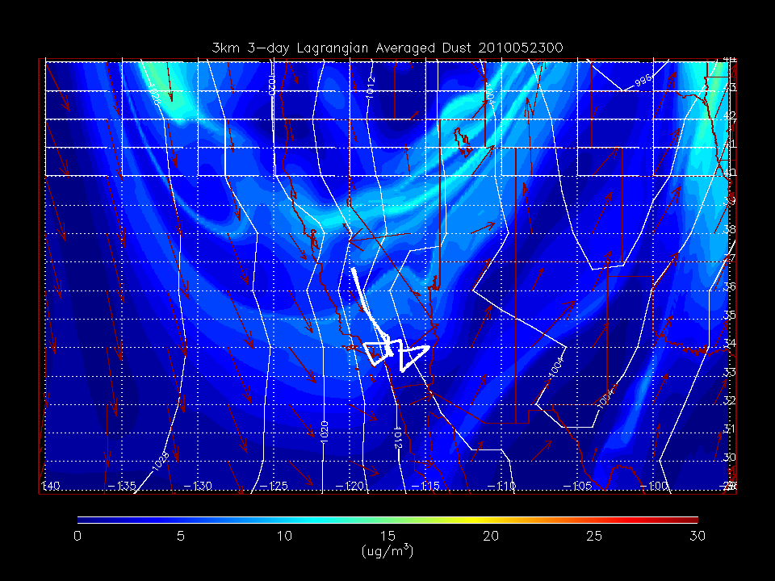
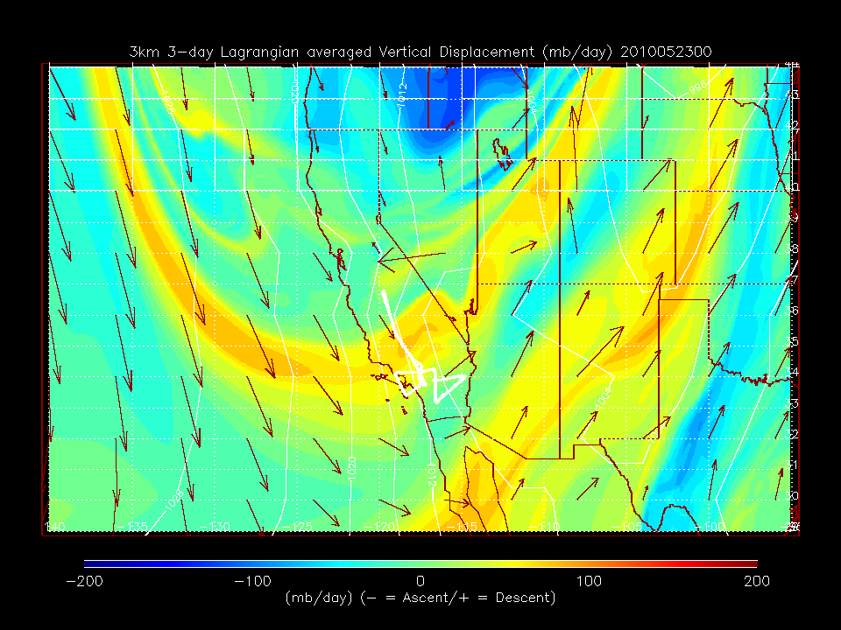
RAQMS RDF 3km CO forecast
RAQMS RDF 3km O3 forecast
3km RDF CO, O3, Dust, and Vertical Displacement 00Z 20100523 (Saturday Afternoon)
RAQMS RDF 3km Dust forecast
RAQMS RDF 3km Descent forecast
Notes:
24

Slide 25
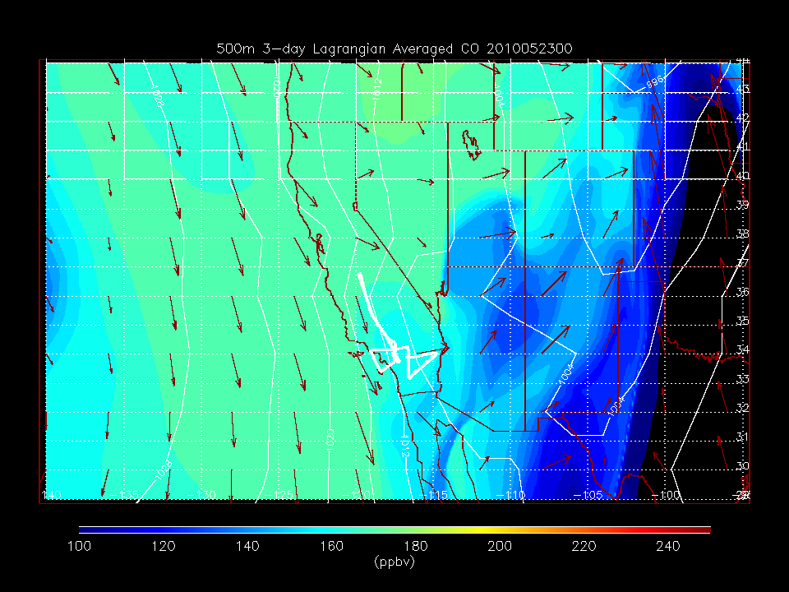
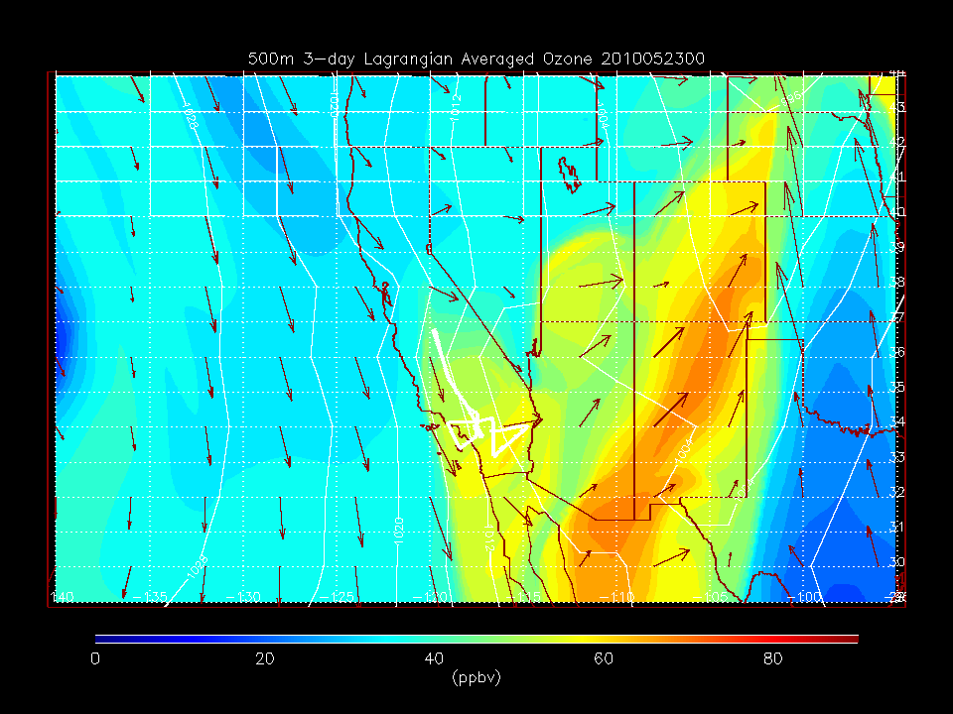
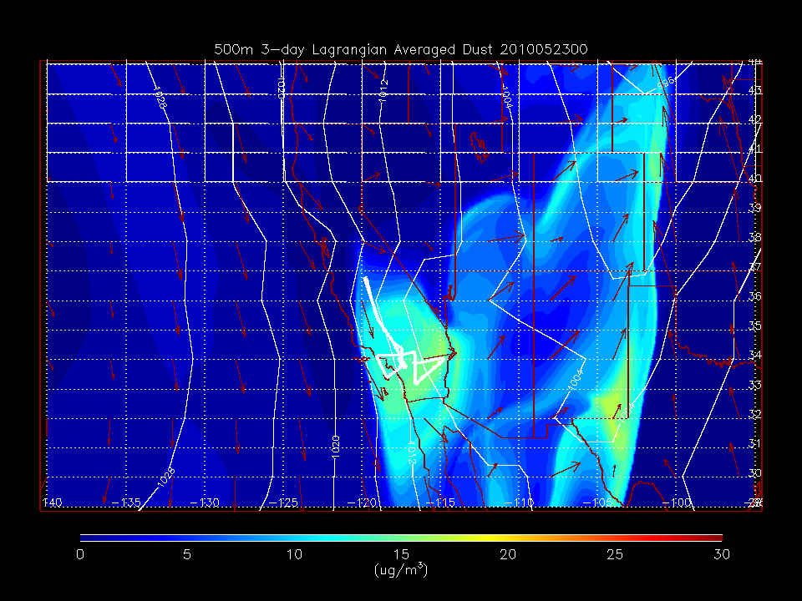
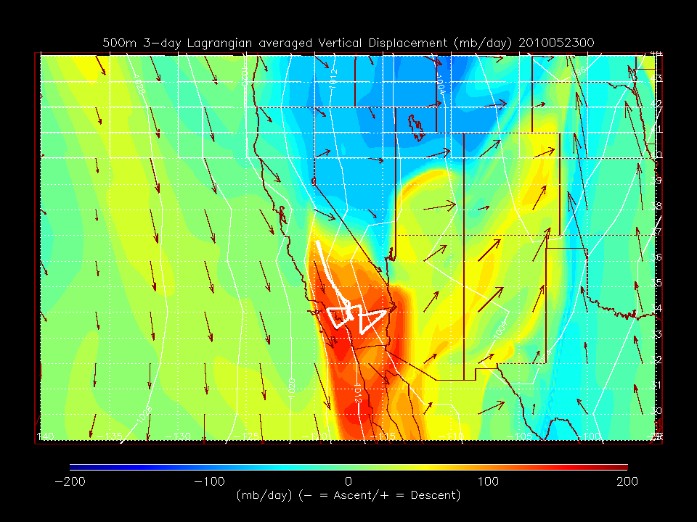
RAQMS RDF 500m CO forecast
RAQMS RDF 500m O3 forecast
500m RDF CO, O3, Dust, and Vertical Displacement 00Z 20100523 (Saturday Afternoon)
RAQMS RDF 500m Dust forecast
RAQMS RDF 500m Descent forecast
Notes:
25

Slide 26
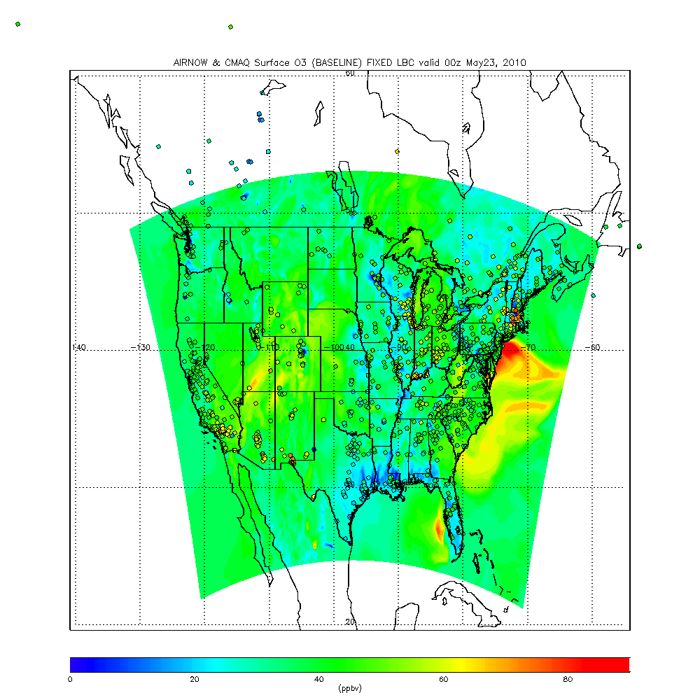
NAM-CMAQ CalNex Experimental Runs
Fixed Lateral Boundary Conditions
RAQMS Lateral Boundary Conditions
FIXED LBC 00Z May 23, 2010
Two real-time experimental NAM-CMAQ CB5 runs were conducted by NCEP (Y. Tang) during CalNex
one with Fixed lateral boundary conditions (LBC)
one with RAQMS LBC.
We are conducting NAM-CMAQ post-mission studies focusing on assimilation of GOES Total Column Ozone.
Here we look at the “Baseline”
(no assimilation) results.

Slide 27
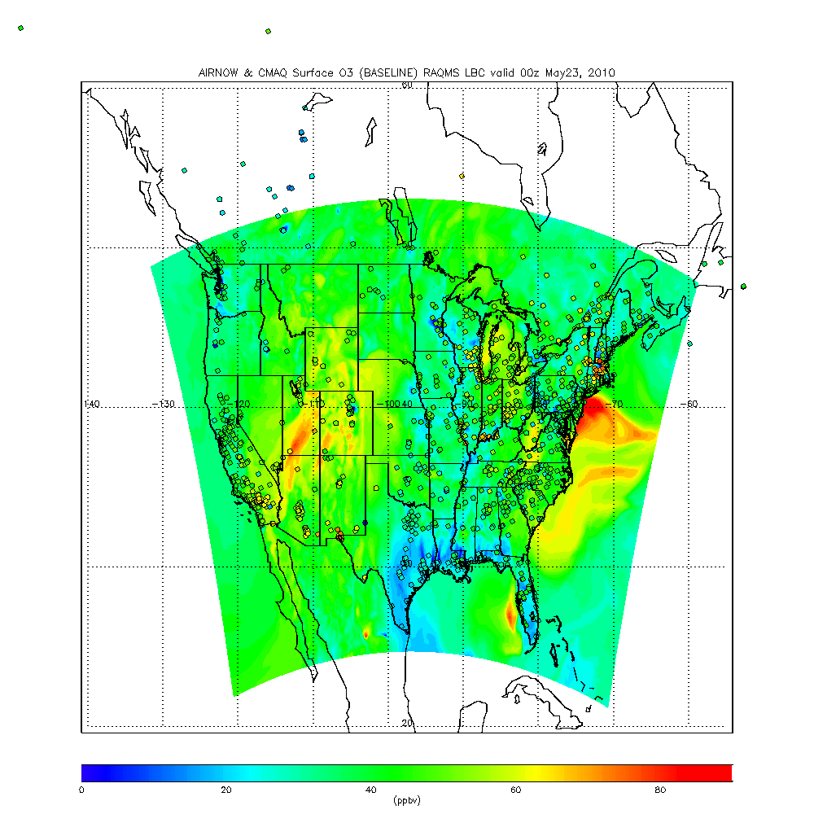
NAM-CMAQ CalNex Experimental Runs
Fixed Lateral Boundary Conditions
RAQMS Lateral Boundary Conditions
RAQMS LBC 00Z May 23, 2010
RAQMS LBC results in increased surface ozone over Southern California and Inter-mountain West
Inter-mountain West
Central Valley
Southern California

Slide 28
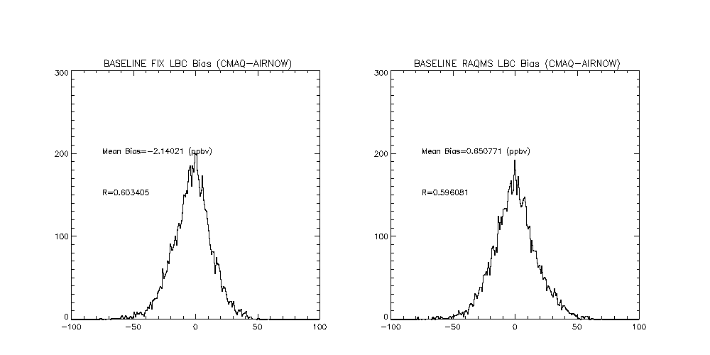
NAM-CMAQ verses AIRNOW May 22-June 30, 2010
Southern California (33N-35N 121W-114W)
FIXED LBC
RAQMS LBC
Bias = -2.14 ppbv
Bias = 0.65 ppbv
RAQMS LBC increases Southern California surface ozone and reduces bias

Slide 29
NAM-CMAQ verses AIRNOW May 22-June 30, 2010
Central Valley (35N-39N 124W-118W)
FIXED LBC
RAQMS LBC
Bias = 2.56 ppbv
Bias = 3.35 ppbv
RAQMS LBC increases Central Valley surface ozone and increases bias

Slide 30
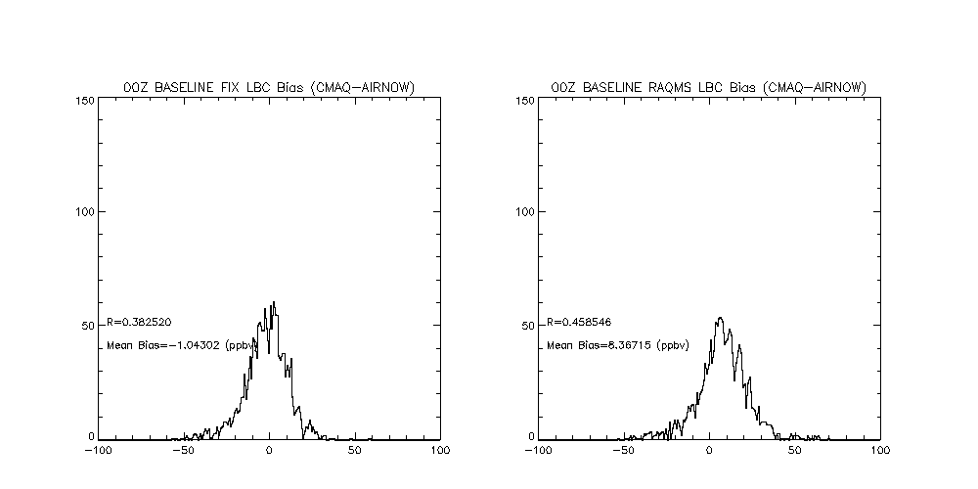
NAM-CMAQ verses AIRNOW May 22-June 30, 2010
Inter-mountain West (35N-45N 115W-105W)
FIXED LBC
RAQMS LBC
Bias = -1.04 ppbv
Bias = 8.36 ppbv
RAQMS LBC increases Inter-mountain surface ozone and increases bias

Slide 31
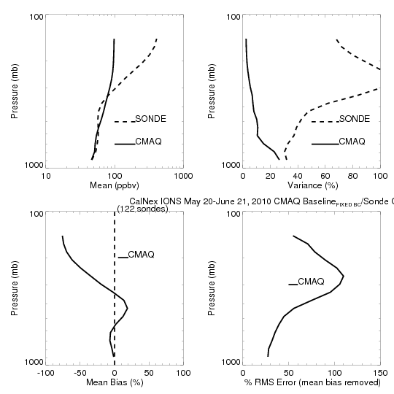
CalNex-2010 O₃ sondes – Owen Cooper (NOAA ESRL)
CalNex Ozonesonde
NAM-CMAQ FIXED LBC
FIXED LBC NAM-CMAQ experiment significantly underestimates upper tropospheric (<300mb) ozone and free tropospheric (<900mb) variance

Slide 32
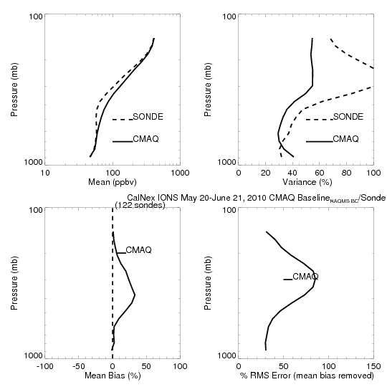
CalNex-2010 O₃ sondes – Owen Cooper (NOAA ESRL)
CalNex Ozonesonde
NAM CMAQ RAQMS LBC
RAQMS LBC NAM-CMAQ experiment overestimates free tropospheric (600-200mb) ozone and boundary layer (>900mb) variance but shows improved agreement in free tropospheric variance

Slide 33
Sacramento O3 May-June 2010
RAQMS 1x1 Degree Re-analysis

Slide 34
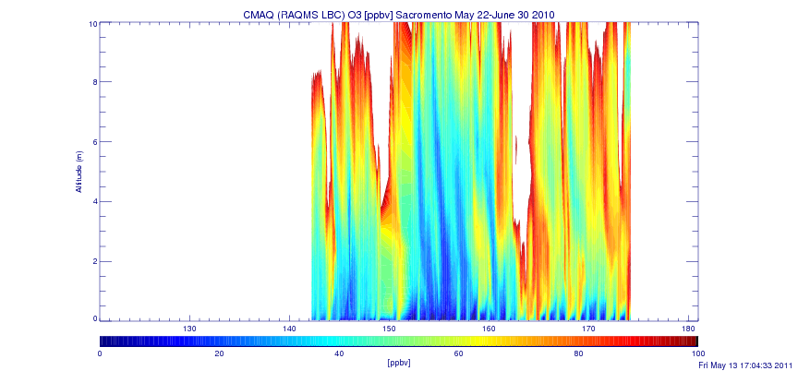
Sacramento O3 May 22 -June 22 2010
NAM-CMAQ with RAQMS LBC
NAM-CMAQ RAQMS LBC experiment shows more descent of high ozone air than RAQMS 1x1 re-analysis which may lead to overestimates in surface ozone
Points to the need for improved vertical resolution in NAM-CMAQ upper troposphere/lower stratosphere

Slide 35
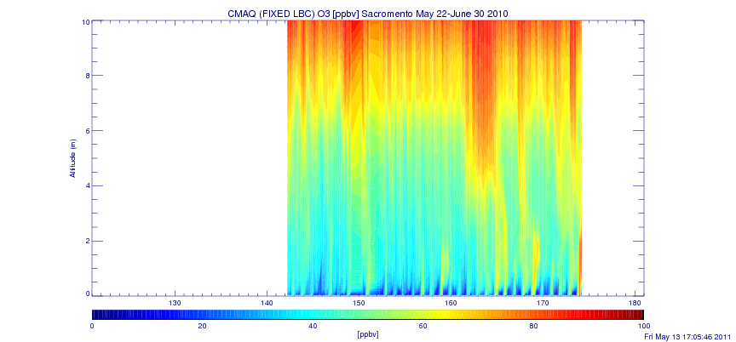
Sacramento O3 May 22 -June 22 2010
NAM-CMAQ with FIXED LBC
FIXED LBC experiment shows less descent of high ozone air then RAQMS LBC experiment
FIXED LBC experiment shows less variance then either RAQMS or the RAQMS LBC experiment

Slide 36
Summary:
Assimilation of global satellite ozone retrievals results in improved agreement with CalNex P3 airborne and ozonesonde ozone measurements and slight improvements in large-scale ozone forecasts
Assimilation of global aerosol retrievals results in improved agreement with CalNex HSRL airborne aerosol extinction measurements and significant improvements in large-scale dust forecasts
Leads to overestimates of insitu aerosol dry mass and extinction
Need to understand the contribution from large aerosols to ambient extinction
Use of real-time RAQMS LBC within experimental CB5 NAM-CMAQ leads to improved agreement with UTLS ozonesonde measurements and improved representation of free tropospheric variance but leads to overestimates in surface ozone over the inter-mountain west
Need to increase the vertical resolution of NAM-CMAQ in the UTLS
Forecasting exceedances under the proposed ozone National Ambient Air Quality Standards (NAAQS) will require improved treatment of free tropospheric ozone within regional AQ forecasting and assessment systems

