Slide 1
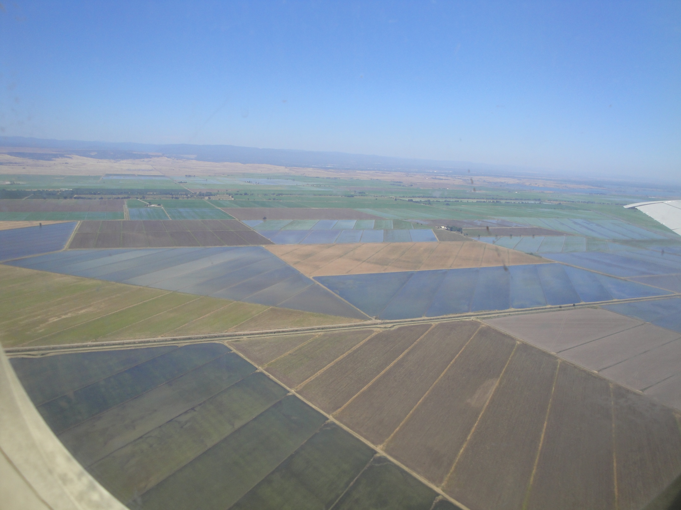
Methane Emissions from Point and Area Sources in California
J. Peischl,^{1,2} T. B. Ryerson,² M. Trainer,² A. E. Andrews,³ E. L. Atlas,⁴
R. Commane,⁶ B. C. Daube,⁶ G. S. Diskin,⁵ E. Dlugokencky,³ G. J. Frost,^{1,2} J. S. Holloway,^{1,2}
J. Kofler,^{1,3} E. A. Kort,⁶ P. M. Lang,³ K. A. Masarie,³ S. A. McKeen,² J. A. Neuman,^{1,2}
P. C. Novelli,³ J. B. Nowak,^{1,2} I. B. Pollack,^{1,2} J. M. Roberts,² G. W. Sachse,⁵
G. W. Santoni,⁶ S. A. Vay,⁵ S. C. Wofsy,⁶ B. Xiang,⁶ and D. D. Parrish²
¹ CIRES, University of Colorado Boulder, Boulder, CO
² NOAA ESRL Chemical Sciences Division, Boulder, CO
³ NOAA ESRL Global Monitoring Division, Boulder, CO
⁴ Marine and Atmospheric Chemistry, RSMAS/University of Miami, Miami, FL
⁵ Chemistry and Dynamics Branch, NASA Langley, Hampton, VA
⁶ EPS and SEAS, Harvard University, Cambridge, MA
Outline:
CH₄ emissions inventories for California
Observations from P-3 during CalNex
a) L.A. Basin (dairies, landfills, wastewater treatment, …)
b) Sacramento Valley (rice, dairies, gas wells, wetlands)
Summary

Slide 2
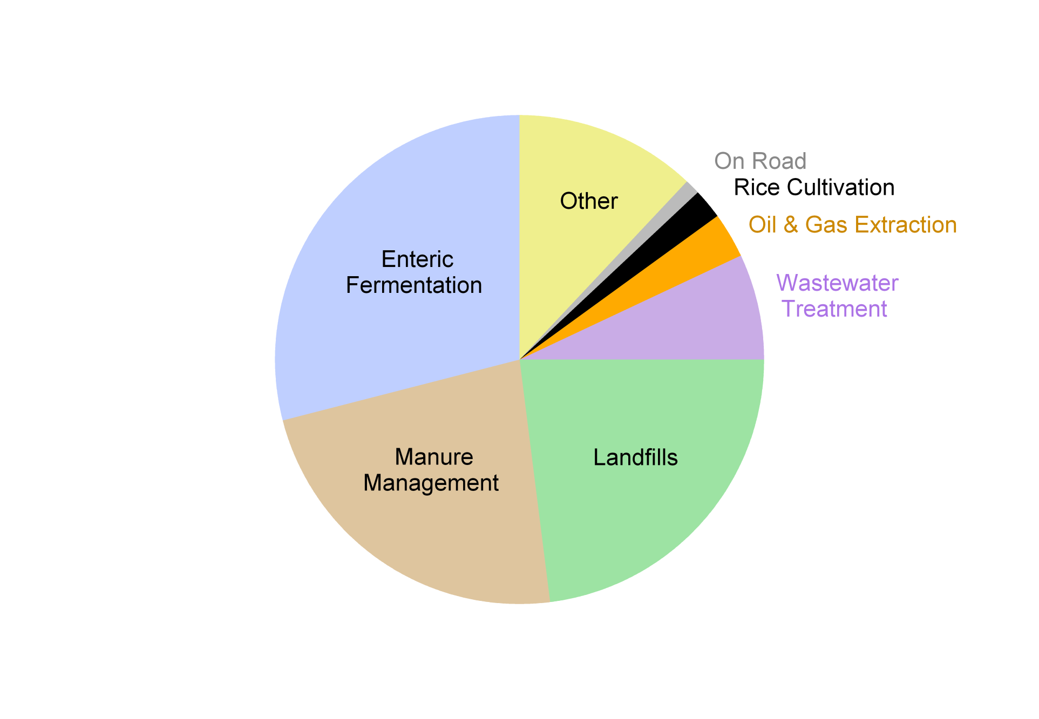
Known sources of CH₄ in California
Air Resources Board (ARB) emissions inventories (EI)
We can evaluate many of these sectors with P-3 data:
dairies in Central Valley
and L.A. Basin
rice in Sacramento Valley
L.A. Basin – combination
of all but rice
cattle – see Nowak
et al. 10:10 am
ARB CH₄ EI: http://www.arb.ca.gov/cc/inventory/inventory.htm
ARB criteria pollutants EI: http://www.arb.ca.gov/ei/maps/basins/abscmap.htm

Slide 3
Known sources of CH₄ in California
Air Resources Board (ARB) emissions inventories (EI)
We can evaluate many of these sectors with P-3 data:
dairies in Central Valley
and L.A. Basin
rice in Sacramento Valley
L.A. Basin – combination
of all but rice
cattle – see Nowak
et al. 10:10 am
L.A. Basin CH₄ to CO inventory emission ratios
total ≈ 0.12
cars ≈ 0.017
ARB CH₄ EI: http://www.arb.ca.gov/cc/inventory/inventory.htm
ARB criteria pollutants EI: http://www.arb.ca.gov/ei/maps/basins/abscmap.htm

Slide 4
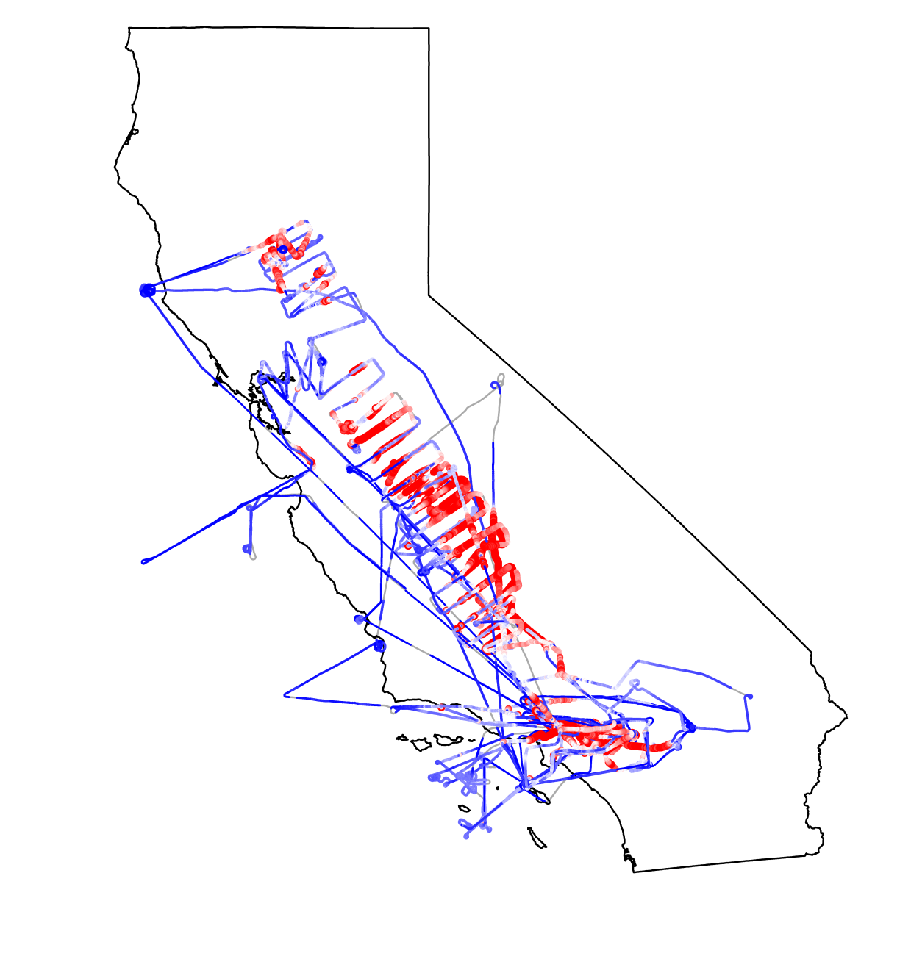
P-3 data show areas with high CH₄ emissions
We can begin to evaluate individual areas and sources from airborne data
Sacramento Valley
(rice, dairies, oil & gas)
San Joaquin Valley (dairies, oil & gas)
L.A. Basin
(landfills, dairies,
wastewater treatment, …)
all P-3 daytime flight CH₄ data

Slide 5
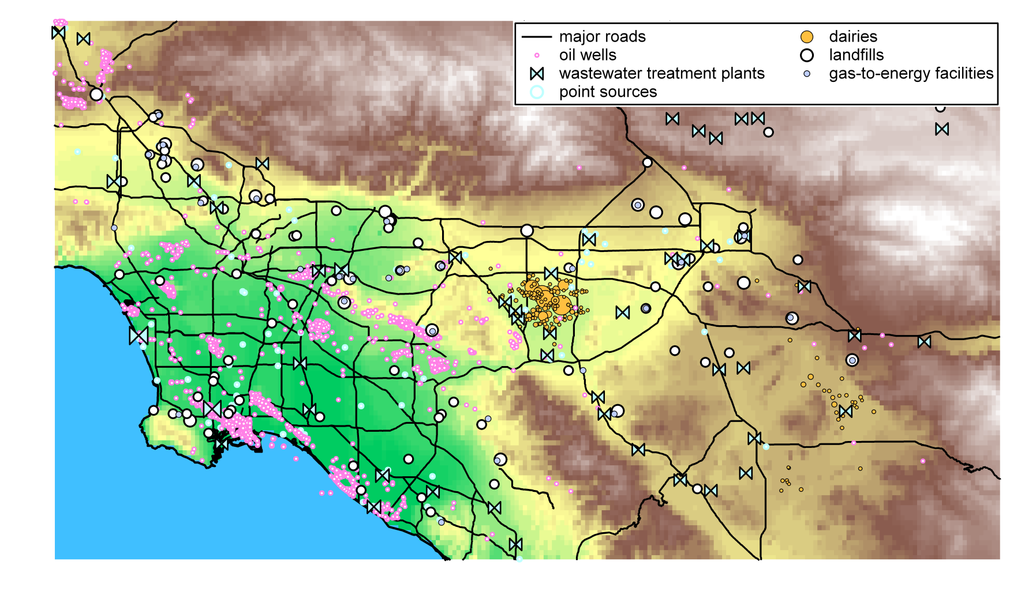
a) CH₄ in L.A. Basin has multiple sources
sources: dairies, landfills, water treatment, traffic, etc.
dairy location and size from William Salas et al.
landfill location from ARB: http://www.calrecycle.ca.gov/SWFacilities/Directory/

Slide 6
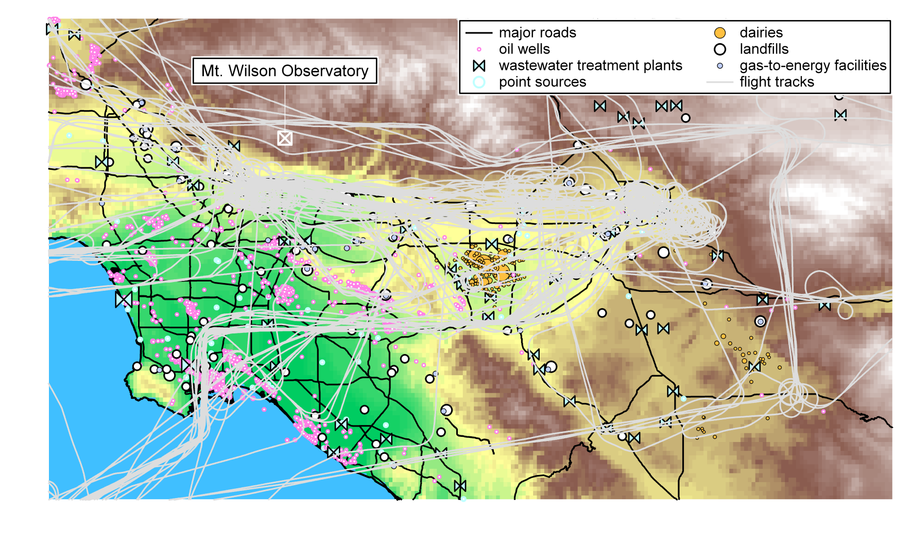
a) CH₄ in L.A. Basin has multiple sources
sources: dairies, landfills, water treatment, traffic, etc.
interpret data from:
i.) fourteen daytime NOAA P-3 flights
ii.) NOAA flasks at Mt. Wilson observatory
dairy location and size from William Salas et al.
landfill location from ARB: http://www.calrecycle.ca.gov/SWFacilities/Directory/

Slide 7
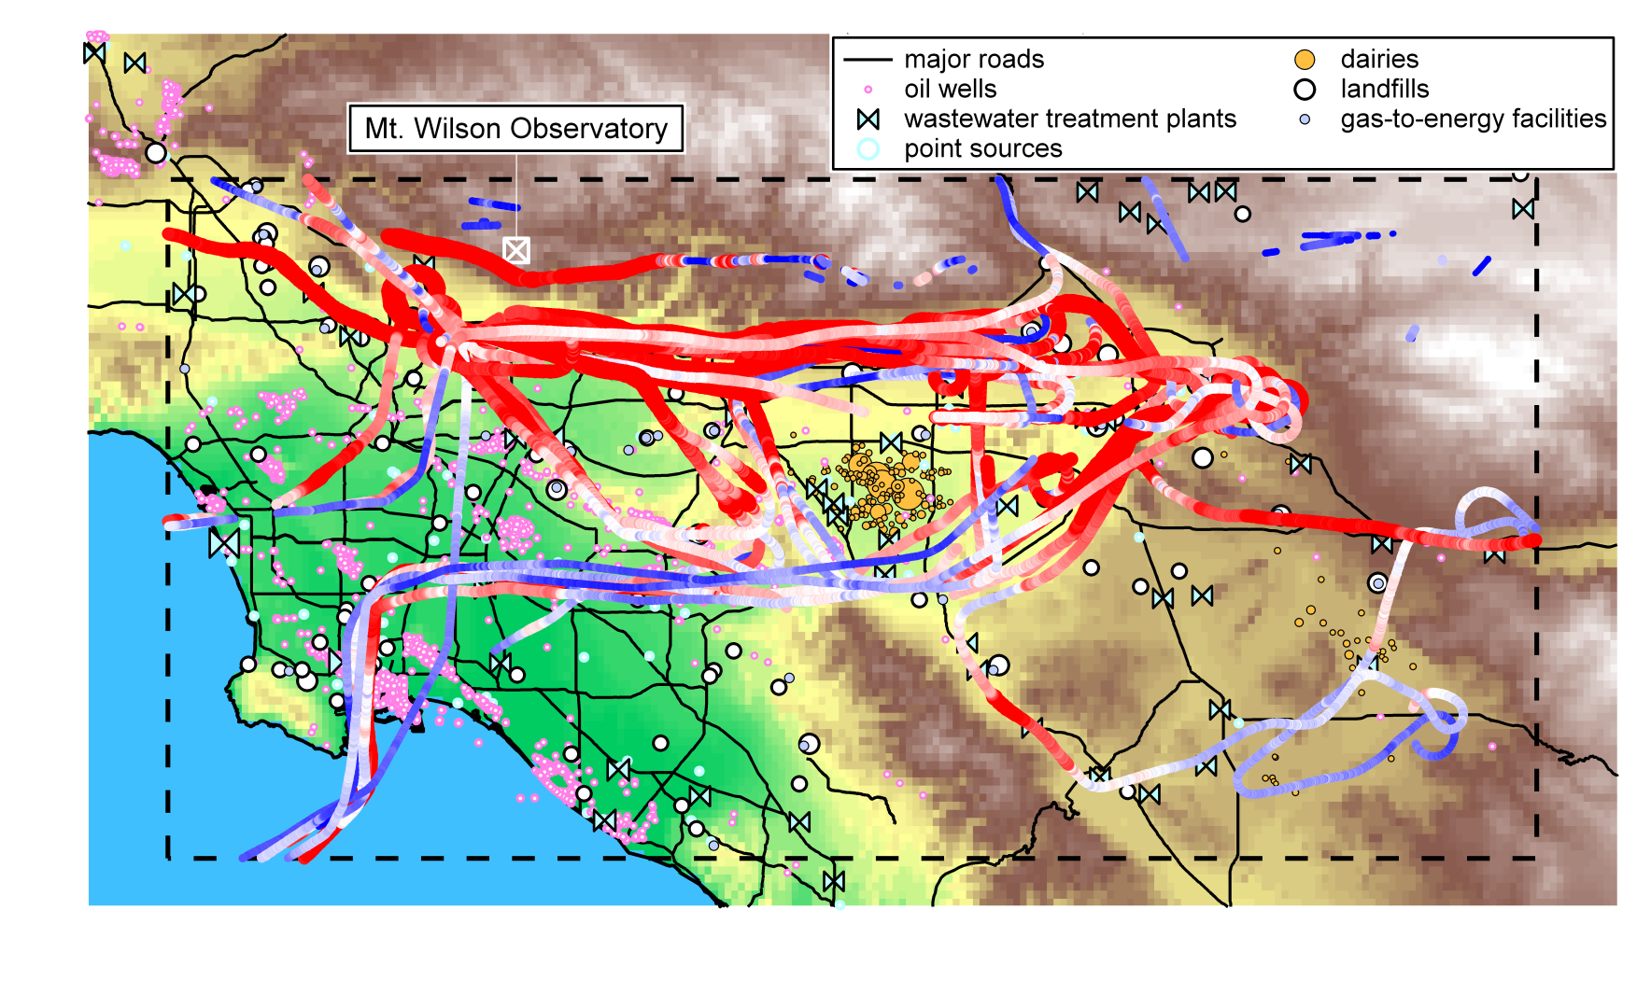
a) CH₄ in L.A. Basin has multiple sources
sources: dairies, landfills, water treatment, traffic, etc.
interpret data from:
i.) fourteen daytime NOAA P-3 flights, dashed box below 1 km AGL
ii.) NOAA flasks at Mt. Wilson observatory
dairy location and size from William Salas et al.
landfill location from ARB: http://www.calrecycle.ca.gov/SWFacilities/Directory/

Slide 8
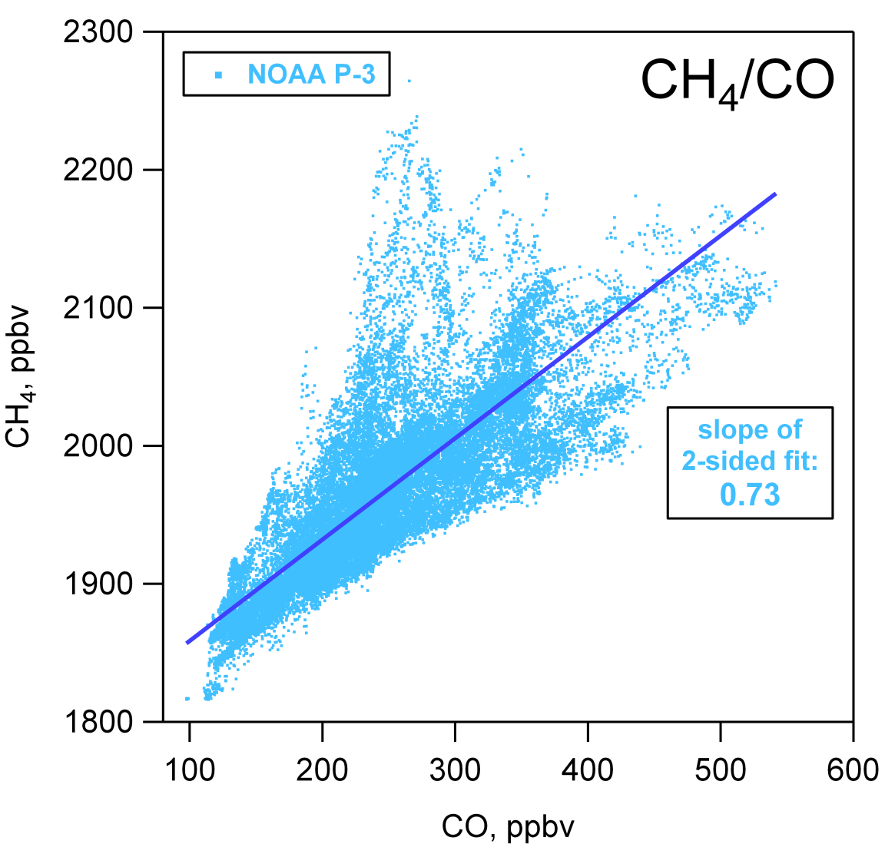
Observed CH₄/CO in L.A. Basin
linear regression of P-3 data influenced by CH₄ sources not correlated with CO emissions

Slide 9
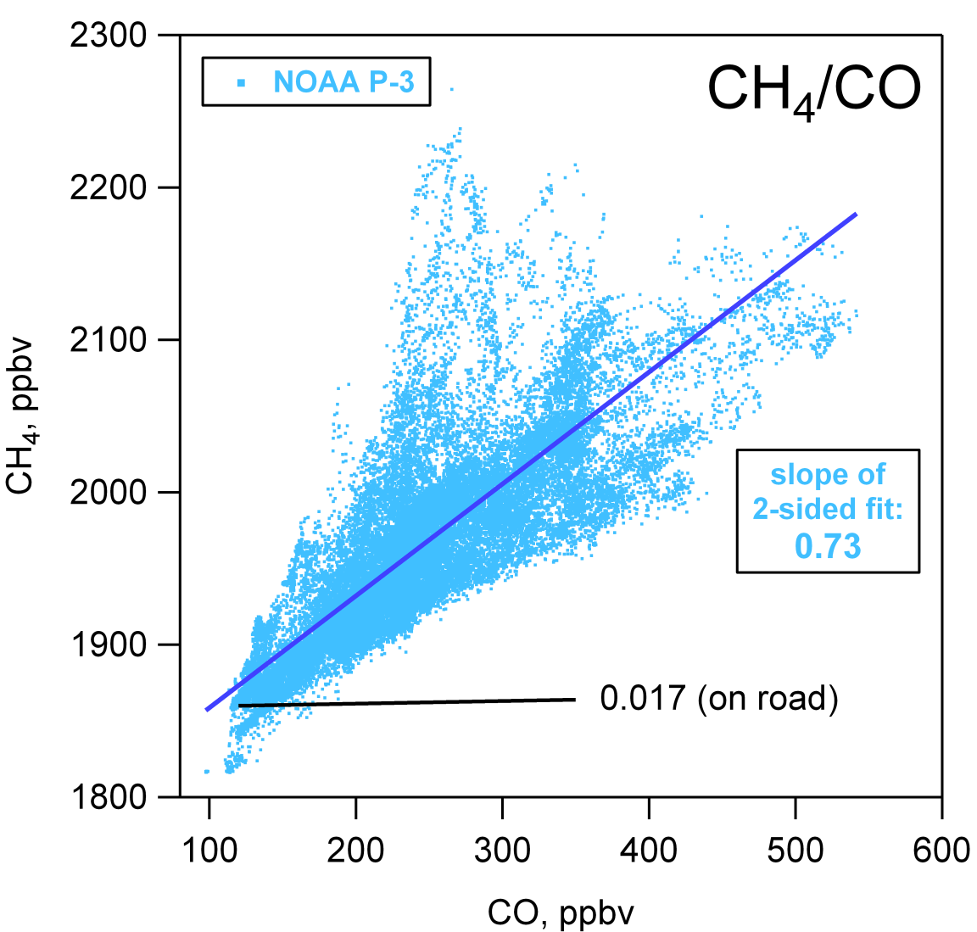
Observed CH₄/CO is higher than expected from ARB criteria pollutants inventory (2008 preliminary EI – latest available)
linear regression of P-3 data influenced by CH₄ sources not correlated with CO emissions
traffic very minor contributor to total CH₄ in L.A. Basin

Slide 10
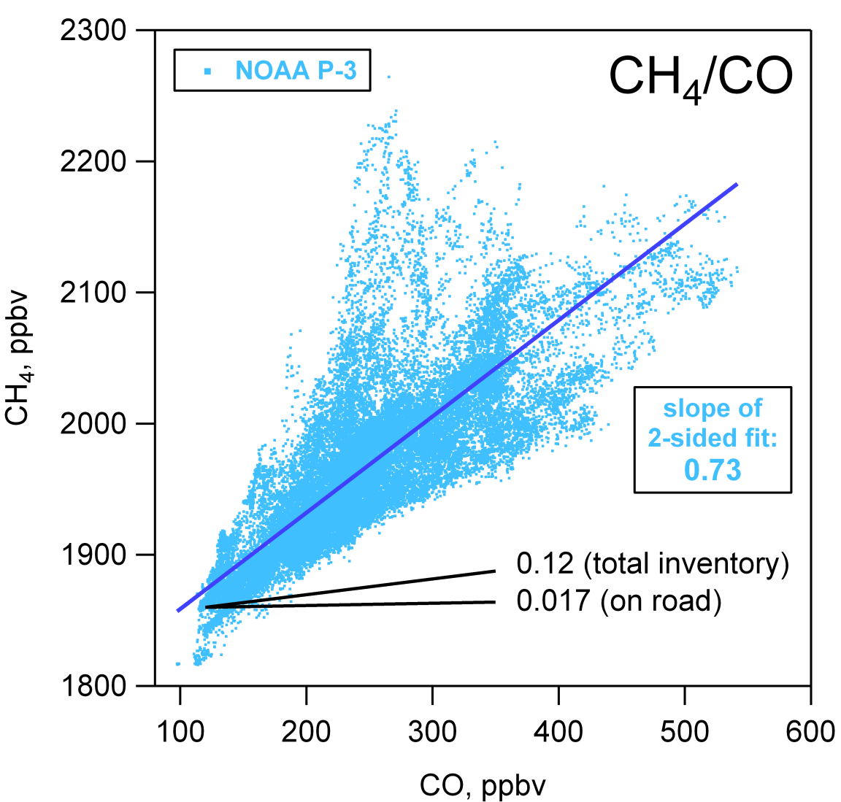
Observed CH₄/CO is higher than expected from ARB criteria pollutants inventory (2008 preliminary EI – latest available)
linear regression of P-3 data influenced by CH₄ sources not correlated with CO emissions
traffic very minor contributor to total CH₄ in L.A. Basin
significant difference between observed and inventory CH₄ ratios to CO

Slide 11
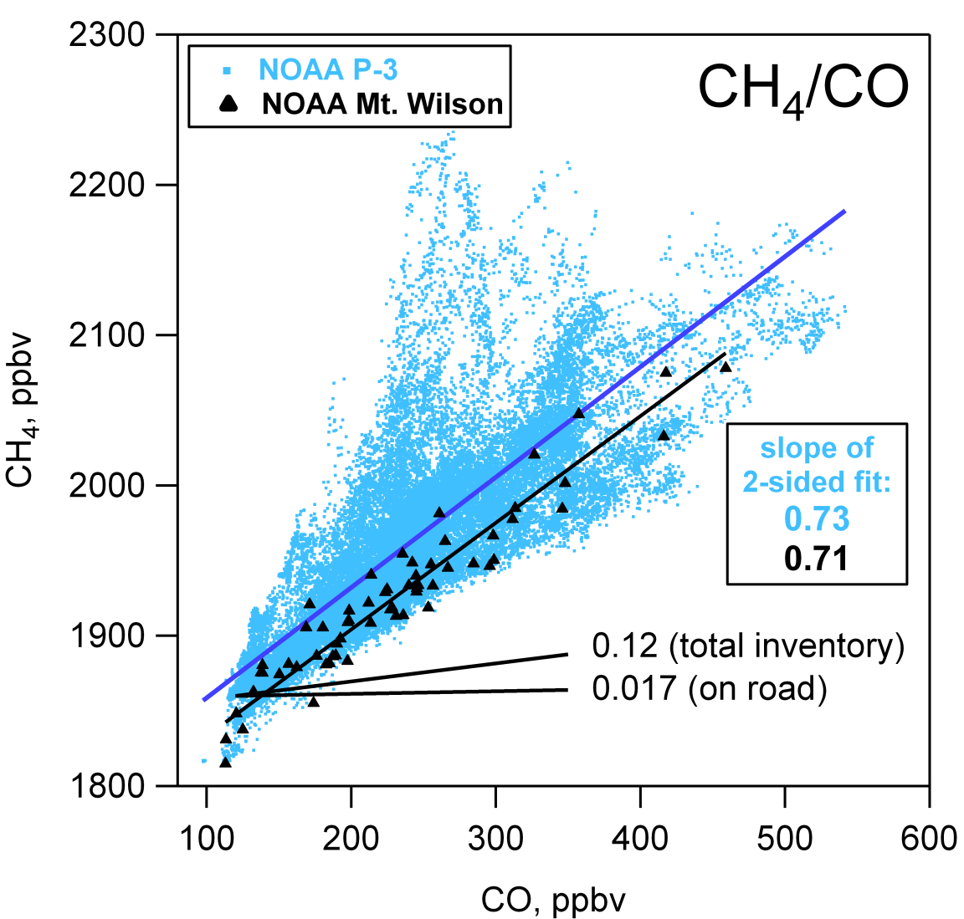
Observed CH₄/CO is higher than expected from ARB criteria pollutants inventory (2008 preliminary EI – latest available)
linear regression of P-3 data influenced by CH₄ sources not correlated with CO emissions
traffic very minor contributor to total CH₄ in L.A. Basin
significant difference between observed and inventory CH₄ ratios to CO
NOAA Mt. Wilson data consistent with a subset of P-3 data

Slide 12
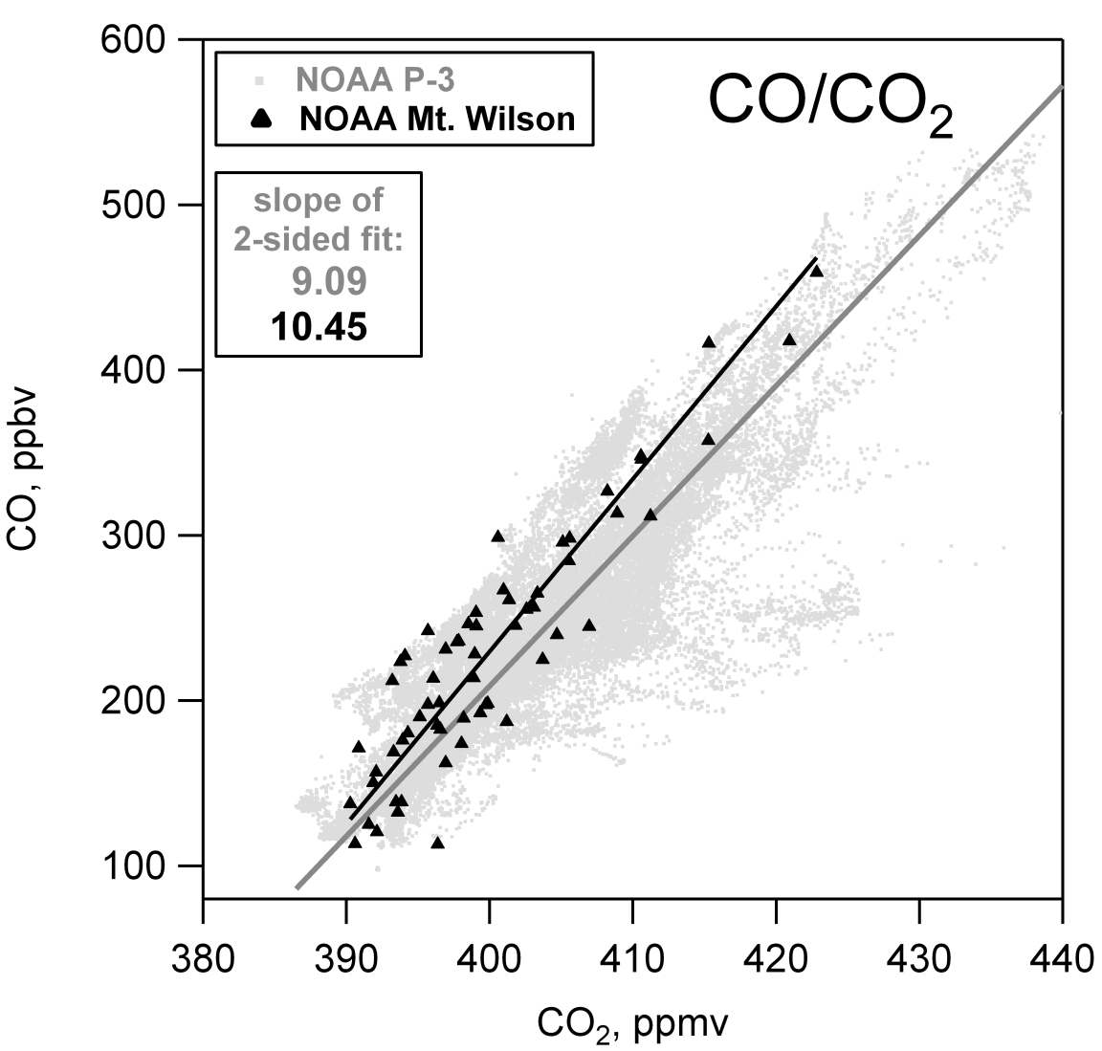
Observed CO/CO₂ is higher for Mt. Wilson data than for P-3 data
linear regression of P-3 data influenced by CO₂ sources not correlated with CO emissions
NOAA Mt. Wilson data consistent with a subset of P-3 data
NOAA Mt. Wilson data show same variability in CO as NOAA P-3, but not for CH₄ and CO₂

Slide 13
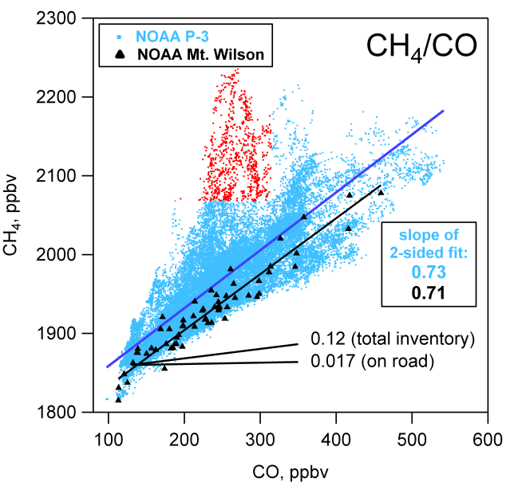
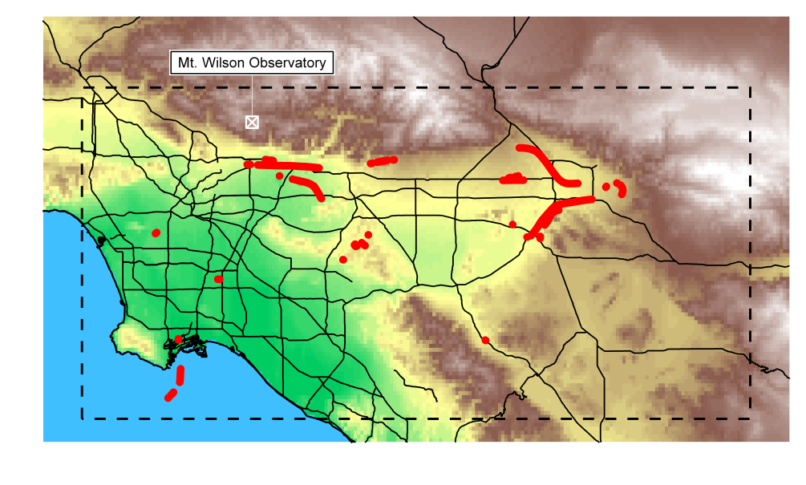
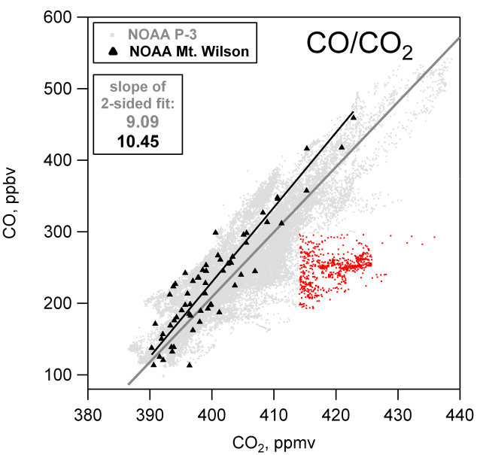
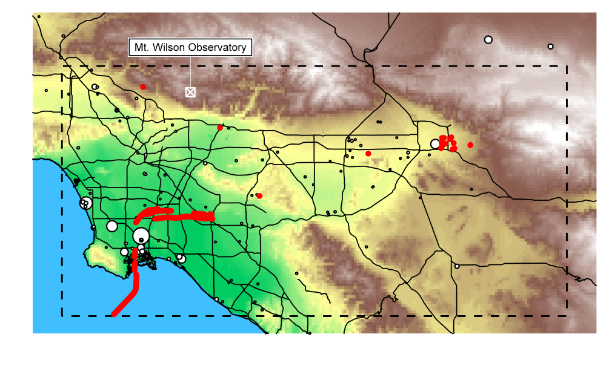
Mt. Wilson data may not sample entire L.A. Basin
Mt. Wilson data not influenced by:
CH₄ emissions from East L.A. Basin, or
CO₂ emissions from Long Beach

Slide 14
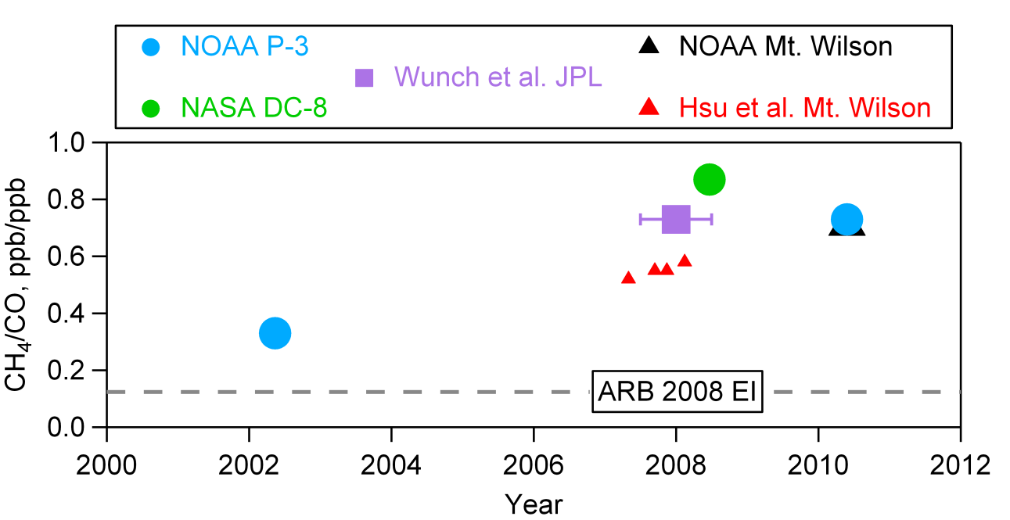
L.A. Basin CH₄/CO emission ratios over time
CH₄/CO
50-200% change in CH₄/CO
over eight years

Slide 15
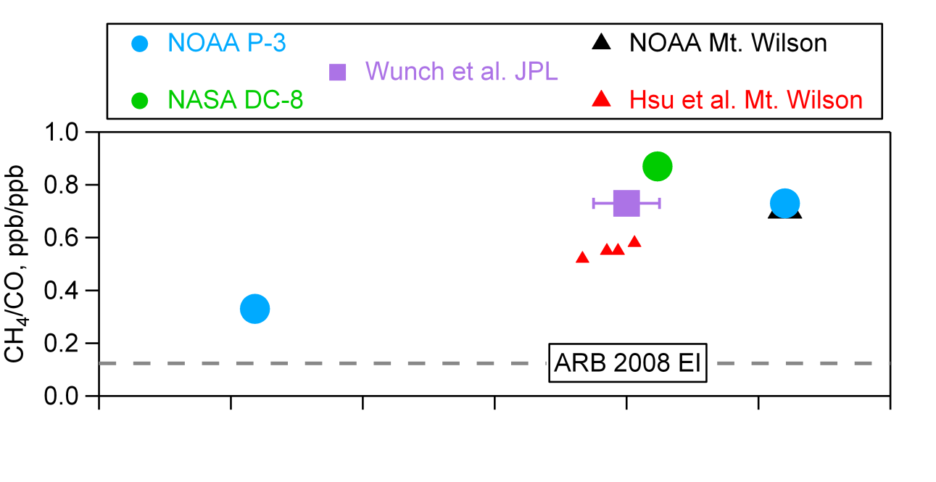
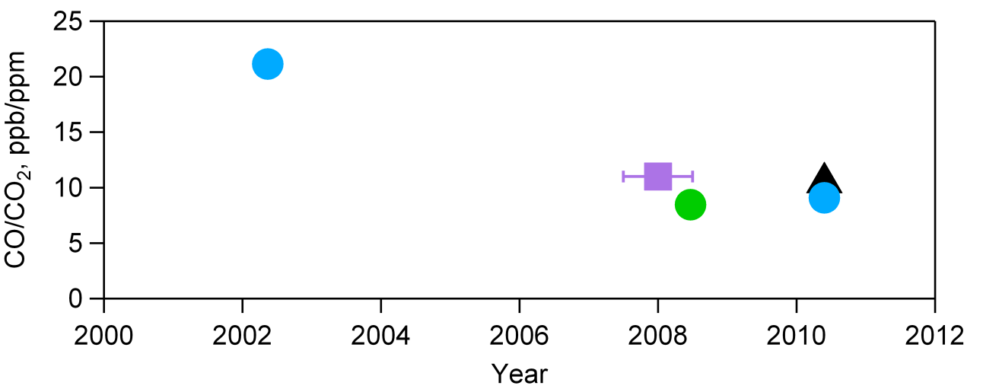
L.A. Basin CH₄/CO emission ratios over time
CH₄/CO
50-200% change in CH₄/CO
over eight years
CO/CO₂
Parrish et al. (2002) have
shown CO decreases
see Warneke et al. and
Pollack et al.

Slide 16
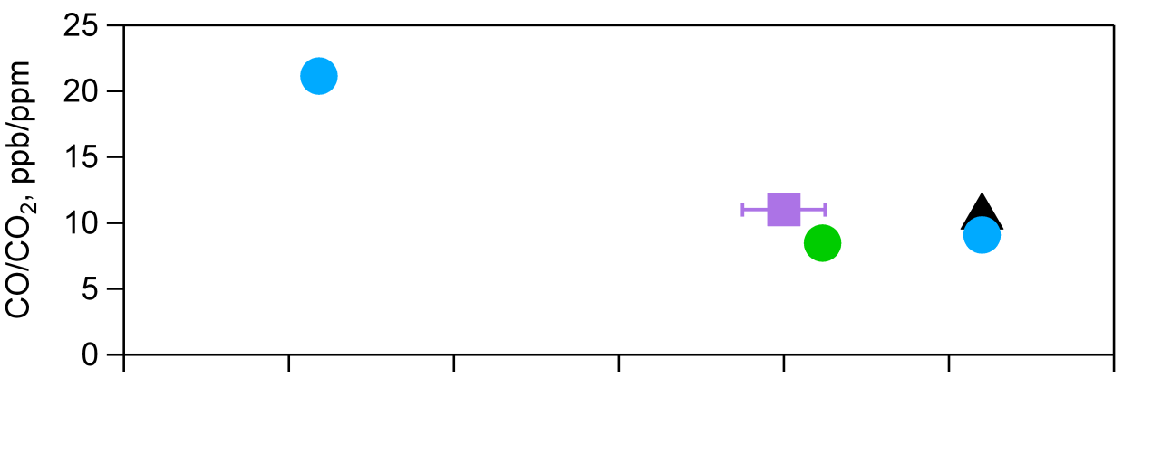
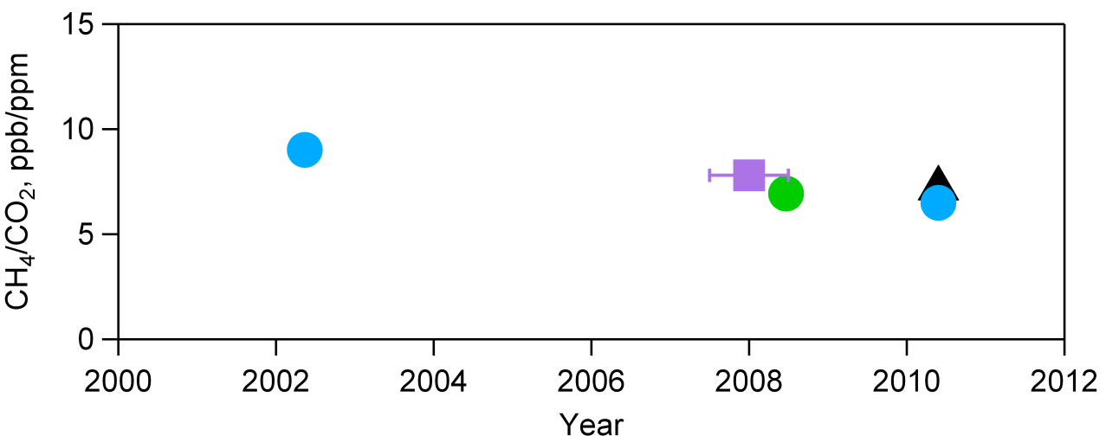
L.A. Basin CH₄/CO emission ratios over time
CH₄/CO
50-200% change in CH₄/CO
over eight years
CO/CO₂
Parrish et al. (2002) have
shown CO decreases
see Warneke et al. and
Pollack et al.
CH₄/CO₂
we need to account for either decreasing CO or changing CO₂ emissions before evaluating absolute changes to CH₄ emissions

Slide 17
b) Agricultural emissions in the Sacramento Valley (rice + dairies, gas wells, wetlands)

Slide 18
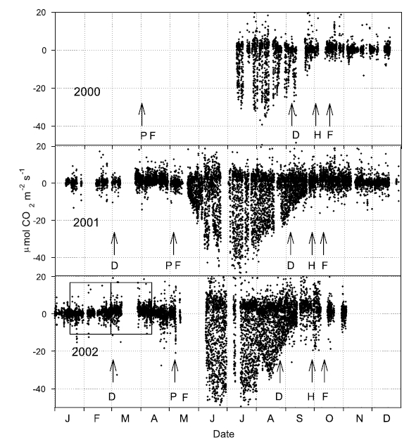
a lot already known about rice CH₄
CO₂ flux
0
McMillan gives fluxes at one rice field
for 2.5 years
shows annual variability in
flooding/planting of 40 days
0
0

Slide 19
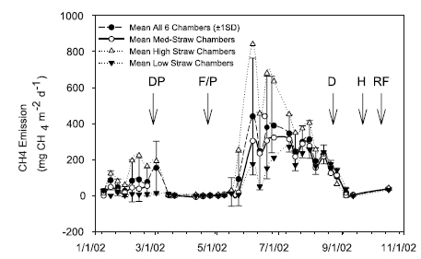
a lot already known about rice CH₄
CO₂ flux
0
McMillan gives fluxes at one rice field
for 2.5 years
shows annual variability in
flooding/planting of 40 days
CH₄ from rice is 2% of total annual
California budget, but more during
growing season
0
0
CH₄ flux
0

Slide 20
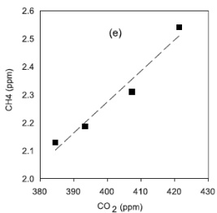
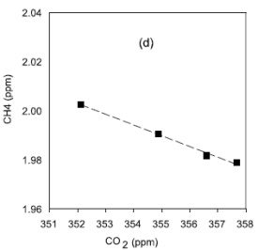
a lot already known about rice CH₄
CO₂ flux
CH₄/CO₂
McMillan gives fluxes at one rice field
for 2.5 years
shows annual variability in
flooding/planting of 40 days
CH₄ from rice is 2% of total annual
California budget, but more during
growing season
balance between photosynthesis and
respiration changes sign of CH₄/CO₂
and depends on season and time of day
night
CH₄ flux
day

Slide 21
a lot already known about rice CH₄
CO₂ flux
CH₄/CO₂
McMillan gives fluxes at one rice field
for 2.5 years
shows annual variability in
flooding/planting of 40 days
CH₄ from rice is 2% of total annual
California budget, but more during
growing season
balance between photosynthesis and
respiration changes sign of CH₄/CO₂
and depends on season and time of day
night
CH₄ flux
day
P-3 adds spatial information – data for model constraints
show data from two flights: before and during growing phase

Slide 22
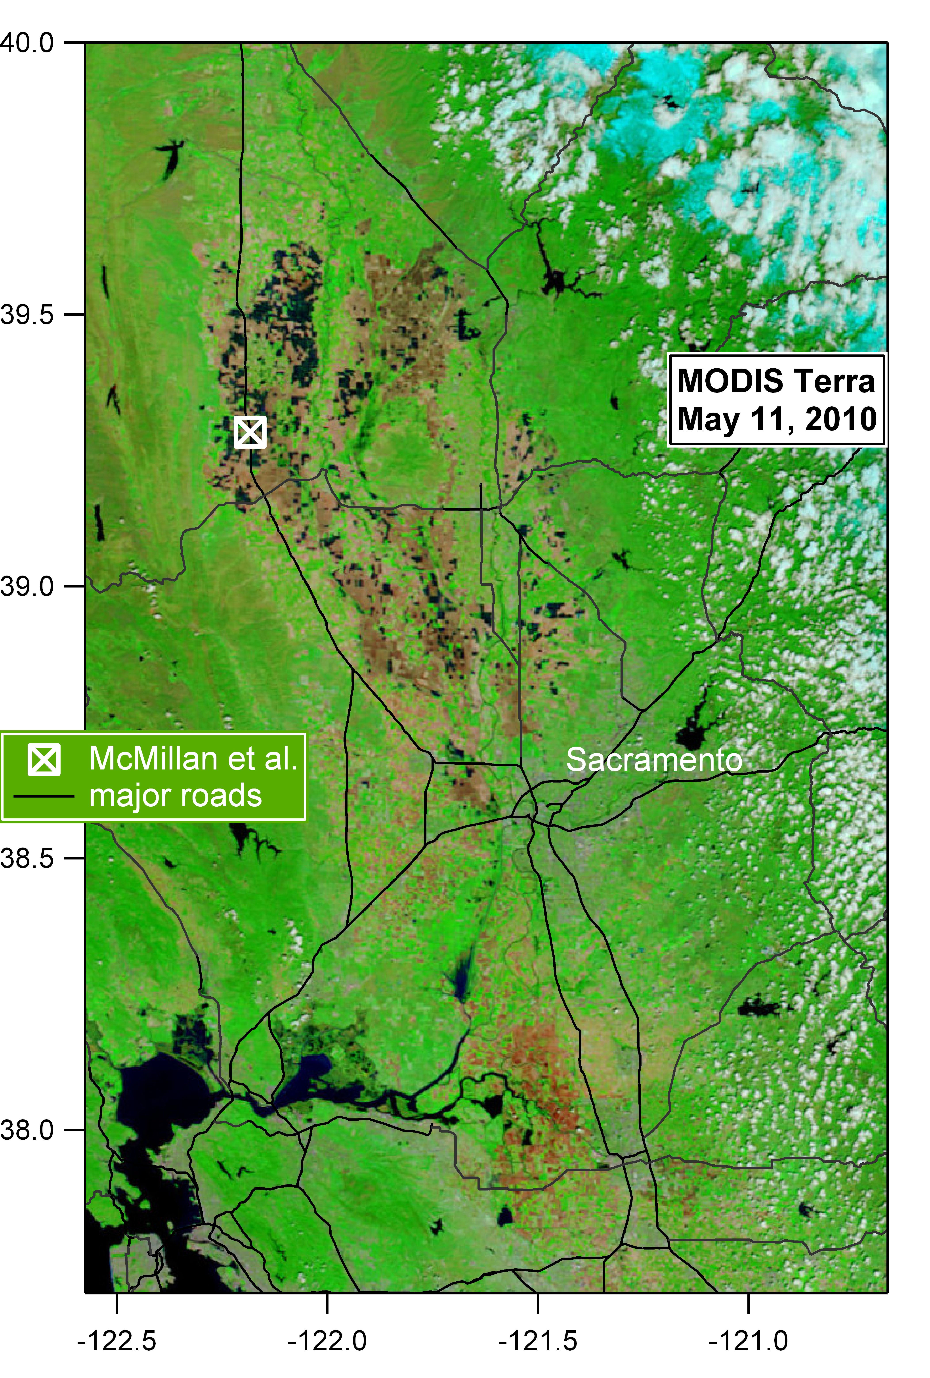
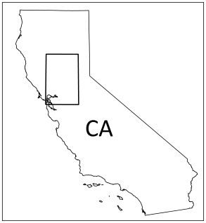
CH₄ emission from Sacramento Valley rice crops
flooded rice fields show up well on MODIS Terra images
some fields have already been
flooded
watch as rice grows over one
month in 2010

Slide 23
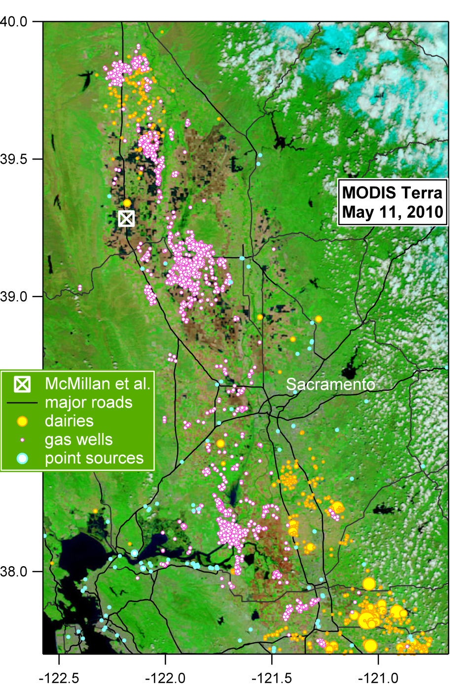
CH₄ emission from Sacramento Valley rice crops
flooded rice fields show up well on MODIS Terra images
some fields have already been
flooded
watch as rice grows over one
month in 2010
other sources of CH₄ in the area

Slide 24
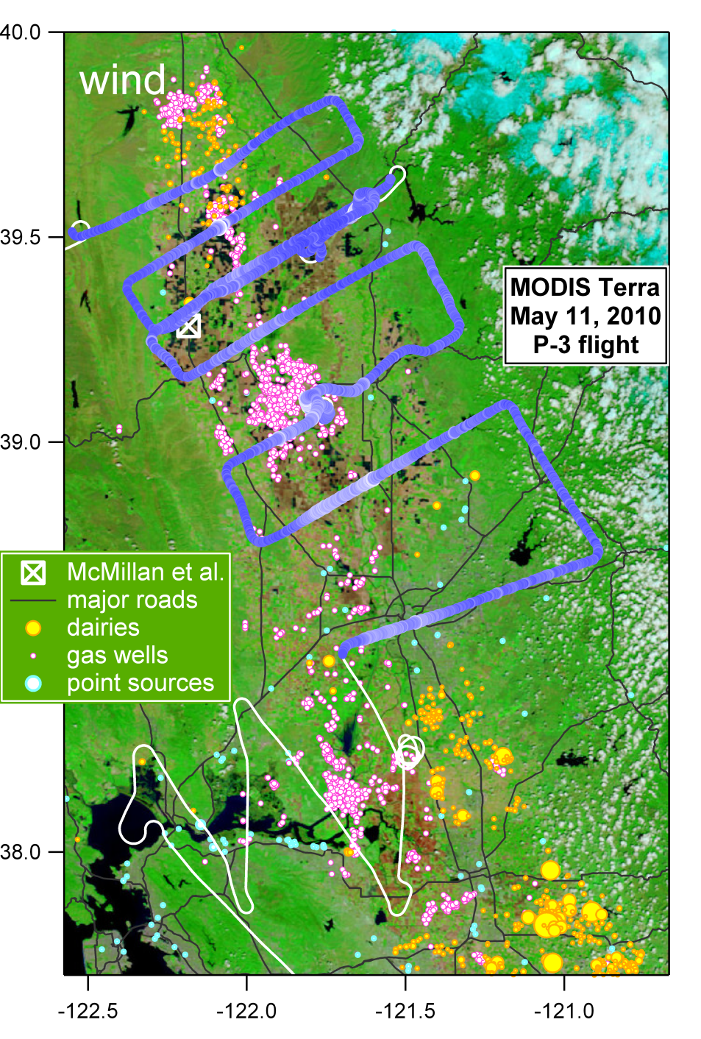
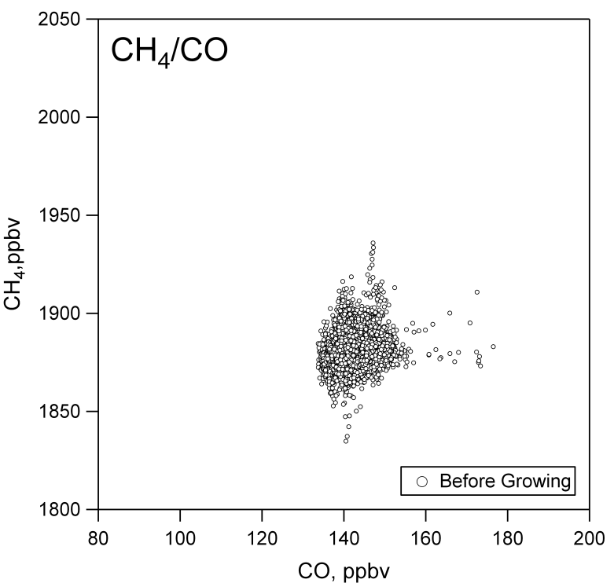
CH₄ emission from Sacramento Valley rice crops
Minimal flooding – before growing phase
P-3 track with CH₄ in boundary layer
data from 12:30 to 3 pm PDT
no CH₄ before growing phase
no correlation with CO – no urban signature
no significant enhancement from dairies, gas wells, or point sources

Slide 25
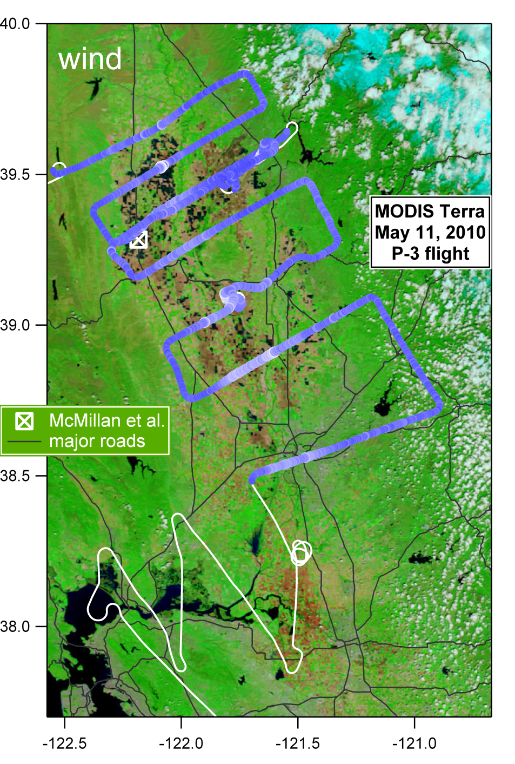
CH₄ emission from Sacramento Valley rice crops
Minimal flooding – before growing phase
P-3 track with CH₄ in boundary layer
data from 12:30 to 3 pm PDT
no CH₄ before growing phase
no correlation with CO – no urban signature
no significant enhancement from dairies, gas wells, or point sources

Slide 26
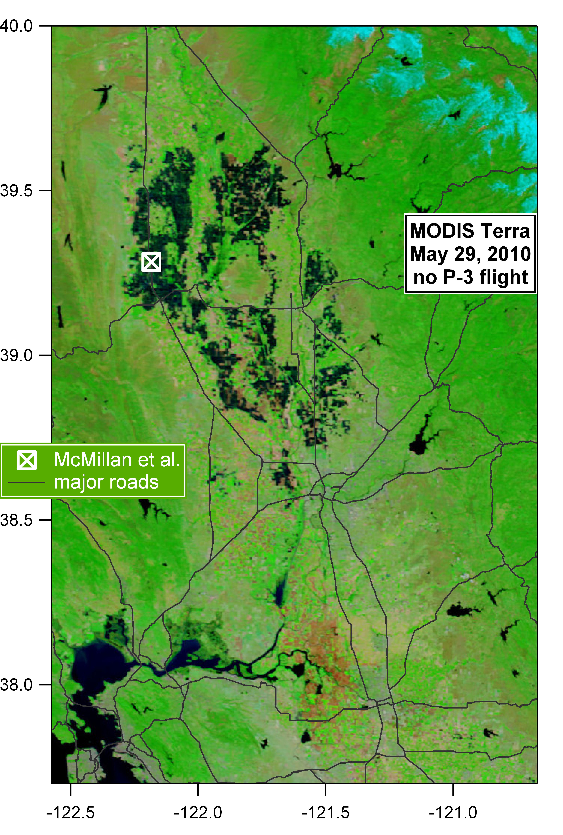
CH₄ emission from Sacramento Valley rice crops
Two weeks later – fields all flooded
no P-3 flight

Slide 27
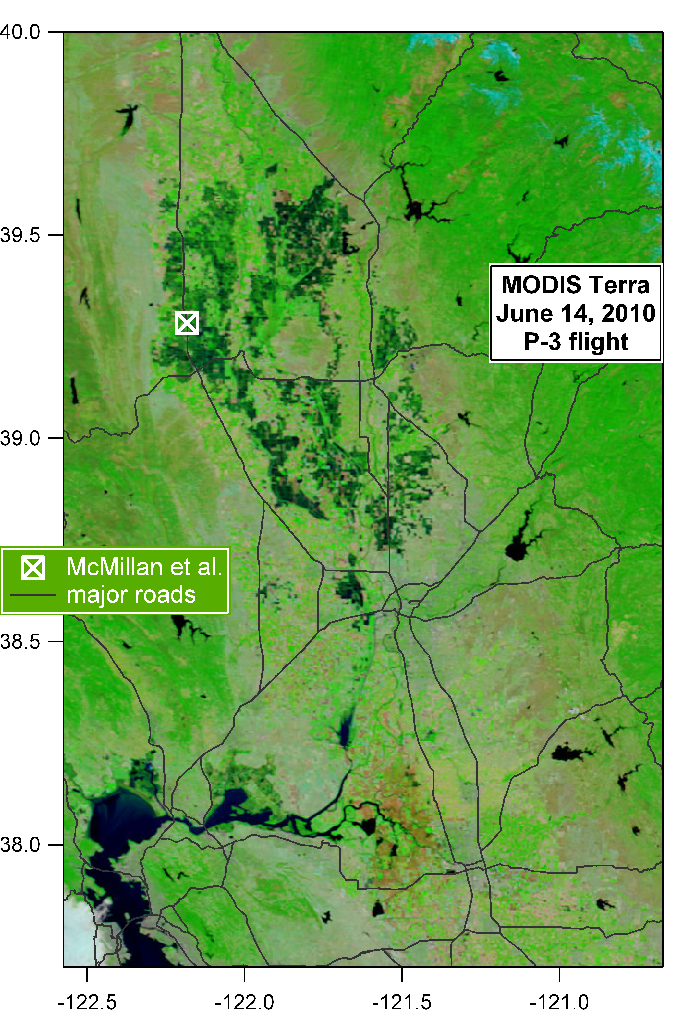
CH₄ emission from Sacramento Valley rice crops
One month later – rice growing phase
satellite shows rice actually growing

Slide 28
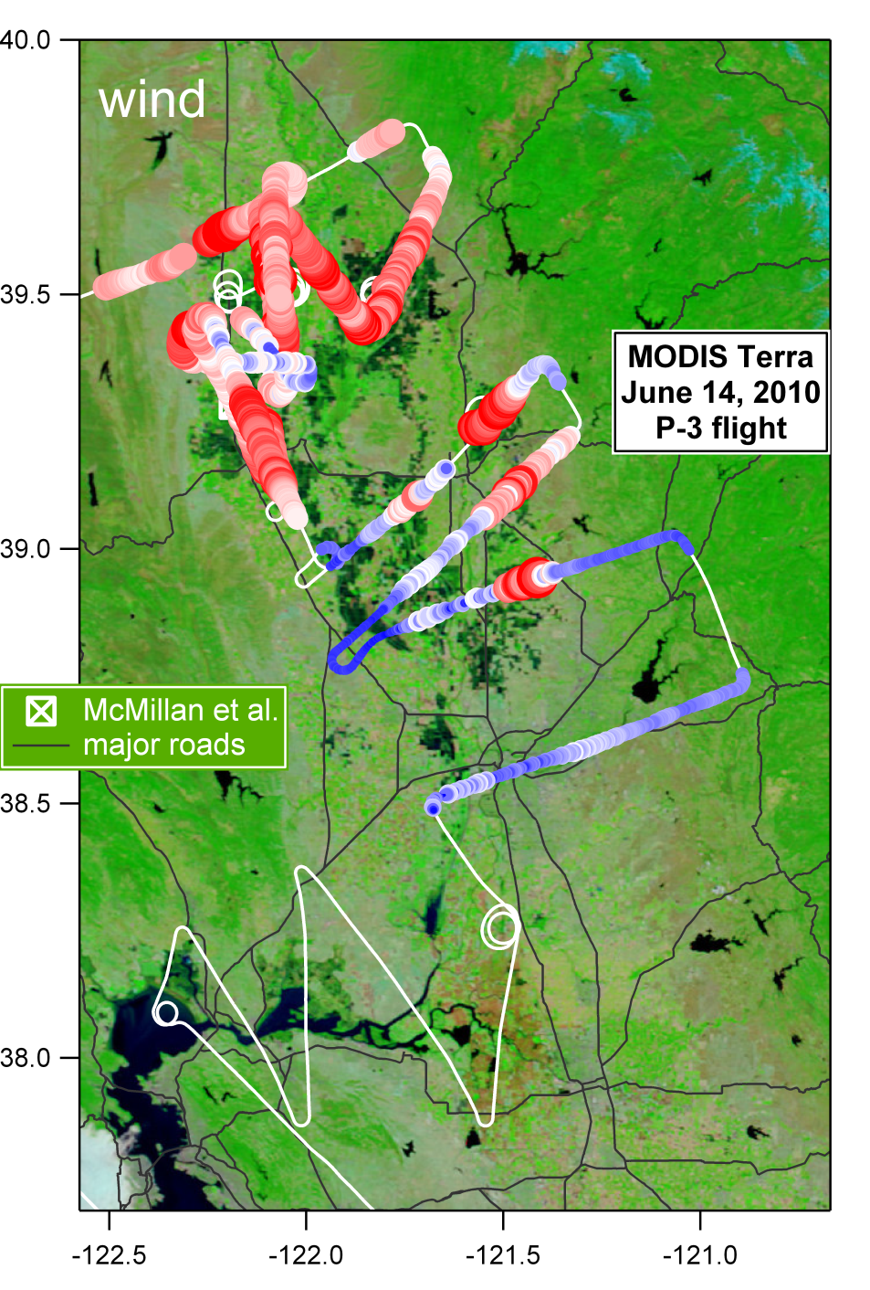
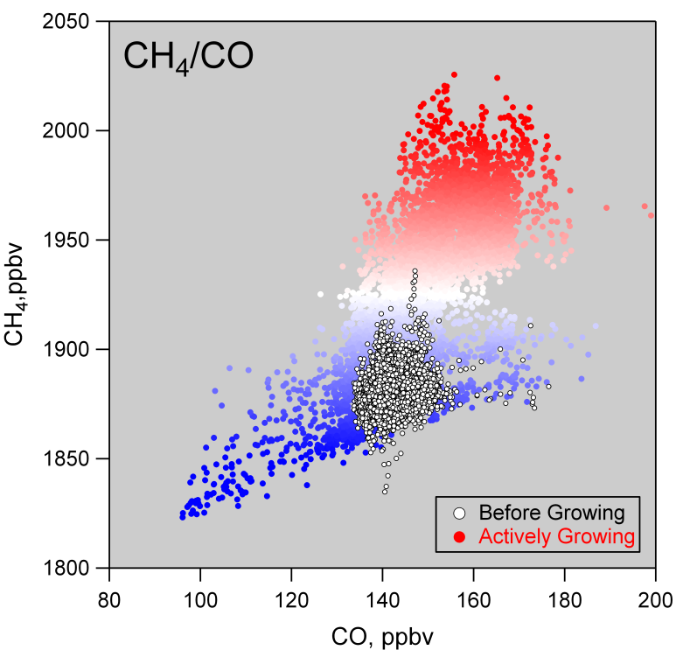
CH₄ emission from Sacramento Valley rice crops
One month later – rice growing phase
same scale as before growing phase
data from 1:30 to 4 pm PDT

Slide 29
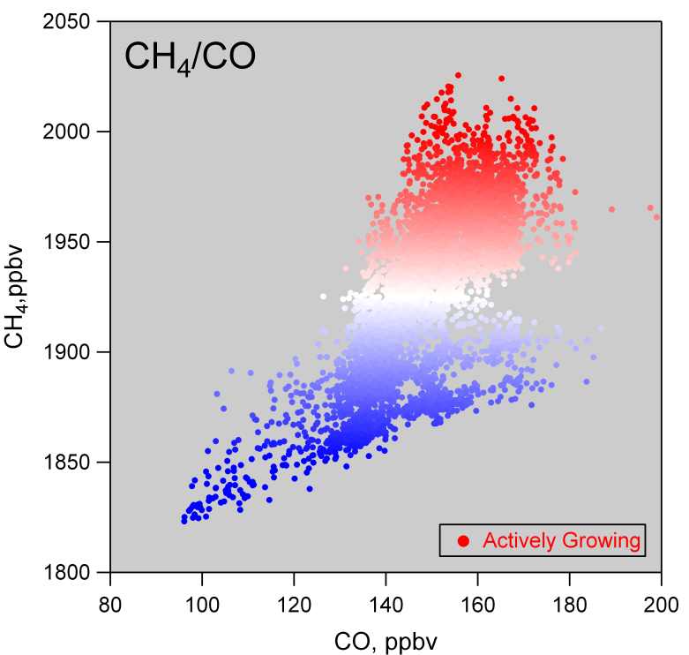
CH₄ emission from Sacramento Valley rice crops
One month later – rice growing phase
same scale as before growing phase
data from 1:30 to 4 pm PDT
using June 14th data only:
use correlation with CO to remove urban CH₄ contribution
compare CH₄ emissions to McMillan

Slide 30
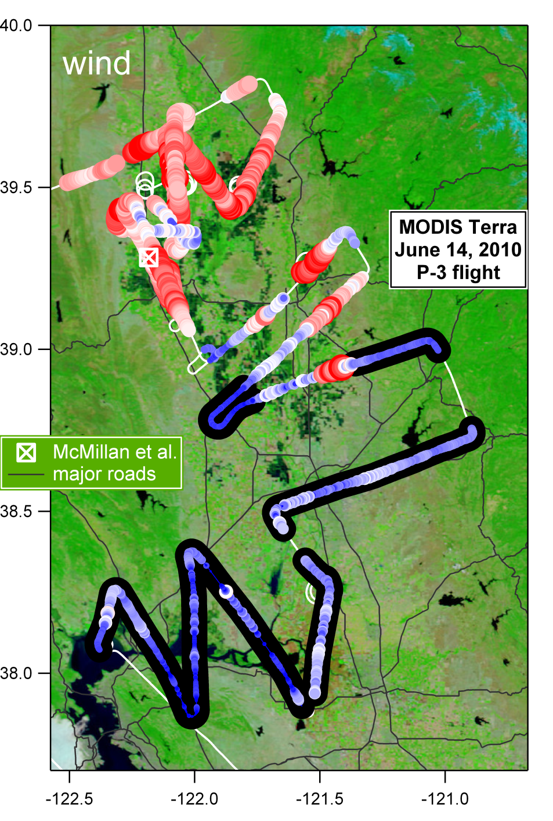
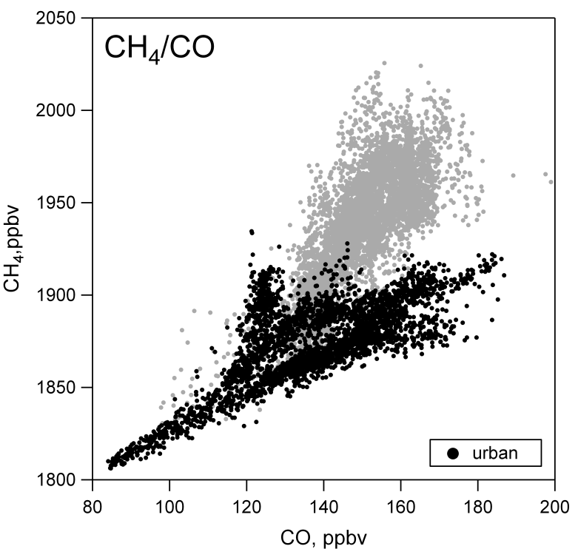
CH₄ emission from Sacramento Valley rice crops
Upwind of rice fields
urban & other non-rice

Slide 31
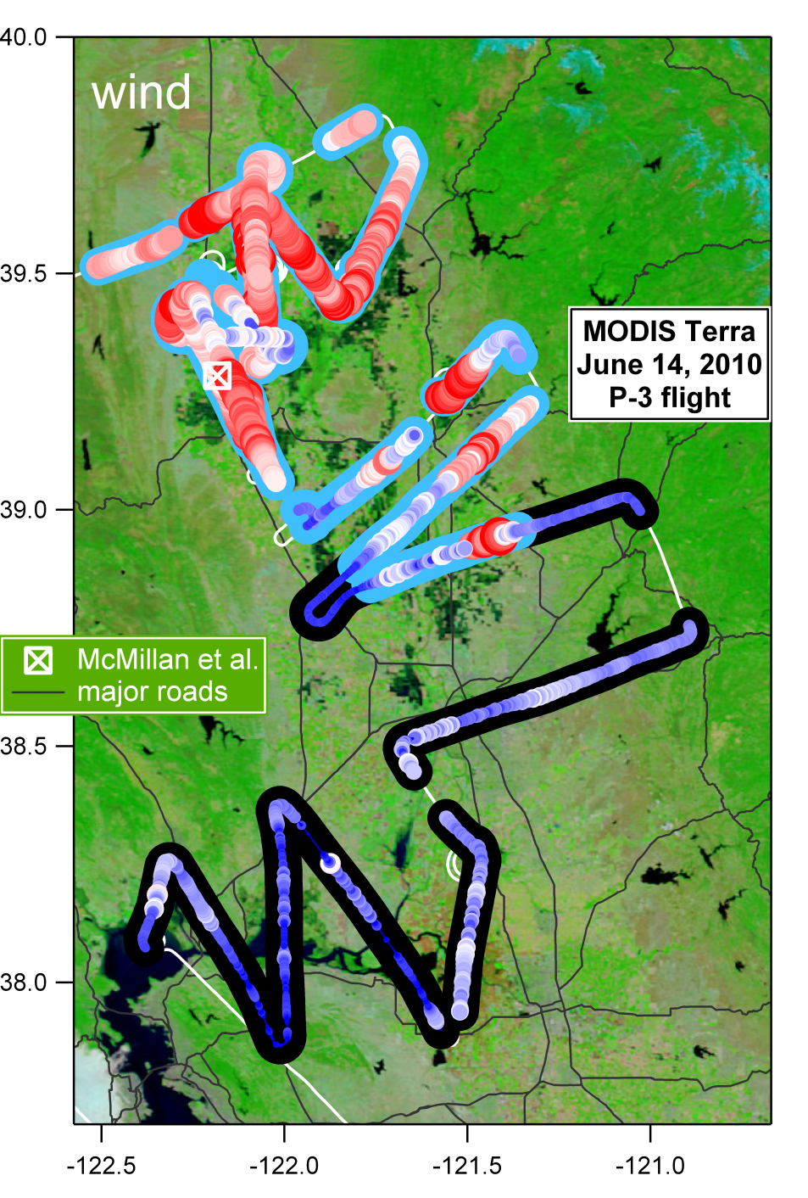
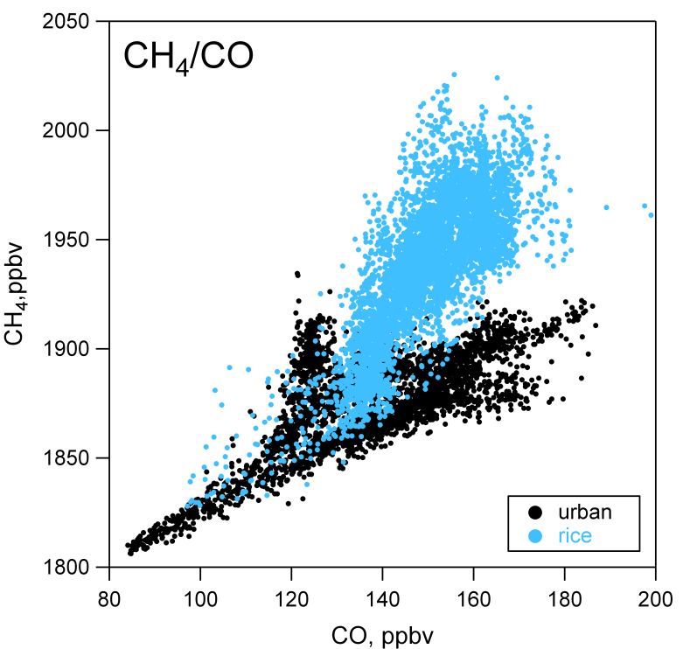
CH₄ emission from Sacramento Valley rice crops
CH₄ from rice
urban & other non-rice
rice

Slide 32
CH₄ emission from Sacramento Valley rice crops
CH₄ from rice
urban & other non-rice
rice
Compare to McMillan: CH₄ and CO₂

Slide 33
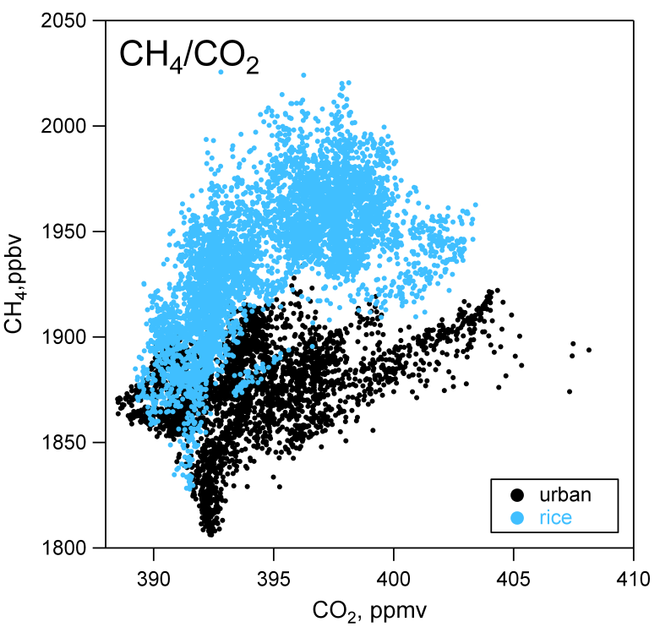
CH₄ emission from Sacramento Valley rice crops
CH₄ from rice
urban & other non-rice
rice
Compare to McMillan: CH₄ and CO₂

Slide 34
CH₄ emission from Sacramento Valley rice crops
CH₄ from rice
urban & other non-rice
rice
Compare to McMillan: CH₄ and CO₂

Slide 35
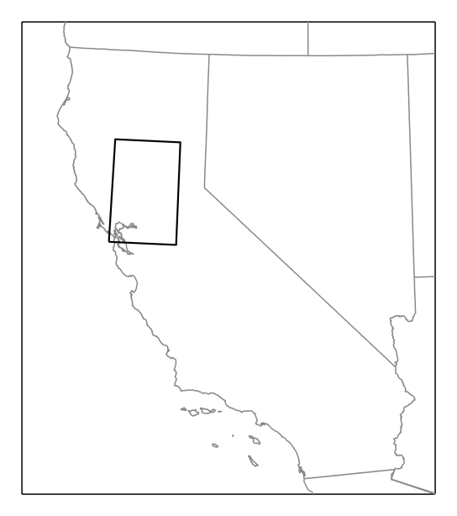
CH₄ emission from Sacramento Valley rice crops
CH₄ from rice
Further analysis of CO₂ and CH₄ from photosynthesis , respiration, and other sources and sinks:
Inverse modeling – NOAA
Transport modeling – Wofsy group, e.g. see Santoni et al. (next)

Slide 36
Summary
We can clearly see CH₄ point and area sources in
P-3 data: rice, dairies, and the mix of sources in
the L.A. Basin. Future analysis will try to
quantify CH₄ contribution from these sources.
ARB criteria pollutants emissions inventory ratio
of CH₄/CO in the L.A. Basin significantly lower
than observations
Data over rice fields provides spatial data, along
with other data sets:
QCLS data from CalNex
(Wofsy group)
NOAA ESRL GMD/LBNL light aircraft
(C. Sweeney, A. Karion, M. Fischer)
NASA ARCTAS-CARB
(G. Diskin, G. Sachse, S. Vay)
to constrain inverse (NOAA) and STILT (Wofsy) models

Slide 37
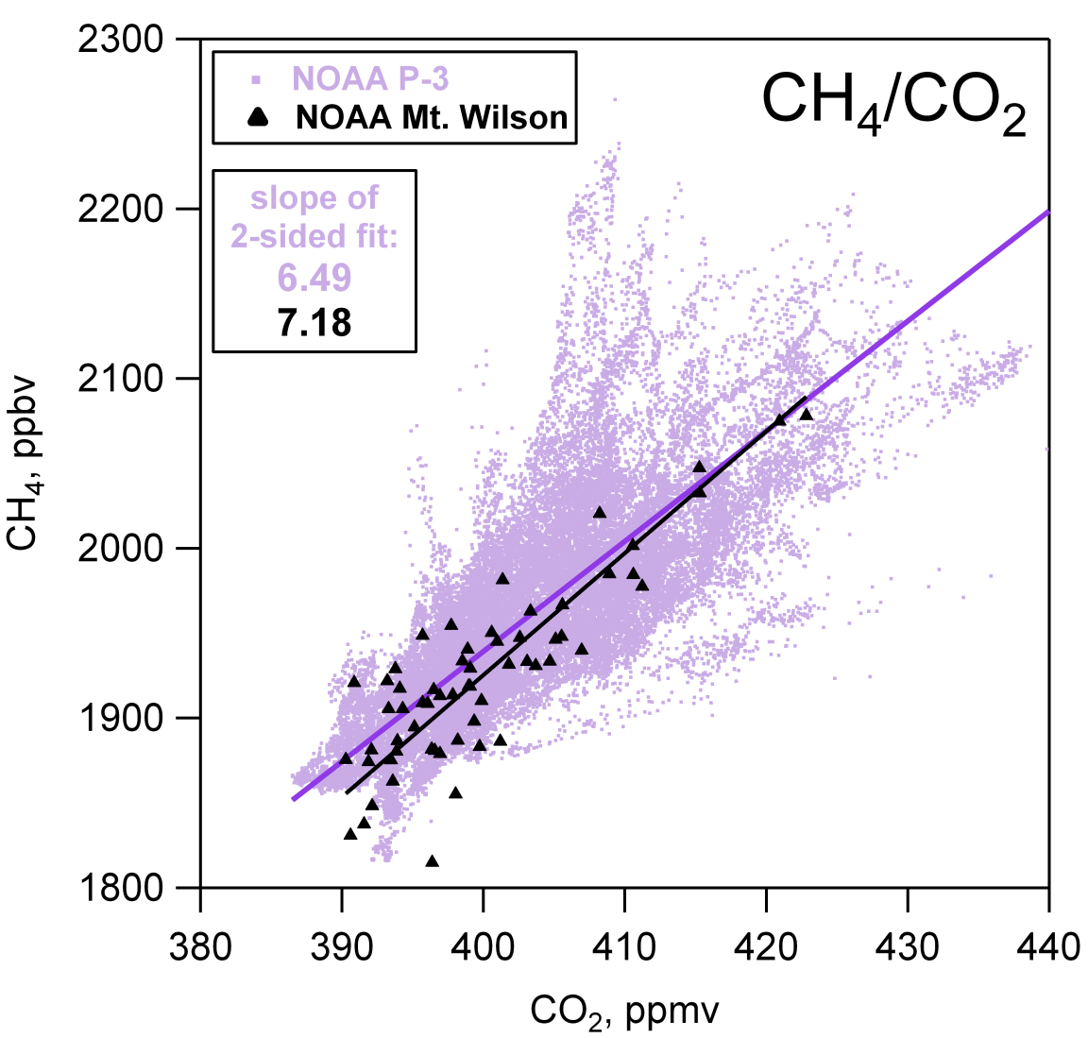

Slide 38
