Slide 1
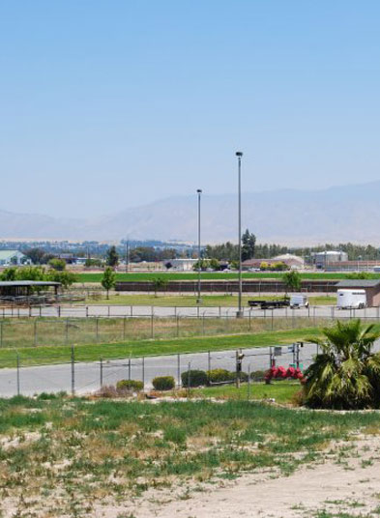
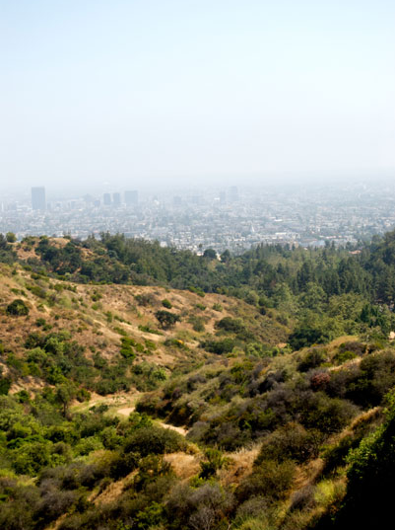



A Tale of Two Extremes: Contrasting NH₃ at the Bakersfield and Pasadena Supersites
Jennifer Murphy
Milos Markovic
Trevor VandenBoer
Raluca Ellis
Department of Chemistry
University of Toronto

Slide 2


Ammonia and Particle Formation
Highly coupled and non-linear
H₂SO₄
HNO₃
NH₄NO₃
(NH₄)₂SO₄
NO_{x}
NH₃
SO₂

Slide 3
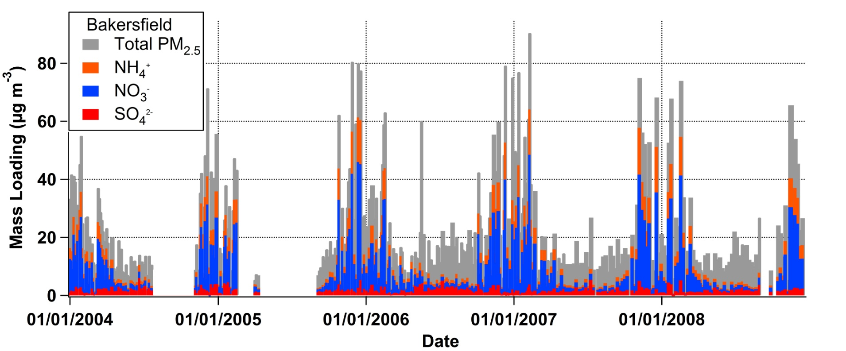
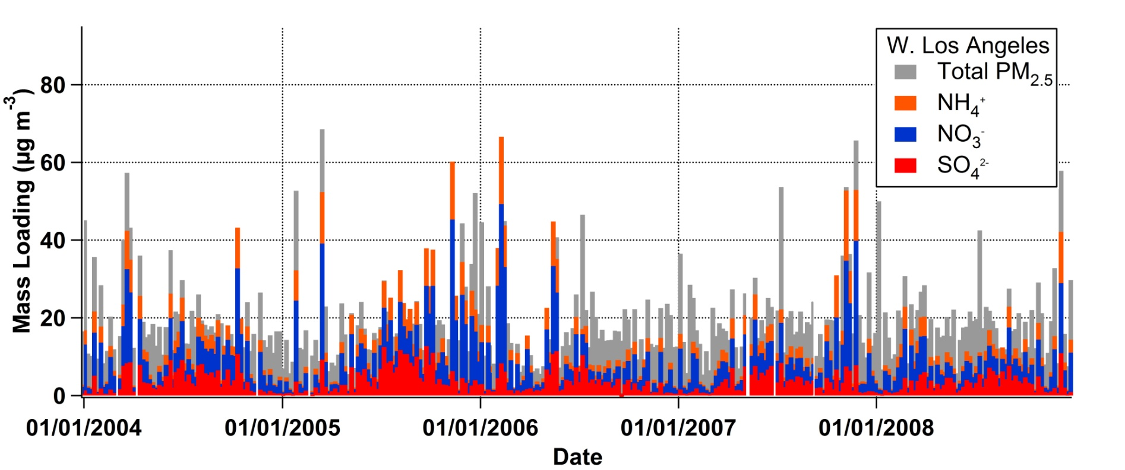
Historical CARB data
seasonality in NH₄NO₃
seasonality in (NH₄)₂SO₄

Slide 4
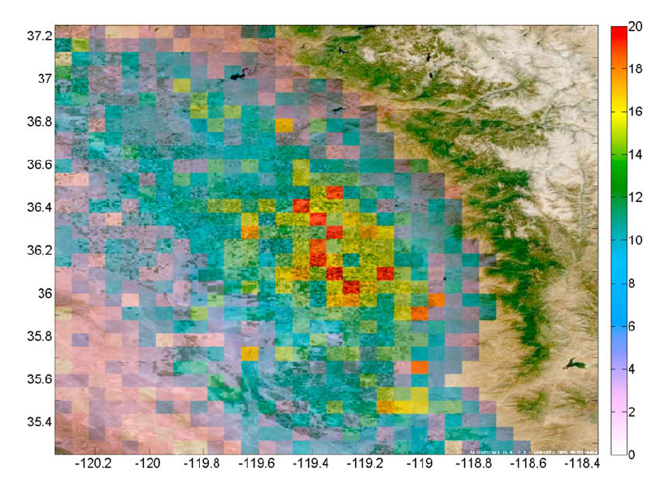
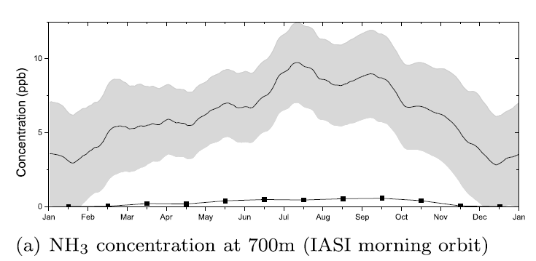
NH₃ in the San Joaquin Valley
Fresno
Visalia
NH₃ (ppb)
TM5 model prediction
Bakersfield
IASI retrieval of atmospheric ammonia
Mar – Oct average at 700 m during morning orbit (09:30 local)
Clarisse et al., JGR, 2010

Slide 5
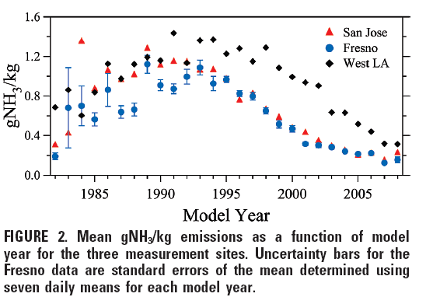
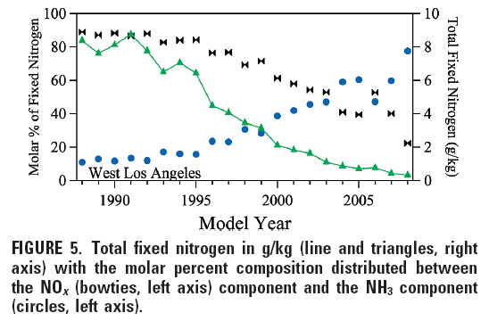
Mobile Emissions of NH₃
Mobile emissions of NH₃ comparable to NO_{x} in new, aggressively driven, vehicles
Bishop et al., ES&T, 2010

Slide 6
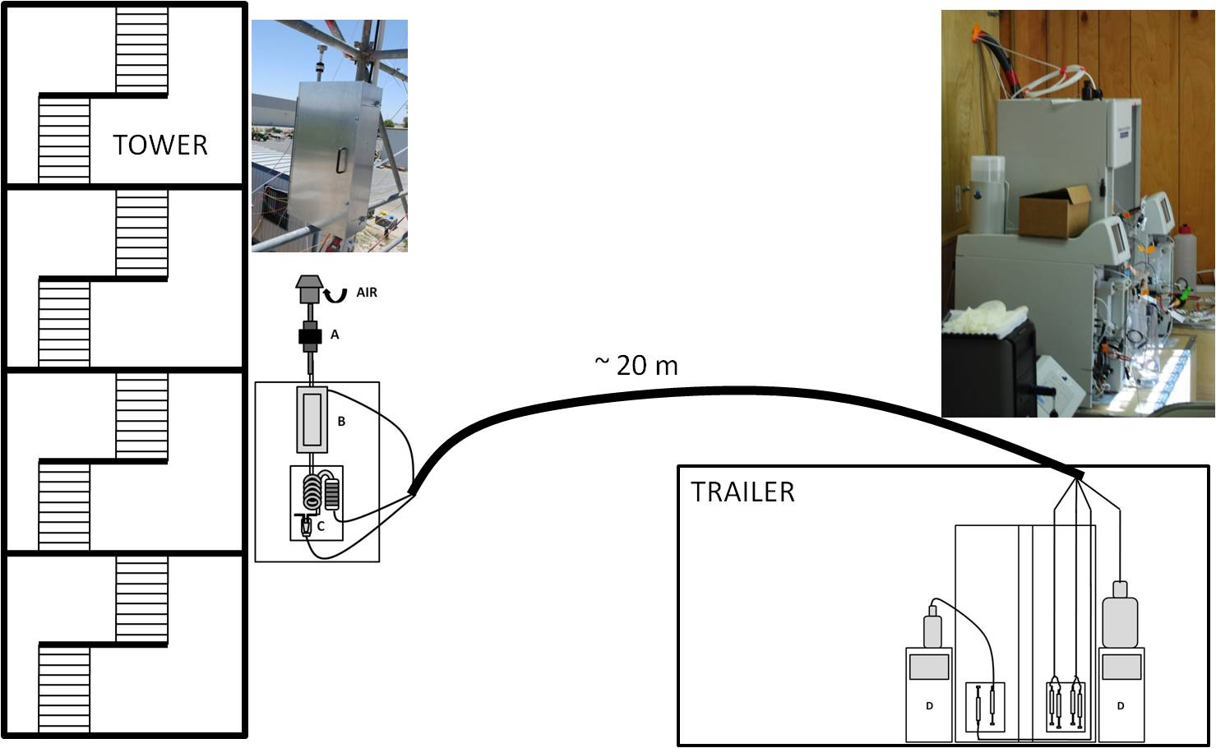
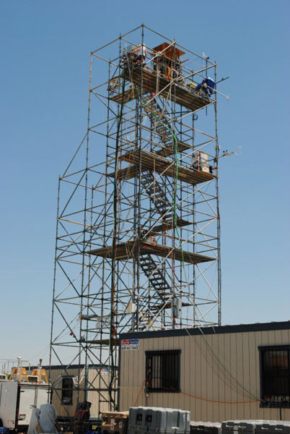
AIM-IC in Bakersfield
A – PM_{2.5} impactor
B – membrane denuder
C – particle collection chamber
D – ion chromatographs
Hourly gas and PM_{2.5} measurements of
SO₄²⁻, NO₃⁻, Cl⁻, Br⁻, NO₂⁻, organic acids
NH₄⁺, K⁺, Na⁺, Mg²⁺, Ca²⁺, amines

Slide 7
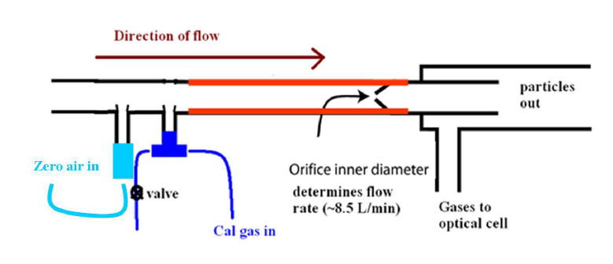
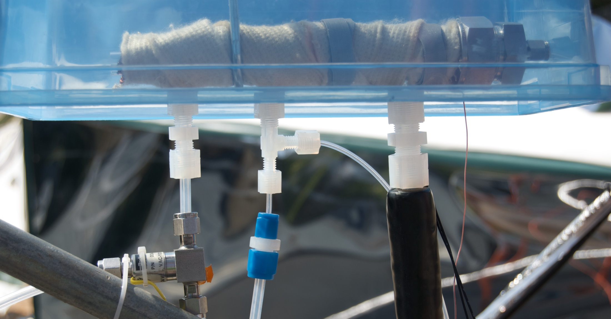
QC-TILDAS in Pasadena
Fast (1Hz) measurements of gas phase NH₃ with minimal sampling artefacts
Ellis et al., Atmos Meas Tech, 2010

Slide 8
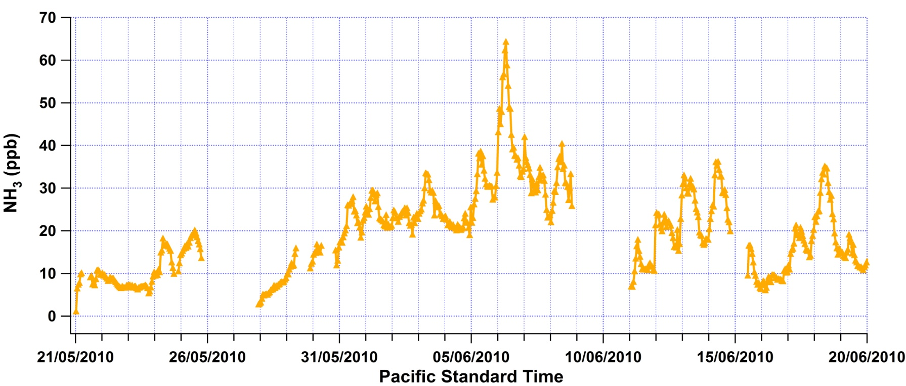
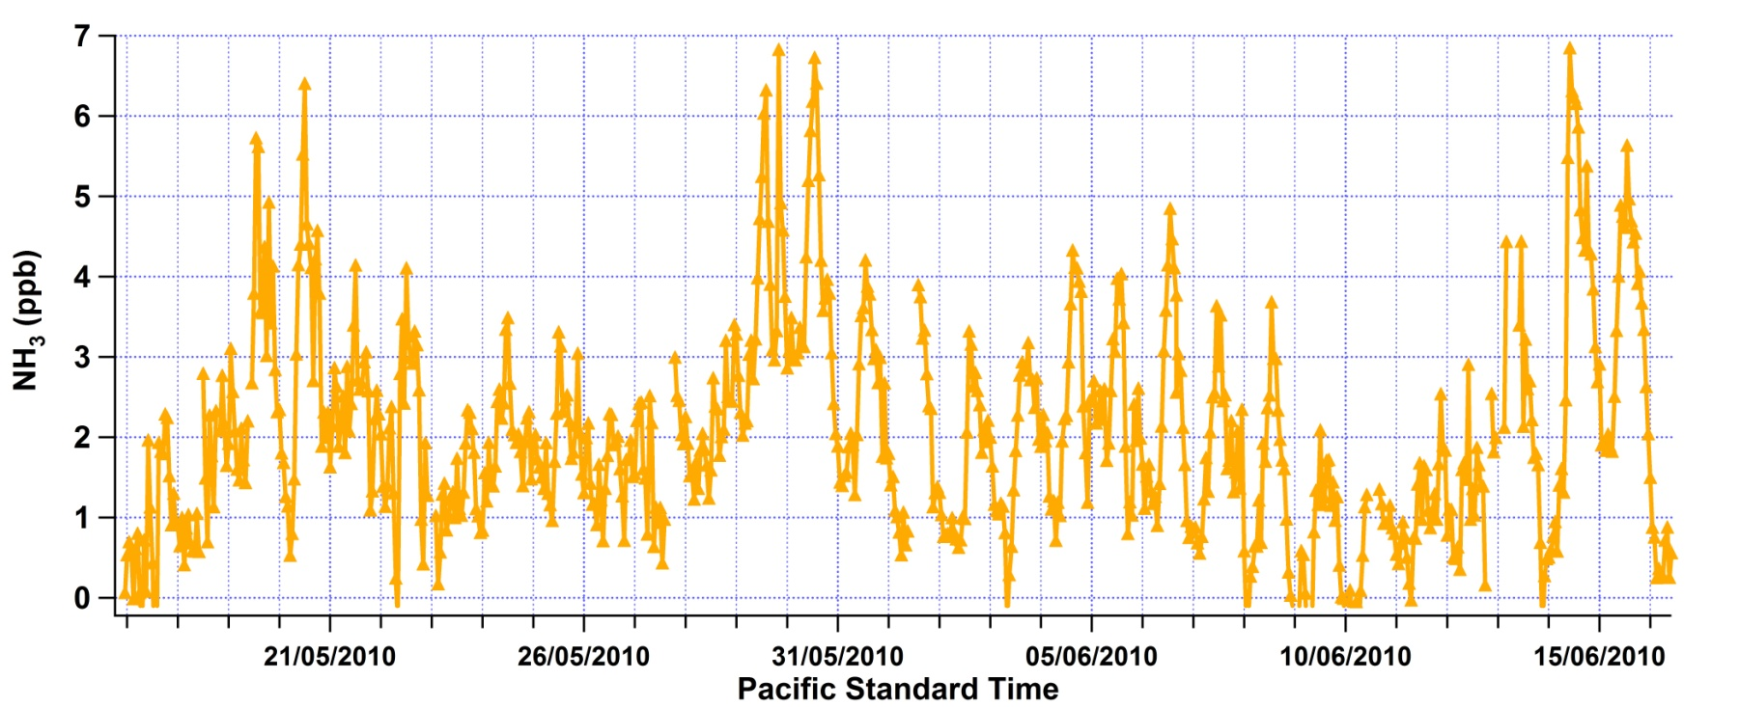
Ammonia Time Series
Bakersfield
Pasadena
hourly averages

Slide 9
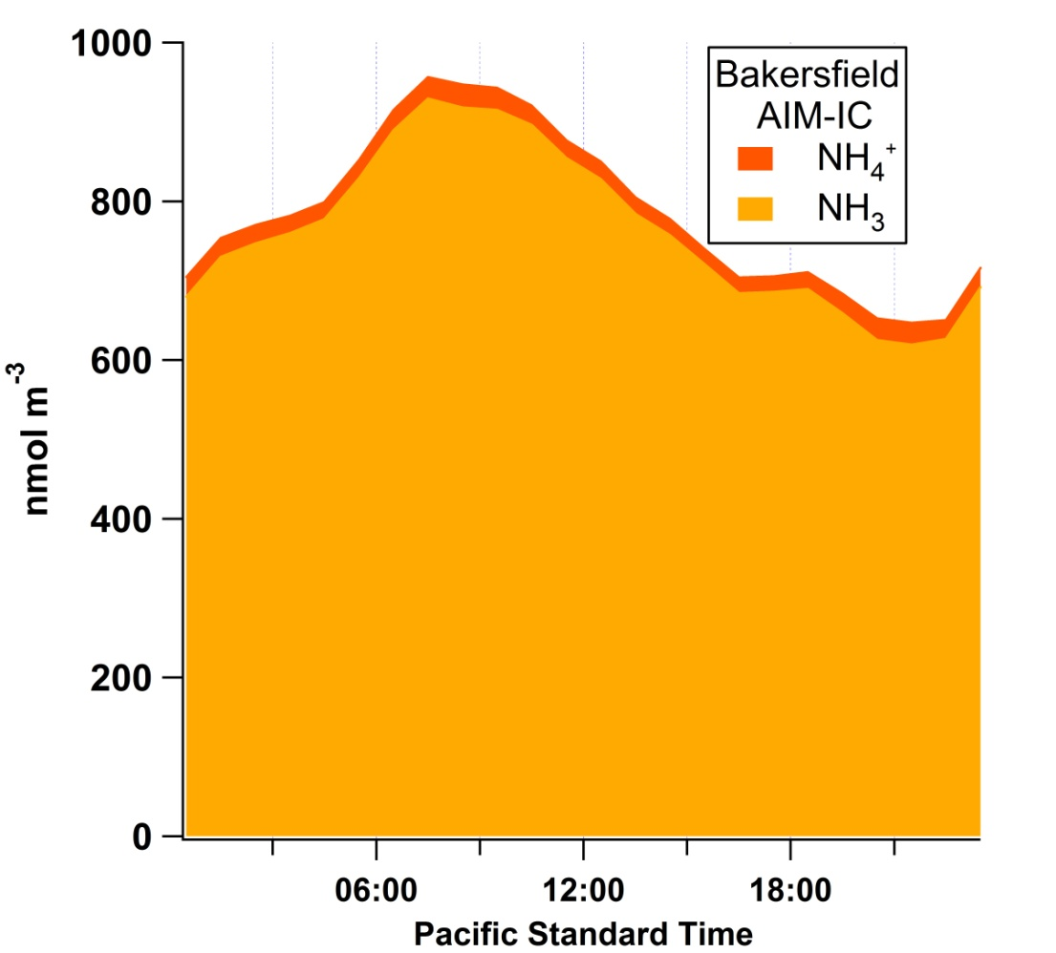
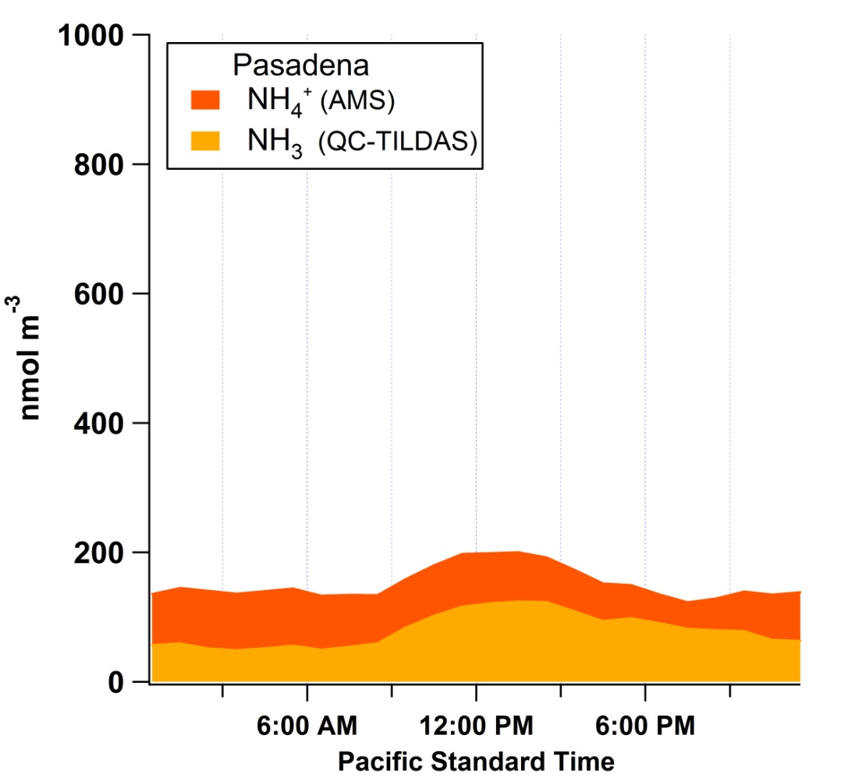
Diurnal Profiles of NH_{x} Partitioning
Ammonia is controlled by emissions and dilution
Ammonia is controlled by partitioning and transport
AMS data from Jimenez group, CU

Slide 10
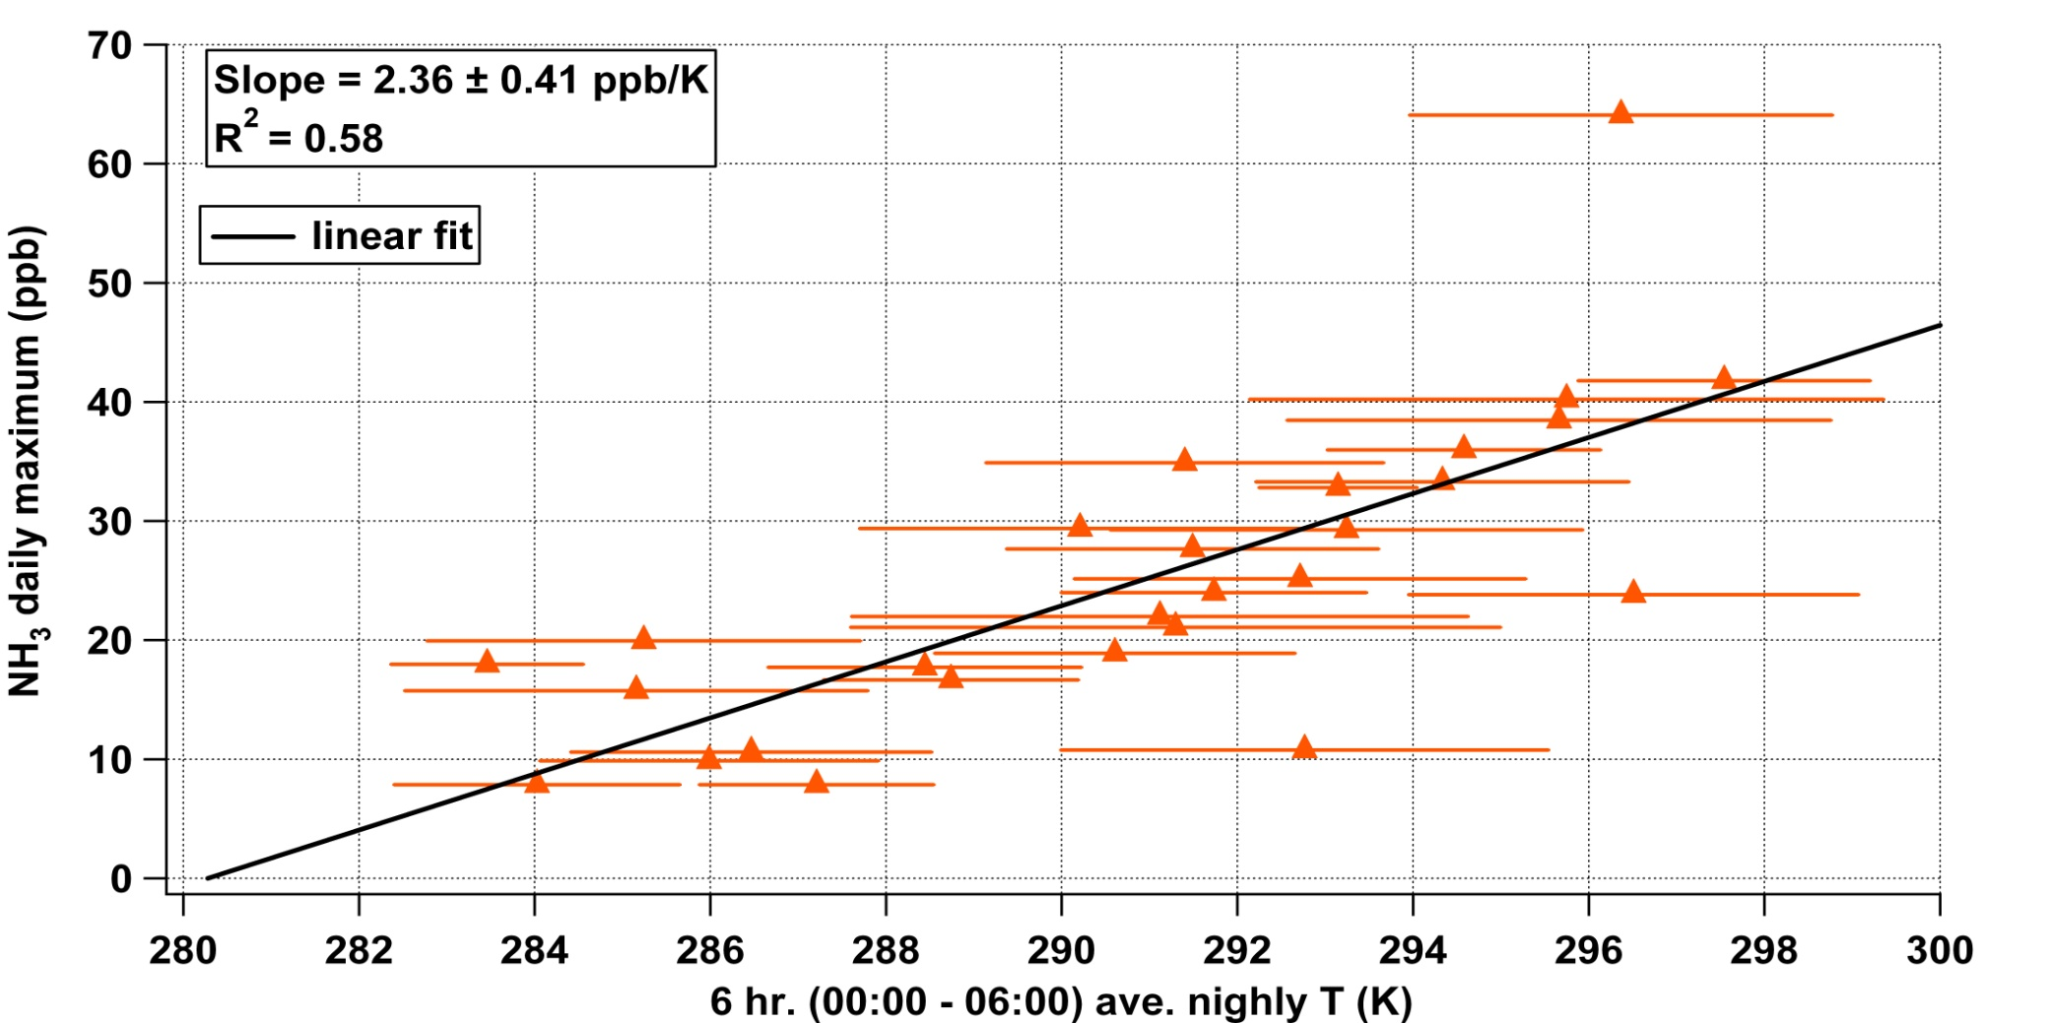
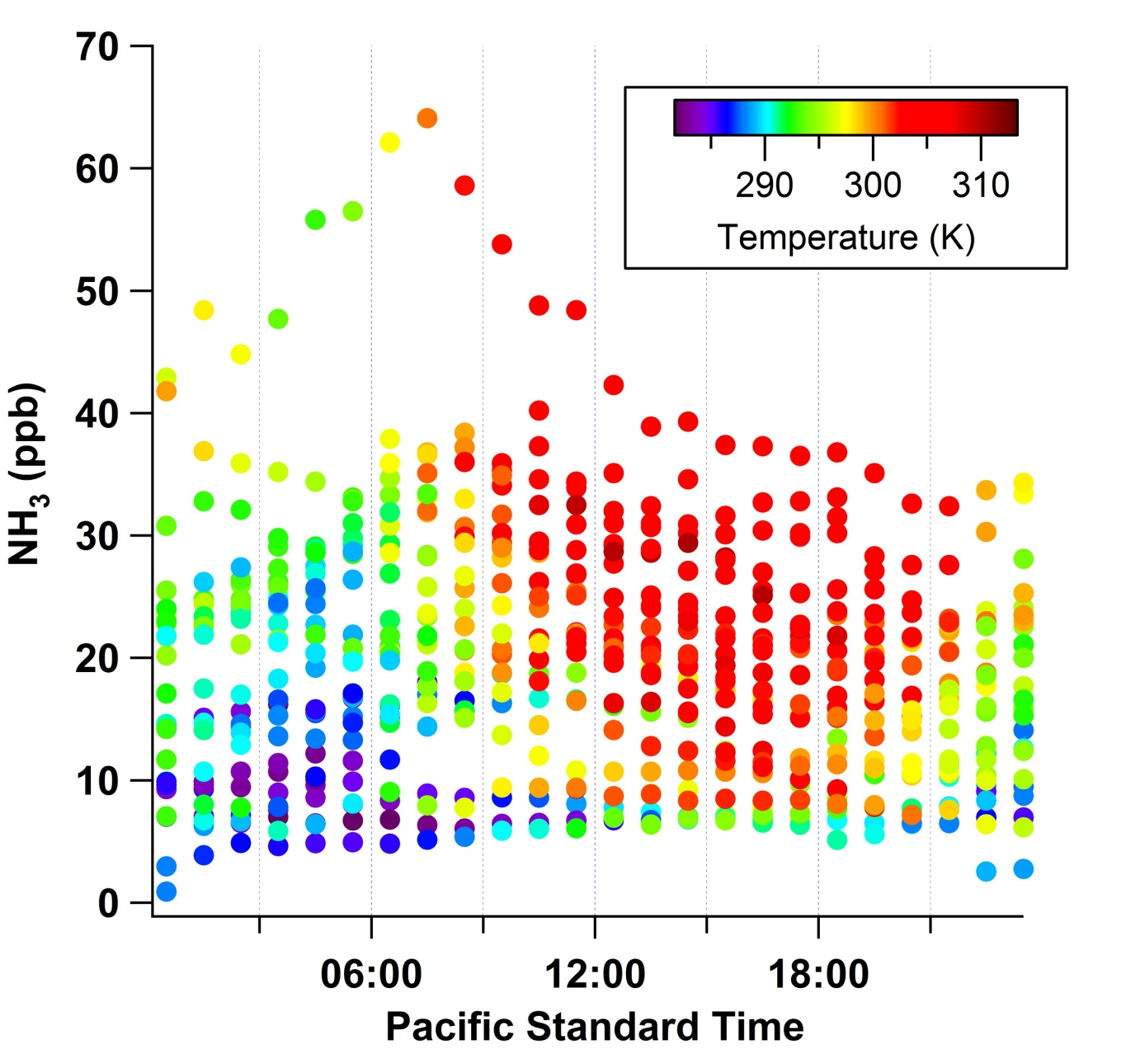
Temperature and NH₃ at Bakersfield
Daily Maximum Ammonia (ppb)
Overnight Temperature (K)

Slide 11
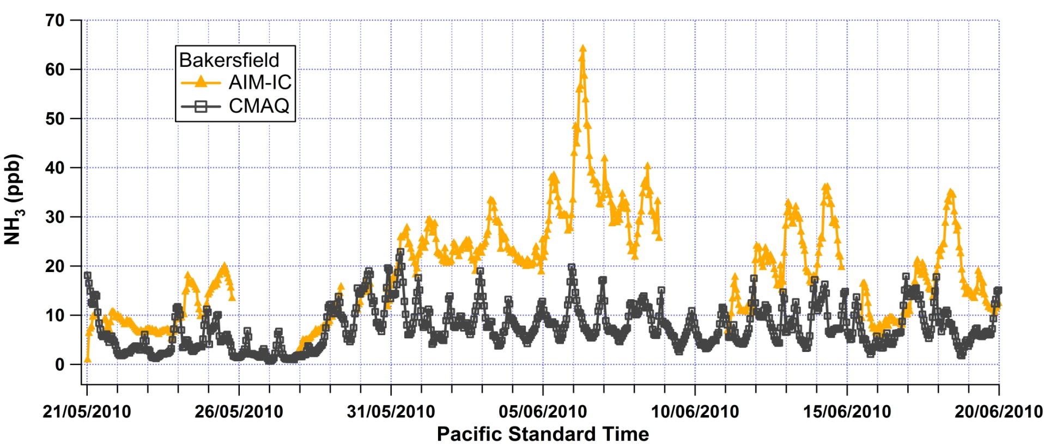
Comparison with Model
CMAQ data courtesy of Kirk Baker, US EPA

Slide 12
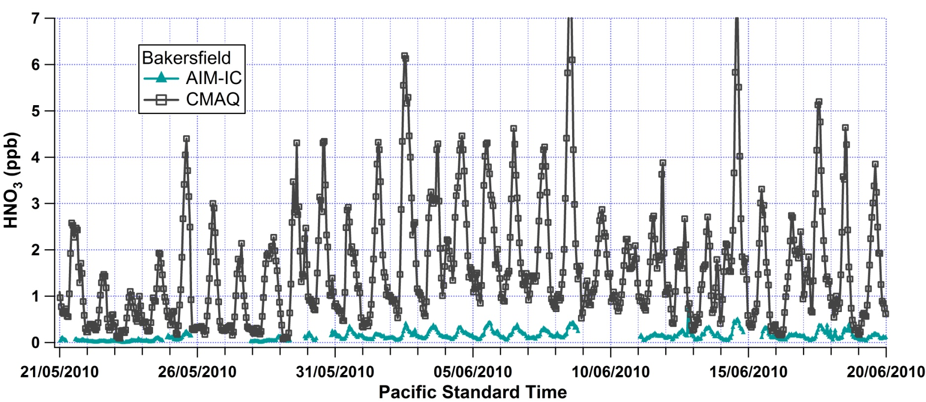
Model usually has a low bias for NH₃
Model usually has a high bias for HNO₃
Model overestimates NH₄NO₃

Slide 13
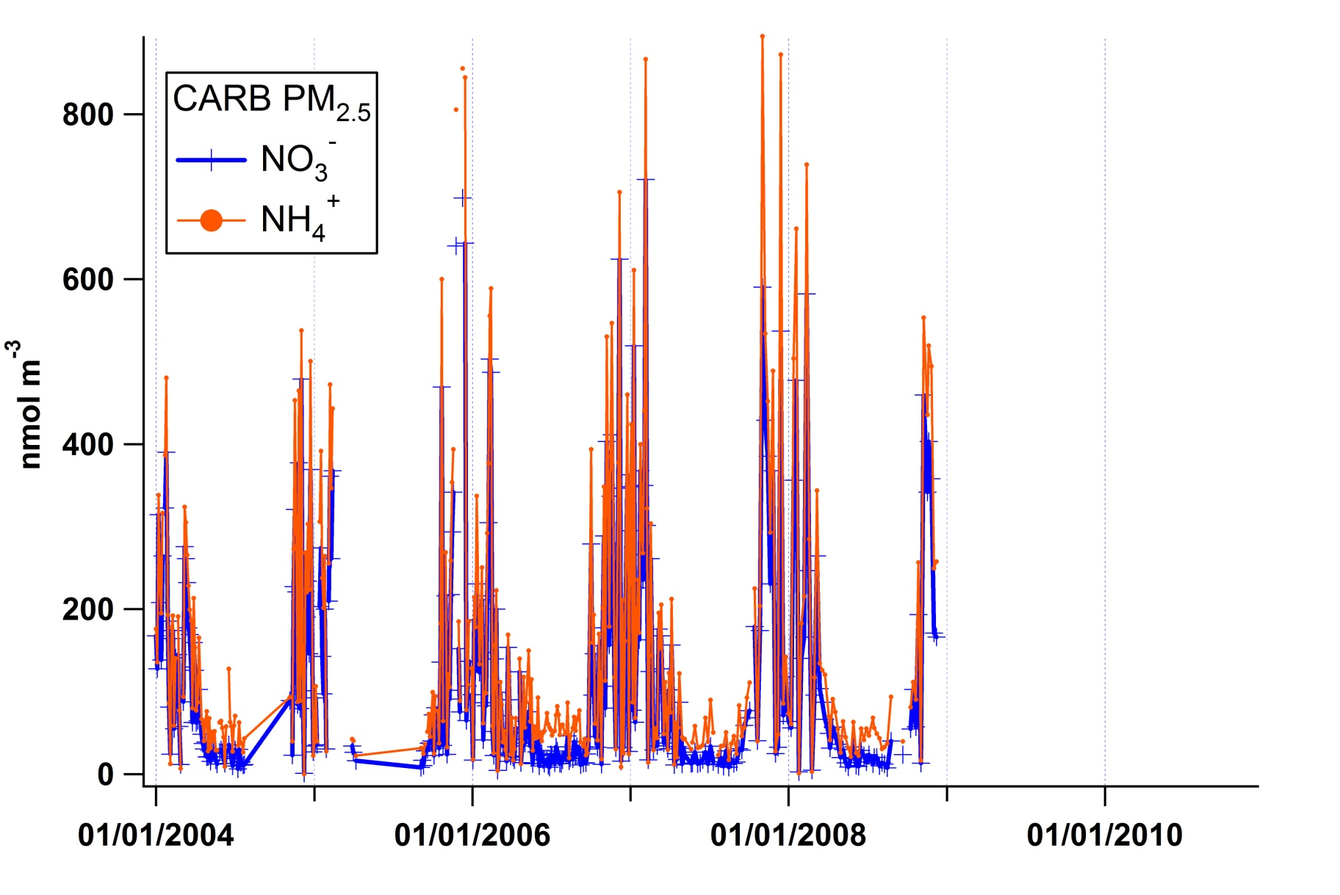
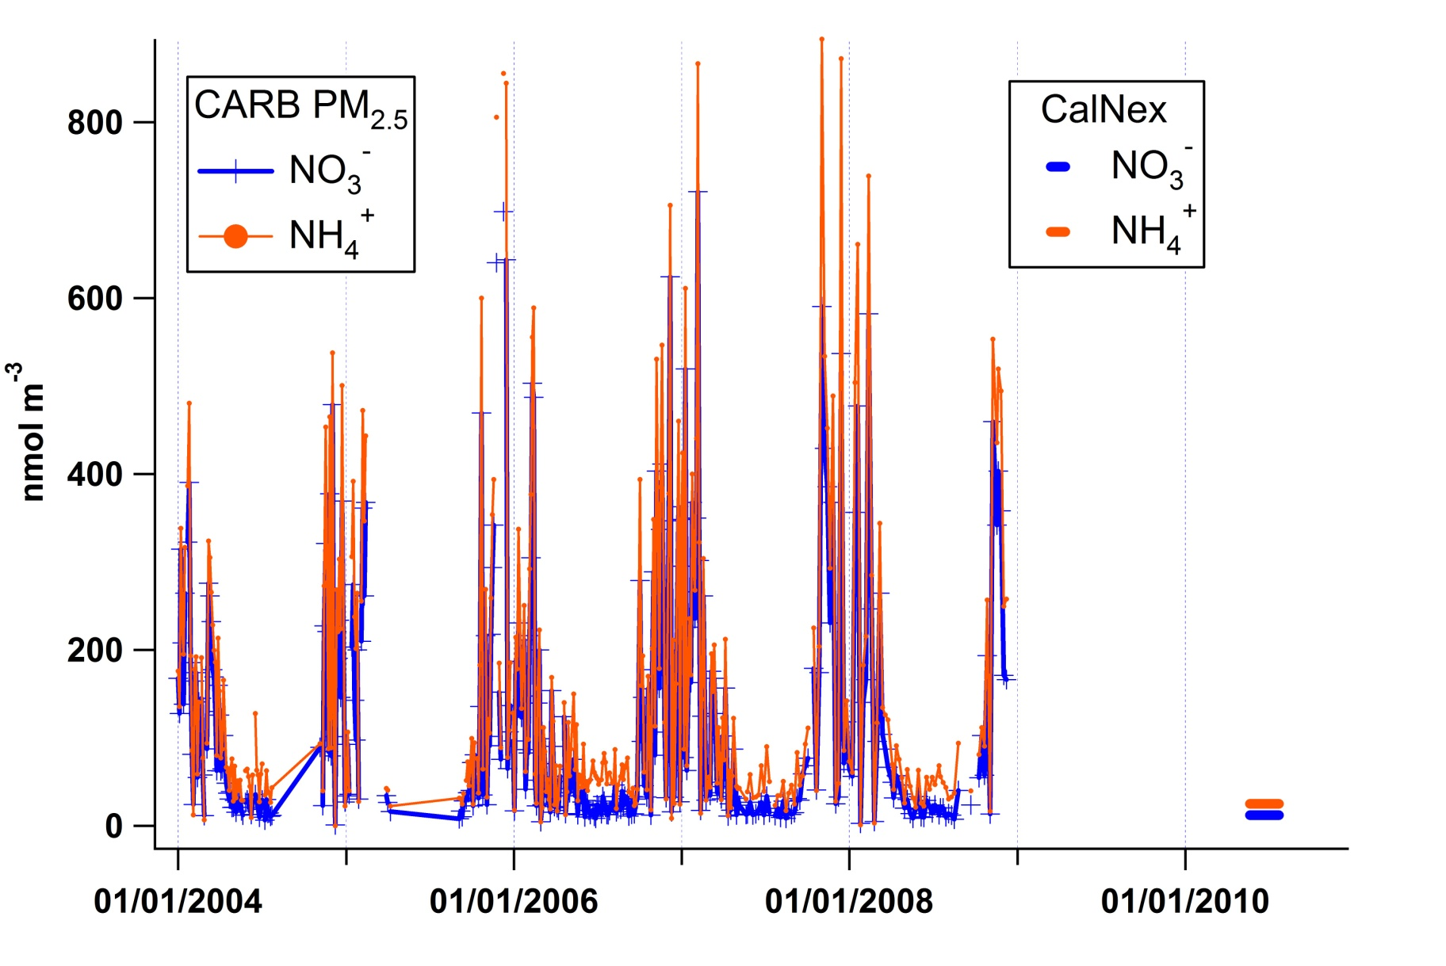
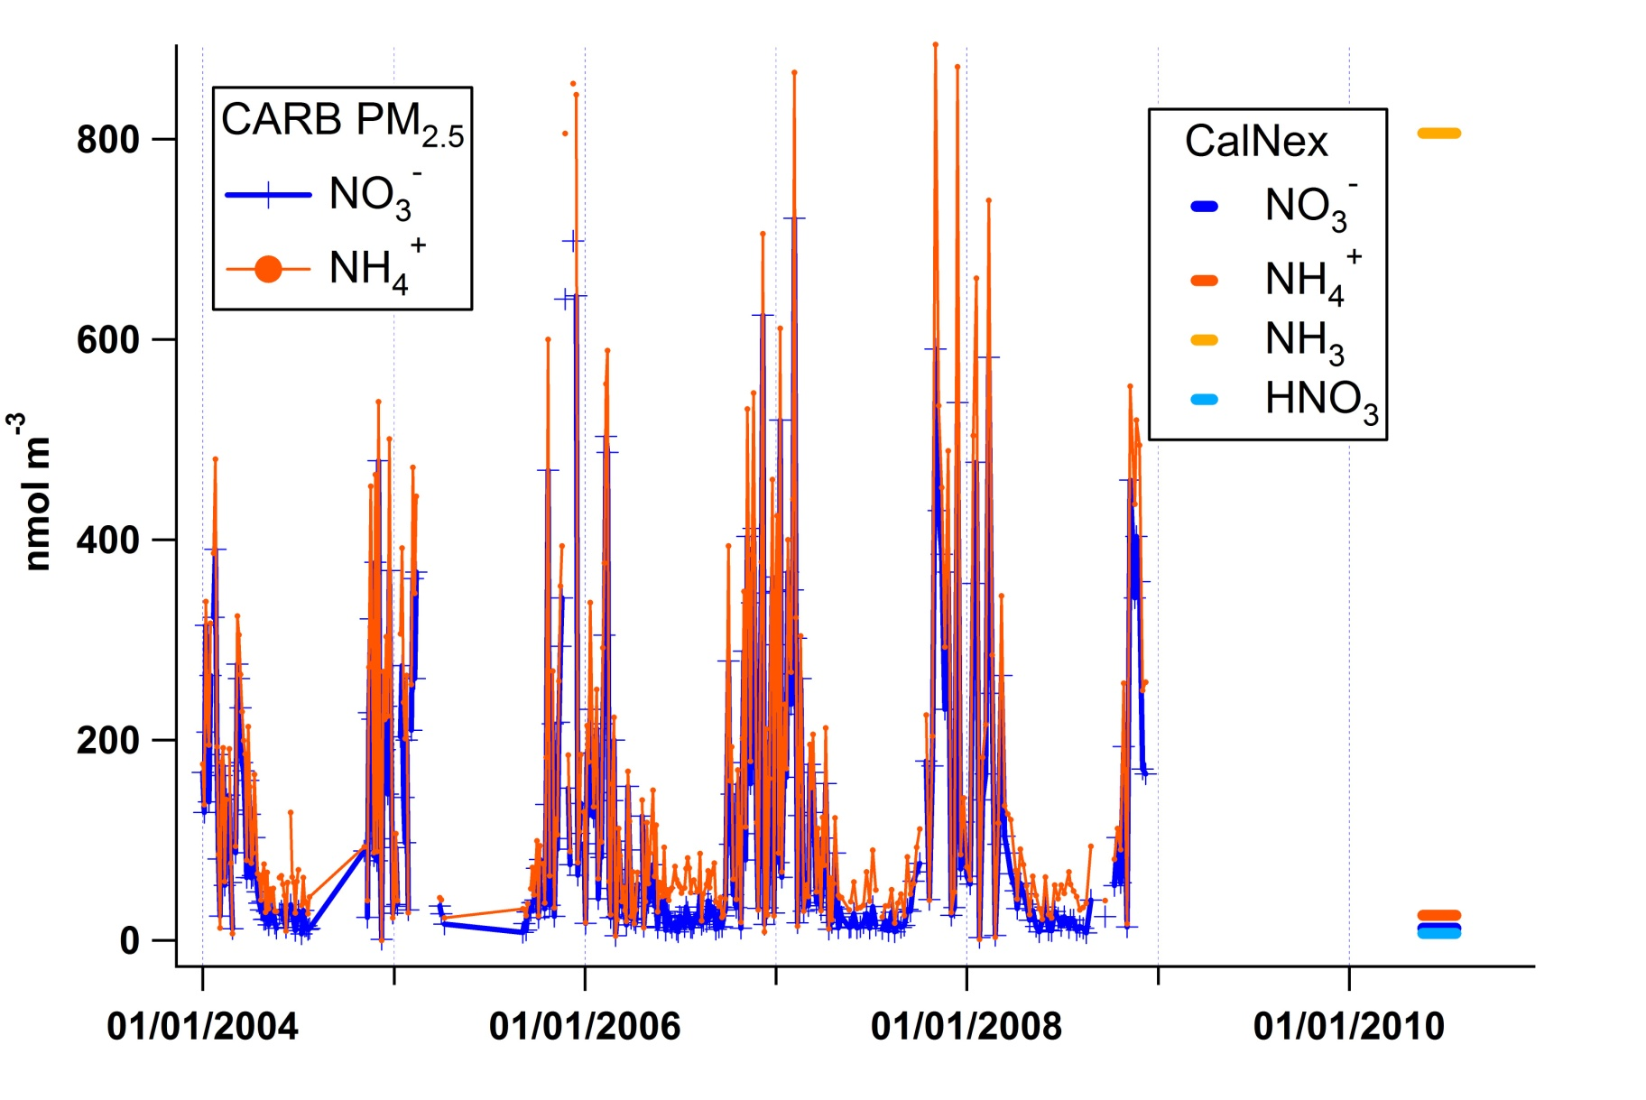
Historical Record at Bakersfield
Partitioning can account for winter NH₄⁺, but not NO₃⁻

Slide 14
Summary
NH_{x} is ~4 times larger at Bakersfield than at Pasadena
different processes control NH₃ at the two ground sites
CMAQ does not represent Bakersfield NH₃ well
(emissions or partitioning)
Additional Questions
aerosol pH
influence of/on organic acids
relative contributions of NH₃ emissions sources

Slide 16
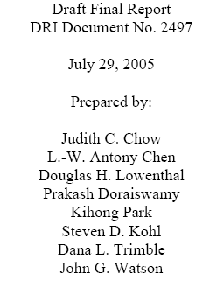
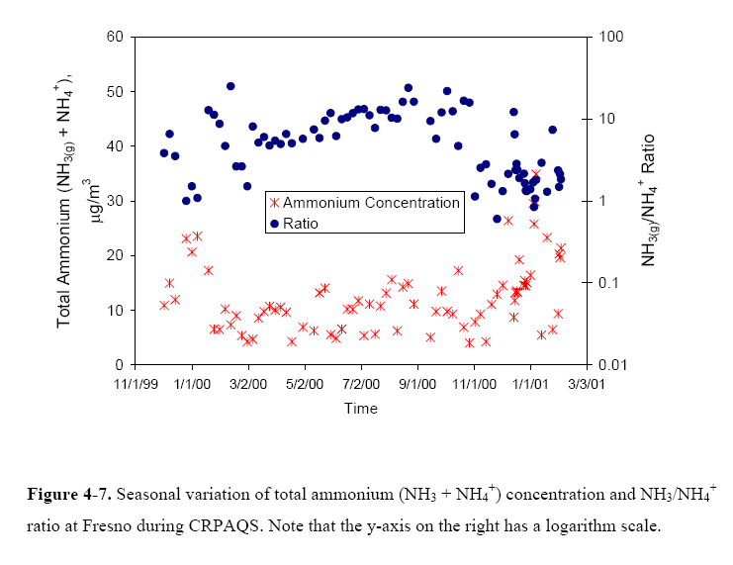

Slide 17
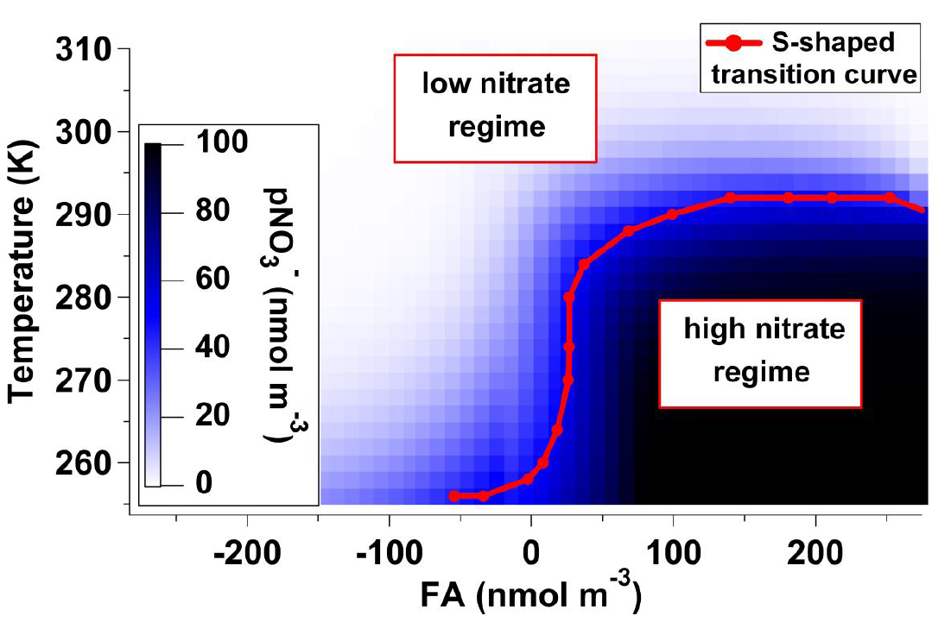
FREE AMMONIA, FA = TA – 2 * TS
= [NH₄⁺] + [NH_{3(g)}] – 2 * [SO₄²⁻]
Ohio Valley
Particle Fraction
predict partitioning using ISORROPIA
Markovic et al., Atmos. Chem. Phys., 2011

Slide 18
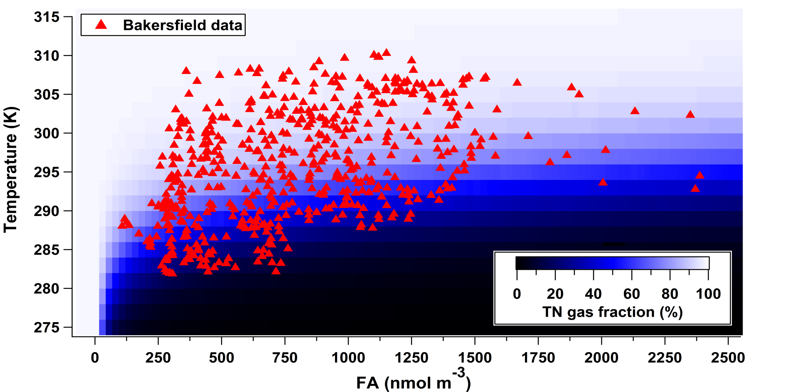
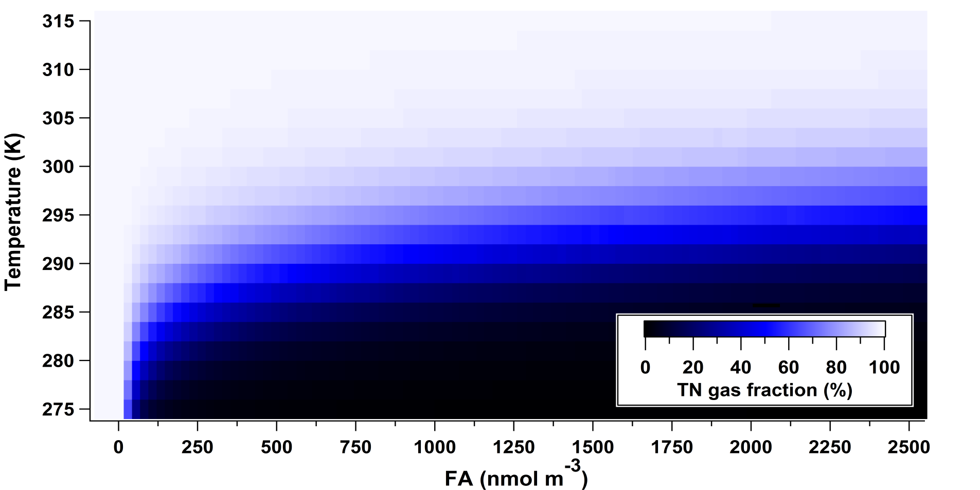
High NH₃, low TS and TN
Nitrate partitioning driven mainly by meteorology
100 80 60 40 20 0
Particle Fraction
Conditions:
RH = 40 %, T = 275 – 315 K, TN = 20 nmol m⁻³ , TS = 21 nmol m⁻³ , TA = 0 - 2750 nmol m⁻³
FA values during the campaign = ( -42 nmol m⁻³ to 2750 nmol m⁻³ )

Slide 19
Pasadena data on chemical map generated assuming TN = 100 nmol m⁻³
TN actually ranges from 10 – 700 and correlates with FA
Particle Fraction

