Slide 1
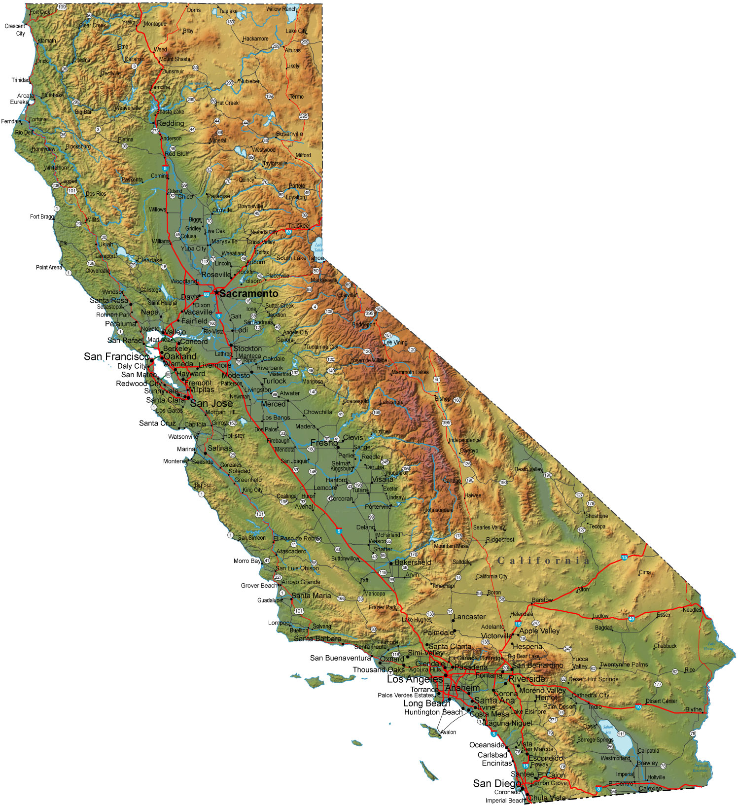
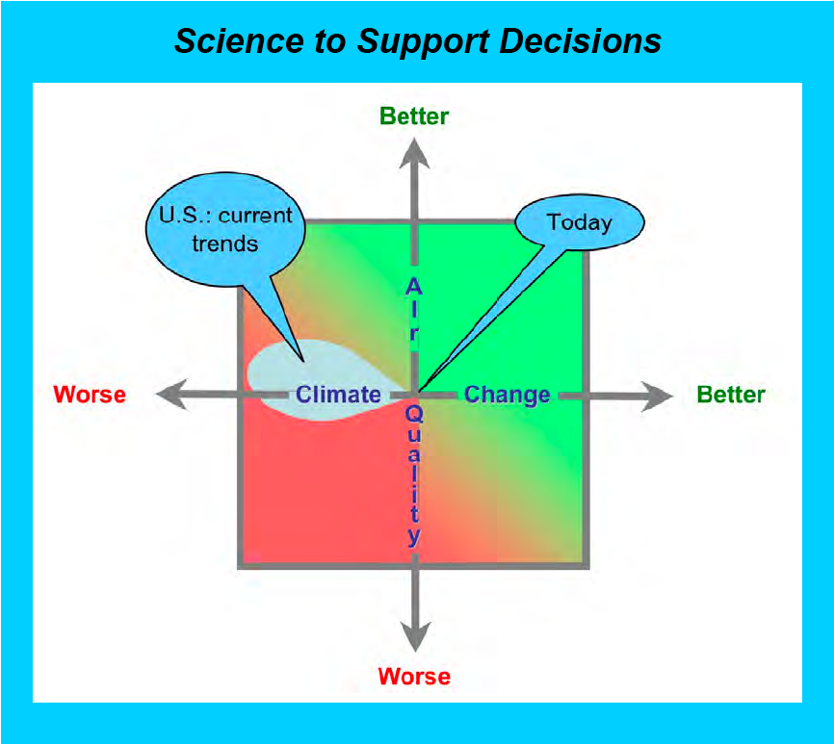
Aircraft measurements of NO₃ and N₂O₅ over Los Angeles during CalNex 2010
Steven S. Brown, James M. Roberts, Nicholas L. Wagner, William P. Dubé, Ilana Pollack, Thomas B. Ryerson, Charles A. Brock, Sara M. Lance, J. Andrew Neuman, Roya Bahreini, Ann M. Middlebrook, John S. Holloway, Eliot Atlas, Carsten Warneke, Joost de Gouw, David D. Parrish
Outline
• Intro to nighttime chemistry – goals and science questions from the night flights
• Nocturnal layers encountered during CalNex flights – structure, transport and chemistry
• Efficiency of N₂O₅ heterogeneous uptake. How does L.A. compare to other regions?
CalNex Data Workshop, Sacramento, CA
May 2011

Slide 2
Diurnal Nitrogen Oxide Cycles
Free Troposphere
Free Troposphere
0.8 - 1 km
Daytime Boundary Layer
Residual Layer
NO
O₃
VOC
NO
O₃
• 50 - 90% of NO_{x} → NO₃, N₂O₅ overnight
• NO₃ is a strong oxidant for HR VOC
• N₂O₅ het. uptake large NO_{x} sink and halogen source
• Chemistry in stable, stratified atmosphere
O₃
NO₂
OH
RO₂
hν
O₃
NO₂
NO₃
OH
NO₂
∆
N₂O₅
HNO₃
Het
NH₃
HNO₃
ClNO₂
PM
0.1-0.4
km
Nocturnal Boundary Layer
DMS
Sea Salt
Bio VOC
VOC, NO_{x}
SO₂, PM
DMS
Sea Salt
Bio VOC
VOC, NO_{x}
SO₂, PM
Soil NO
Soil NO
Day: Catalytic O₃ production
Night: NO_{x}, VOC ,O₃ transformed

Slide 3
May 24
P-3 Night Flights During CalNex
May 24: Day into night (mainly late afternoon), Central Valley Transport
May 30: Evening into night, LA Basin & over water. Atlantis over-flight
May 31: Nighttime only, LA Basin, over water & deserts.
June 2, 3: Night into Day, LA Basin & deserts
NO₃ up to 430 pptv; N₂O₅ up to 3.5 ppbv
May 30
May 31

Slide 4
NO₃ , N₂O₅ Production Rate, Lifetime - May 31st
Desert
Los
Angeles
Los
Angeles

Slide 5
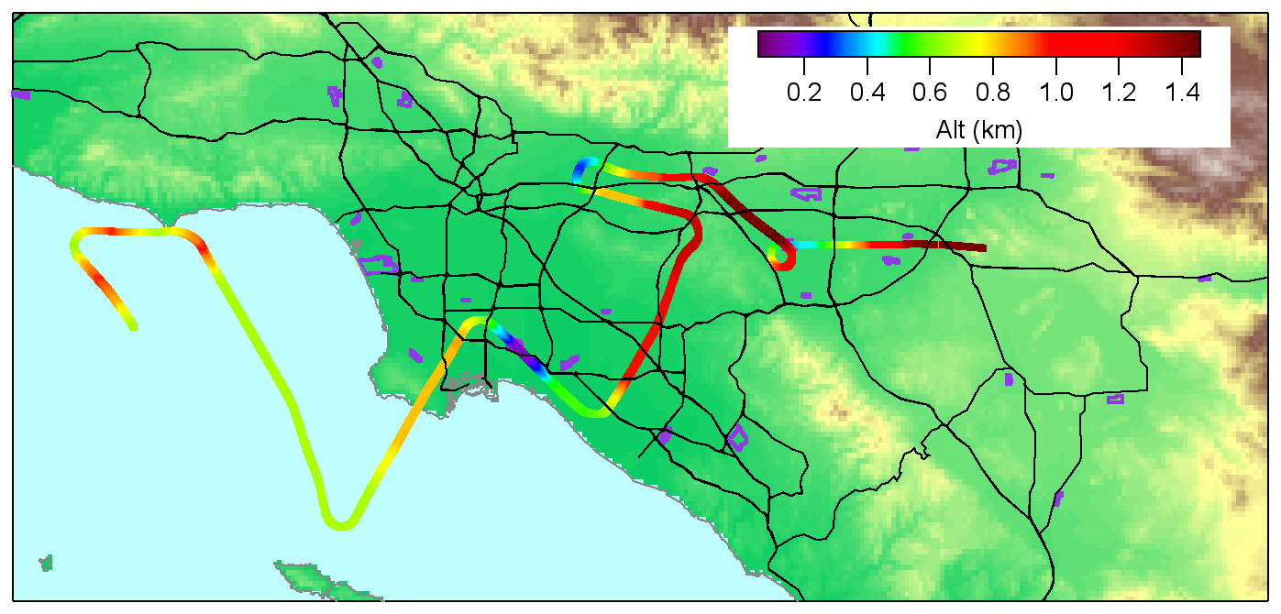
Layer Structure and Transport at Night: Vertical Profiles
Brackett
El Monte
Ontario
LAX
Chino
Long
Beach
80 vertical profiles during darkness / early morning
58 associated with missed approaches

Slide 6
Coastal Boundary Layer Profile
LAX Missed Approach, May 30, 23:30 PDT
Residual
Layer
Nocturnal
Boundary
Layer
Surface layer ?

Slide 7
Coastal Boundary Layer Profile
Partitioning among reactive nitrogen species

Slide 8
East Basin Boundary Layer Profile
Chino Missed Approach, May 31, 02:20 PDT
Residual
Layer
Intermediate
Layer
NBL ?

Slide 9
Chino Boundary Layer Profile
Partitioning among reactive nitrogen species

Slide 10
Coastal Boundary Layer Profile
Marine Intrusion
LAX Missed Approach, June 2, 02:30 PDT
Residual
Layer ?
Nocturnal /
Marine
Boundary
Layer

Slide 11
East Basin Boundary Layer
Marine Intrusion
Takeoff from Ontario, June 2, 01:00 PDT

Slide 12
East Basin Boundary Layer
Marine Intrusion
Reactive nitrogen partitioning

Slide 13
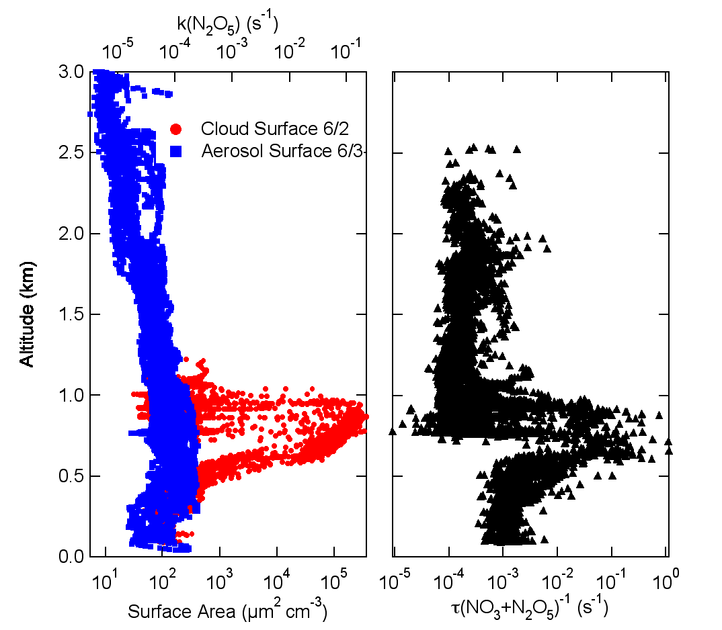
Role of Marine Stratus Clouds
LA Basin
Before Sunrise

Slide 14
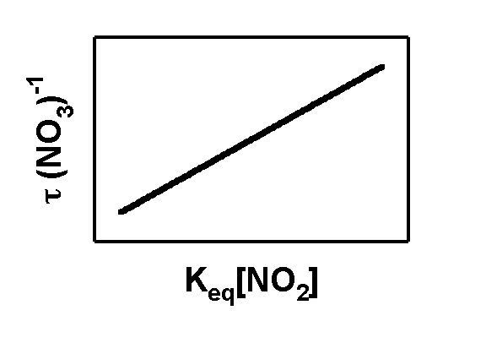
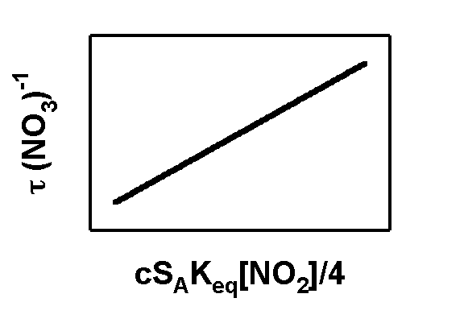
Determination of γ(N₂O₅) from Steady State Lifetimes
k_{NO3}
Oxidation Products
k_{S}
VOC
NO₂
NO₃
O₃
NO₂
H₂O
(Het)
K_{eq}
N₂O₅
HNO₃
k_{N2O5}
k_{N2O5}
k_{NO3}
But .. covariance between K_{eq}[NO₂] ,S_{A} & k(N₂O₅) !
γ(N₂O₅)
k_{NO3}

Slide 15
October 12, 2006 Flight
Example Plume – East L.A. Basin
7.5 hours after sunset, 600 m above ground level,
57% relative humidity, aerosol surface area = 330 µm² cm⁻³
γ(N₂O₅) range 0.001 - 0.007
Relative humidity 25-65 %
Organic Fraction 52 - 70%
Entire Flight:
But … All determinations in the residual layer

Slide 16
What Factors Should Control γ(N₂O₅) ?
All Data from 5/31, 6/3 Flights
Relative Humidity: Deliquesced vs. Effluoresced aerosol
Aerosol nitrate: Suppression of N₂O₅ uptake by NO₃⁻
Aerosol chloride: Enhancement of N₂O₅ uptake by Cl⁻
Aerosol organic: Suppression of N₂O₅ uptake; role of organic coatings
Do these factors explain all of the aircraft γ(N₂O₅) ?
Probably not … But there is some consistency with prior results

Slide 17
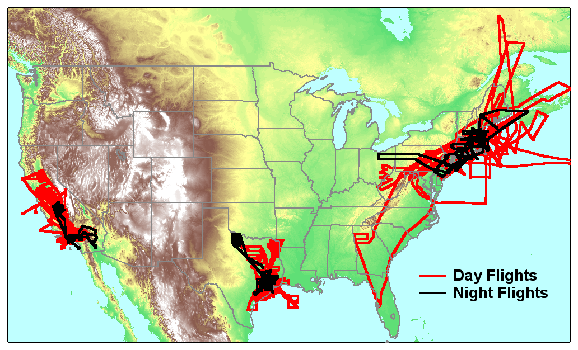
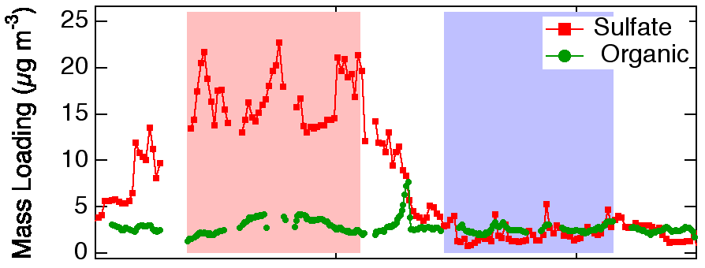
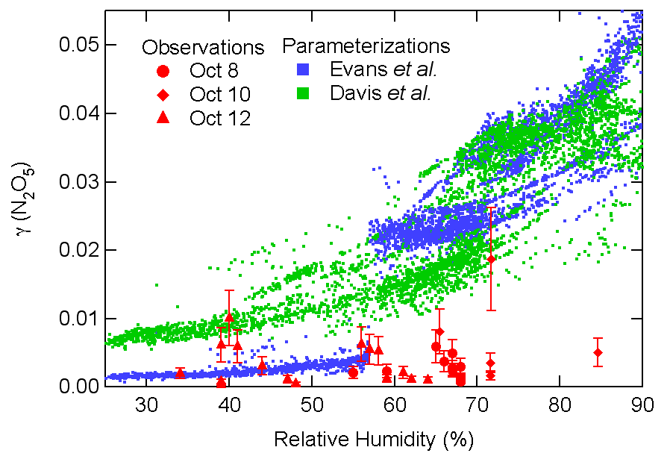
Database for Aircraft Determinations of γ(N₂O₅)
NOAA P-3
γ = 0.02
New England
2004
γ < 0.002
Reference
662 nm diode
NO₃
NO₃ + N₂O₅
O_{x}
NO₂
NO_{x}
CalNex
2010
Texas
2006
405 nm diode
• New England 2004: Large variability. Residual layer γ(N₂O₅) < 0.005, except in sulfate plumes at high RH (60-85%).
• Texas 2006: Less variability. Residual layer γ(N₂O₅) = 0.003 avg. for urban / industrial plumes, 0.008 for rural, less polluted. RH range to 85%.
• CalNex 2010: Residual layer γ(N₂O₅) similar to the other studies
Extensive vertical profiling in L.A. shows variability vs both RH and Altitude
Important role of clouds in L.A.
ClNO₂ as tracer for nighttime het. chemistry

Slide 18
What About NO₃ Oxidation ?
k(NO₃) from WAS can samples
• NO₃ loss rate coefficients small in residual layer, larger at low altitude
• Biogenic >> Oxygenates >> Anthropogenic

Slide 19
Future Work
Categorize / describe / average nighttime P-3 vertical profiles
Nighttime transport patterns
Construct parameterization of N₂O₅ uptake – what governs it?
Budgets of NO₃ / N₂O₅; oxidative vs. heterogeneous chemistry
Role of ClNO₂ in LA air quality !

Slide 21
NO₃ , N₂O₅ Production Rate, Lifetime – June 2nd
Los
Angeles
Los
Angeles
Desert
Sunrise
Variability in NO₃, N₂O₅ observed daily, regionally and as a function of altitude

