Slide 1


Evidence for different gas/particle partitioning of water-soluble organic compounds in two urban atmospheres with contrasting emissions
X. Zhang, J. Liu, E. T. Parker and R. J. Weber
Georgia Institute of Technology
CalNex Data Analysis Workshop
May 16-19, 2011
Sacramento, CA

Slide 2
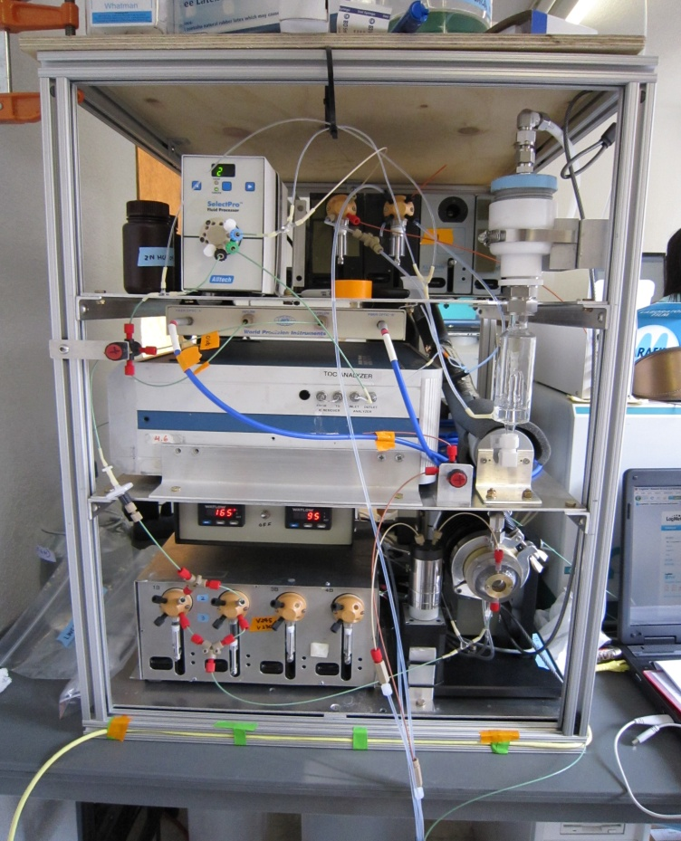
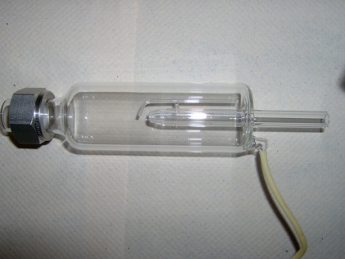
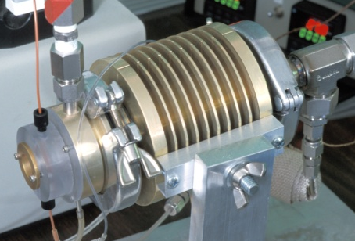
Gas and Particle Water-Soluble Organic Carbon
measurements during CalNex
WSOCg:
Mist Chamber – TOC
(H > 10³M/atm)
TOC
WSOCp:
PILS – TOC (PM_{2.5})
One 5-min sample every 10 mins

Slide 3
Determine WSOC partitioning
Fp - the fraction of total WSOC in the particle phase
WSOC_{p}
F_{p} =
(Hennigan et al., GRL, 2008)
WSOC_{p} + WSOC_{g}
Two data sets:
CalNex (May-Jun, 2010)
Atlanta (Aug-Sep, 2010)
Investigate Fp as a function of:
1) Relative humidity (LWC)
2) Organic carbon mass
BVOC & AVOC
BVOC & AVOC
SVOC
Water (haze, cloud)
SVOC
Organic Aerosol
K_{H}
OH, O₃ NO₃
stable
OH, O₃ NO₃
Notes:
Use atlanta as a contrast

Slide 4
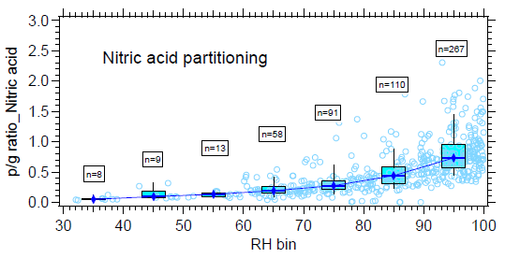
CalNex: Fp and Relative Humidity
Unlike NO₃⁻, Fp peak in the
afternoon (lowest RH, highest T
during a day)
NO₃⁻
WSOC
J. Liu et al., poster #36
Nitrate aerosols partition to liquid water, but WSOC don’t..

Slide 5
CalNex: Fp and Organic carbon mass
Partitioning Theory (Pankow et al, 1994)
VOC
SVOC
OH O₃ NO₃
p⁰
Organic Aerosol
Partitioning
coefficient
Pankow-type partitioning of WSOC dominates in LA

Slide 6
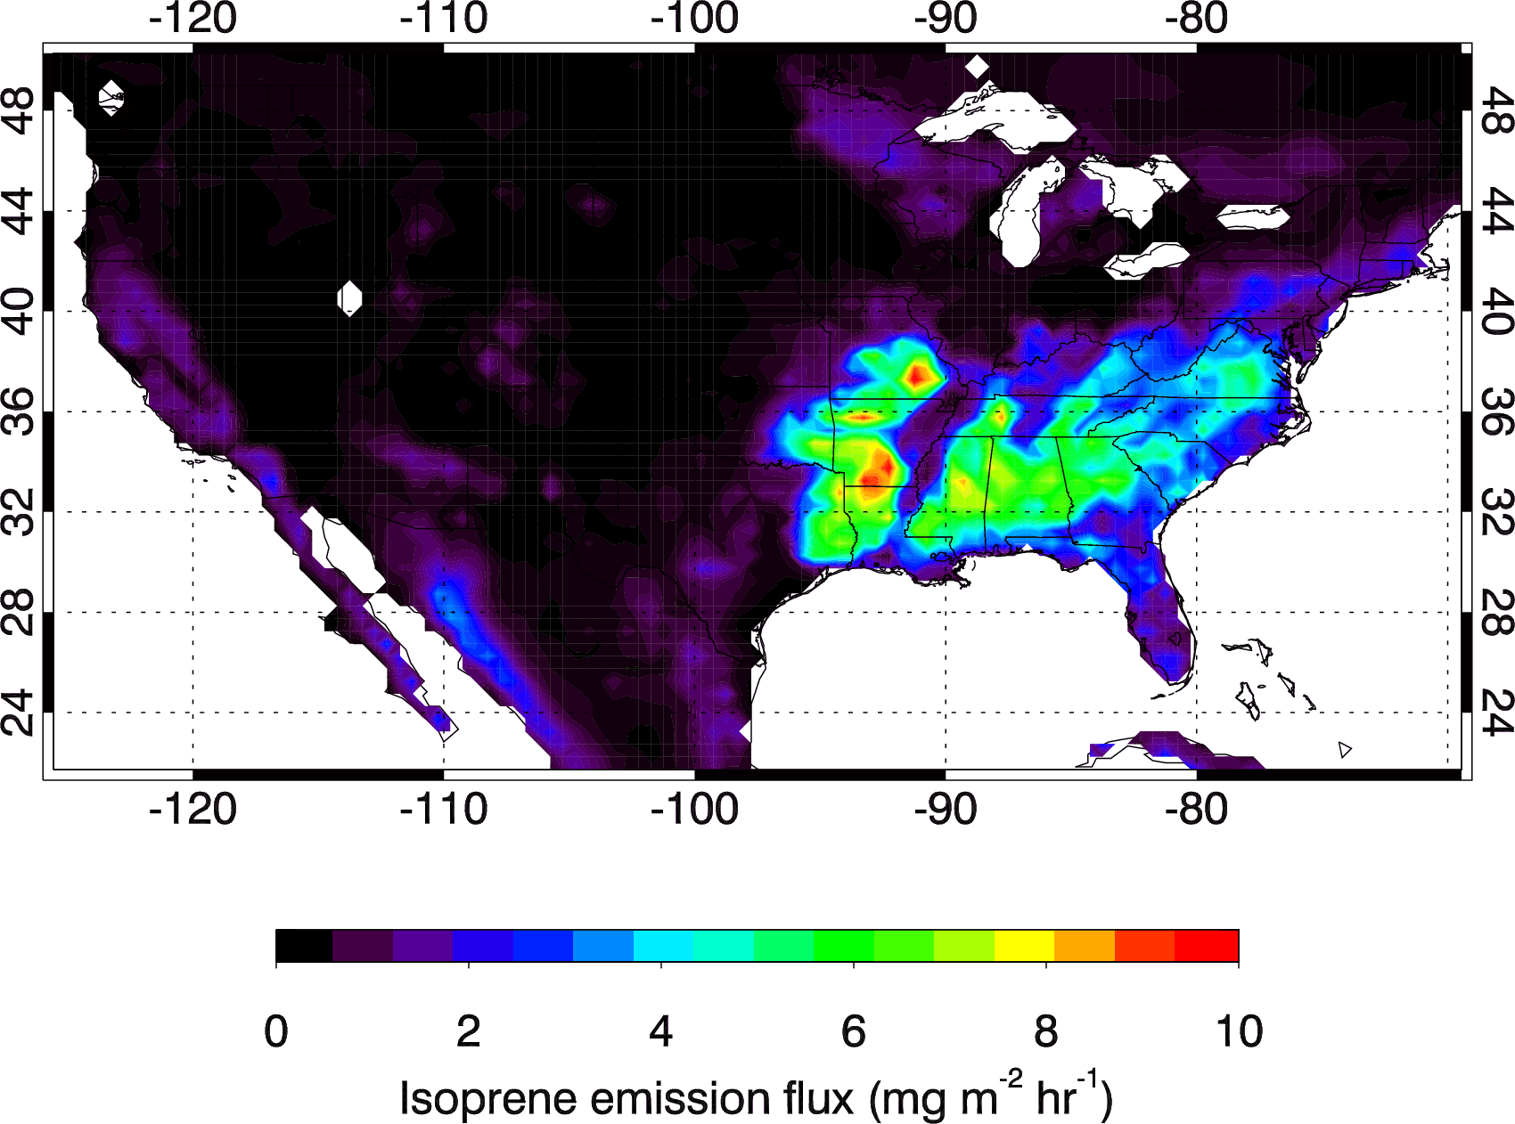
Estimated VOC Emissions in LA and Atlanta
LA: Anthrop. VOCs dominant
ATL: Biogenic VOCs dominant
Isoprene
Anthrop. VOCs
4.8 times
1.7 times
(Müller et al., ACP, 2008)

Slide 7
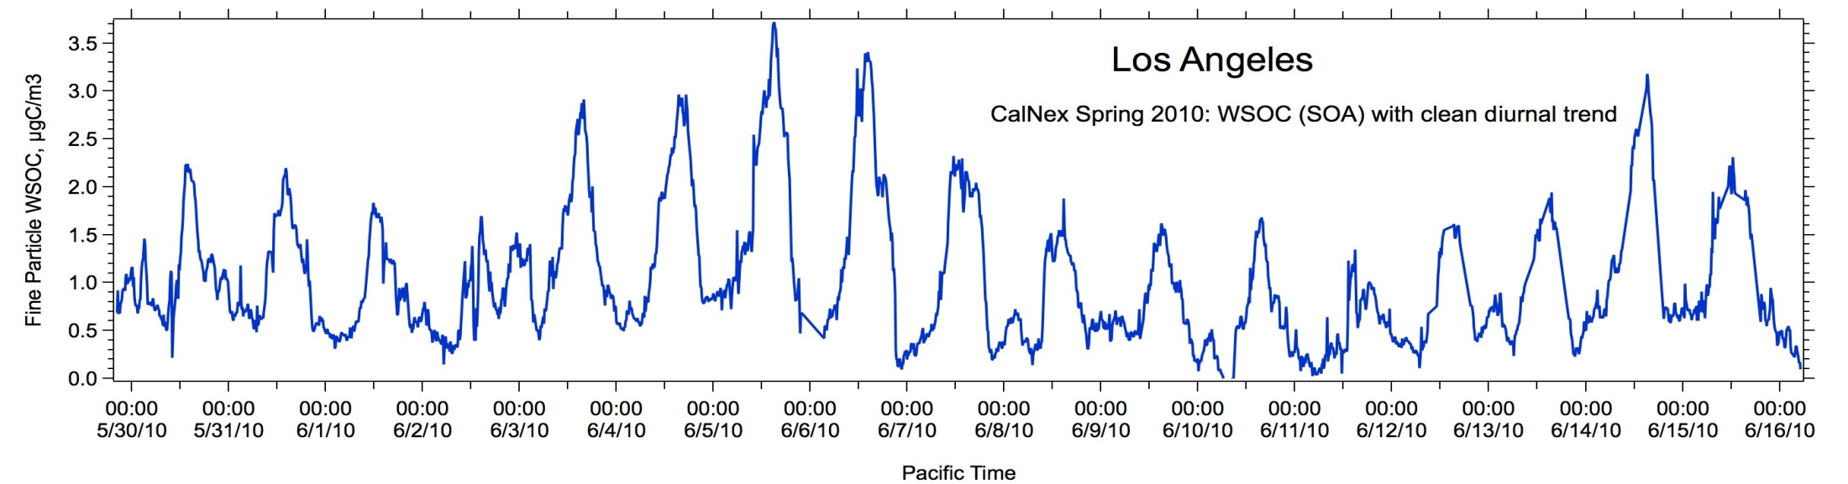
SOA formation in Atlanta very different from LA
WSOC_{p}
WSOC_{p}
Rain
In Atlanta (and other sites in eastern US) no clear diurnal trend to SOA

Slide 8
Atlanta: Fp dependence on RH & OC
RH
70%
OC

Slide 9
Atlanta: When RH is below 70% (mostly later after noon)
Segregate the data by RH </ > 70%
RH frequency distribution
8AM -9AM
2PM –3PM
During dry period (RH below 70%),
OC partitioning likely to dominate;
70%

Slide 10
Atlanta: Examine Fp dependence during daily transition from wet to dry periods
RH
OC
“wetter period”
[5AM, 11AM]
8AM -9AM
2PM –3PM
RH
OC
“drier period”
[12PM, 6PM]
Notes:
ms to be some RH dependence, why?

Slide 11
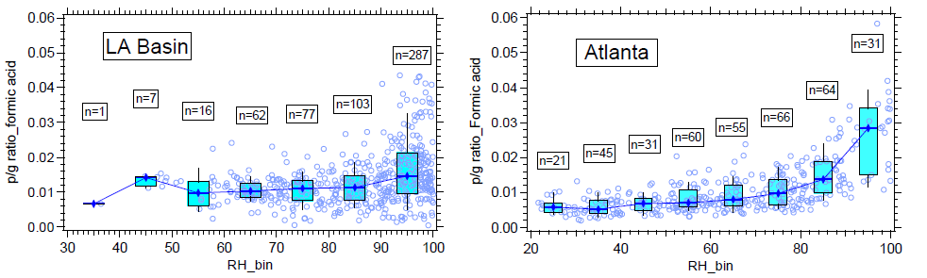
Evidence from other species and studies
CalNex vs. Atlanta formic acid partitioning
(J. Liu et al., poster#36)
5-month (May – Sep, 2007) in Atlanta by Hennigan et al.
RH
OC

Slide 12
Summary
In LA, WSOC partitioning consistent with absorption to organic mass (Pankow’s theory) with no clear dependence on particle water (RH);
August In Atlanta, WSOC partitioning has a transition from evidence for partitioning to particle water at night into late morning to some evidence for partitioning to organic mass in afternoon when particle is dry; Also,
  Formic acid partitioning in Atlanta related to LWC, not so much in LA
  (J. Liu et al., poster#36)
  Overall, during a longer time period (May-Sept), WSOC partitioning most obvious to LWC (Hennigan et al., 2009)
Why the difference?
  Different VOC mixture in the two urban atmospheres;
  Different dispersion/dilution patterns.
Implication: is it appropriate to apply one mechanism to predict SOA
in all types of environments?

Slide 13
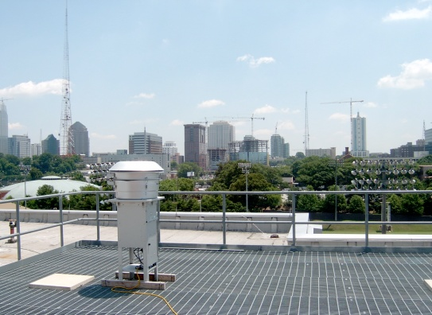
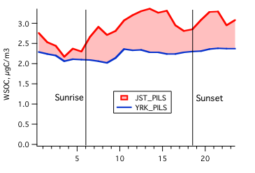
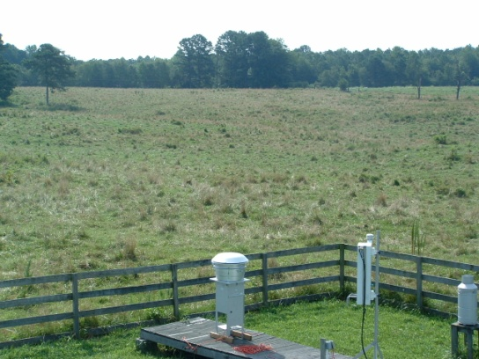
Characteristics of WSOCp in the Southeast
Urban/Rural Diurnal Tends-AMIGAS
Average over more than 1 month
Small, but measurable, primary WSOCp at urban site
Atlanta
WSOC_{p}
Summer 2008
urban
rural
~ 70 km apart
Yorkville (NW of Atl)
Time of day
Atlanta signal riding on large regional signal
some evidence for a daytime increase (urban photochemical SOA?), 20%
Zhang et al. 2011
Notes:
Daytime avg urban increase is about 20% above rural

