Slide 1
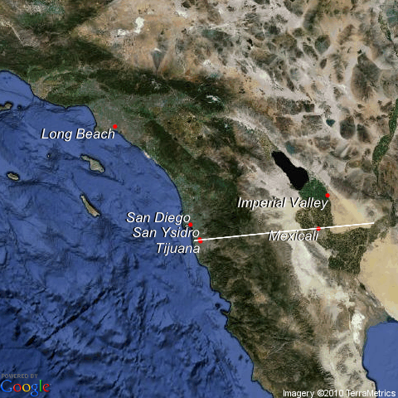
Temporal variations of aerosol components in Tijuana, Mexico, during the Cal-Mex campaign
S. Takahama, A. Johnson, J. Guzman Morales, L.M. Russell
Scripps Institution of Oceanography, University of California San Diego
R. Duran, A. Cortez, B. Puckita, G. Rodríguez
Universidad de Autónoma de Baja California, Tijuana
R. Subramanian
Droplet Measurement Technologies, Inc.
D. Toom-Sauntry, R. Leaitch
Science & Technology Branch, Environment Canada

Slide 2
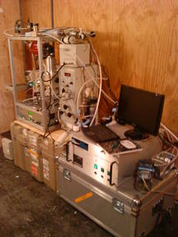
Measurement of submicron aerosol composition and concentrations in Tijuana, Mexico
Notes:
Measured many properties of aerosols with several instruments – they all shared a common inlet.

Slide 3
Measurements of BC, organic, and NR inorganic aerosol
Instrument: Single Particle Soot Photometer (SP2)
Measures: black carbon mass and number
Time resolution: single particle
Instrument: Aerosol Chemical Speciation Monitor (ACSM)
Measures: submicron non-refractory inorganic ion and organic molecular fragment concentrations
Time resolution: 15-30 min
Instrument: Fourier Transform Infrared Spectroscopy (FTIR)
Measures: submicron organic functional group concentrations
Time resolution: 6-12 hours
Notes:
Measurements of black carbon number concentration (SP2), non-refractory (NR) organic and inorganic aerosol mass fragments (ACSM), and organic aerosol functional groups (FTIR) were collected during the campaign.

Slide 4
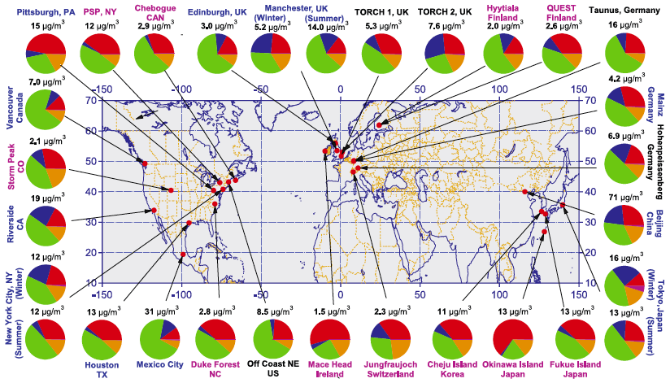
Zhang et al., 2007
Tijuana: 4.0 μg/m³
NR-PM₁ Composition similar to S. California
May 15 - June 30

Slide 5
Temporal variations in non-refractory PM₁ (Parque Morelos, May 15-June 30, ACSM)
Notes:
Most components peak around 7 or 8 am, sulfate relatively constant

Slide 6
Organic Functional Groups by FTIR
H
H
O
O
HO
“fictitious” organic molecule
HO
C
OH
Carboxylic Acid (COOH)
HO
NH₂
O
O
NO₂
Organic hydroxyl or alcohol (COH)
NO₂
Alkane and alkene
(C-CH, C=C-H)
Primary Amine (CNH₂)
Carbonyl (C=O)
Organic Nitrate (CONO₂)
6
Peak area is proportional to the moles of bond on the sample filter.
Proportionality constant varies with each functional group and is calibrated in the laboratory.
Notes:
6

Slide 7
Functional group composition in Tijuana resembles composition observed in other urban areas.
Distinctly different from average composition of samples collected in non-urban areas.

Slide 8
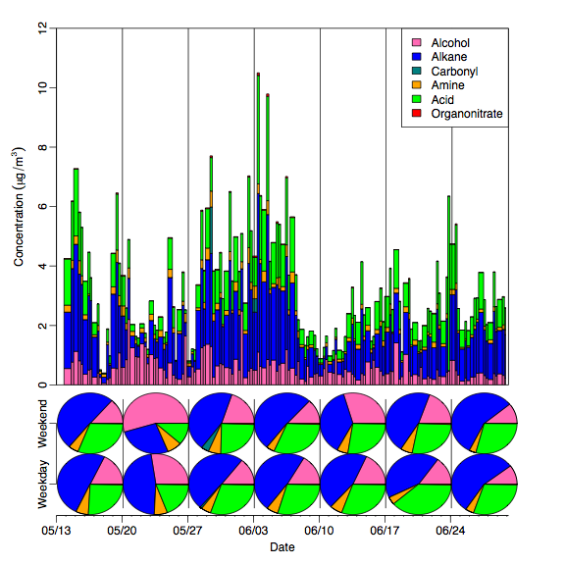
Weekly variations in functional group composition
Generally uniform composition throughout, except during low-concentration periods.
Weekday and weekend composition is similar with a few exceptions.

Slide 9
Potential sources of organic functional groups
Notes:
Functional group possible sources (also show PMF correlations)

Slide 10
POSITIVE MATRIX FACTORIZATION
From functional group composition and correlations to other variables….
Factor 1
Biomass burning
(K, levoglucosan)
Observed
variable and uncertainty
e.g. Absorbance spectrum representing organic functional groups
Factor 2
Dust
PMF
(Ca, Si, Fe, Al)
Factor 3
Oil combustion
(V, Ni, Fe, S)
......
......
Adapted from S. Liu

Slide 11
PMF factors
Fossil-fuel combustion
1 Less oxygenated (S, V)
2 More oxygenated (S)
Burning
Correlated with K
Marine
Correlated with Na, Cl

Slide 12
Components from FTIR spectra decomposition
Notes:
Main points: Fossil fuel combustion (FFCombustion1 and 2) almost always present (have to check 5/29); marine influence strong during a few periods which span several days.

Slide 13
Temporal variations in BC number concentrations
Peak during morning hours daily
Extreme values during weekend evenings

Slide 14
BC emission events during evening hours
Evening areas shaded in grey (10pm to 3am)

Slide 15
Association of black carbon with sources of organic PM
Black carbon number concentrations correlate with organic aerosol measurements from ACSM on weekday mornings and weekend evenings.
BC number concentrations also correlate with FTIR-PMF (Positive Matrix Factorization on FTIR spectra) combustion factor/component on on weekday mornings and FTIR-PMF Burning factor/component on weekend evenings.
Notes:
Black carbon number concentrations correlate with organic aerosol measurements from ACSM on weekday mornings and weekend evenings, suggesting common sources. BC number concentrations also correlate with
FTIR-PMF (Positive Matrix Factorization on FTIR spectra) combustion factor/component on on weekday mornings and FTIR-PMF Burning factor/component on weekend evenings, which suggests possible sources for the black carbon particles during these periods.

Slide 16
Correlation of BC number concentrations with ACSM mass fragments (markers)
Mass fragments: m/z 57, 60, 73 often associated with biomass burning.
These mass fragments correlate strongest with BC number concentrations during weekend evenings.

Slide 17
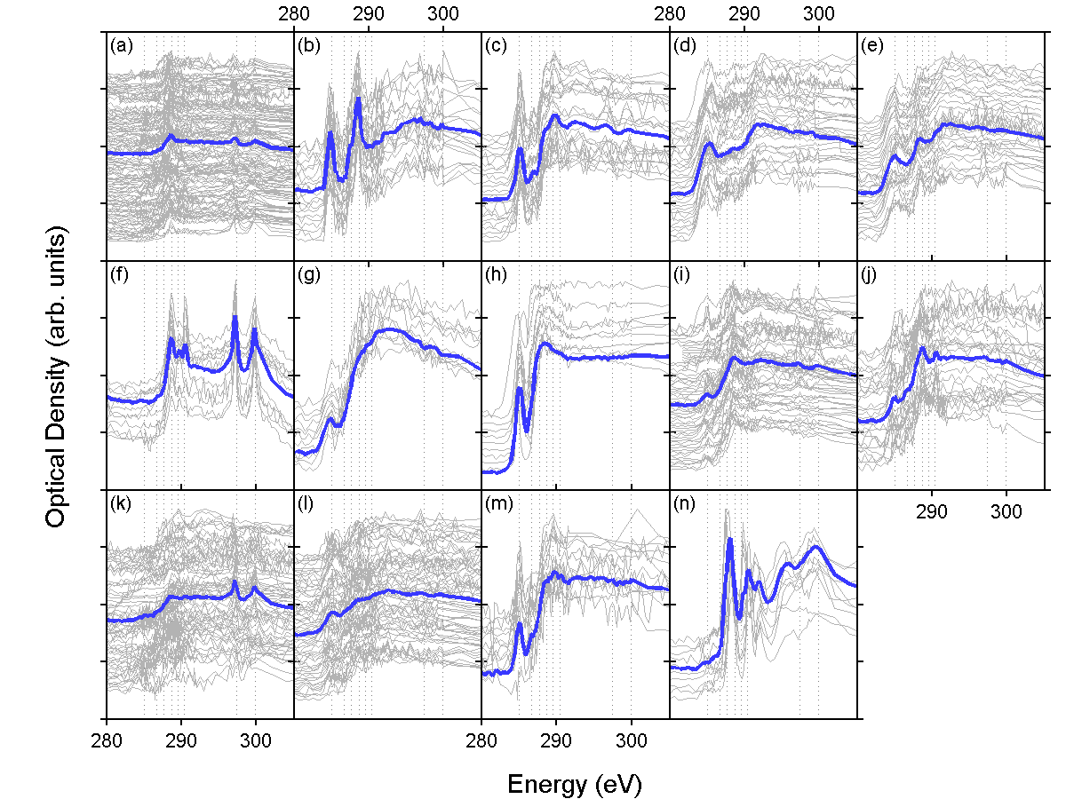
Shape and chemical distribution
with X-ray microscopy

Slide 18
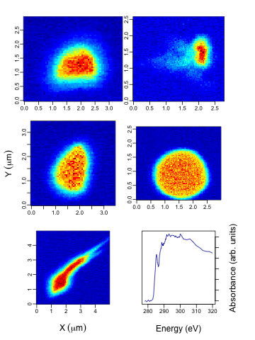
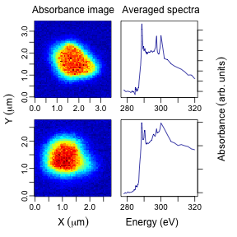
Particle types
Black carbon particles
Acid-dominated
Acid-dust mixtures
Particle type | Number | Size range (mean) μm
Acid-dominated | 6 | 1.4–4.6 (2.6)
Acid-dust mixtures | 15 | 1–3.5 (2.1)
Black carbon | 18 | 0.2–3.1 (1.5)
Notes:
Acid-dominated has carboxylic carbonyl (~288.7 eV) (and potassium) (type “a” from Takahama et al. 2007). Studied particles ranged between 1.4-4.6 micrometers (mean of 2.6 micrometers).
Acid-dust mixture has carboxylic carbonyl (~288.7 eV) and carbonate (~290.4 eV) peaks. Studied particles ranged between 1-3.5 micrometers (mean of 2.1 micrometers).
Black carbon particles have strong absorption at 285 eV (sp2-hybridized orbitals; graphitic character). Studied particles ranged between 0.2-3.1 micrometers (mean of 1.5 micrometers).

Slide 19
Conclusions
Overall NR-PM₁ composition resembles observations made in S. California.
Overall functional group composition resembles observations in other urban areas (Mexico City, Houston).
Diurnal variations between weekday and weekend periods did not vary significantly.
NR-PM₁ (including organic, ammonium, and nitrate) concentrations peaked in the morning.
BC number concentrations also peaked in the morning.
BC sources were associated with traffic and biomass burning events.

