Slide 1

Insights from the CARES Campaign in Northern California - Biogenic SOA formation and roles in New Particle Growth
Ari Setyan¹, Qi Zhang¹, M. Merkel², Y. Sun¹, C. Song³, B. Knighton⁴, T.B. Onasch⁵, J. Jayne⁵, D.R. Worsnop⁵, S. Herndon⁵, A. Wiedensohler², J.E. Shilling³, B.A. Flowers⁶, M.K. Dubey⁶, D. Vovchuk¹
¹ University of California, Davis, CA.
2 Leibniz Institute for Tropospheric Research, Leipzig, Germany. 3 Pacific Northwest National Laboratory, Richland, WA. 4 University of Montana, MT. 5 Aerodyne Research Inc., Billerica, MA. 6 Los Alamos National Laboratory, Los Alamos, NM

Slide 2
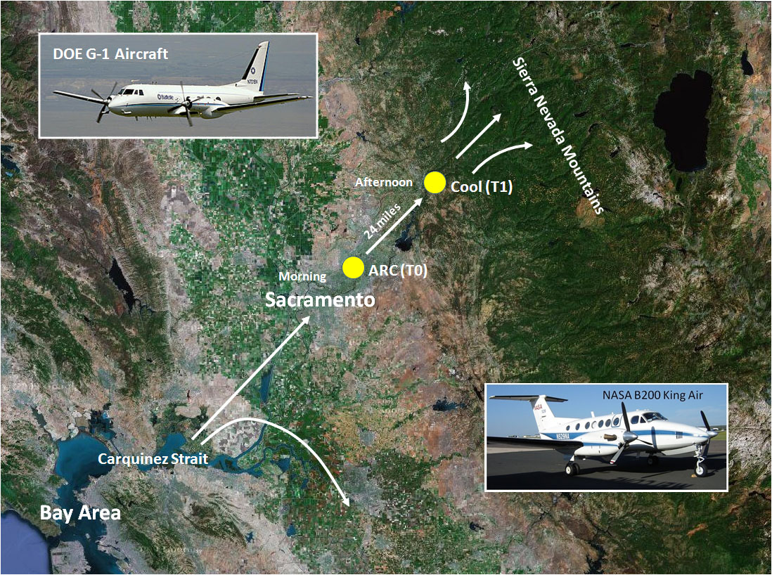
Introduction
Carbonaceous Aerosols and Radiative Effects
Study
T1
T0
Objectives: - To investigate the evolution and aging of carbonaceous aerosols (anthropogenic and biogenic);
- To use field data to improve models.

Slide 3
Instrumentation
TD – AMS / SMPS
Aerosol
Inlet
PM₁
Bypass: ambient T
Aerodyne
HR-ToF-AMS
Nafion dryer
Thermodenuder
(35 – 200 ºC)
SMPS
CCN counter
PILS
PM₁ composition
Size distributions (number and chemical species)
Volatility distribution

Slide 4
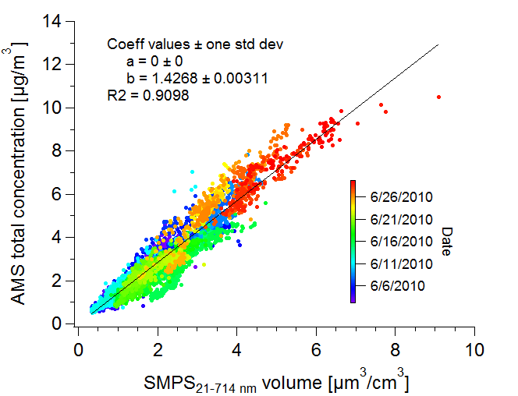
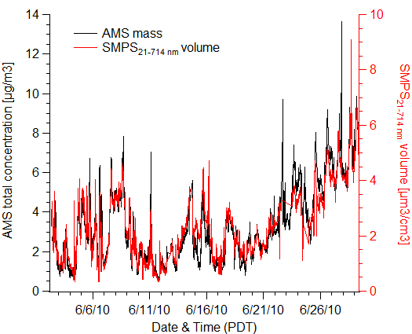
AMS mass agree well with SMPS volume
PM₁ density = 1.4
Notes:
E:\2010.06_CARES\DataTreatment\CARES_parts1_2.pxp AMStotal_vs_SMPSvolume ()

Slide 5
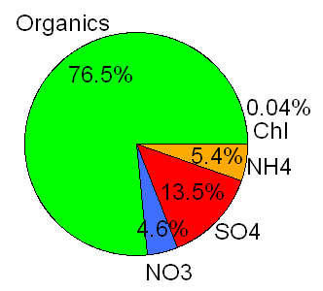
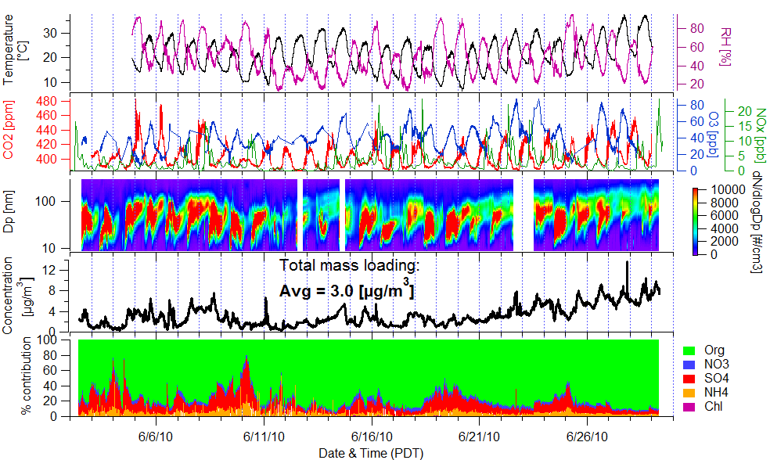
PM₁ concentration, composition & size vary dynamically
Organics dominate PM₁ composition
CO2 and O3 data: B. Flowers, M. Dubey
Notes:
E:\2010.06_CARES\DataTreatment\CARES_parts1_2.pxp TimeSeries_Contribution_3() PieChart_Species()

Slide 6
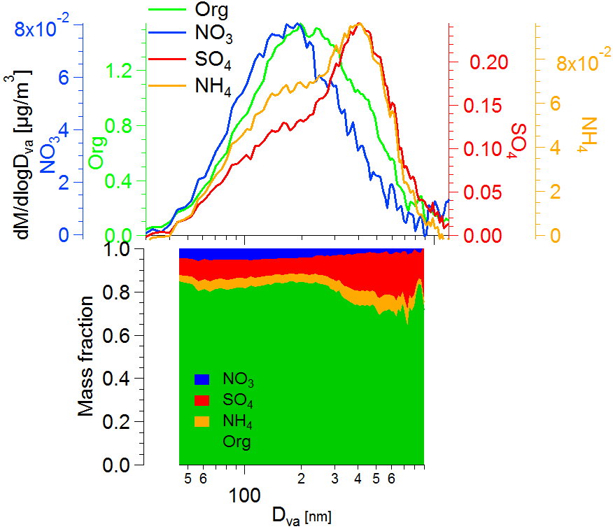
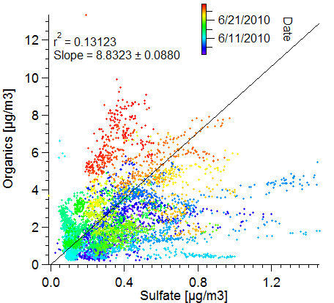
Sulfate and organics are externally mixed, due to different sources and formation mechanisms
Notes:
E:\2010.06_CARES\DataTreatment\CARES_SizeDistr.pxp PToF_SizeDistr()

Slide 7
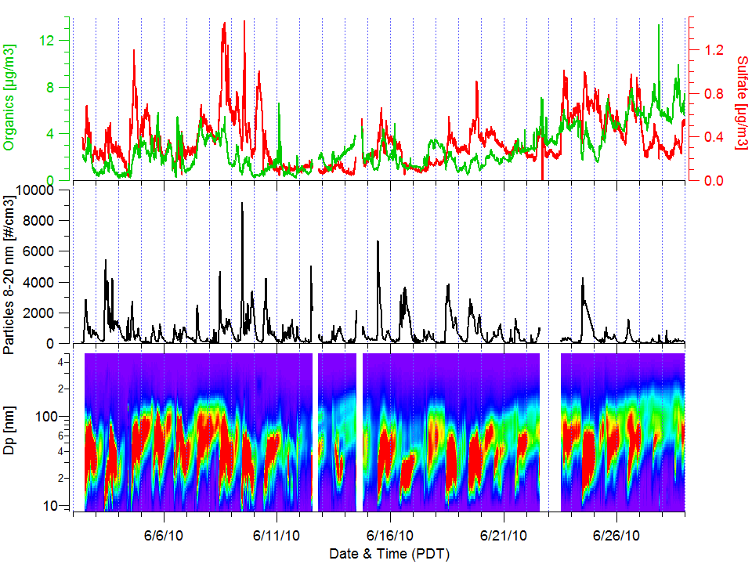
New particle formation & growth events
Notes:
AAS_Plot_1()

Slide 8
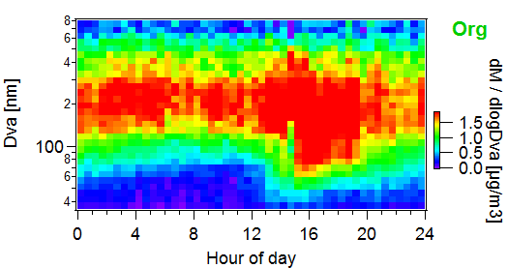
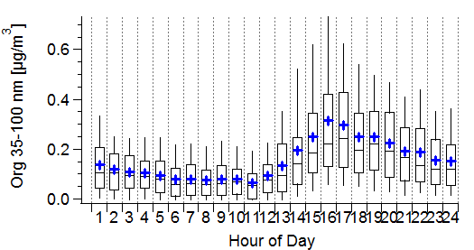
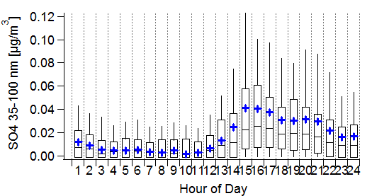
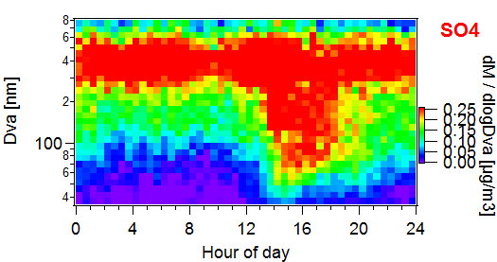
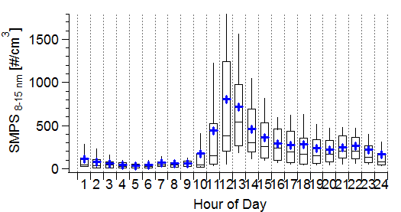
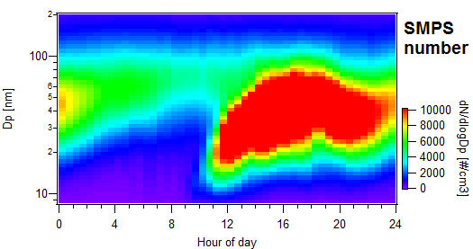
Organics and sulfate are important in new particle growth

Slide 9
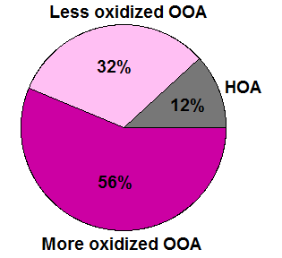
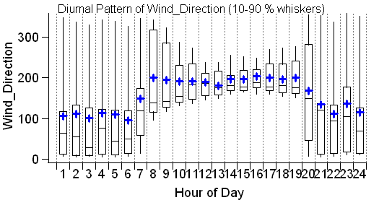
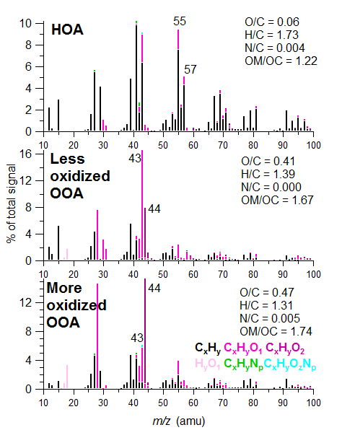
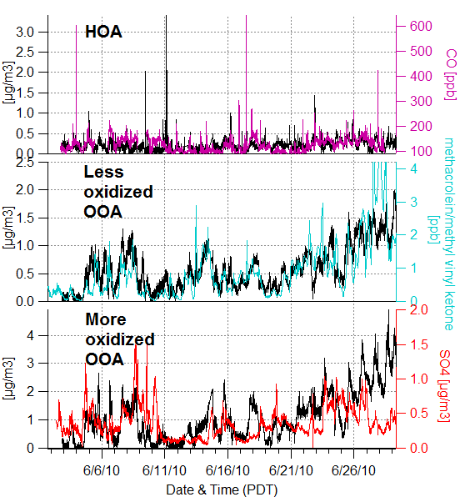
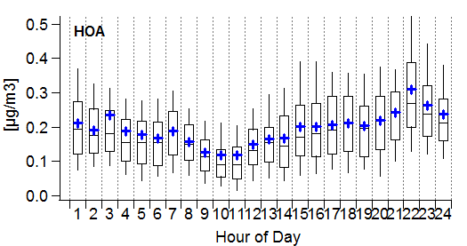
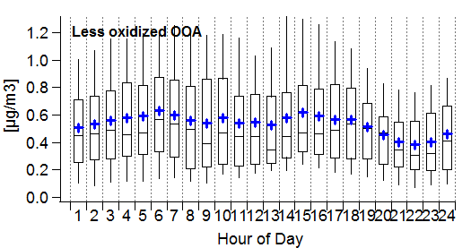
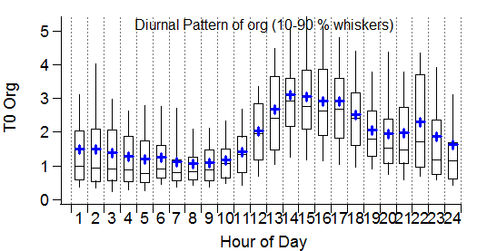
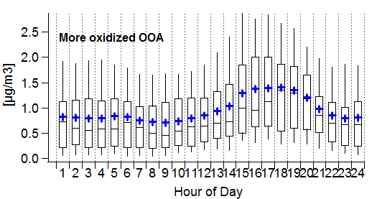
PMF analysis of HR spectra
T0
T0 data: C. Song
~ Biogenic influenced SOA
~ Urban transport SOA

Slide 10
Biogenic influenced vs urban transport SOA
LV-OOA
SV-OOA
Ng et al., Atmos Chem Phys, 10 (10), 4625-4641, 2010.
Notes:
Sally_TrianglePlot_PMF() Sally_TrianglePlot_PMF_2()

Slide 11
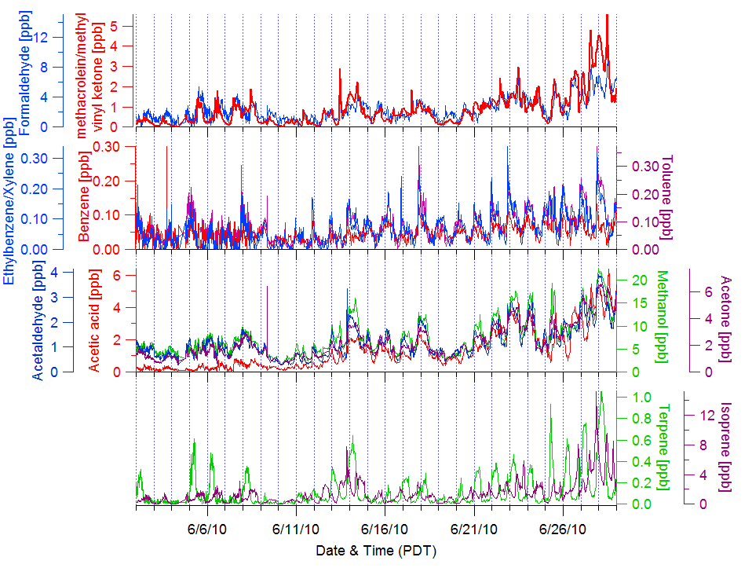
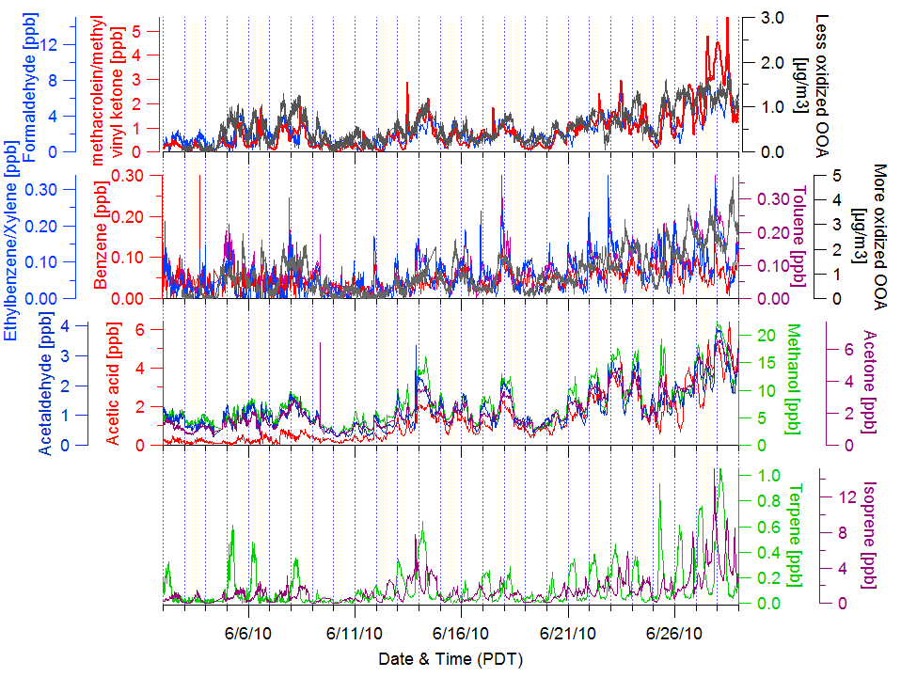
Biogenic influenced vs urban transport SOA
PTR-MS data: B. Knighton, S. Herndon
Notes:
CalNex_20110519_C() CalNex_20110519_D

Slide 12
Conclusions
Organics (76%) are the major components of PM₁.
Nucleation events observed almost every day. Both organics and sulfate play a key-role for the new particle growth
3 OA components identified by HR-PMF:
  OOA-1 (O/C = 0.47): 56%, Urban transport
  OOA-2 (O/C = 0.41): 32% Biogenic influenced
  HOA (12%): combustion POA (local + transport)
Unique case studies will be performed to study biogenic SOA production, SOA’s role in new particle growth, and transport of urban plumes.

Slide 13
Acknowledgements
Financial support:
Department of Energy (DOE)
Atmospheric Aerosol Health (AAH) program of UC Davis
Thank you for your attention
Any questions?

