Slide 1
Source Signatures of Organic Compounds and Particle Growth in Bakersfield, CA
Lars Ahlm¹, Shang Liu¹, Lynn M. Russell¹, Douglas A. Day^{1,2}, Robin Weber³, Drew Gentner³, Allen Goldstein³, Sally Pusede⁴, Ronald C. Cohen⁴, and Frank N. Keutsch⁵
¹ Scripps Institution of Oceanography, University of California, San Diego, La Jolla, California, USA.
² now at Cooperative Institute for Research in the Environmental Sciences, University of Colorado, Boulder, Colorado, USA.
³ Department of Environmental Science, Policy, and Management, University of California at Berkeley, Berkeley California, USA.
⁴ Department of Chemistry, University of California Berkeley, Berkeley California, USA.
⁵Department of Chemistry, University of Wisconsin-Madison, Madison, Wisconsin, USA.

Slide 2
Main Questions to be Addressed
What sources contribute to the organic aerosol mass in Bakersfield?
What fractions of the organic aerosol mass are HOA and OOA?
What processes control particle number concentration?
What vapors contribute to condensational growth during the frequently observed growth events?

Slide 3
Particle Measurements at Bakersfield
FTIR: organic functional groups
  OM₁: 3-6 hour filter samples, 5 samples a day
  OM_{2.5}: 23 hour filter sample, 1 sample a day
HR-AMS: non-refractory organics, sulfate, nitrate, ammonium, and chloride
  online measurement with 2 min resolution
SMPS: particle number size distribution
  online measurement with 10 min resolution
XRF: elemental concentration
  XRF measurements were conducted on PM₁ and PM_{2.5} filters

Slide 4
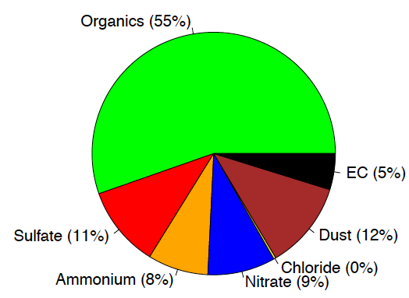
Chemical Composition of Submicron Particles
80% of OM_{2.5} is OM₁
Elemental carbon from CARB
Notes:
Organics, sulfate, ammonium, nitrate, chloride are from the AMS measurements.
Dust is the sum of all elements (except for sulfur) measured by the XRF
EC is from CARB, “OptEC” was used. No information of the particle size collected from the ECEC documents, so here we assume all the EC are in submicron particles.
The rest of the talk will focus on the “Organics” part.

Slide 5
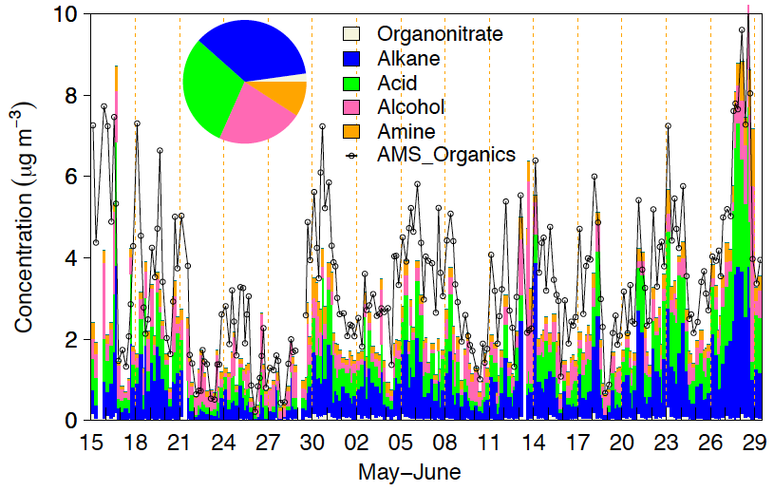
Time series of organic functional group concentrations
36%
30%
2%
9%
22%
Notes:
Alkane, carboxylic acid, and alcohol groups dominate the OM.
The AMS and the FTIR OM agree well: AMS OM = FTIR OM *1.07, and AMS OM and FTIR OM correlate to each other with r = 0.77.
For the AMS measurements, HR-V mode is used, and CE =1 is used (because the AMS sulfate is comparable to the PILS PM2.5 sulfate from Murphy group).

Slide 6
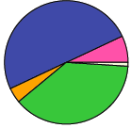
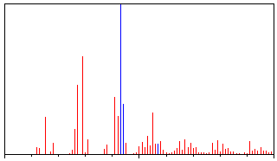
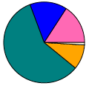
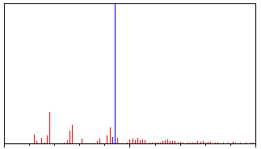
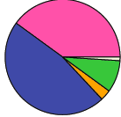
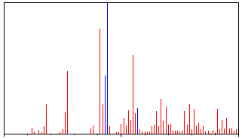
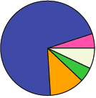
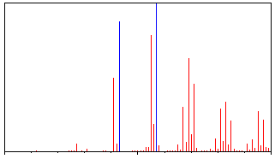
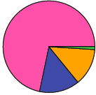
FTIR and AMS factors from PMF
high43-OOA
m/z 43
O/C = 0.7
(Sulfate)
high44-OOA
O/C = 0.8
(Sulfate)
m/z 44
Petroleum Drilling
Operations (V)
Petrolium Drilling Operations
m/z 44
HOA
m/z 57
Organonitrate (ON)
OA (NO_{x} EC)
20
40
60
80
100
Vegetative Detritus (Si, Ca)

Slide 7
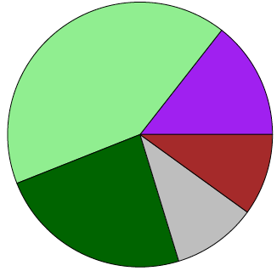
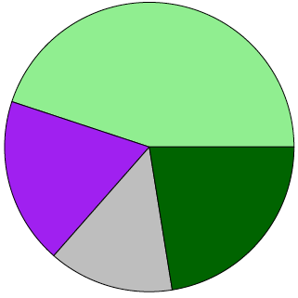
Types and Sources of Organic Aerosol at Bakersfield
Organics
FTIR factors:
AMS factors:
Petroleum Drilling
Operations (V)
High 43
-OOA
O/C = 0.7
Vegetative
Detritus (Si, Ca)
High 44
-OOA
O/C = 0.8
ON OA
(NOx, EC)
HOA
OOA (sulfate)
Both show 65% of OM is OOA and 11-14% of OM is HOA.
Notes:
Positive Matrix Factorization (PMF) was applied to both the FTIR and AMS measurements to identify sources contributing to organics. Four factors (SOA, HOA, Petroleum Drilling Operation, and Vegetative Detritus were identified for FTIR-PMF, and four factors (SV-OOA, LV-OOA, HOA, and Petroleum Drilling Operation) were identified from AMS-PMF analysis. The HOA factor correlates to NOx and EC and the Petroleum Drilling Operation factor correlates to V, which is a tracer for oil operation. The SOA factors correlate to sulfate and S, indicating their secondary origin.

Slide 8
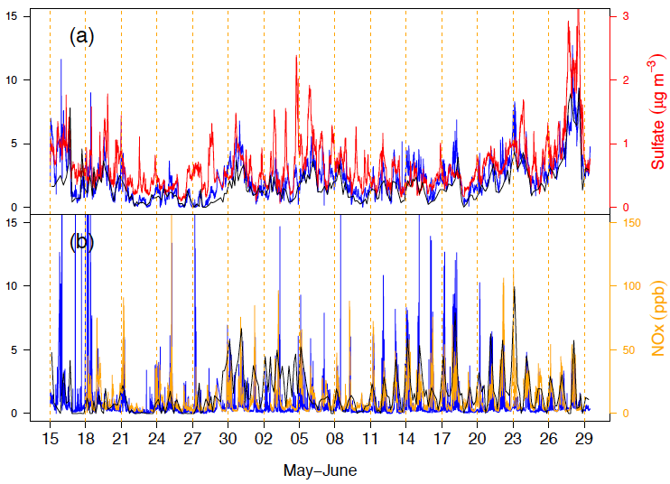
Comparison of HOA and OOA Factors from FTIR and AMS PMF analyses
Sum of AMS high O/C factors
Sum of FTIR high O/C factors
Concentration (μg m⁻³)
AMS HOA factor
FTIR ON OA factor

Slide 9
Time series of the particle number size distribution in Bakersfield
Growth of 10-20 nm diameter particles up to 40-100 nm occured on most days.
The growth could be followed from early morning to at least 7pm on 31 of the 46 days – regional events over horizontal scales of at least 100 km.

Slide 10
Average diurnal variations in particle number size distribution
The growth was in general linear with time until around 1pm but decreased in rate during afternoon and evening.
The average growth rate was 7.3 nm hr⁻¹ with a standard deviation of 2.6 nm hr⁻¹ (within the range of what has been observed in for instance Atlanta, Mexico City and Leipzig).

Slide 11
Chemical compounds contributing to ultrafine (D_{p}<100nm) mass and particle growth
Ultrafine mass distribution
Ammonium
(3 %)
Sulfate (14 %)
Organics (83 %)

Slide 12
Median diurnal cycles of mass and number concentrations
Provided by CARB
EC
m/z 57 (POA tracer)
Rush hour
m/z 44 (SOA tracer)
Photochemical production
Ultrafine organic mass
Particle number concentration
Number concentration increases from ~10,000 to ~20,000 cm⁻³ between 10am and 2pm as a result of new particle formation

Slide 13
How does the ultrafine mass during growth events correlate with other parameters?
The correlation between ultrafine mass and OH concentration (R=0.56) was better than the the corresponing correlation with ozone (R=0.29) during the growth events.
Some correlation also with UV radiation (R=0.52).
No clear correlation between ultrafine mass and SO₂ (R=0.16) or biogenic VOCs such as isoprene (R=-0.03) and alpha-pinene (R=0.08) during the events.
The best correlations were found for gas-phase formaldehyde (R=0.80), oxalic acid (R=0.70), formic acid (R=0.68), glyoxal (R=0.61).
SO₂, oxalic acid and formic acid from Jennifer Murphy’s group
OH data from William Brune’s group

Slide 14
Main conclusions
Traffic emissions, petroleum operations and vegetative detritus contribute to organic mass at Bakersfield.
FTIR and AMS measurements agree that the OOA fraction of OM₁ is 55-63 %.
New particle formation was the dominating source of particle number at the site.
Ultrafine particles grew primarily through condensation of organic vapors.

Slide 15
Acknowledgement
We would like to thank Jennifer Murphy and her group at University of Toronto for providing data of SO₂, formic acid and oxalic acid, William Brune’s group at Pennsylvania State University for OH-data and CARB for providing data of elemental carbon.

