Slide 1
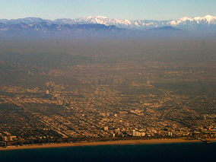


Diurnal Variations of CO₂ Emissions during CalNex-LA: Magnitude and Sources
Sally Newman¹, Xiaomei Xu², Sergio Alvarez³, Bernhard Rappenglueck³, Christine Haman³, Barry Lefer³, Charles Miller⁴, and Yuk Yung¹
¹California Institute of Technology
²University of California, Irvine
³University of Houston
⁴Jet Propulsion Laboratory
With acknowledgements to Eric Kort (Harvard), Wayne Angevine (NOAA),
and Paul Wennberg (Caltech). We thank Caltech and the California Air Resources Board for their support in making this campaign a success.

Slide 2
Major questions to be addressed
How does the magnitude of CO₂ emissions vary during the course of a spring day, both in situ and in the atmospheric column?
What is the diurnal variation of the sources of CO₂ emissions, from fossil fuel combustion and the biosphere?

Slide 3
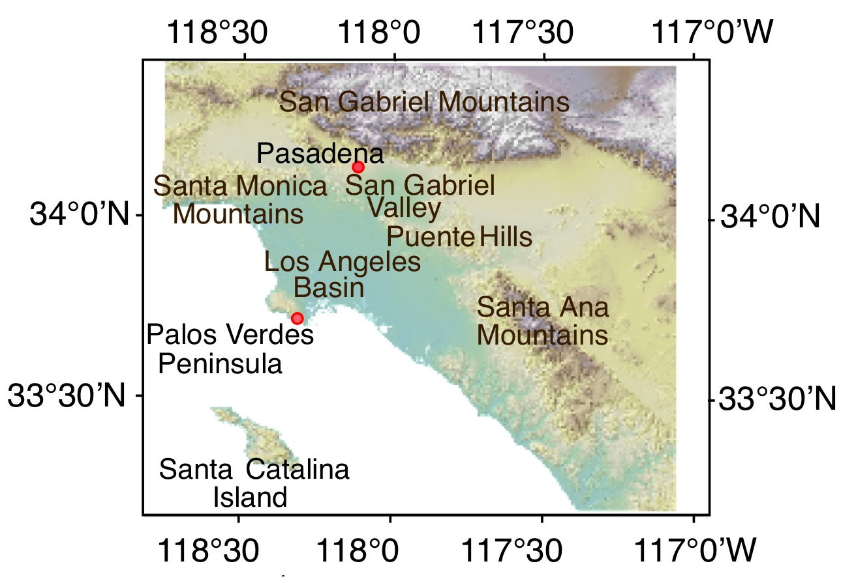
Location of CalNex-LA Ground Campaign

Slide 4
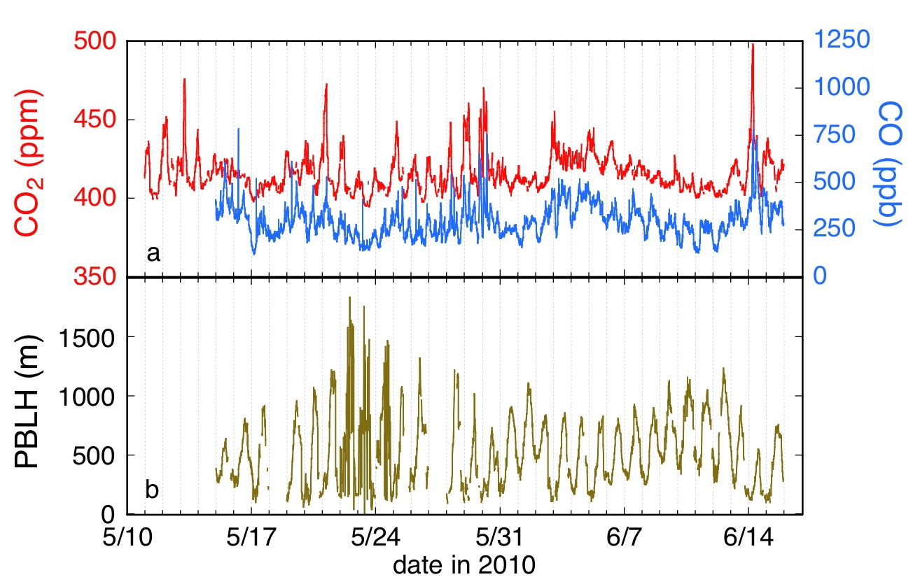
Time Series of CO₂, CO, and PBLH
CO₂ by cavity ring-down spectroscopy, CO by vacuum ultraviolet fluorescence,
PBLH by Lidar

Slide 5

Time Series of CO₂, CO, and PBLH
CO₂ by cavity ring-down spectroscopy, CO by vacuum ultraviolet fluorescence,
PBLH by Lidar, Δ¹⁴C by accelerator mass spectrometry

Slide 6
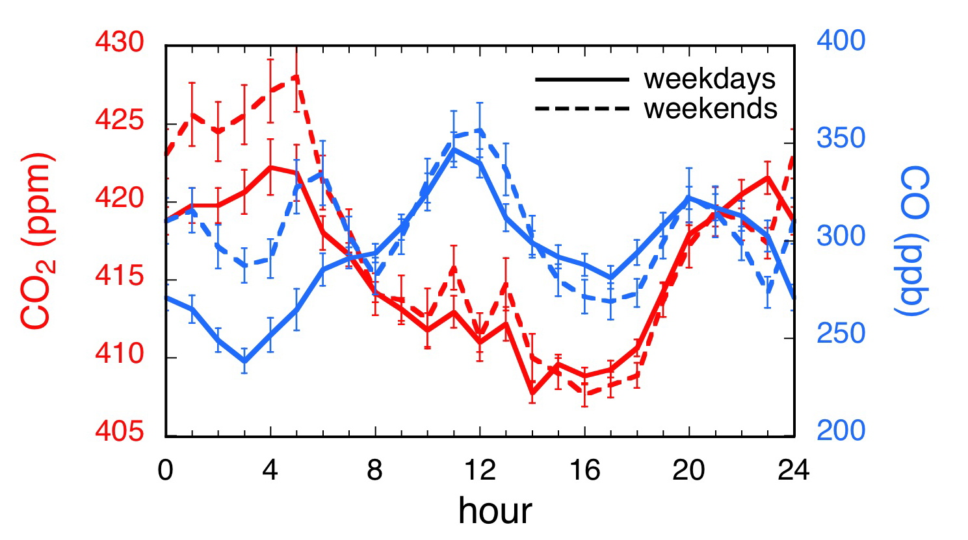
Diurnal variations in CO₂ and CO mixing ratios
The CO₂ pattern differs from that of CO because of daytime photosynthetic uptake.
Concentrations are higher during early mornings on weekends than weekdays.

Slide 7
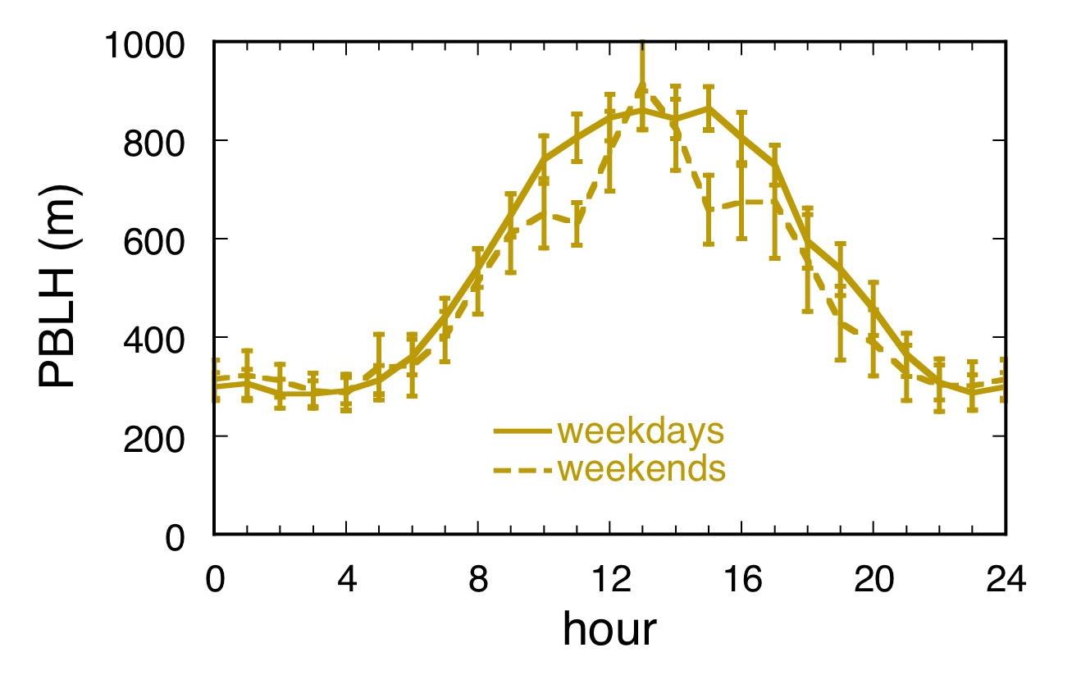
Weekday and Weekend Diurnal Variation of Boundary Layer Height above Ground Level

Slide 8
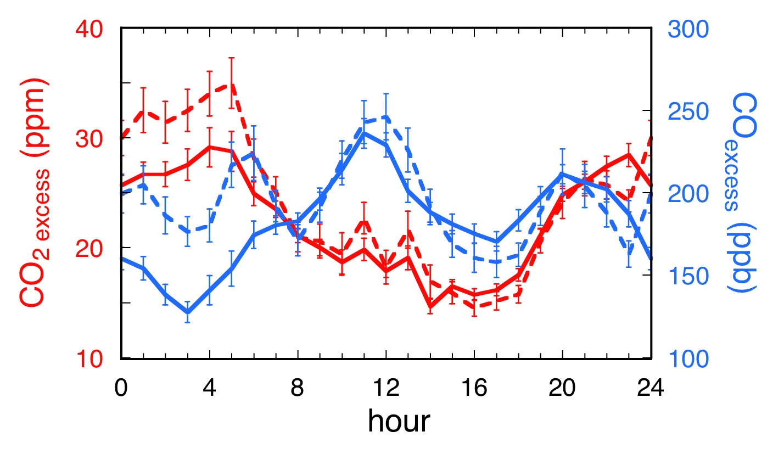
Diurnal Variation of CO₂ and CO in Excess of Background Levels
Background for CO₂ = 393.1 ppm, from Palos Verdes
Background for CO = 110.8 ppb, from NOAA THD and POC30N
15-35 ppm CO₂ and 125-250 ppb CO were added at the surface.

Slide 9
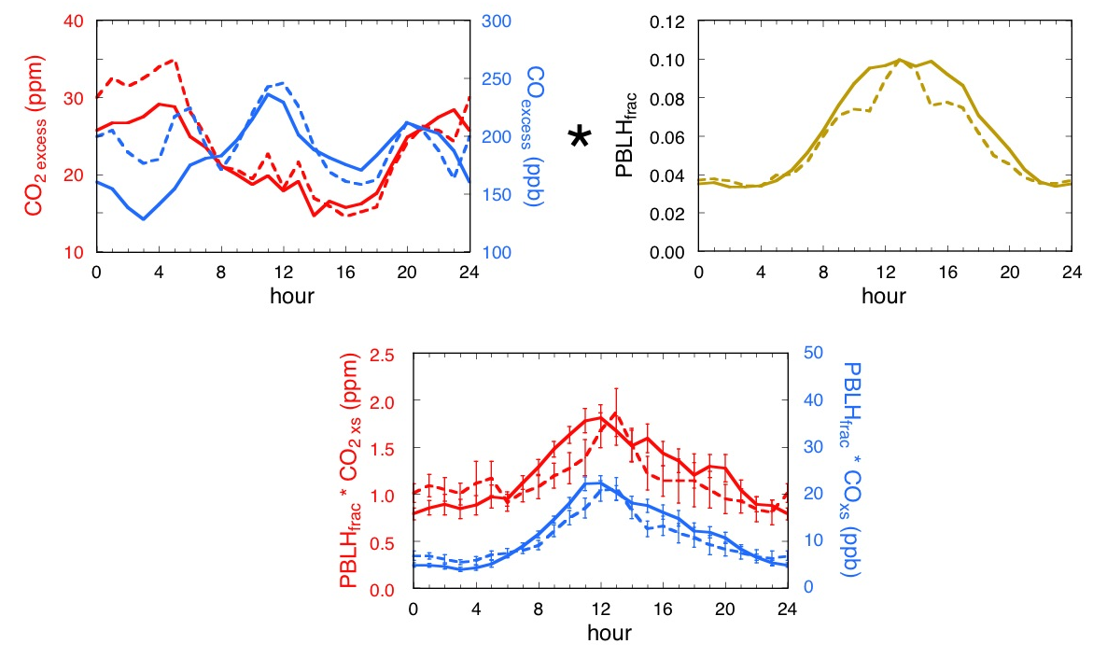
Calculation of Local Contribution to Column CO₂ and CO
Variation in the planetary boundary layer height dominates the observed CO₂ pattern.
0.8-1.9 ppm CO₂ and 4-22 ppb CO were added to the column.

Slide 10
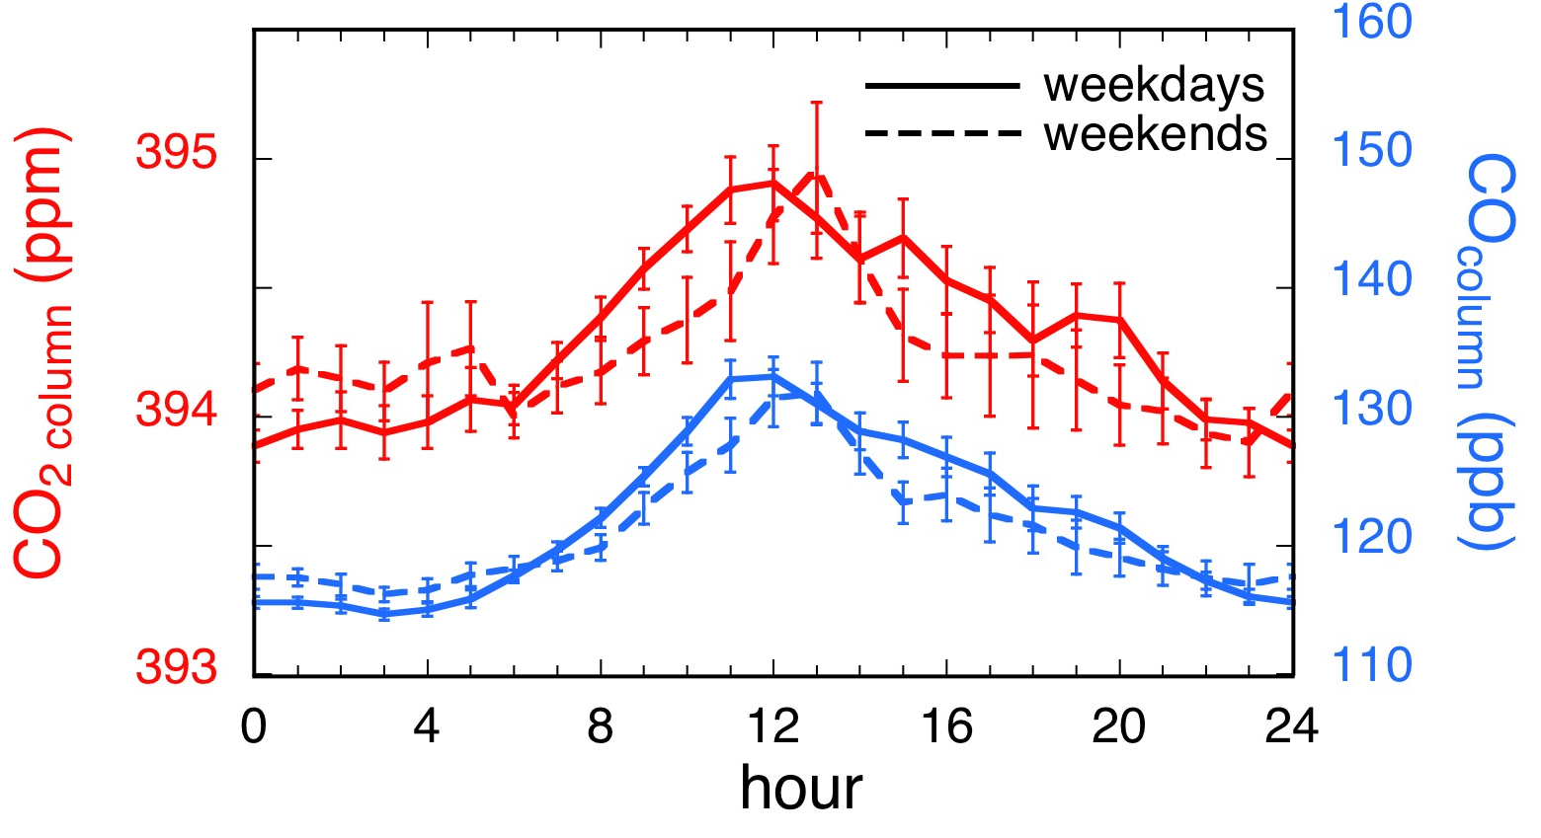
Diurnal Column CO₂ Mixing Ratios

Slide 11
Is it reasonable, to first order, to assume no entrainment or advection?

Slide 12
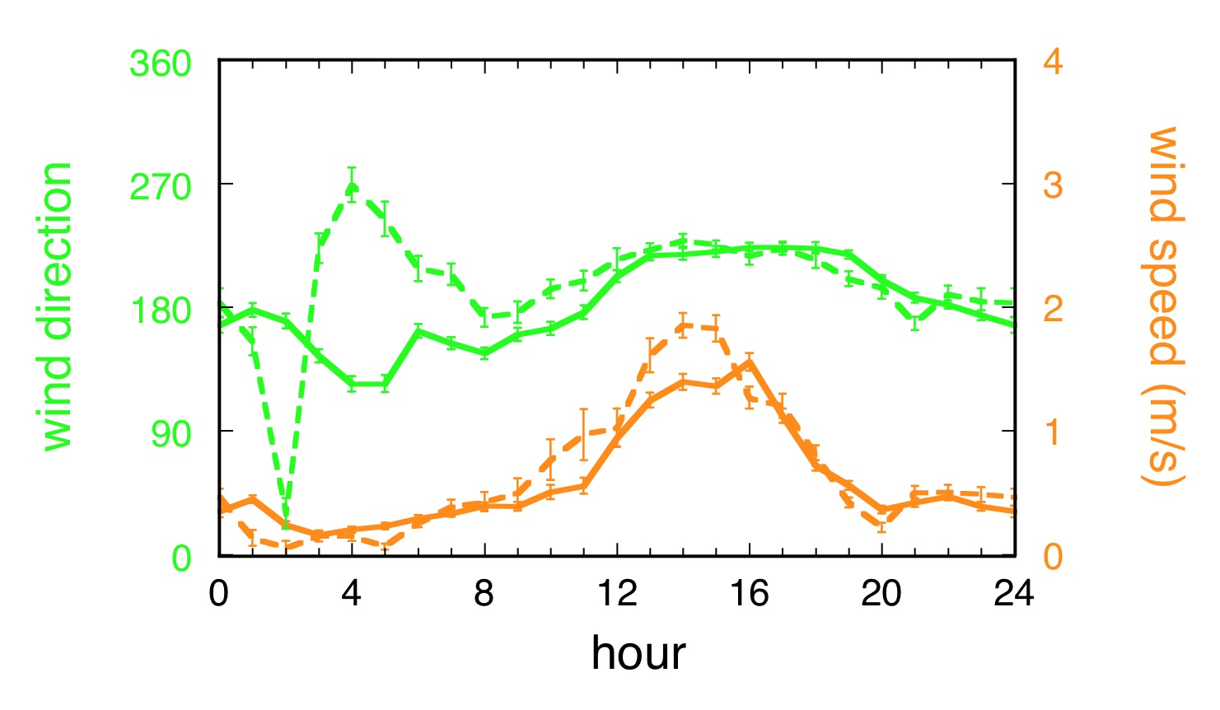
Overnight, there was minimal wind to move air masses or disturb the stable planetary boundary layer.
During the day, the footprint at this time of year was very limited.
Modeling by Eric Kort, Harvard. Met fields from Wayne Angevine, NOAA.

Slide 13
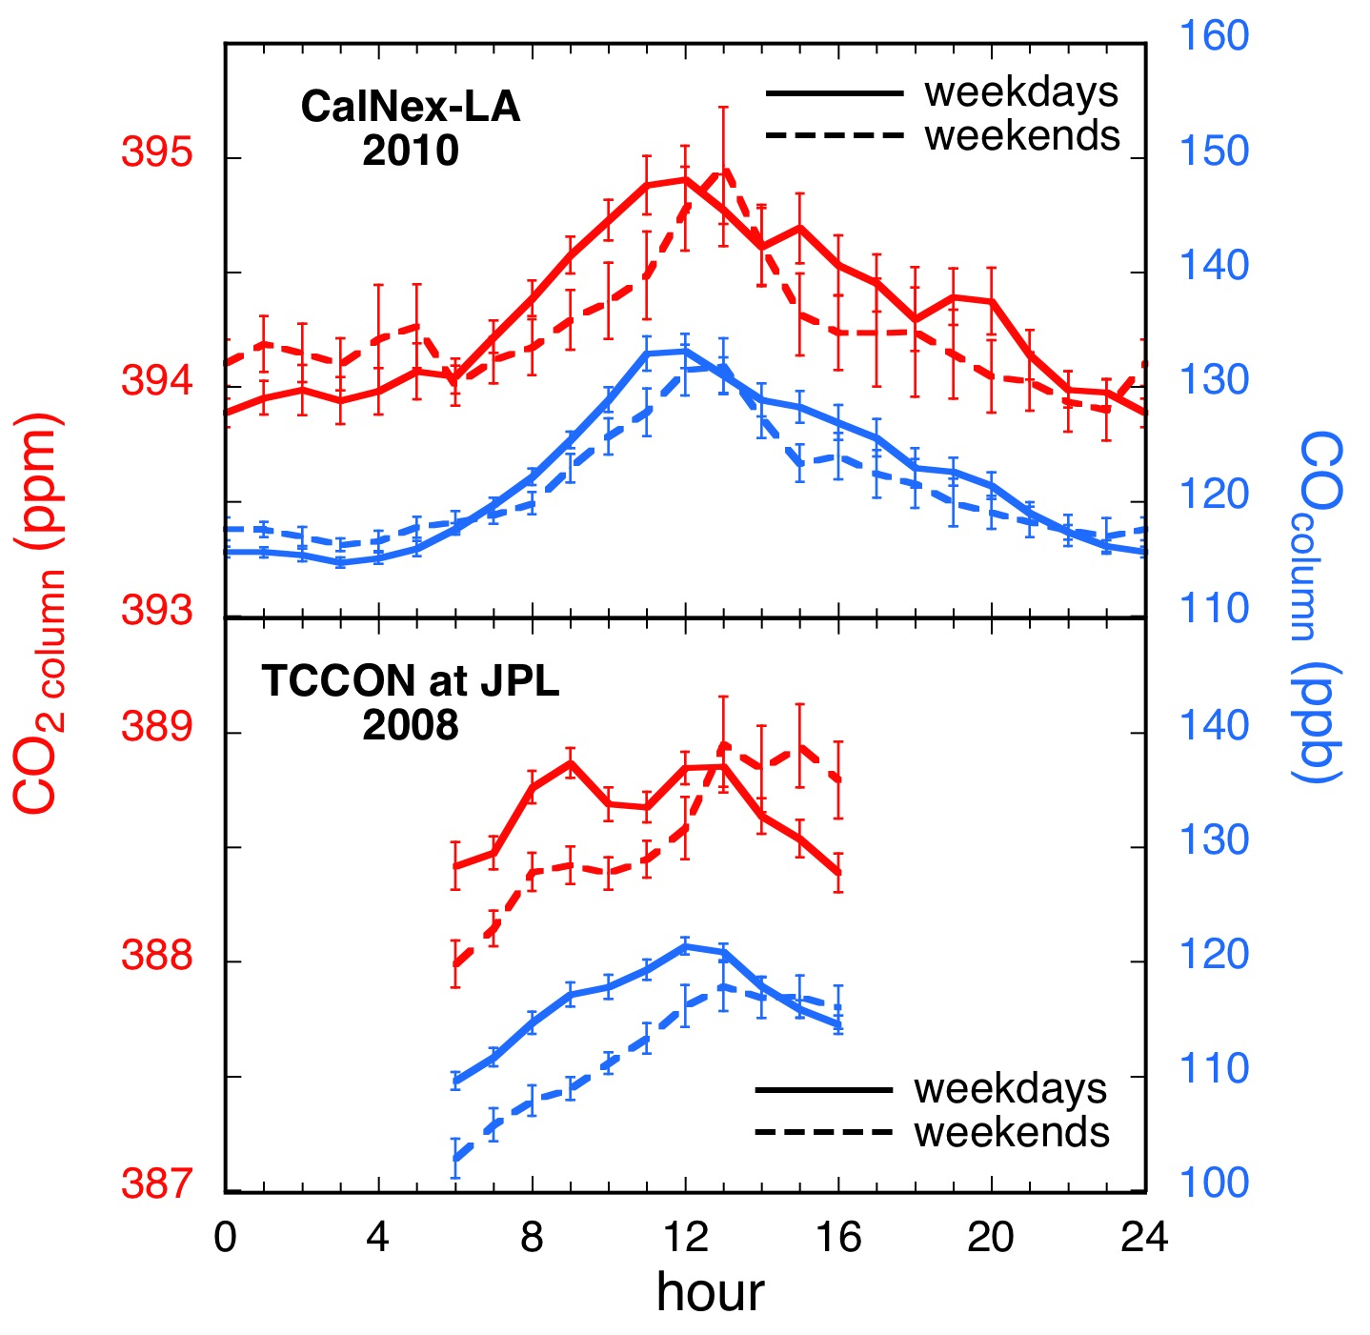
Comparison of Column CO₂ Determined in situ
and by TCCON FTS
Favorable comparison with TCCON data from JPL during the same time of year supports neglect of advection and entrainment, to first order.
TCCON Data Archive:http://tccon.ipac.caltech.edu/. D. Wunch, et al., 2011
Notes:
6:00 – 16:00 CalNex-LA:

Slide 14
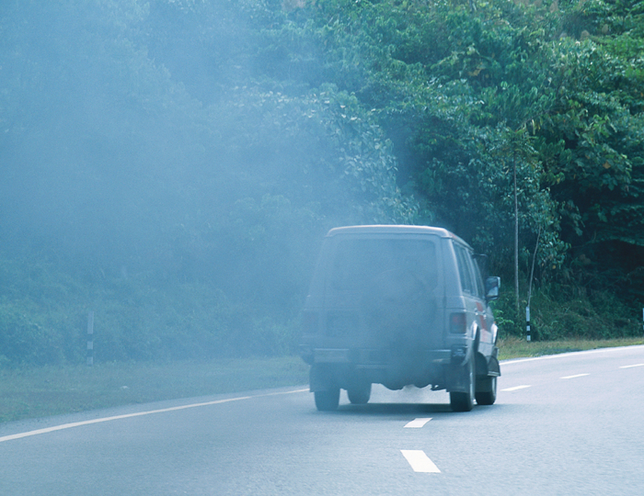
Using CO/CO₂ measurements to determine the amount of total CO₂ emissions from burning of fossil fuels.
http://www.greencarmagazine.net

Slide 15
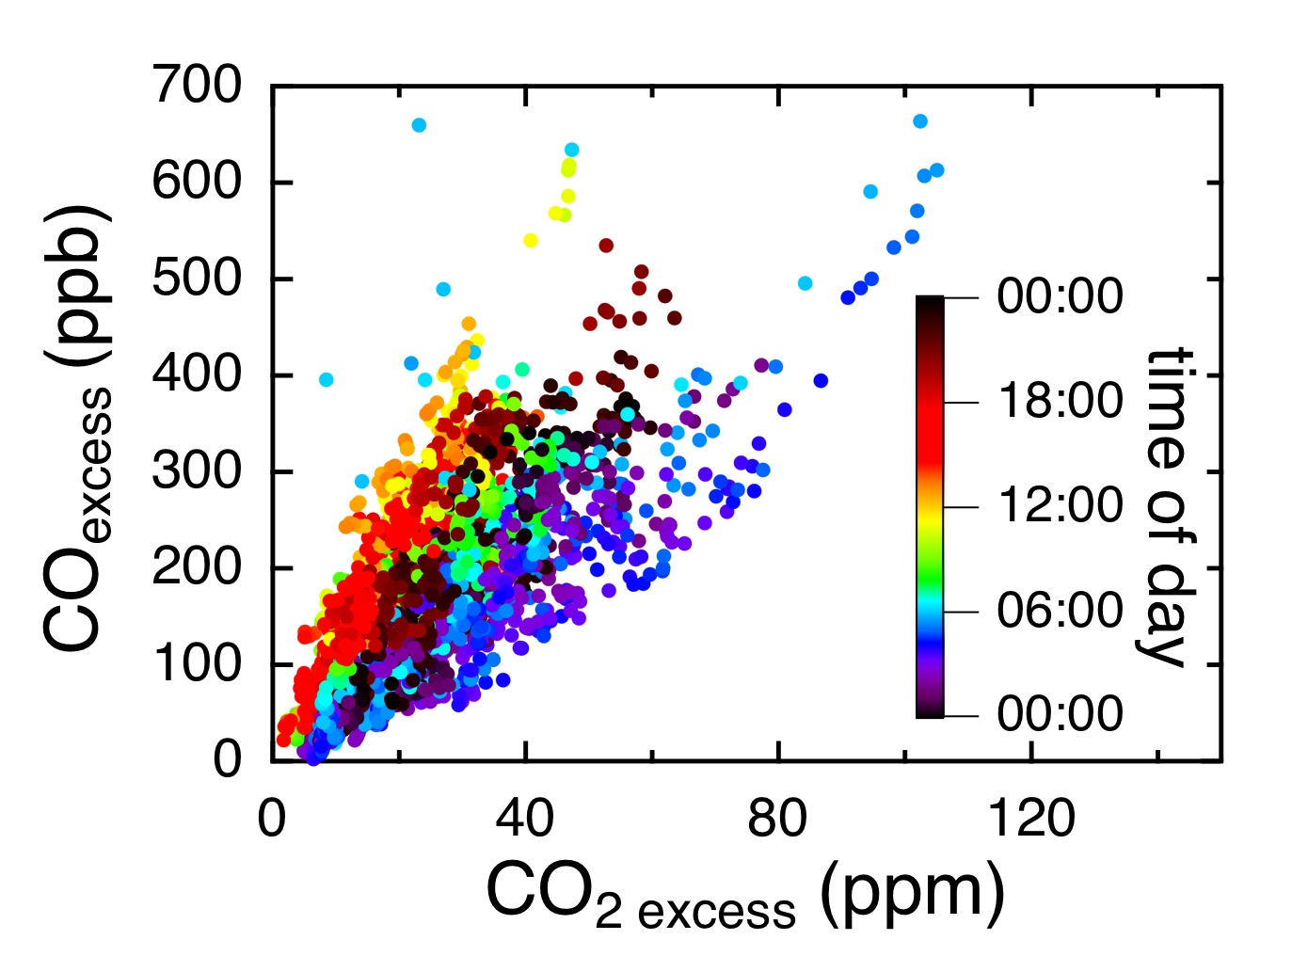
Variation of CO and CO₂ Local Contributions with Time of Day

Slide 16
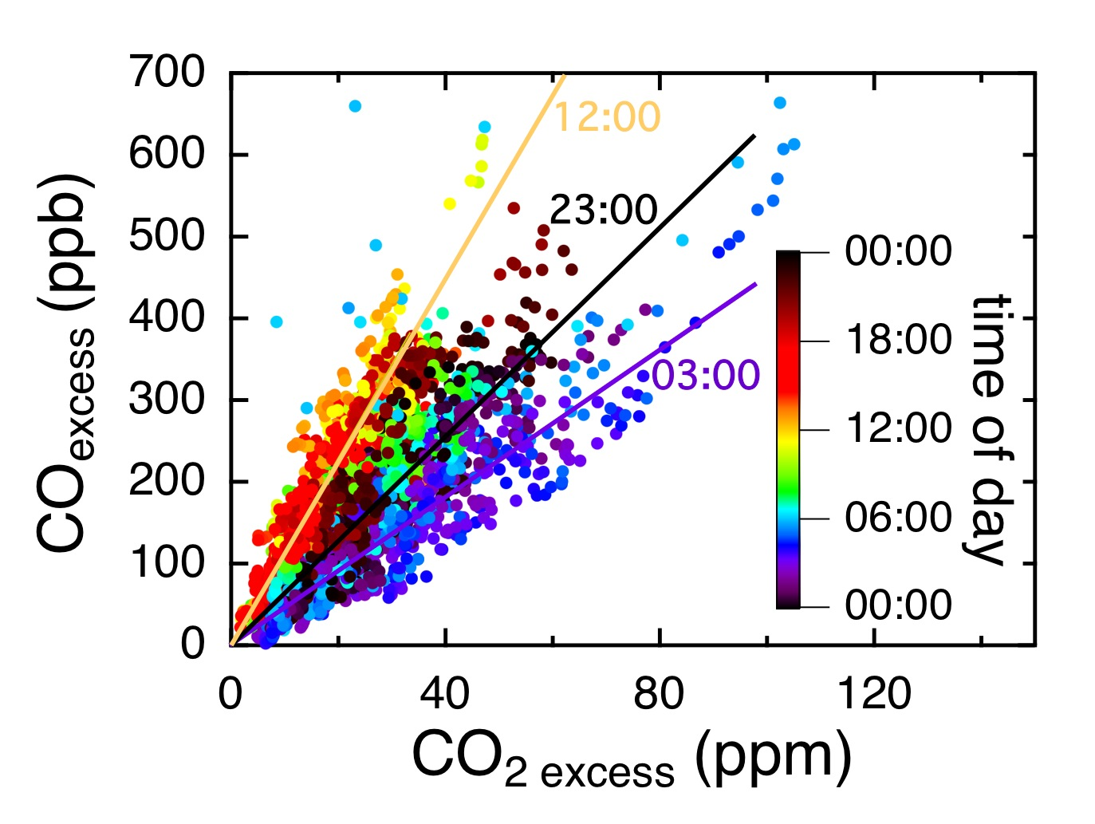
The ratios vary significantly with time of day.

Slide 17
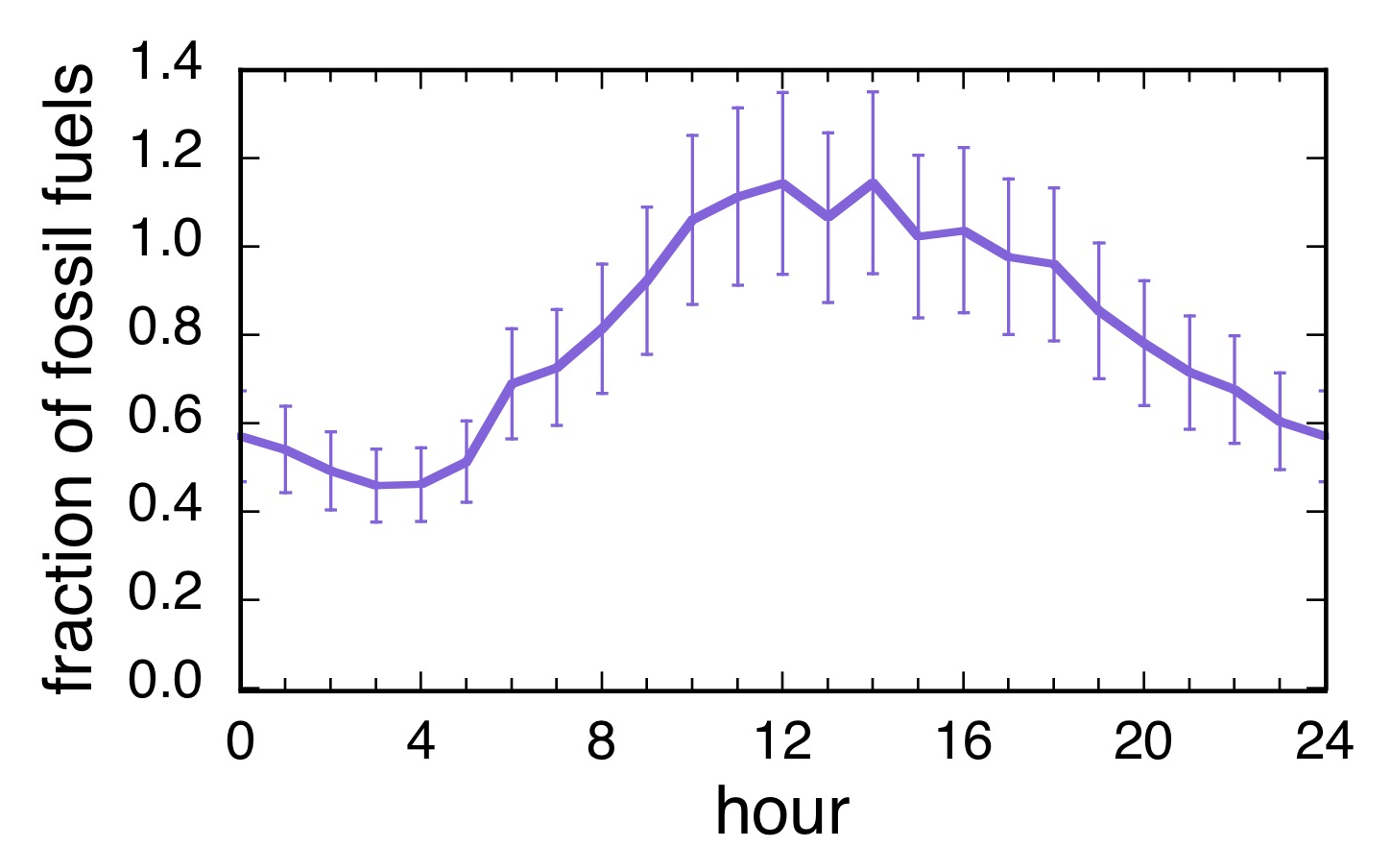
Variation of the Fraction of Local Emissions of CO₂ from Fossil Fuels
Assuming an emission ratio of CO/CO₂ from fossil fuels of 0.011 ± 0.002 (Wunch et al., 2009)

Slide 18

Adding Results from ¹⁴CO₂
Black circles are from Δ¹⁴C from flask samples aggregated from alternate day mid-afternoon collections.

Slide 19
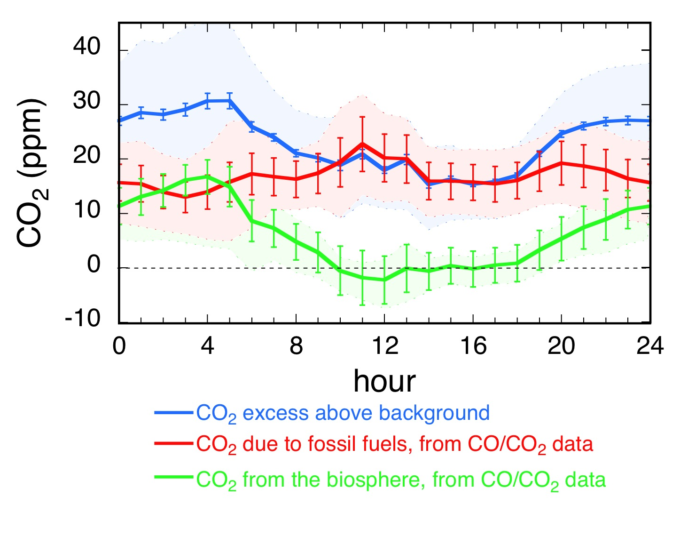
Allocation of Sources of Local CO₂ Emissions
There is significant variation in the sources of CO₂ emissions on a diurnal timescale.

Slide 20
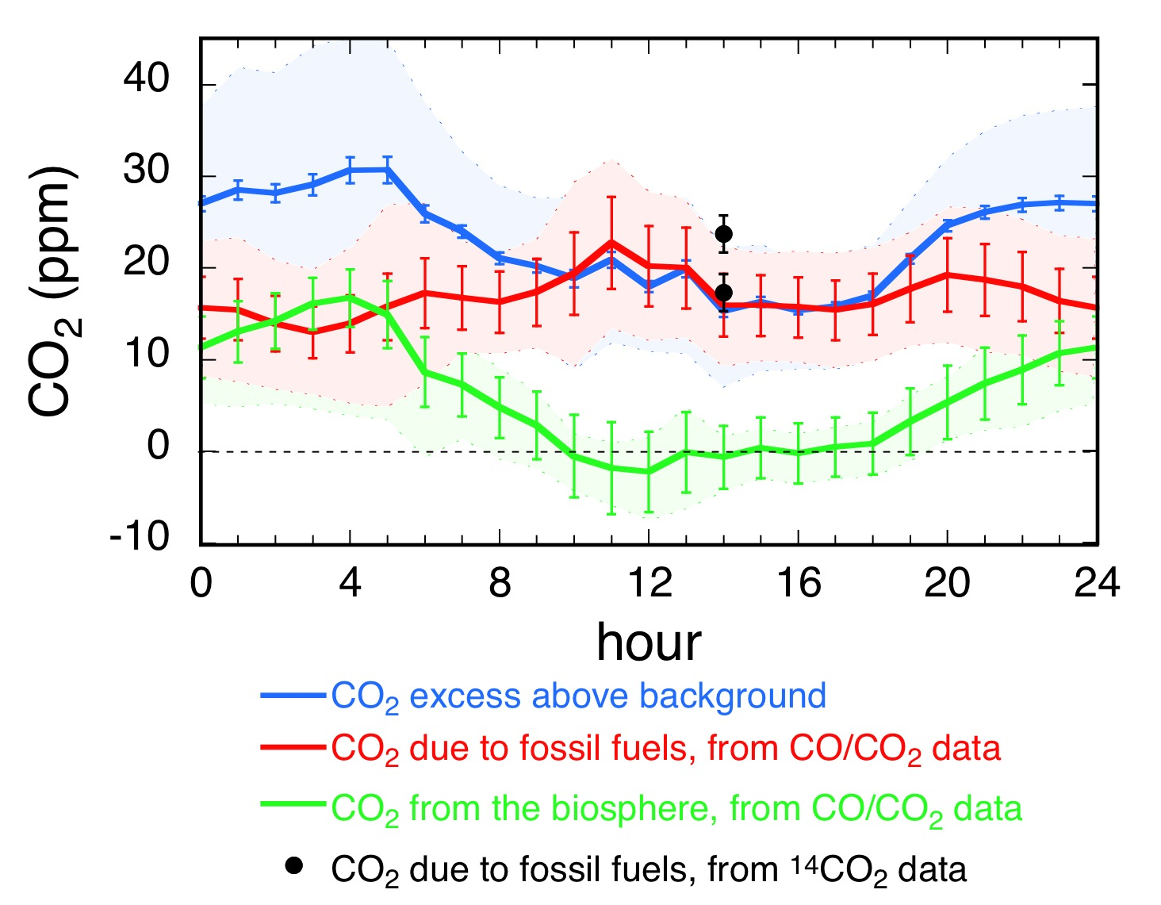
Adding Fossil Fuel CO₂ from ¹⁴C Data

Slide 21
Conclusions
How does the magnitude of CO₂ emissions vary during the course of a spring day, both in situ and in the atmospheric column?
In situ CO₂ varies 15-20 ppm during the day, whereas total column CO₂ only varies 1-1.1 ppm at this time of year.
Diurnal patterns are due mainly to variations in boundary layer height, with superimposed anthropogenic and biogenic influences.
Notes:
Diurnal patterns are due mainly to variations in boundary layer height, with superimposed anthropogenic influences.
With appropriate knowledge of the planetary boundary layer height, we can reproduce remote sensing measurements, to first order using simple dilution and enhancement calculations, refined with appropriate calculations incorporating advection and entrainment.

Slide 22
What is the diurnal variation of the sources of CO₂ emissions, from fossil fuel combustion and the biosphere?
Fossil fuel combustion contributes 50 – 100% of the local emissions, ranging from 13 to 23 ppm, whereas the biosphere contributes up to 17 ppm at night and is a sink of up to 2 ppm during the day.

Slide 23
The CO/CO₂ ratio is an important tool for determining the contributions of anthropogenic vs biological sources on a time scale as fine as an hourly diurnal pattern. These species can be measured much more frequently and cheaply than the gold standard of ¹⁴C.

Slide 25
Conclusions
Diurnal patterns are due mainly to variations in boundary layer height, with superimposed anthropogenic influences.
Using CO/CO₂ ratios we can derive the diurnal cycle of both anthropogenic and biogenic emissions.

Slide 26
How does the magnitude of CO₂ emissions vary during the course of a spring day, both in situ and in the atmospheric column?
  What controls the observed diurnal patterns of CO₂ and CO mixing ratios?
  Can we use in situ mixing ratios to validate remote sensing measurements?
What is the diurnal variation of the sources of CO₂ emissions, from fossil fuel combustion and the biosphere?

Slide 27
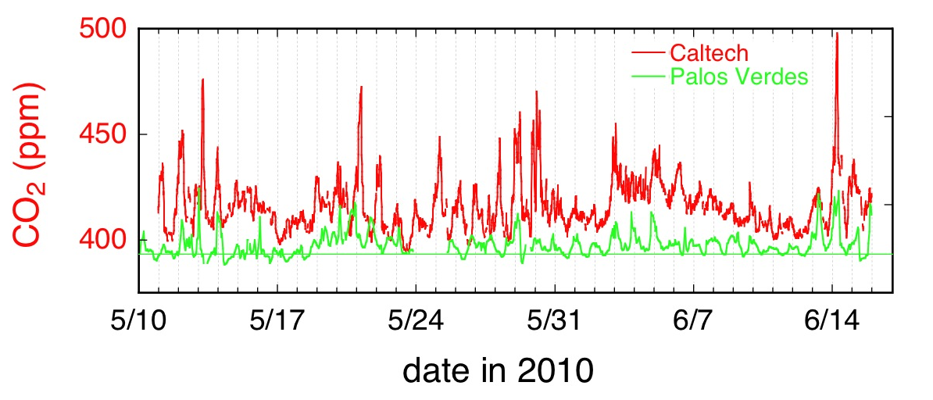
Comparison between CalNex-LA (Caltech) and Background Air (Palos Verdes) CO₂
Average daily minimum CO₂ in Palos Verdes was 393.1 ppm.

Slide 28
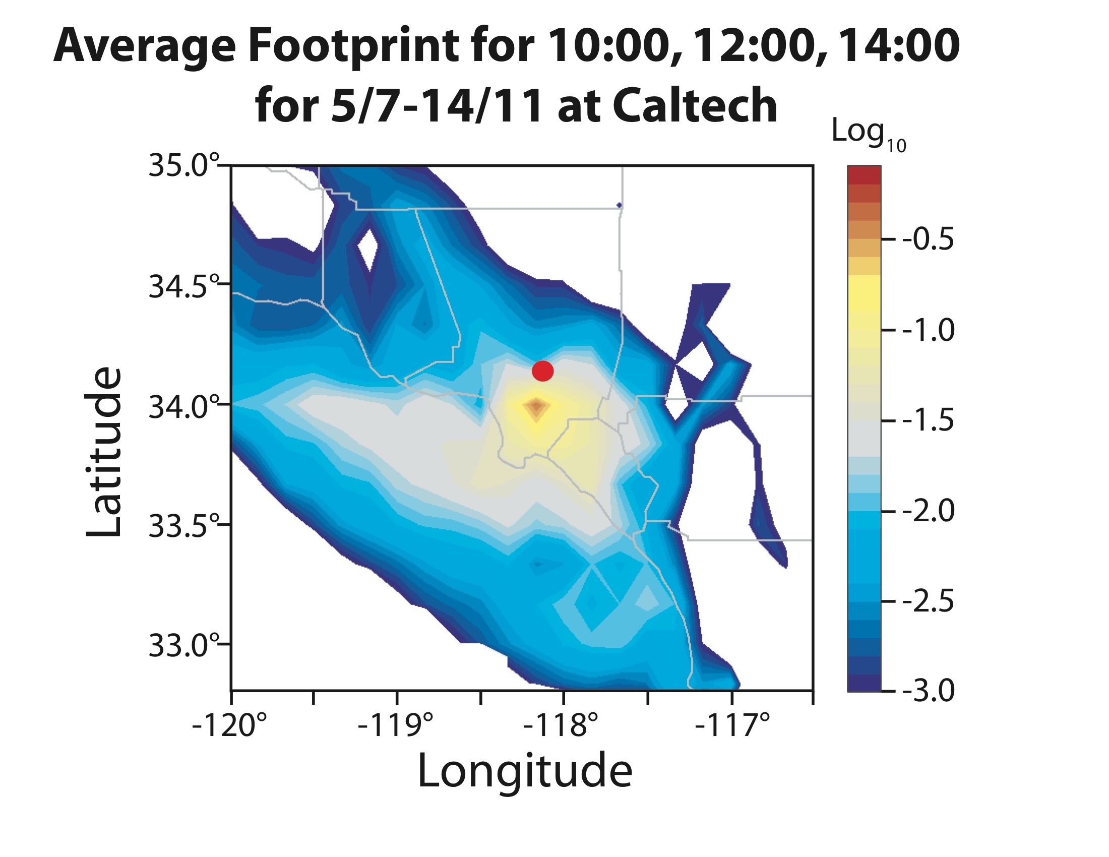
Modeling by Eric Kort, Harvard. Met fields from Wayne Angevine, NOAA.

Slide 29
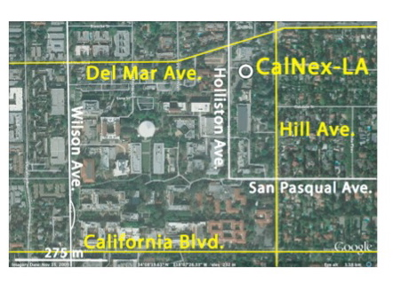

Slide 30
This simple dilution calculation produces a diurnal pattern consistent with column determinations.
Unlike remote sensing techniques, in situ measurements can give 24-hour patterns.
Notes:
This simple dilution calculation produces a diurnal pattern consistent with column determinations.
Unlike remote sensing techniques, in situ measurements can give 24-hour patterns.

Slide 31
Locations of CalNex-LA Ground Campaign (Pasadena) and Background Site (Palos Verdes)

