Slide 1
Measurements of pollutants and their spatial distributions over the Los Angeles Basin
Ross Cheung^{1,2}, Olga Pikelnaya^{1,2}, Catalina Tsai¹, Jochen Stutz^{1,2}, Dejian Fu^{2,3}, and Stanley P. Sander^{2,3}
5/16/2011
¹Department of Atmospheric and Oceanic Sciences, UCLA
²Joint Institute for Regional Earth System Science and Engineering, UCLA
³NASA Jet Propulsion Laboratory, Caltech

Slide 2
Motivation
Observation of spatial and temporal distribution of trace gases in the LA Basin
Study pollution transport of criteria pollutants in the LA basin
Provide data for assimilation into air quality models
Use inverse modeling to validate emissions inventories

Slide 3
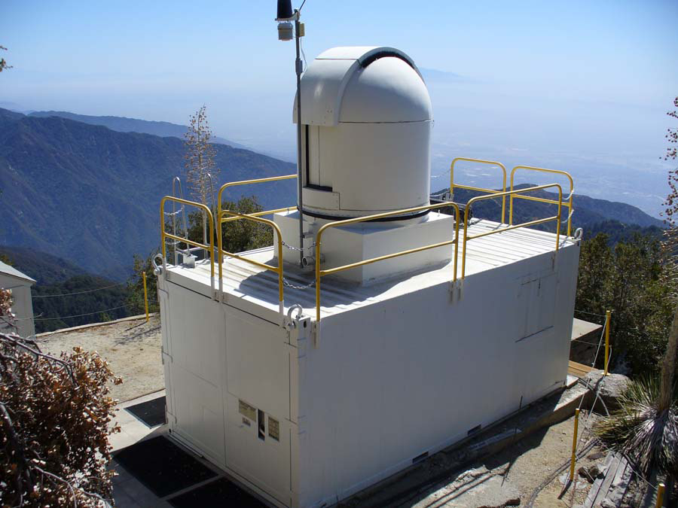
California Laboratory for Atmospheric Remote Sensing (CLARS)
Mt. Wilson, CA, in San Gabriel Mountains,
with a near full view of the LA basin
Longitude: 34° 13' 28'' N
Latitude: 118° 3' 25'' W
Altitude: 1706 meters/5597 feet ASL
Most of the time above the boundary layer
UCLA Multi-AXis Differential Optical Absorption Spectrometer (MAX-DOAS)
JPL Near-IR FTS (Fourier Transform Spectrometer) – see talk by Dejian Fu, Tuesday May 17th, 9:10 am
Measurements started in mid-May 2010 and are still continuing
CLARS observatory at Mt. Wilson

Slide 4
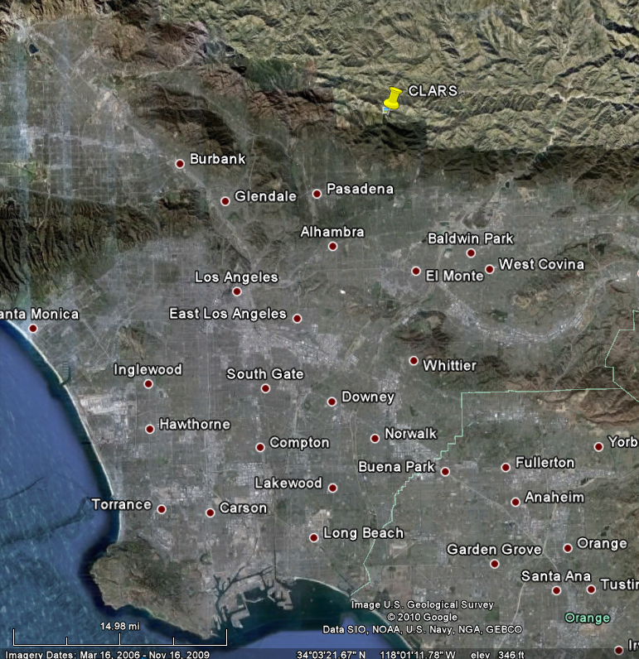
Viewing Geometry
Continuous scans in elevation and azimuth.
Cycle length: 60-80 minutes
240.6 °
147.4 °
182°
Azimuth Angles | 147.4°, 160°, 172.5°, 182°, 240.6°
Elevation Angles | -10°, -8°, -6°, -4°, -2°, 0°, 3°, 6°, 90°

Slide 5
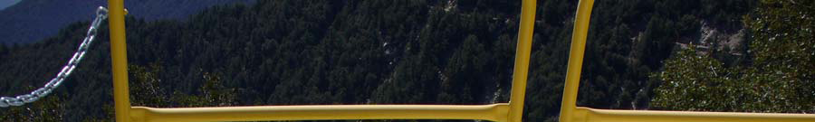
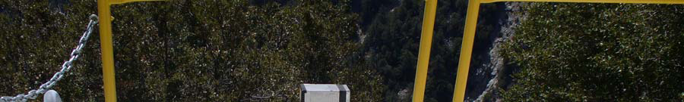
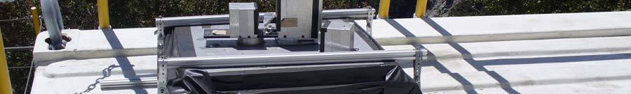
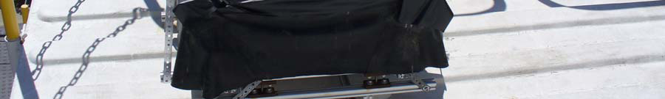
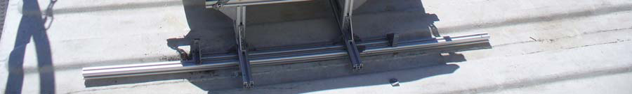
UCLA MAX-DOAS
MAX-DOAS can point in virtually any direction, measures scattered sunlight from sunrise to sunset
Field of view: 0.4°
Acquisition time: ~1 minute
Scattered sunlight from the sky (positive α)
Spectralon
Wavelength interval (nm) | Trace gases measured
316.4 – 448.2 | NO₂, HCHO, Glyoxal, O₄
463.5 – 591.9 | NO₂, O₄
Scattered sunlight from the basin (negative α)

Slide 6
Viewing geometry
MAX-DOAS measures path-integrated concentration along path s:
Slant Column Density (SCD) :
Differential slant column densities (DSCD) obtained by removing zenith SCD:
α
α
MAX-DOAS at Mt. Wilson
O₄ vertical profile
Scattering both in atmosphere and off ground
Notes:
This a schematic of observation geometry. Point out upwards and downwards looking elevation viewing angles.
DSCD depends on trace gas spatial distribution.
For trace gases, C distribution is what you ultimately want to retrieve, however, we have O4, with known vertical distribution.
Therefore, by measuring O4, we obtain information on aerosol extinction that we then use to retrieve other trace gas vertical profiles.

Slide 7
Viewing geometry
MAX-DOAS measures path-integrated concentration along path s:
Slant Column Density (SCD) :
Differential slant column densities (DSCD) obtained by removing zenith SCD:
α
α
MAX-DOAS at Mt. Wilson
O₄ vertical profile
Scattering both in atmosphere and off ground
O₄ gives important information about atmospheric path length
Notes:
This a schematic of observation geometry. Point out upwards and downwards looking elevation viewing angles.
DSCD depends on trace gas spatial distribution.
For trace gases, C distribution is what you ultimately want to retrieve, however, we have O4, with known vertical distribution.
Therefore, by measuring O4, we obtain information on aerosol extinction that we then use to retrieve other trace gas vertical profiles.

Slide 8
Wavelength Dependence of DSCD
DSCD: (5.3 ± 0.3) x 10¹⁶
All figures are in the same viewing direction
323-362 nm
DSCD: (7.3 ±0.1) x 10¹⁶
464-507 nm
DSCD: (7.4 ± 0.2) x 10¹⁶
419-447 nm
DSCD: (10 ± 0.2) x 10¹⁶
520-588 nm
Path length is wavelength dependent due to scattering effects
Notes:
We know that rayleigh and lorentz-mie scattering are wavelength dependent, we should expect to see further (longer path length) the longer the wavelength is, and that it is reflected in our DSCD

Slide 9
Scattering Effects
Elevation -4º
Azimuth 182º
NO₂ DSCD
molec/cm²
DSCDs increase with increasing path lengths
O₄ DSCD
molec²/cm⁵
Obtaining NO₂ and O₄ DSCDs at different wavelengths adds valuable information on radiative transfer

Slide 10
Scattering Effects
Elevation -4º
Azimuth 182º
NO₂ DSCDs increase close to Mt. Wilson
NO₂ DSCD
molec/cm²
No strong RT effects seen in O₄
O₄ DSCD
molec²/cm⁵
Obtaining NO₂ and O₄ DSCDs at different wavelengths adds valuable information on radiative transfer

Slide 11
Overview of May 31 data
Looking eastwards (towards Baldwin Park and West Covina)
Looking westward (towards Santa Monica)
Az 147º
Az 160º
Az 172º
Az 182º
Az 241º
NO₂ DSCD
molec/cm²
HCHO DSCD
molec/cm²
O₄ DSCD
molec²/cm⁵
40 viewing directions in 2 wavelengths, every 60-80min
Notes:
This is meant to be an overview slide, with most changes discussed on next slide when we zoom into 172 degrees

Slide 12
DSCDs at 172° Azimuth
Increase in NO₂ later in day – transport of pollution
NO₂ DSCD
molec/cm²
NO₂ above boundary layer relatively constant
HCHO DSCD
molec/cm²
O₄ DSCD
molec²/cm⁵
O₄ surprisingly constant throughout this day

Slide 13
DSCDs at 172° Azimuth
NO₂ DSCD
molec/cm²
NO₂ and HCHO greatest when looking into boundary layer
HCHO DSCD
molec/cm²
O₄ DSCD
molec²/cm⁵
O₄ greater in horizontal elevation angles

Slide 14
Overview of May 31 data by elevation angle
Downwards looking
Upwards looking
Elev. -6º
Elev. -4º
Elev. -2º
Elev. 0º
Elev. 3º
NO₂ DSCD
molec/cm²
HCHO DSCD
molec/cm²
O₄ DSCD
molec²/cm⁵
Notes:
By looking at different elevations, you are looking at different altitudes. For example, -6 is looking into the basin, while 3 – above the boundary layer.
NO2 levels are higher when looking downwards – not surprising as we expect in to be greater in the BL. O4 DSCDs increase as elevation angle become positive – longer pathlength.

Slide 15
Overview of May 31 data by elevation angle
241° Azimuth behaves differently from others
Elev. -6º
Elev. -4º
Elev. -2º
Elev. 0º
Elev. 3º
NO₂ DSCD
molec/cm²
HCHO DSCD
molec/cm²
O₄ DSCD
molec²/cm⁵
O₄ values increase with elevation angle – increasing path length

Slide 16
Overview of May 31 data by elevation angle
Diurnal variability in NO₂, HCHO
Elev. -6º
Elev. -4º
Elev. -2º
Elev. 0º
Elev. 3º
NO₂ DSCD
molec/cm²
HCHO DSCD
molec/cm²
O₄ DSCD
molec²/cm⁵
Clear vertical gradient in NO₂ and HCHO DSCDs

Slide 17
Quantifying the Effect of Radiative Transfer
Weighing factor for each atmospheric layer’s contribution to absorption and scattering at each elevation angle: Differential Box Air-Mass Factor (DBAMF)
DBAMFs for May 31st
DBAMFs calculated with TRACY II Monte- Carlo Radiative Transfer Model
Weight moves lower in atmosphere with decreasing elevation angle

Slide 18
Quantifying the Effect of Radiative Transfer
Weighing factor for each atmospheric layer’s contribution to absorption and scattering at each elevation angle: Differential Box Air-Mass Factor (DBAMF)
DBAMFs for May 31st
DBAMFs calculated with TRACY II Monte- Carlo Radiative Transfer Model
Weight moves lower in atmosphere with decreasing elevation angle

Slide 19
Quantifying the Effect of Radiative Transfer
Weighing factor for each atmospheric layer’s contribution to absorption and scattering at each elevation angle: Differential Box Air-Mass Factor (DBAMF)
DBAMFs for May 31st
DBAMFs calculated with TRACY II Monte- Carlo Radiative Transfer Model
Weight moves lower in atmosphere with decreasing elevation angle

Slide 20
Retrieval of BL and FT NO₂ concentrations
NO₂ elevated and well-mixed in in boundary layer (BL).
Boundary layer height was determined by Ceilometer at Caltech.
NO₂ concentration free troposphere from horizontal elevation scan
Concentration C_{j} for each atmospheric layer j is:
Notes:
The simple example of retrieval is to express lower atmosphere in two well-mixed layers – BL and FT. Then we can retrieve concentrations in both.

Slide 21
NO₂ mixing ratios, May 31st
Boundary Layer Height courtesy of C. Haman and B. Lefer, University of Houston
Values in 3 azimuths agree well
Notes:
This slide shows results of calculations for may 31st. Top panel shoes BLH values we used. They were measured by celiometer operated by UH.
Middle panel is NO2 in FT, bottom in the BL.
We see lower NO2 in the FT compared to the BL, which is expected. We also see that values from 3 azimuths agree well, which gives us confidence in our results.
We also compared our retrieved NO2 in the BL with the LP-DOAS NO2 measurements that are presented in the dotted line on the bottom panel. LP was taking path averaged NO2 measurements from the top of the Millikan Library looking towards the mountains.
Both instruments show good agreement.
If you have more time, you can go into explaining that FT NO2 shows less diurnal variations than BL NO2.

Slide 22
NO₂ mixing ratios, May 31st
Boundary Layer Height courtesy of C. Haman and B. Lefer, University of Houston
For more on the Long-path DOAS, see talk by Catalina Tsai, Tuesday, May 17th, 1:30 pm
Notes:
This slide shows results of calculations for may 31st. Top panel shoes BLH values we used. They were measured by celiometer operated by UH.
Middle panel is NO2 in FT, bottom in the BL.
We see lower NO2 in the FT compared to the BL, which is expected. We also see that values from 3 azimuths agree well, which gives us confidence in our results.
We also compared our retrieved NO2 in the BL with the LP-DOAS NO2 measurements that are presented in the dotted line on the bottom panel. LP was taking path averaged NO2 measurements from the top of the Millikan Library looking towards the mountains.
Both instruments show good agreement.
If you have more time, you can go into explaining that FT NO2 shows less diurnal variations than BL NO2.

Slide 23
Conclusions and Outlook
UCLA MAX-DOAS measured spatial and temporal distribution of NO₂, HCHO, and O₄ (aerosol extinction) during CalNex
Raw data clearly shows the change of trace gas levels with location and altitude in the LA basin
Initial radiative transfer calculations result in reasonable boundary layer NO₂ mixing ratios
More detailed radiative transfer calculations are currently performed
Retrieval of concentration distributions will be performed directly and through an adjoint 3D air quality model (see talk by Dan Chen, Tuesday May 17th 4:10 pm)

Slide 24
Acknowledgements
We would like to thank the NOAA and the California Air Resources Board (CARB) for providing funding, and the NASA Jet Propulsion Laboratory for providing access to the CLARS facility on Mt. Wilson

