Slide 1
CO2 inventories, linking/leveraging off of regional pollutant information
Kevin Gurney
Associate Professor
Department of Earth and Atmospheric Sciences/Department of Agronomy
Purdue University
Support from: NASA, DOE, Knauf insulation, Showalter Trust, Rosen Center

Slide 2
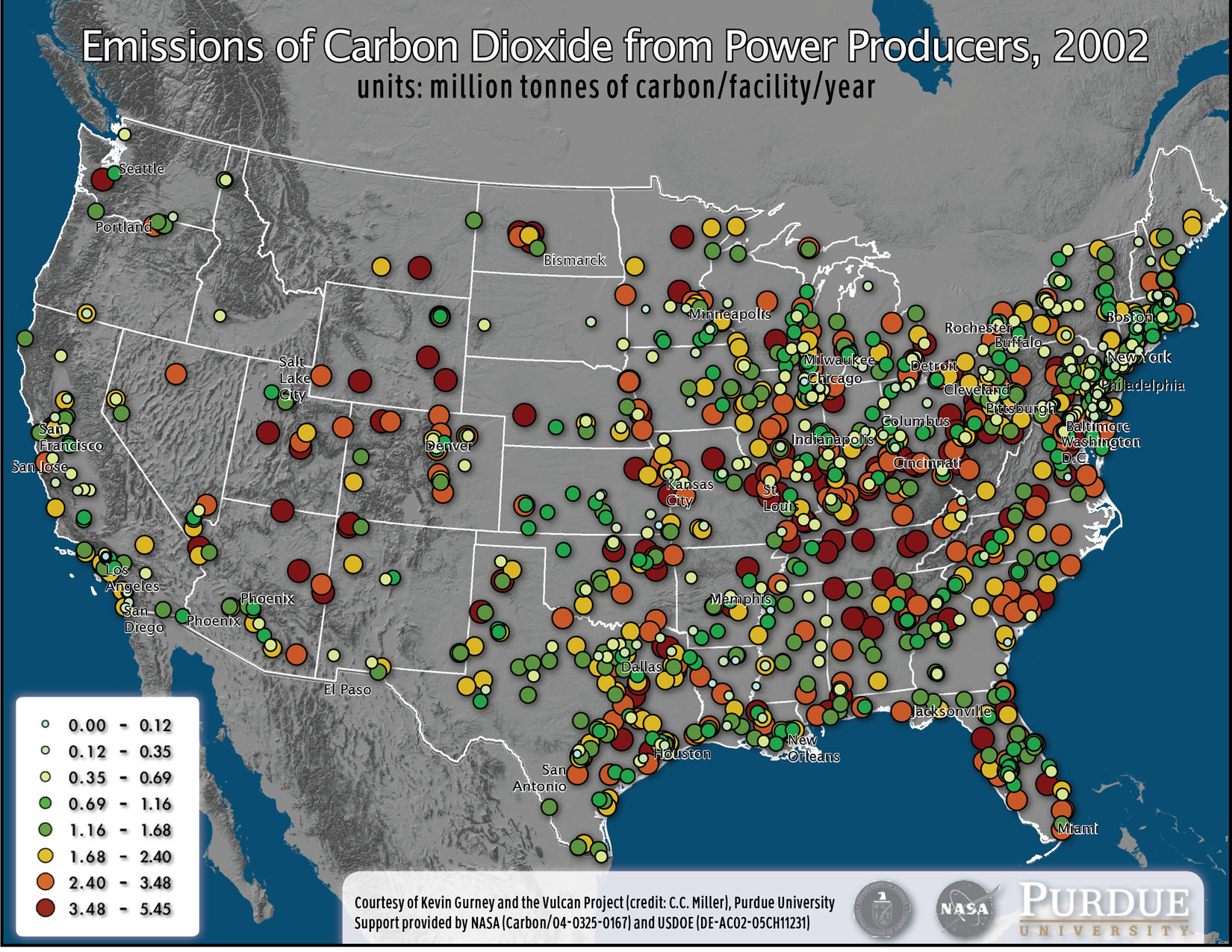
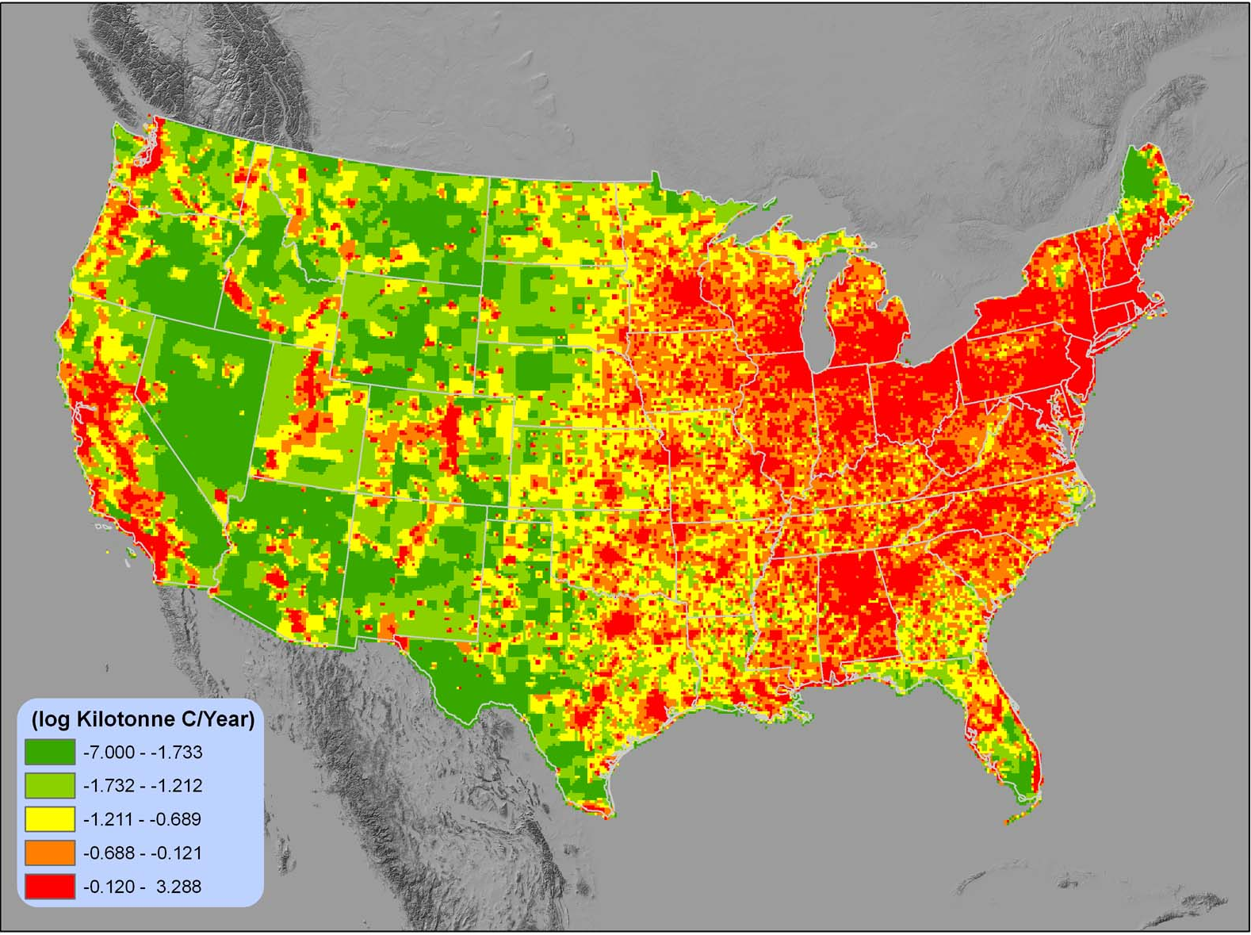
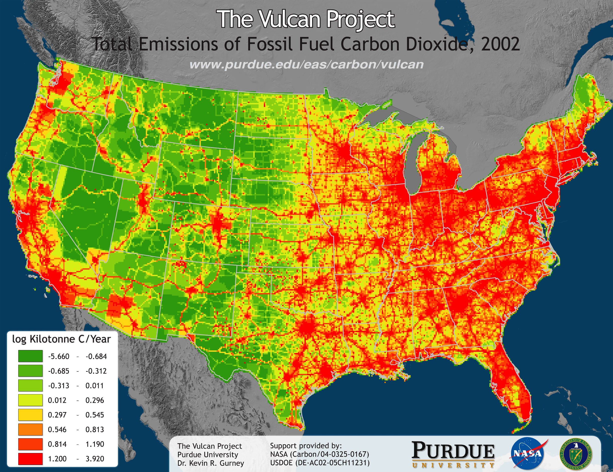
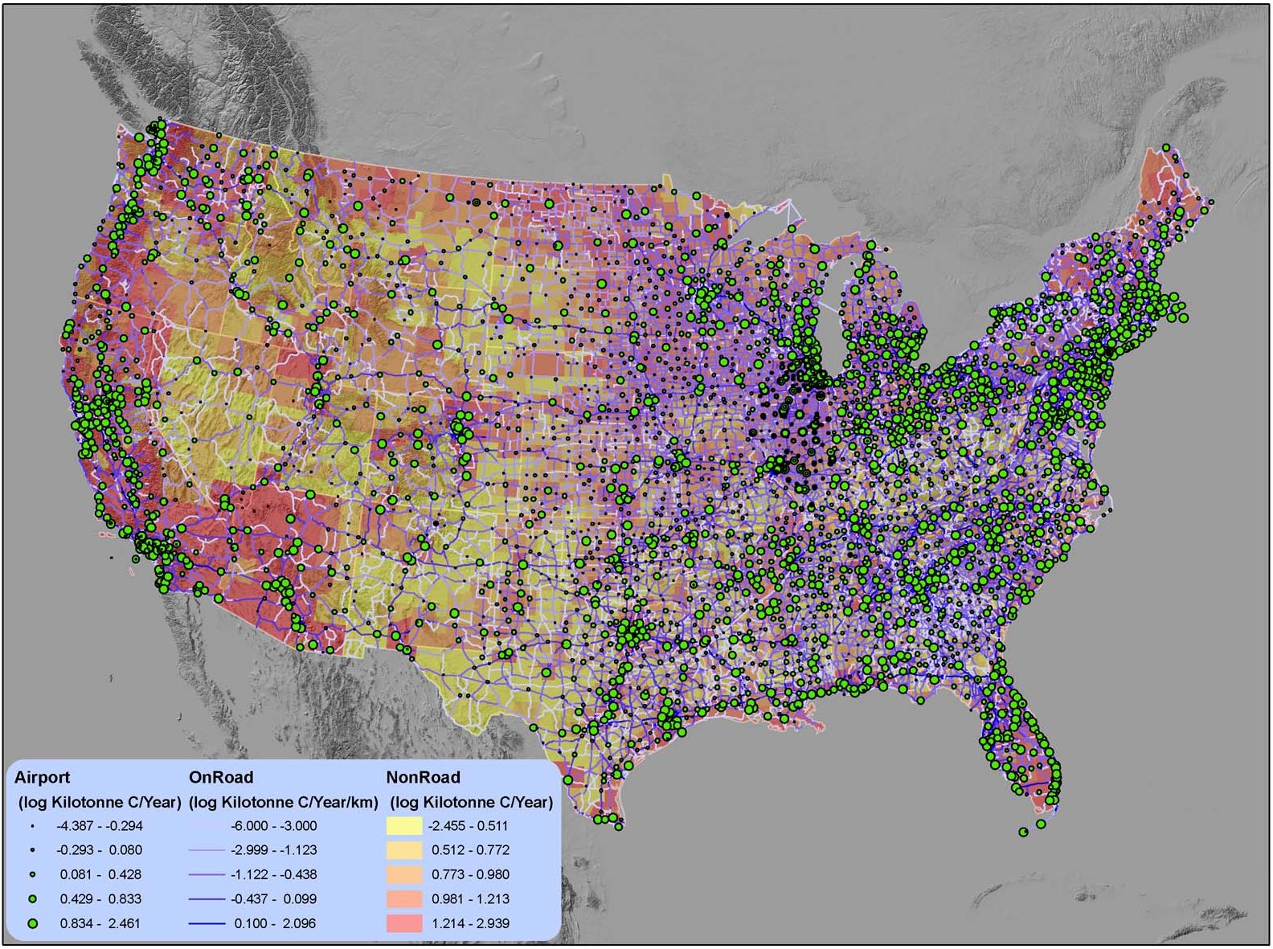
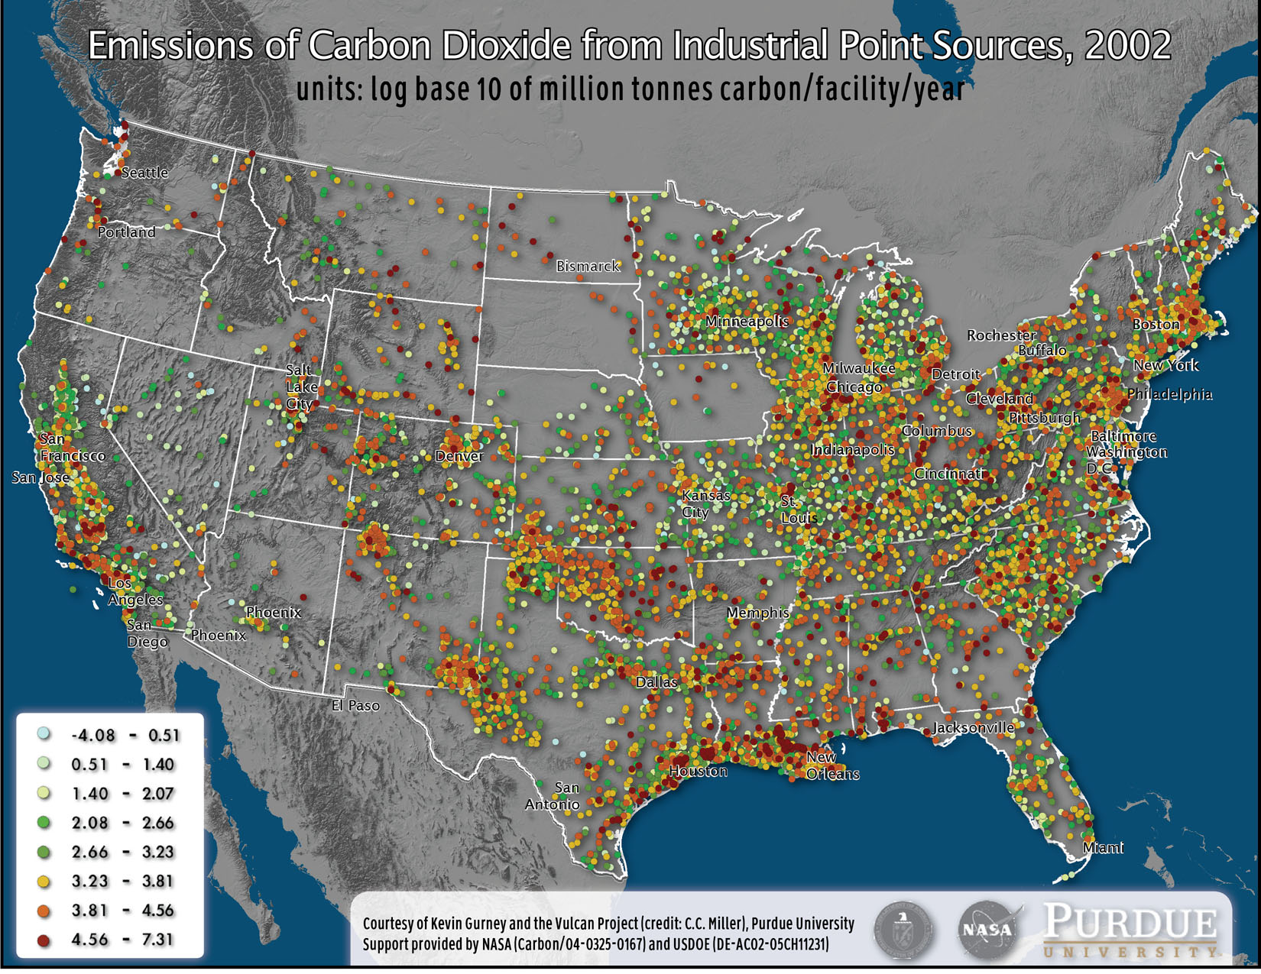
Vulcan
Version 1.3 now available
www.purdue.edu/eas/carbon/vulcan
Gurney et al., Env. Sci & Tech, 2009
Notes:
Key points: CO2 emissions are produced at the “native” resolution: points, roadways, powerplant locations. They are then transformed onto a common 10 km grid. Results are produced hourly for 2002.

Slide 3
Manipulate existing AQ to generate CO₂
QA/QC
QA/QC
QA/QC
QA/QC

Slide 4
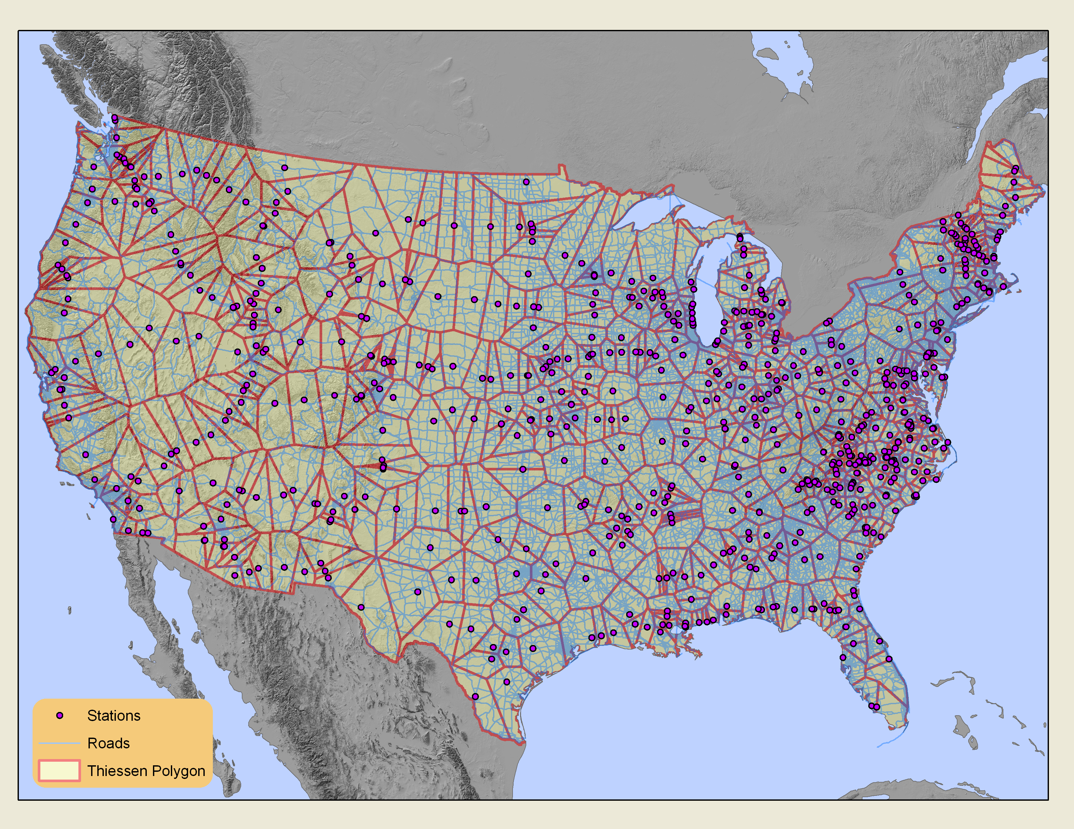
Mobile temporal structure
Improving mobile temporal structure: FOIA request turned up >6000 traffic monitoring stations
Notes:
Yuyu: you can update figures here if you like.

Slide 5
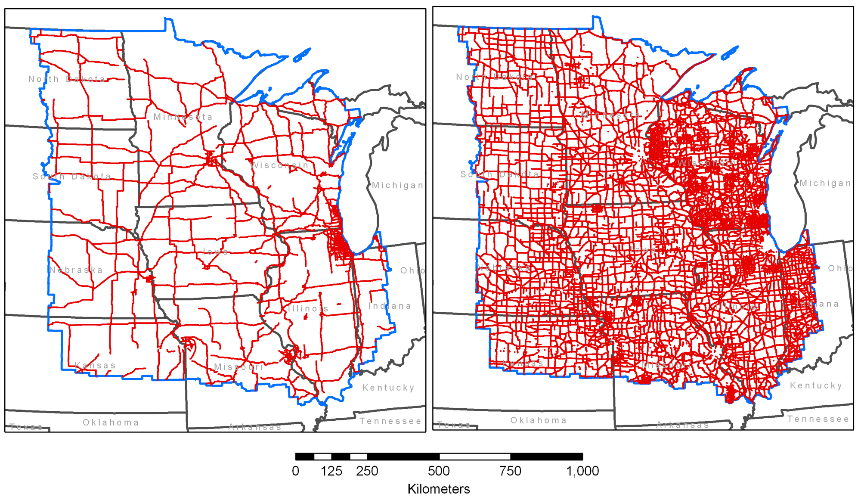
Improved mobile road atlas
Improved road atlas from the 2008 census – better coverage and road classification.
Version 1.1
Version 1.2
Notes:
Yuyu: you should include a better road atlas figure for just the midwest states

Slide 6
Urban-scale onroad

Slide 7
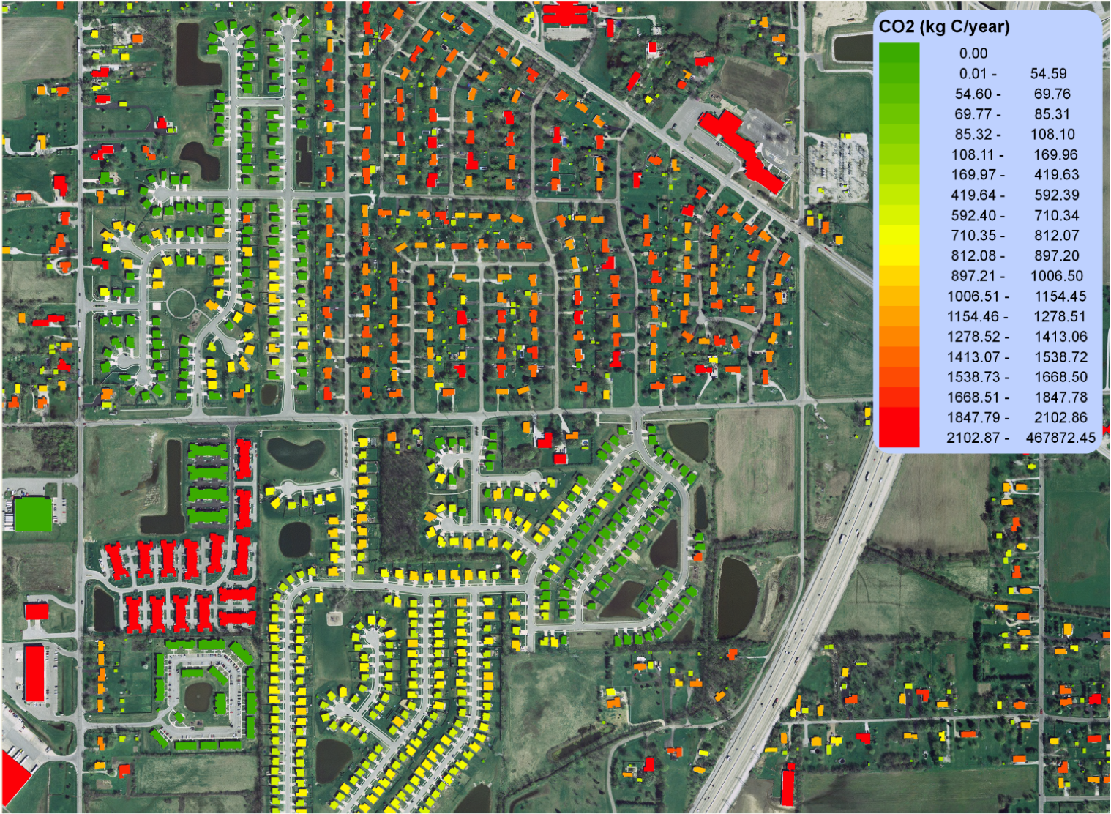
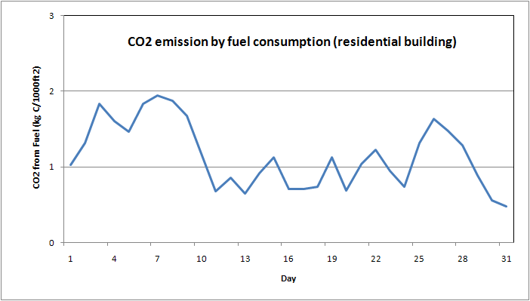
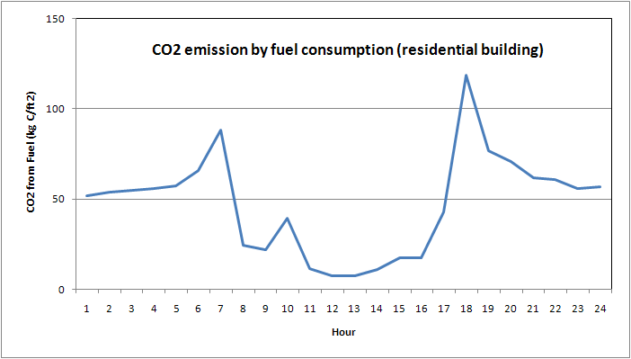
Hestia Pilot

Slide 8
An opportunity
Inventory/accounting/reporting of GHGs: regulation-driven
Atmospheric transport
(significant uncertainty, scale limited)
Atmospheric measurements (in situ, aircraft, satellite)
Transport uncertainties? See:
Gurney et al., Nature 2002
Gurney et al., Tellus, 2003

Slide 9
An opportunity
Inventory/accounting/reporting of GHGs: regulation-driven
verification
space/time, comprehensive behavior/energy/material flow system
Assimilation,
Improvement (both directions)
Multiple added benefits:
what-if capability (mitigation)
Local decision support
Economically efficient
Other science (energy systems, sociology, demography)
Leverage error down
Comparative analysis
Scale independent
Avails of multiple data streams
Atmospheric monitoring (in situ, aircraft, satellite)

Slide 10
Linked inventories:
Our experience is that CO2 can actually help with the criteria pollutant inventories – the case of Alabama residential NOx
With emission linkage comes evaluation leverage. Some species have far less ambiguous source functions compared to GHGs.
We will produce a preliminary CO/CO2 emissions inventory soon (at Vulcan scale)
Multiple user communities (helps with funding): modeler and decisionmakers – very different needs from a data and data product point of view (normalization is powerful)
Useability of data products is a big issue for us (funding hard)
I would like NEI to report FUEL! Right now we shoehorn EPA and DOE/EIA data together)
Move to data mining of very different data types.

