Slide 1
Coordinated US Initiative on Emissions Research
Introduction and Goals
First Workshop
4 December 2009
NOAA DSRC, Boulder, CO
Claire Granier and Greg Frost
NOAA Earth System Research Laboratory, Chemical Sciences Division
CIRES, Univ. Colorado
Schedule for Today’s Workshop
Morning (9:00 – 11:50): Overview presentations (≤10 min)
  Motivation
  Inventory development
  Inventory evaluation and data access
Lunch (11:50 – 13:00)
Afternoon (13:00 – 16:00): Open discussions
  Identify specific research questions that could improve inventories
  Discuss collaborations
Notes:
Presentations will discuss development, evaluation, and data access work and needs of these efforts

Slide 2
Initiative Participants
Coordinated US Initiative on Emissions Research
Federal Regulatory
US EPA
Federal Research
NOAA
DOE
NASA
US Forest Service
UC Berkeley
Colorado
Illinois
Iowa
Purdue
Wash/St L
Private Sector
Northrop Grumman
Panorama Pathways
Academic
NCAR
First Workshop, 4 December 2009, NOAA DSRC, Boulder, CO
Notes:
Shows all who have expressed interest in this initiative
Not all agencies present here today
Some of these groups have long history of working together
We could definitely have better representation from many of these agencies
We will continue to invite others to join; need your help
Success of this partnership: depends on discovering mutual areas of interest and natural areas of collaboration

Slide 3
Motivation
Coordinated US Initiative on Emissions Research
Understand the chemical composition of the atmosphere and how it is changing over time
Observe atmosphere
Quantify budgets of constituents
Evaluate changes in budgets
Investigate AQ-climate linkages
Predict future AQ and climate
Pursue multiple approaches
Air Quality Climate
Models
Evaluations
Inventories
Observations
Regulation
Research
Regulation
Research
First Workshop, 4 December 2009, NOAA DSRC, Boulder, CO
Notes:
Some aspects of NOAA’s mission (applies to NCAR and to some branches of EPA too)
Observe atmosphere at different spatial and temporal scales
Quantify contributions of natural & anthropogenic sources to AQ and climate
Evaluate short- and long-term changes in these sources, effectiveness of deliberate emission controls
More recently, focus has been on coupled nature of AQ and climate

Slide 4
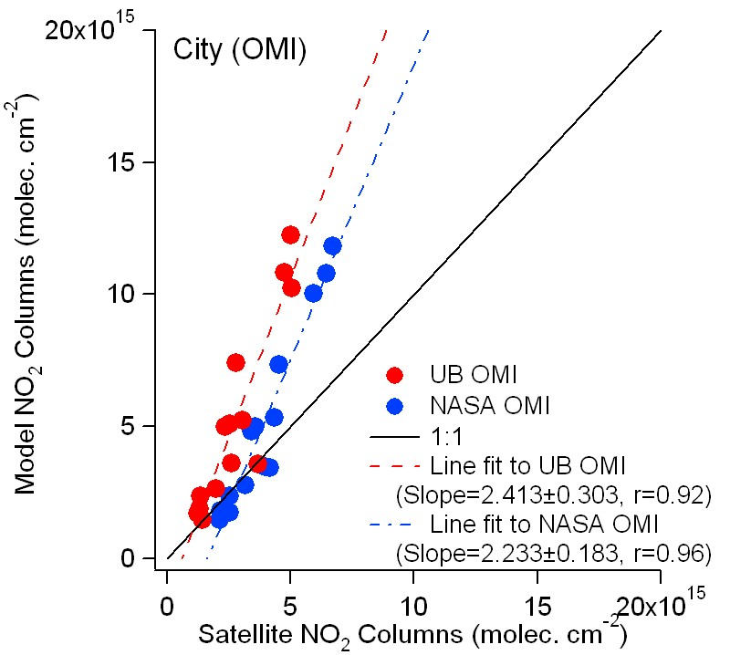
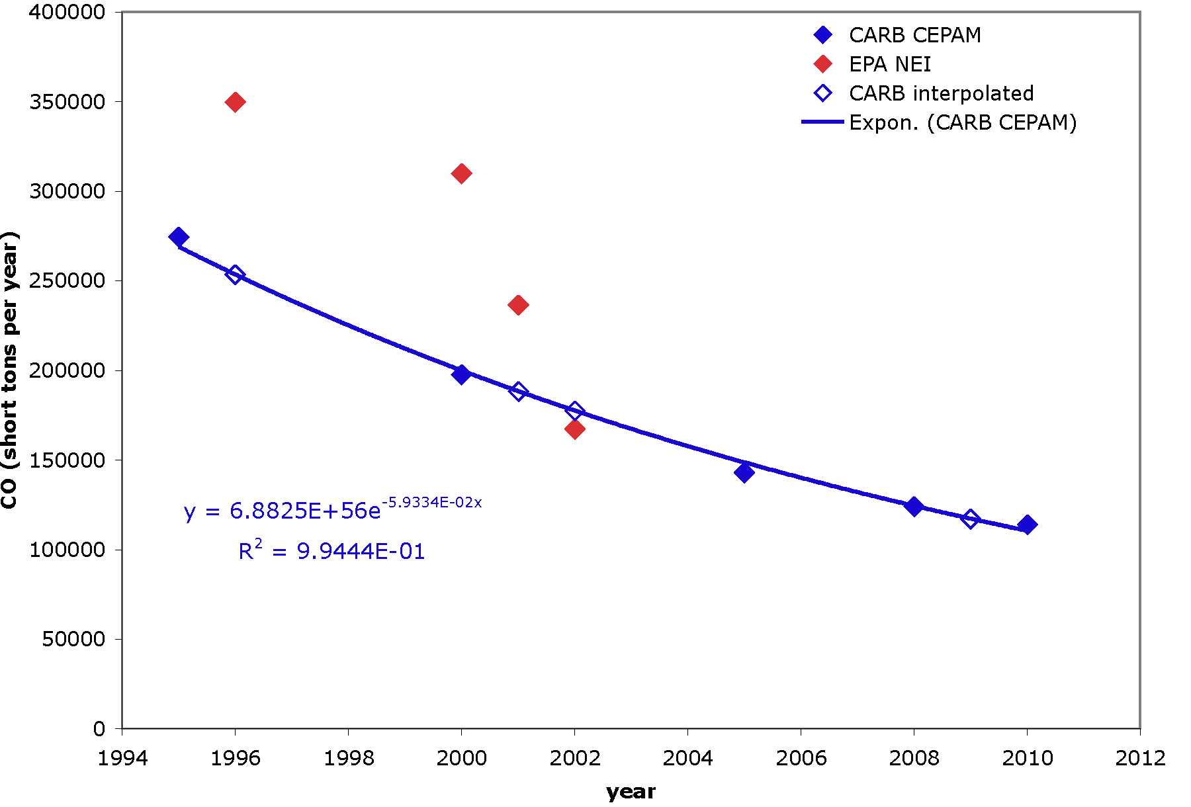
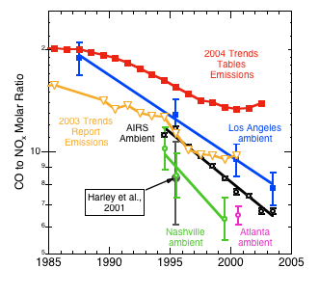
NOAA Emission Evaluation
Coordinated US Initiative on Emissions Research
D. D. Parrish, Atmos. Environ., 2006
J. Miller, NOAA ESRL GMD
S.-W. Kim et al., JGR, 2009
CO Emissions (tons/yr)
J. Turnbull, NOAA ESRL GMD
Year
First Workshop, 4 December 2009, NOAA DSRC, Boulder, CO
Notes:
Top left plot: David Parrish compared CO/NOx ratios measured in urban areas with bottom-up trends from EPA inventories and Rob Harley’s fuel-based approach. EPA magnitudes and even trends did not agree well with ambient observations.
Top right: Evaluation of EPA emissions of various GHGs by John Miller in GMD, based on 14CO2 analysis, for eastern N America
Bottom left plot: Jocelyn Turnbull (GMD) compared CO inventories from EPA and California Air Resources Board (CARB) for 1995-2010… big differences in trends
Bottom right: Si-Wan’s paper on satellite NO2 columns over Western US cities: big overestimates in NOx emissions if use NEI 1999

Slide 5
Issues that Limit Emissions Research
Coordinated US Initiative on Emissions Research
Where We Want to Go
Research Progress
Species- and Region- Dependent Inventory Methods
State, National, Regional and Global Data Not Compatible
Grid Inventories vs. Sector and Area Totals
Infrequent Temporal Availability
Emission Trends vs. Method Changes
Documented Data, Data Access, & User-Friendliness
Where We Are
First Workshop, 4 December 2009, NOAA DSRC, Boulder, CO
Notes:
Difficulty of updating inventories
Can we construct emission trends if methods change

Slide 6
Motivations for Collaborative Emissions Initiative
Coordinated US Initiative on Emissions Research
Improve inventory development and evaluation process
Observational evaluations provide feedback to inventory developers
How to define the observations needed for improving emissions
Links AQ & climate researchers
EPA mandate to build GHG inventory
Links to international programs (IGBP, IPCC, HTAP)
Air Quality Climate
Models
Evaluations
Inventories
Observations
Regulation
Research
Regulation
Research
First Workshop, 4 December 2009, NOAA DSRC, Boulder, CO
Notes:
How would this initiative help us to address this mission?
Improve inventory development and evaluation process
Observations: provide feedback to inventory developers
Inventories: by understanding underlying inventory drivers, can design new observations
Help link AQ and climate research communities
EPA now has mandate to build GHG inventory
Timing excellent for coordinated US emissions effort

Slide 7
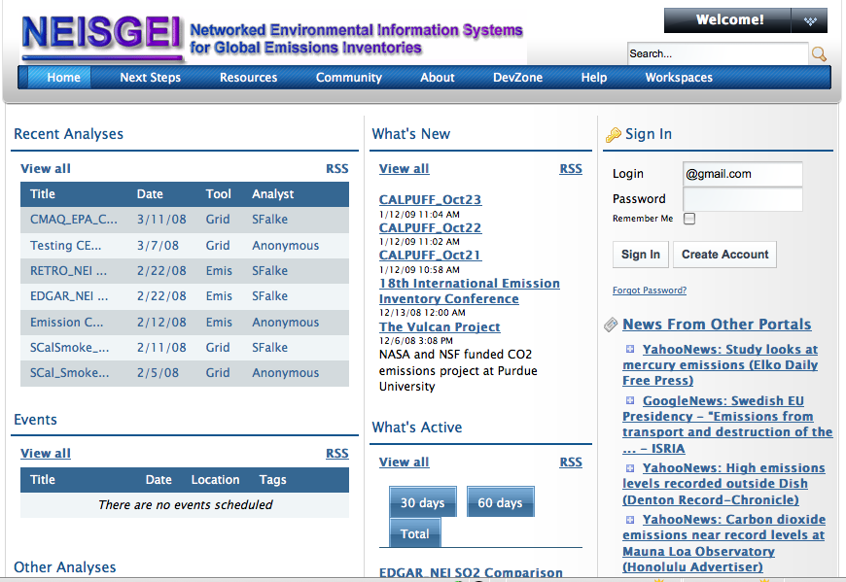
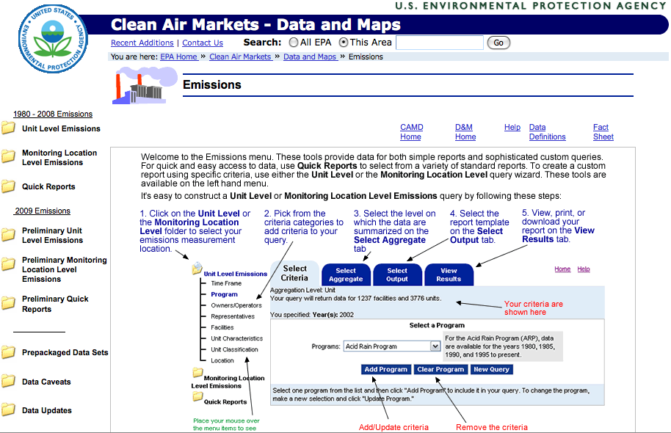
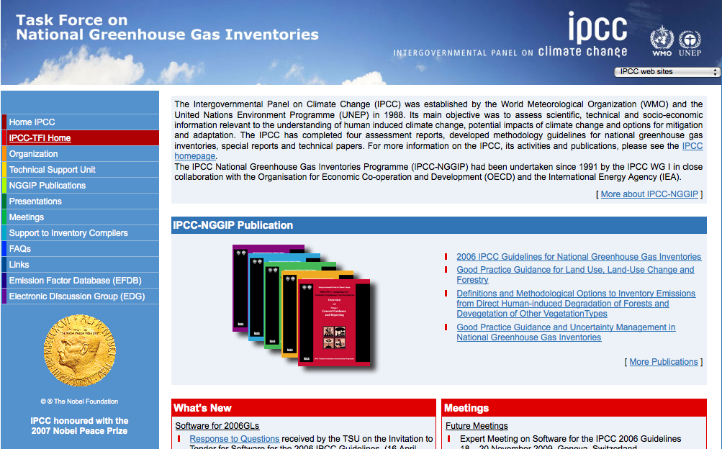
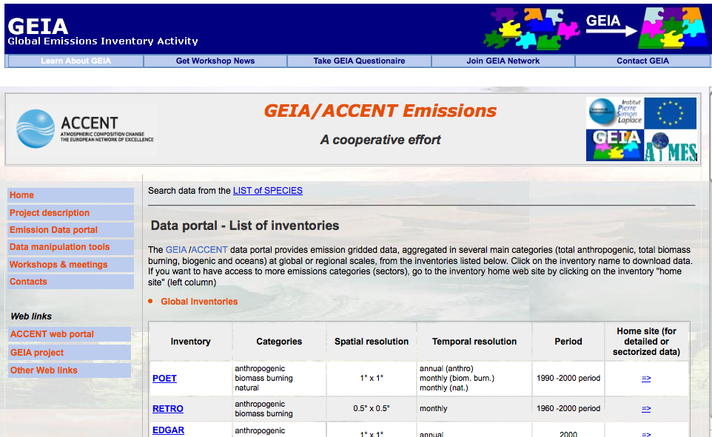
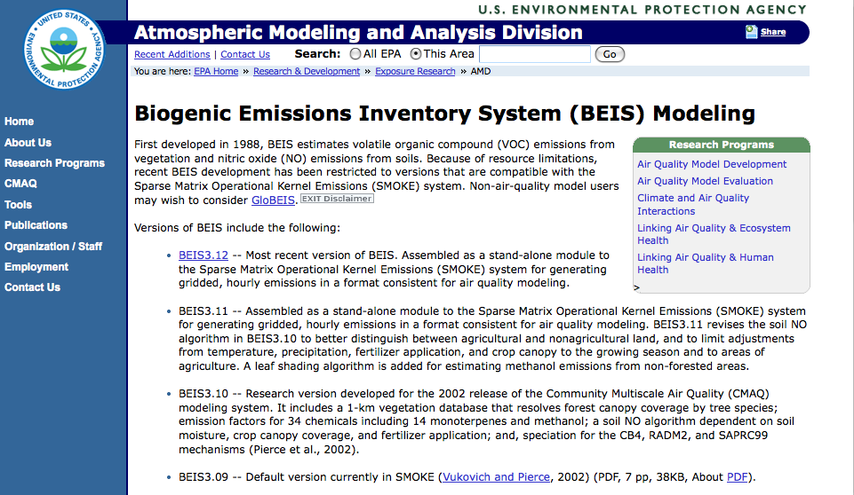
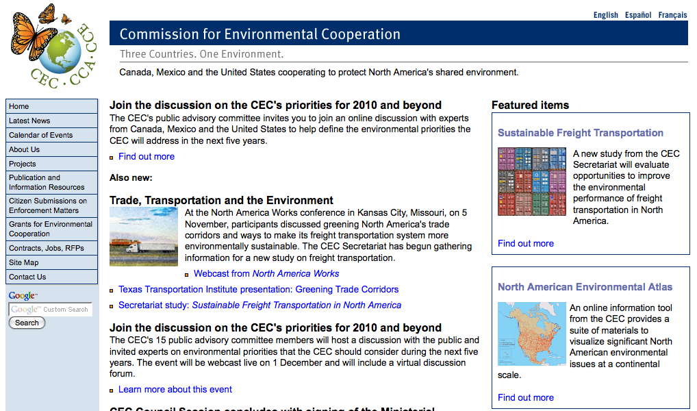
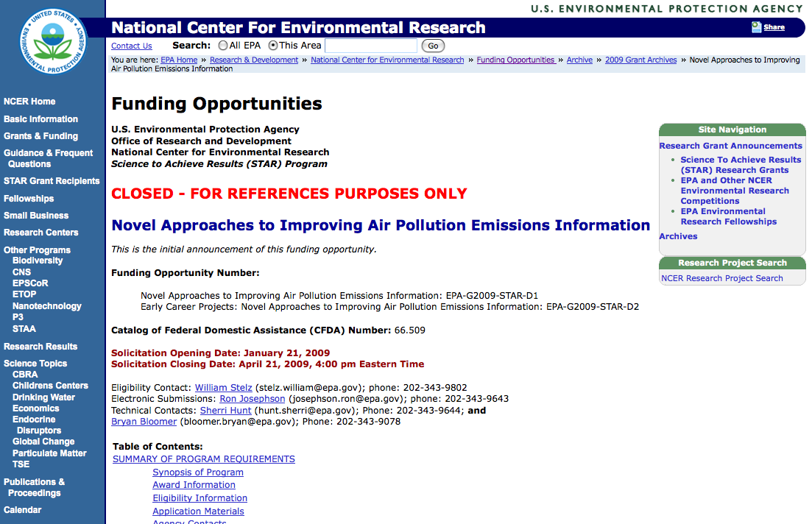
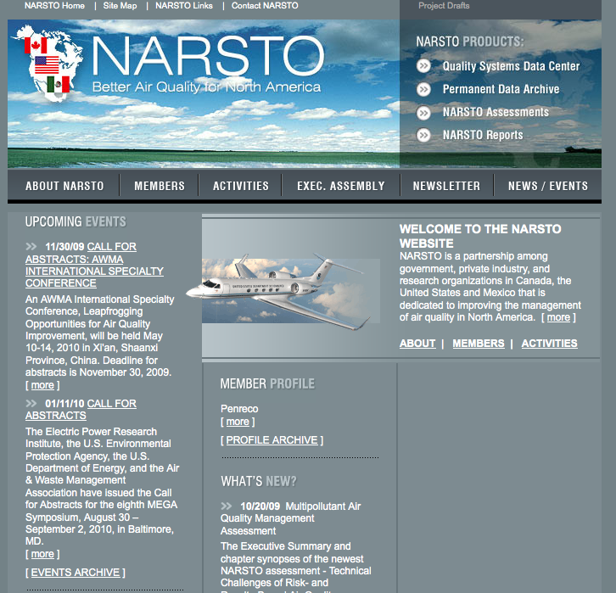
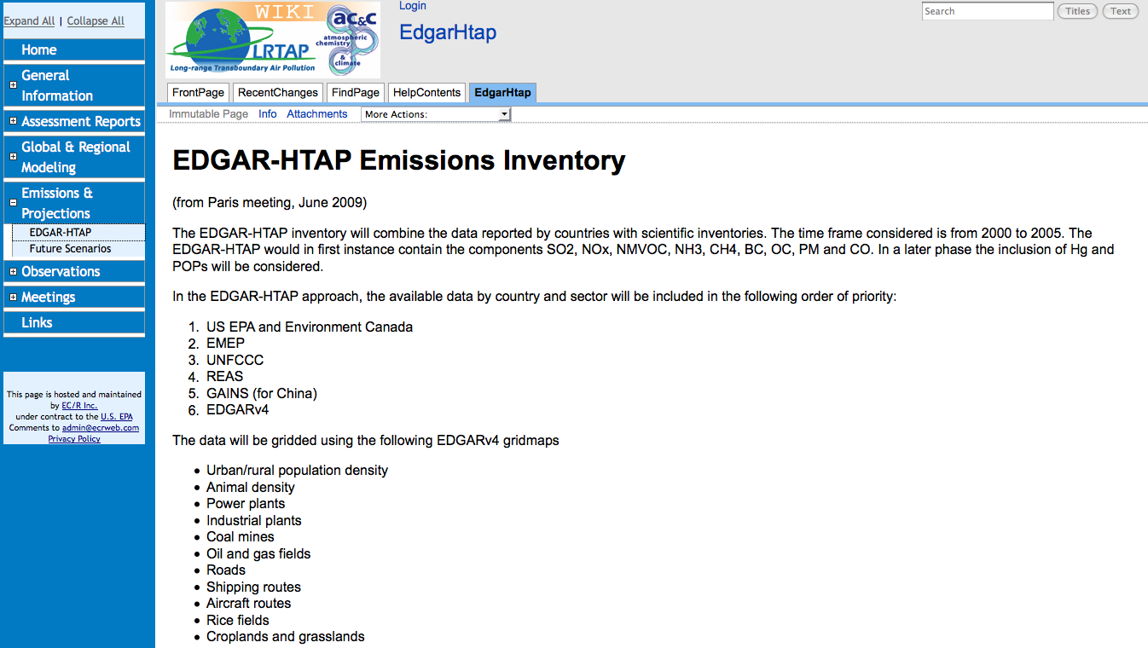
Examples of Coordinated Emissions Activities
Coordinated US Initiative on Emissions Research
First Workshop, 4 December 2009, NOAA DSRC, Boulder, CO
Notes:
From top left, going down each column:
NEISGEI: US emissions clearinghouse
GEIA: international collaboration and clearinghouse
HTAP: international modeling exercise
EPA’s CEMS interface: very helpful
EPA’s BEIS: Guenther collaboration with EPA’s Geron/Pierce
EPA’s STAR grant proposal for emission evaluation
IPCC emission activity
CEC emission evaluation (US, Canada, Mexico)
NARSTO emis assessment (US, Canada, Mexico)

Slide 8
Suggestions to Guide this Initiative
Coordinated US Initiative on Emissions Research
Focus on research emission inventories
Do not interfere with regulatory inventory development process
Build on existing approaches to emissions development and observation
Facilitate new directions in collaborative emissions research
Adapt emission products for research community
Encourage active feedback between development and observation groups
Encourage multiple approaches to development and evaluation
Bring an openness to new findings and encourage sharing of results
Assess resources needed for collaborative efforts
Carry out periodic synthesis activities and progress assessments
Where We Are
Where We Want to Go
Research Progress
First Workshop, 4 December 2009, NOAA DSRC, Boulder, CO

