Slide 1
Emissions Information Infrastructures
NEISGEI and GEOSS
Stefan Falke
Northrop Grumman and
Washington University in St. Louis
stefan.falke@gmail.com

Slide 2
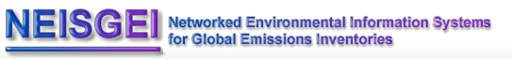
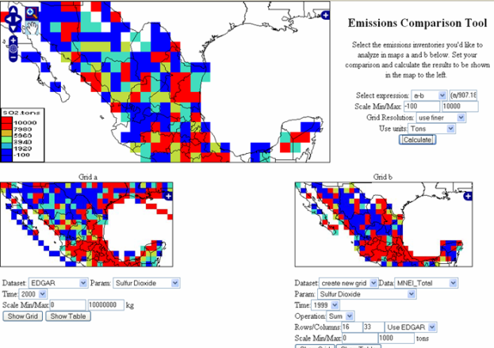
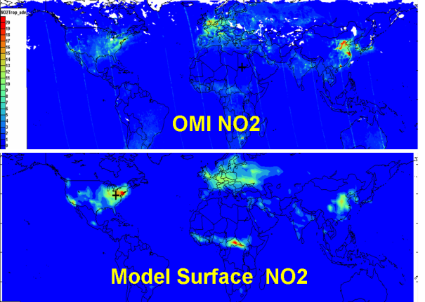
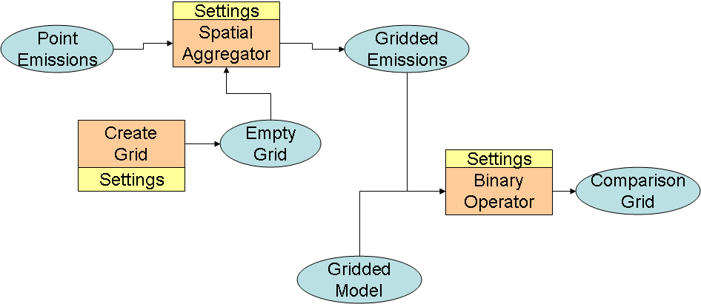
Objectives:
  standards-based access to distributed emission inventory data
  tools for data processing and analysis
  means for sharing data & tools
  contribute to community-based, collaborative environments (cyberinfrastructure)
Approach:
  Create web services for accessing emissions related data
  Create metadata and register datasets in common catalogs, provide standard interfaces for datasets, develop analysis services, and create service workflows
  Create “mashup” applications for emissions analysis and visualization
  Develop information exchange connections within service oriented frameworks and with Web 2.0 technologies
Mashups
Analyses
Flows

Slide 3
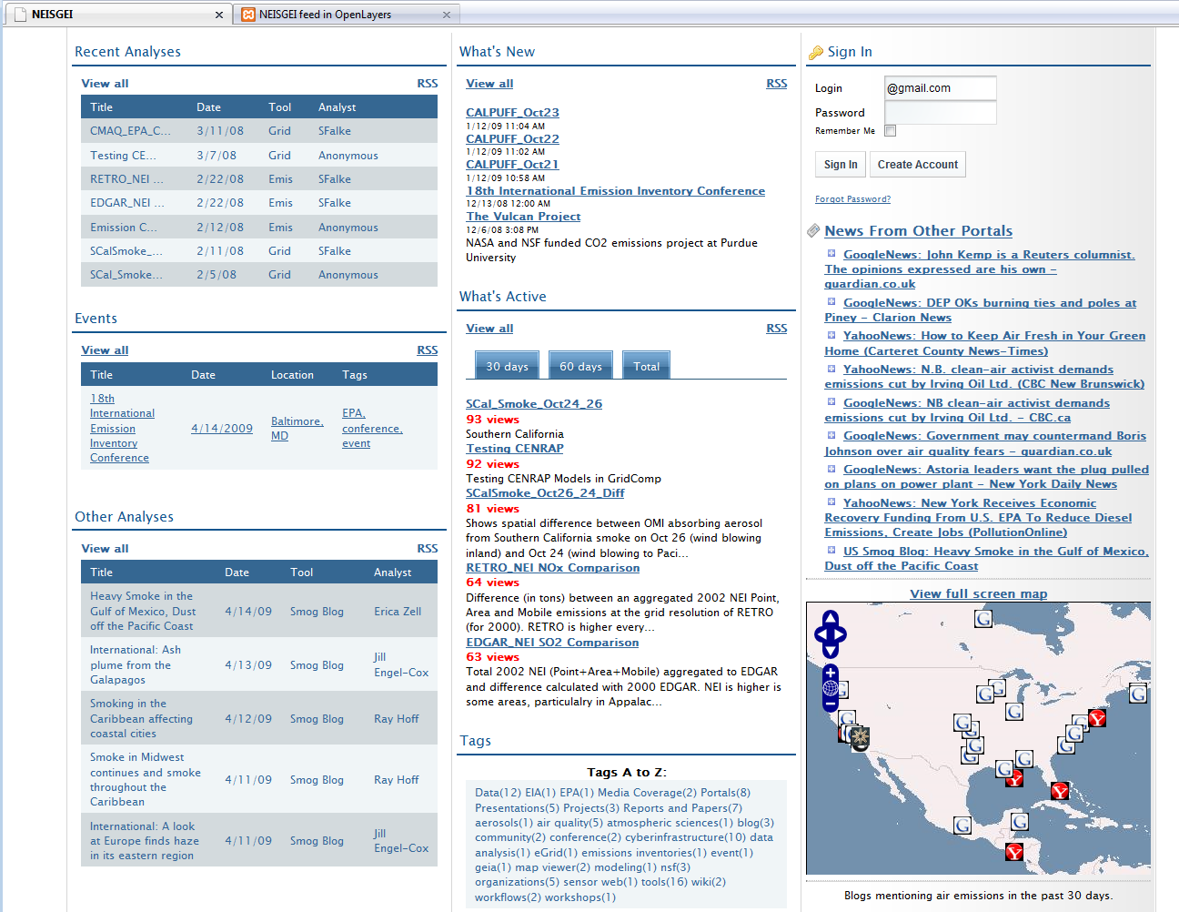
NEISGEI Portal – www.neisgei.org
What’s New
Summarizing Analyses
RSS Aggregation
What’s Active
Delicious Database Access
Summarizing External Analyses
Tagging Portal Content

Slide 4
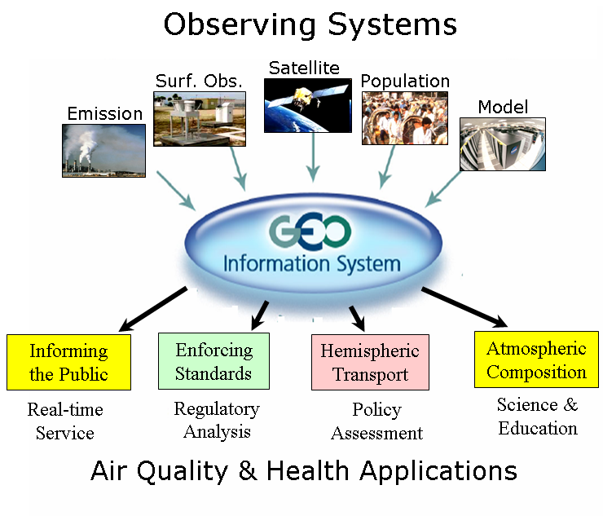
A Global Earth Observation System of Systems (GEOSS) Vision for Connecting Air Quality Systems

Slide 5

Air Quality Community Infrastructure evolving in the GEOSS Architecture Implementation Pilot
General search and use of GEOSS data and services
GEO
Web
Portals
Users
Air Quality Community Catalog
GEOSS
Common
Infrastructure
Air Quality
Metadata
Registry
GEOSS
Registry
GEOSS
Clearing-house
AQ-specific search and use of GEOSS data and services
Metadata
Registration Tools
AQ Web
Applications
AQ Databases
AQ Web
Portals
AQ Data Brokers
Others
Other Search Tools
Data Providers

Slide 6
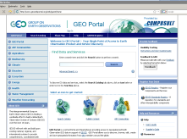
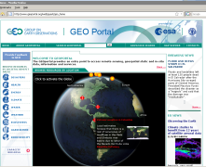
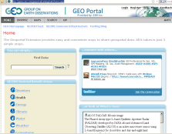
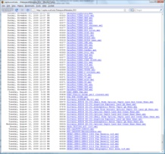
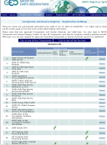
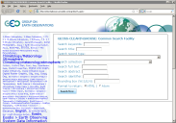
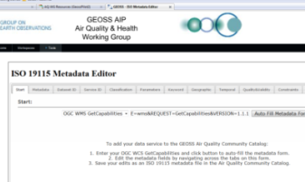
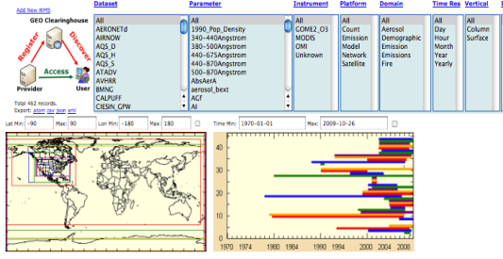
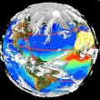
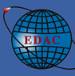


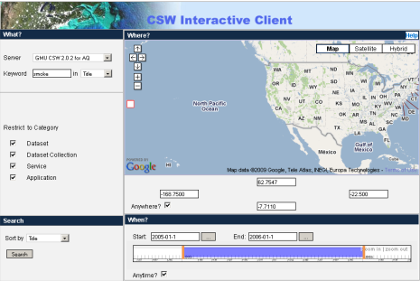
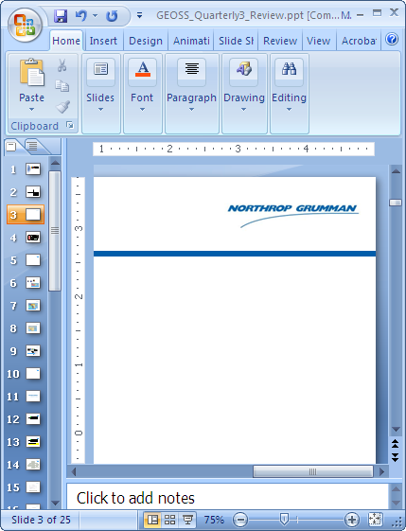

AIP-2 Implementations on the
AIP Air Quality Community Infrastructure
100+ data web service
metadata registrations
General search and use of GEOSS data and services
Users
Air Quality Community Catalog
GEOSS
Common
Infrastructure
Emissions Thread in AIP-3?
AQ-specific search and use of GEOSS data and services
EDAC
DataFed
SEDAC
NGC
Giovanni
ESA
Data Providers
AIP-2 Workspace: https://sites.google.com/site/geosspilot2/air-quality-and-health-working-group

Slide 7
GEO Air Quality Community of Practice
Brand new group aimed at providing a global forum for communication and collaboration among the many air quality projects and systems.
An Emissions Community of Practice?
Help define the direction / scenario / priorities for the upcoming Phase 3 of the GEO Architecture Implementation Pilot.

